Slide 1


Slide 2
CRICKET ANALYTICS AND TOURNAMENT INTELLIGENCE SYSTEM

Slide 3

PRESENTED BY,
GROUP I
MEMBERS :
S.N | Name | College/University | Subject
1 | Gaurav Kishor Boruah | Dhemaji College | Physics
2 | Jigyash Boruah | North Lakhimpur University | Anthropology
3 | Monojjol Borah | North Lakhimpur University | Statistics
4 | Riddhi Kr. Dutta | Silapathar College | Physics
5 | Rokibur Rahman | A.D.P. College | Physics
6 | Saradi Boruah | Dhakuakhana College (Autonomous) | Physics

Slide 4
Project Objective :
This project analyzes IPL player and team performances using Python, Pandas, and Matplotlib.
The project includes:
Data Cleaning
Batting Analysis
Bowling Analysis
Team Analysis
Statistical Analysis
Player Performance Index (PPI)
Data Visualization.

Slide 5
Dataset:
DATA SOURCE :
Ipl_Tournament_Data.csv
cleaned_data.csv
team_summary.csv

Slide 6
1. Ipl_Tournament_Data.csv :
The dataset contains 250 records and 18 attributes. ipl_tournament_data.csv is the primary dataset of the project. It contains detailed IPL match and player performance data, including team information, batting, bowling, fielding, venues, and match results. This raw dataset is used as the starting point for data cleaning, analysis, and the creation of summarized team-performance data.

Slide 7
2. cleaned_data.csv :
cleaned_data.csv is the processed and cleaned version of the original IPL dataset. It contains organized and standardized match, player, batting, bowling, fielding, and result data. This cleaned dataset is used for accurate analysis, data aggregation, and visualization in the project.

Slide 8
.team_summary.csv :
team_summary.csv, It contains 10 teams and 4 attributes is the summarized team-level dataset created from the cleaned IPL data. It provides an overall comparison of teams based on key performance indicators such as total runs, total wickets, and total matches played. This file is used to analyze and compare the overall performance of different IPL teams.

Slide 9
BATTING ANALYSIS

Slide 10
Batting analysis studies the players' runs, balls faced,
fours, sixes, and strike rate to understand theirperformance. It helps identify the top batsmen and most effective hitters in the tournament.

Slide 11
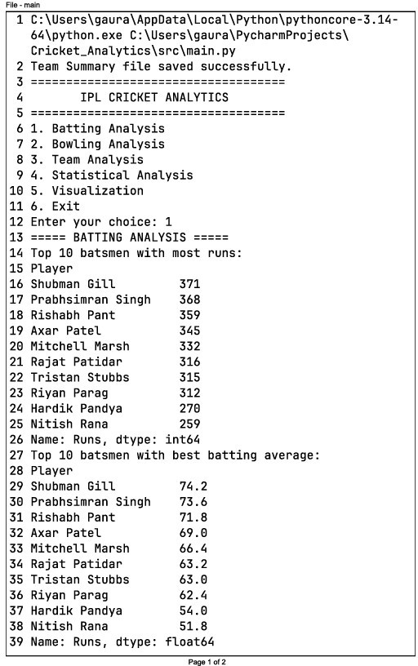
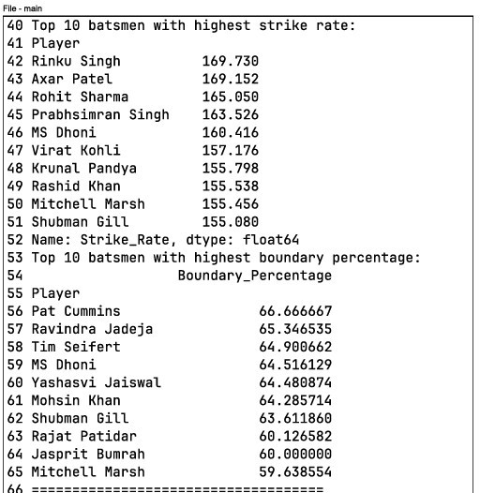

Slide 12
The batting analysis compares players based on total runs, average runs, strike rate, and boundary percentage. For example, Shubman Gill scored the highest total runs (371) and had the highest average (74.2), while Rinku Singh had the highest strike rate (169.73). This helps us identify the top-performing and most aggressive batsmen.

Slide 13
GRAPHICAL REPRESENTATION

Slide 14
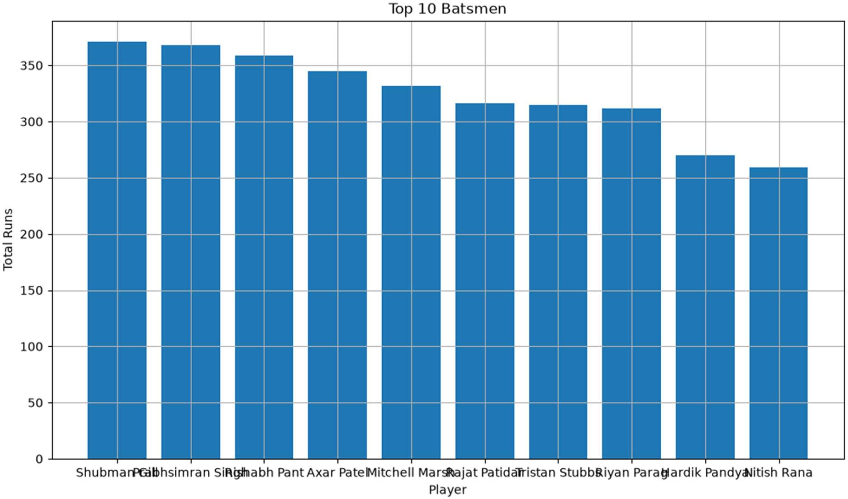

Slide 15
This bar chart shows the top 10 batsmen based on total runs scored. Shubman Gill is the highest scorer with 371 runs, followed by Prabhsimran Singh with 368 runs and Rishabh Pant with 359 runs.

Slide 16
BOWLING ANALYSIS

Slide 17
The bowling analysis compares bowlers based on wickets, economy rate, and bowling average. For example, Mohammed Shami took the most wickets (10), while Axar Patel had the best economy rate (4.446). Mohammed Shami and Arshdeep Singh also recorded the best bowling average of 1.5.

Slide 18
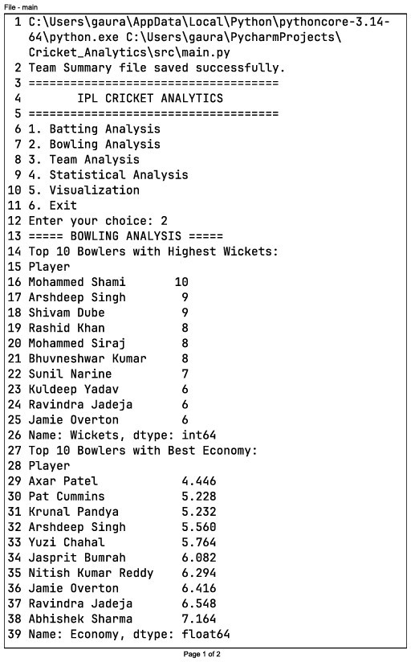
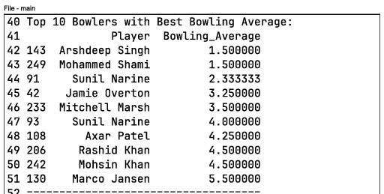

Slide 19
GRAPHICAL REPRESENTATION

Slide 20
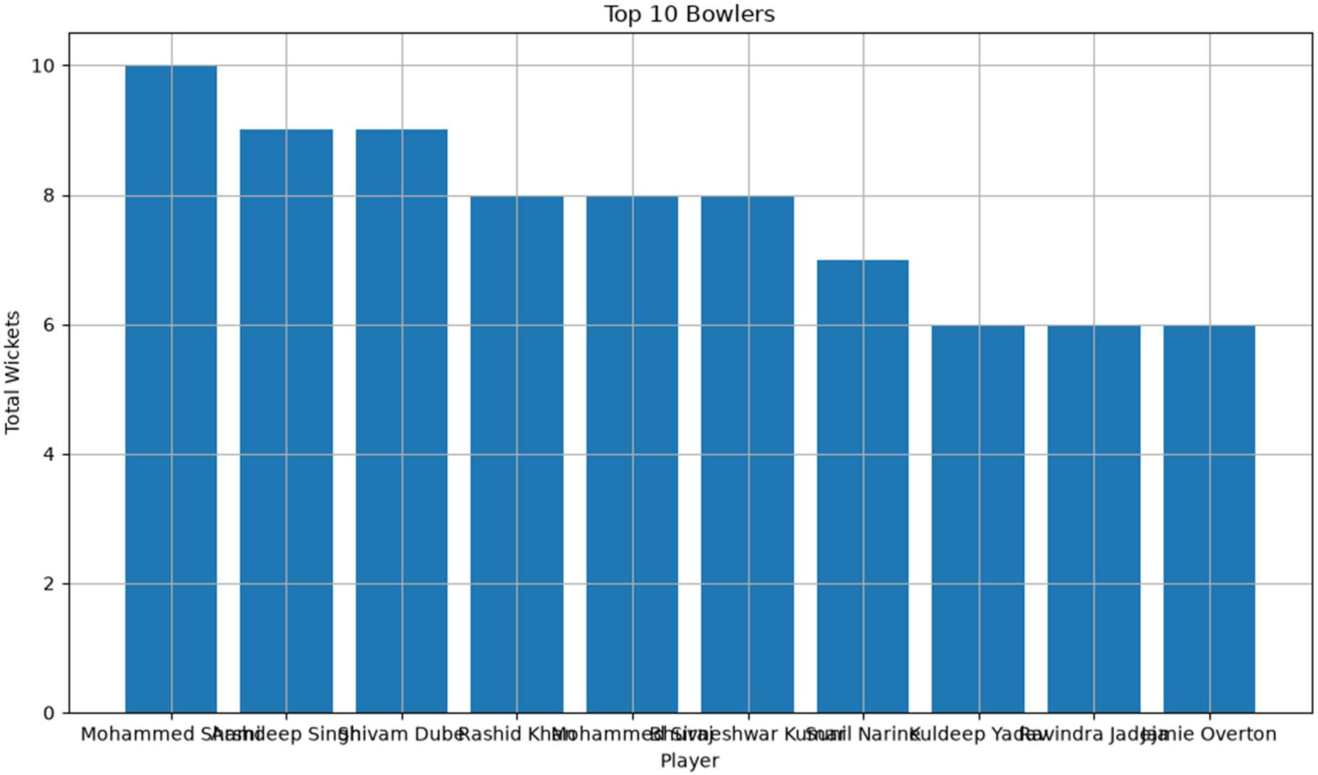

Slide 21
This bar chart shows the top 10 bowlers based on total wickets. Mohammed Shami took the highest number
of wickets with 10, followed by Arshdeep Singh and Shivam Dube with 9 wickets each.

Slide 22
TEAM ANALYSIS

Slide 23
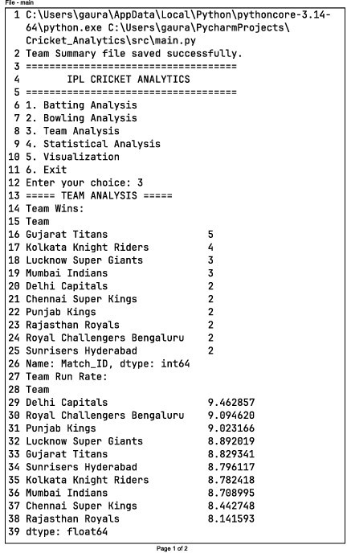
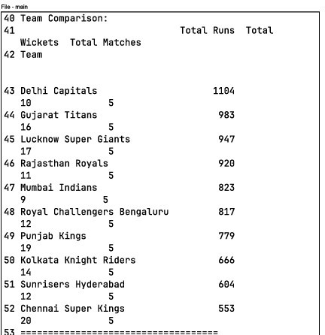

Slide 24
The team analysis compares IPL teams based on wins, run rate, total runs, and wickets. For example, Gujarat Titans recorded the most wins (5), while Delhi Capitals had the highest run rate (9.46) and total runs (1104).
This analysis helps us compare the overall performance of different teams.

Slide 25
GRAPHICAL REPRESENTATION

Slide 26
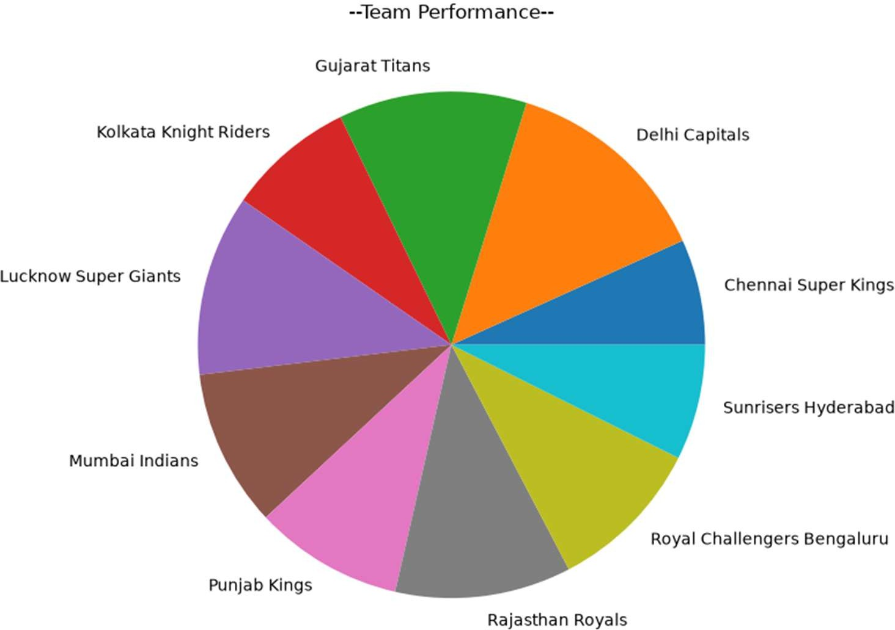

Slide 27
This pie chart illustrates the overall performance distribution of different IPL teams. Each slice represents a team's contribution to the total performance. Delhi Capitals have the largest share, indicating the strongest performance among the teams shown, while Chennai Super Kings and Sunrisers Hyderabad have comparatively smaller shares. The remaining teams, including Gujarat Titans, Lucknow Super Giants, Mumbai Indians, Punjab Kings, Rajasthan Royals, Royal Challengers Bengaluru, and Kolkata Knight Riders, contribute moderate portions, reflecting a relatively balanced competition among most teams.

Slide 28
STATISTICAL ANALYSIS

Slide 29
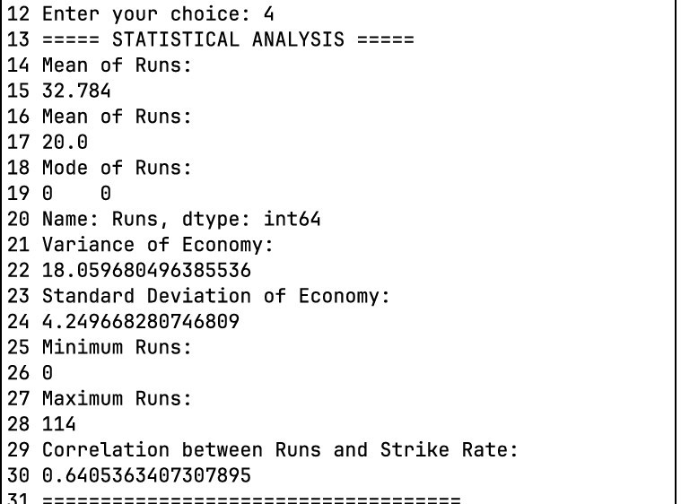

Slide 30
The analysis shows that the average runs scored are 32.78, while the median runs are 20, indicating that a few high scores increase the overall average. The most common score is 0, meaning many players were dismissed without scoring. Runs range from 0 to 114, showing a wide variation in batting performance. The economy rate has a variance
of 18.06 and a standard deviation of 4.25, suggesting moderate differences among bowlers. The correlation between Runs and Strike Rate is 0.64, which indicates a moderately strong positive relationship—players who score more runs generally tend to have higher strike rates.

Slide 31
GRAPHICAL REPRESENTATION

Slide 32
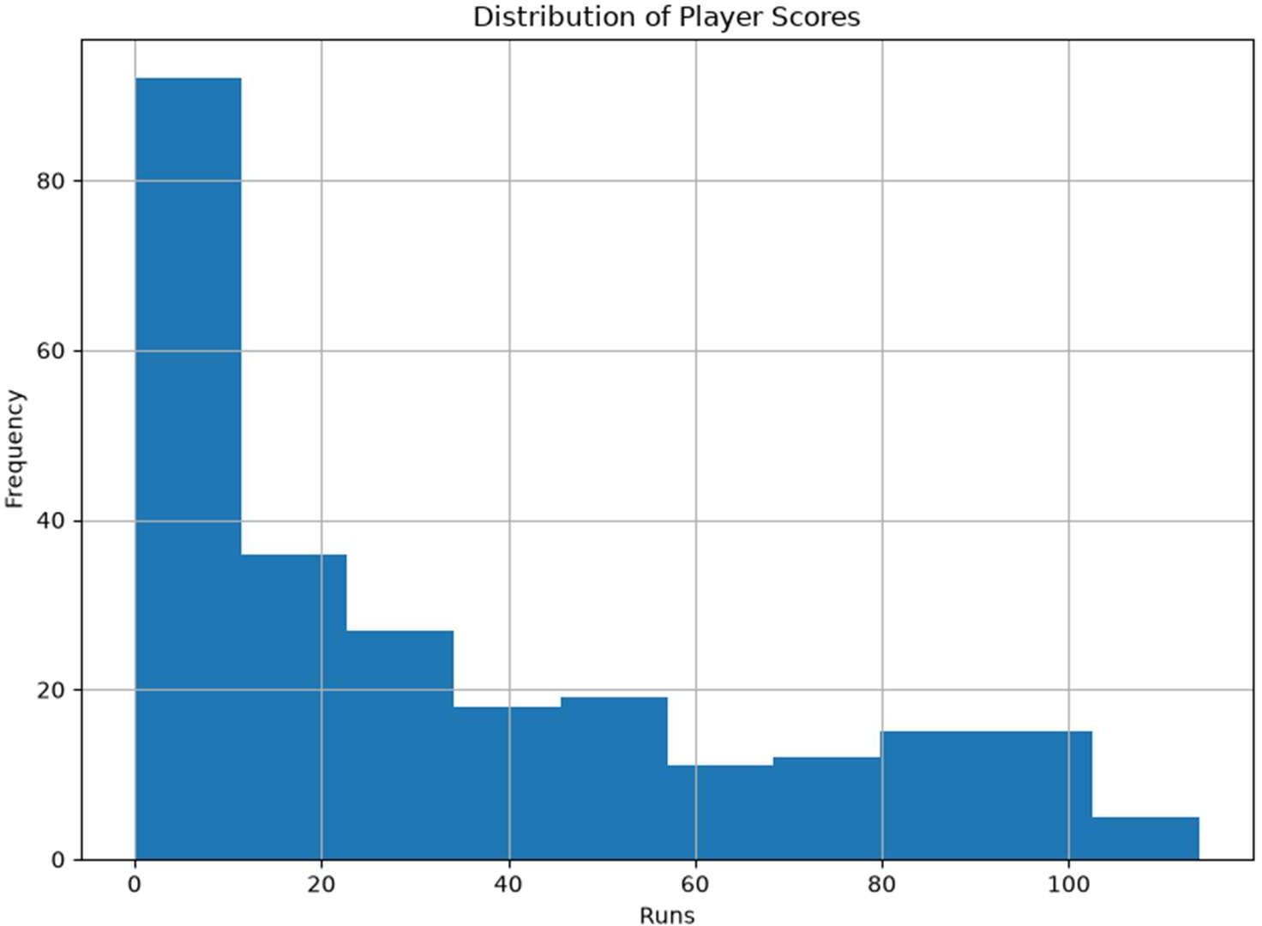

Slide 33
This histogram shows the distribution of player scores. Most players scored between 0 and 20 runs, as indicated by the highest bars on the left side of the chart. As the number of runs increases, the frequency of scores decreases. Only a few players scored 50 runs or more, and very high scores above 100 runs are rare. Overall, the chart suggests that low to moderate scores were much more common than high scores.

Slide 34
VISUALIZATION

Slide 35
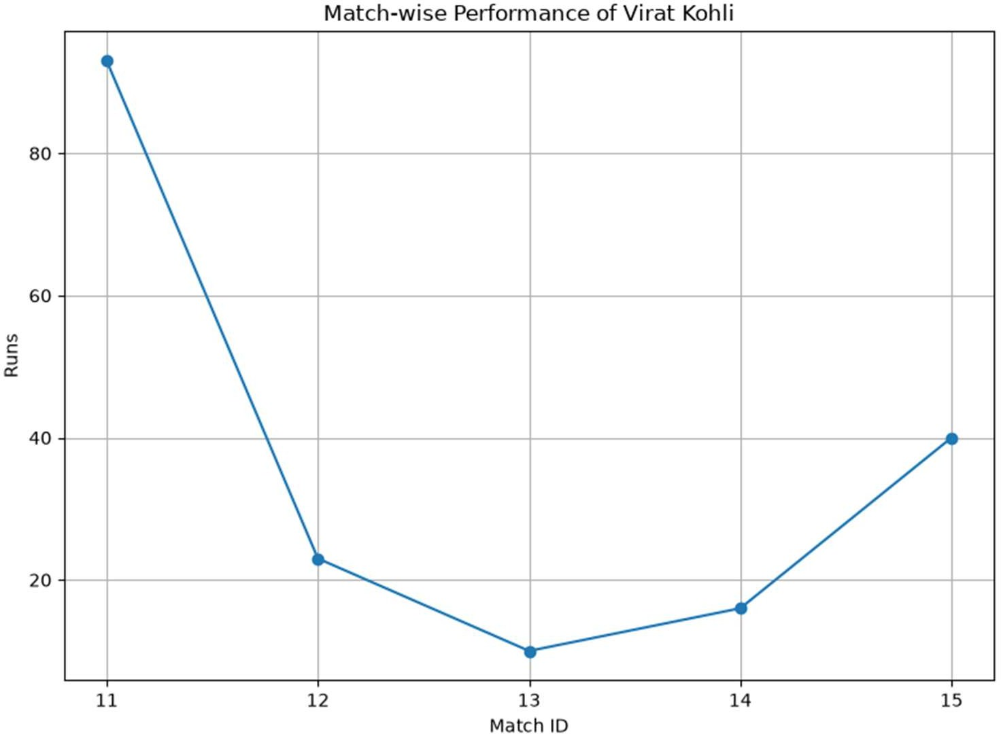

Slide 36
This line chart shows Virat Kohli's match-wise performance across five matches. He scored a high of 93 runs in Match 11, followed by a sharp decline to 23 and 10 runs in Matches 12 and 13. His performance then improved, scoring 16 runs in Match 14 and 40 runs in Match 15. Overall, the chart highlights an excellent start, a temporary dip in form, and a gradual recovery in the later matches.

Slide 37
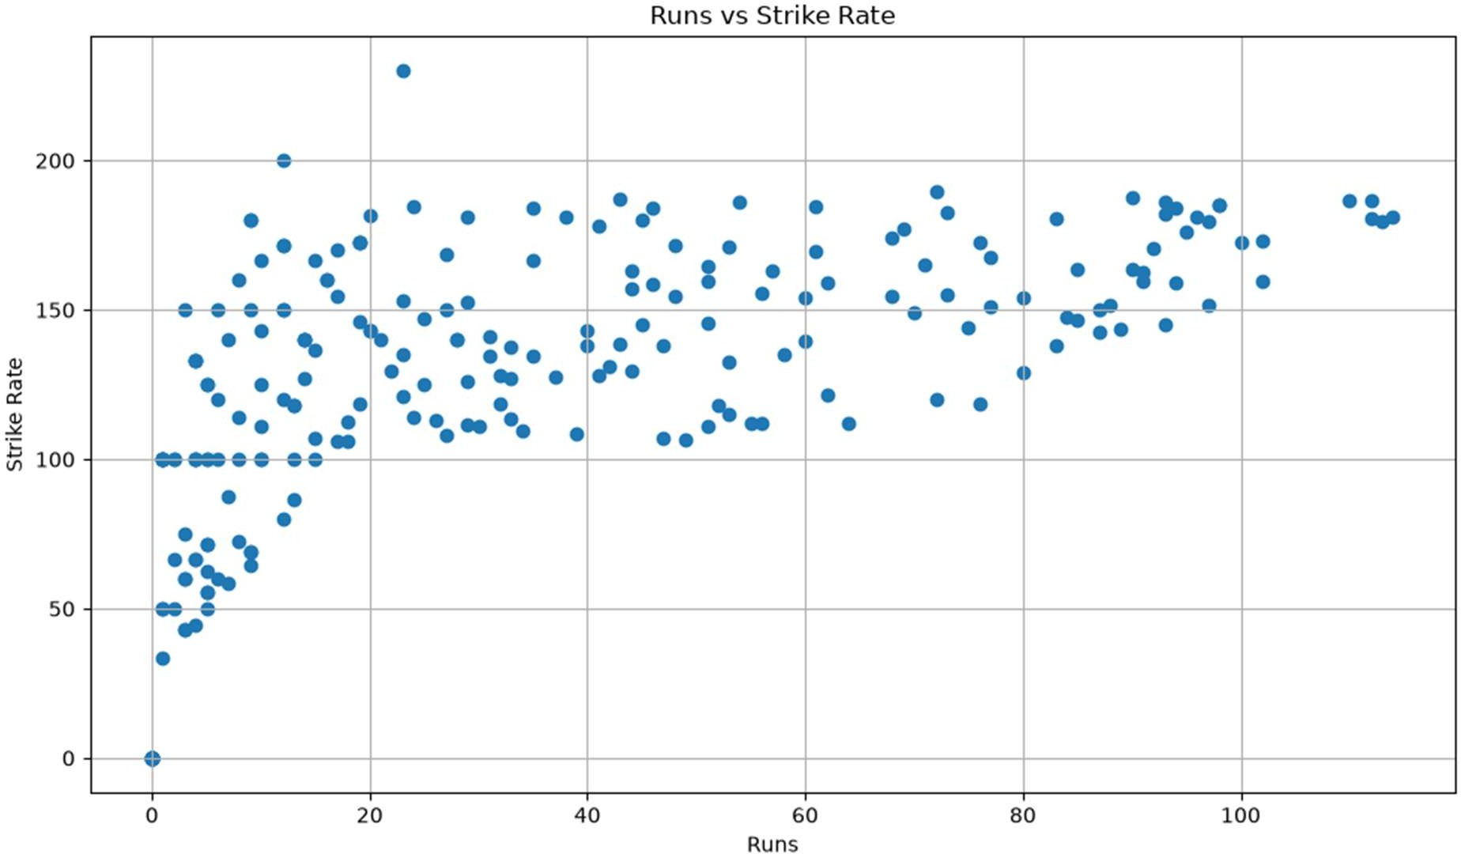

Slide 38
This scatter plot shows the relationship between Runs scored and Strike Rate. The points indicate a moderate positive correlation, meaning players who score more runs generally tend to have higher strike rates. Most players have strike rates between 100 and 180, while a few exceptional performances reach above 200. Overall, the chart suggests that higher-scoring innings are often associated with faster scoring rates.

Slide 39
PPI

Slide 40
PPI combines a player's scoring ability and scoring speed into a single value. A higher PPI indicates better overall batting performance, reflecting both consistency and aggressive scoring. It is useful for comparing players and identifying top performers in a dataset.
PPI Formula:
PPI = 0.4 × Runs + 25 × Wickets + 5 × Catches + 0.1 × Strike Rate − 2 × Economy
Where:
Runs measure batting contribution.
Wickets carry the highest weight, reflecting bowling impact.
Catches reward fielding performance.
Strike Rate rewards faster scoring.
Economy Rate is subtracted, as lower economy indicates better bowling.

Slide 41
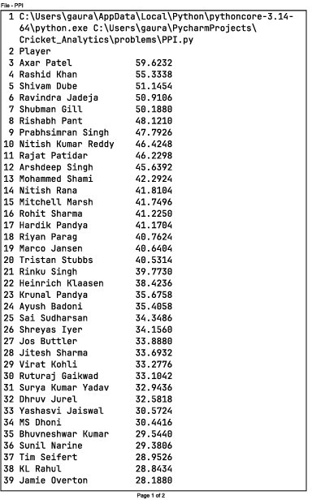
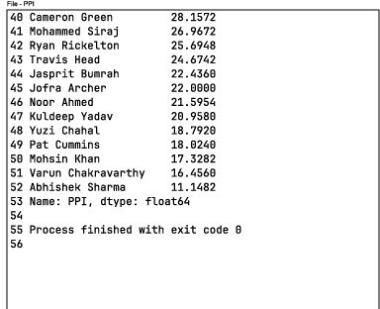

Slide 42
This output ranks players based on their Player Performance Index (PPI), which combines batting, bowling, and fielding contributions into a single score. Axar Patel tops the list with a PPI of 59.62, followed by Rashid Khan (55.33) and Shivam Dube (51.15), indicating outstanding all-round performances. Players such as Ravindra Jadeja, Shubman Gill, and Rishabh Pant also rank highly. At the lower end of the list are players like Varun Chakravarthy and Abhishek Sharma. Overall, the PPI ranking provides a comprehensive comparison of player performances and helps identify the most impactful players in the dataset.

Slide 43
IDEAL PLAYING XI

Slide 44
The Ideal Playing XI is selected by choosing the best-performing players from the analysis. It includes top batsmen, effective bowlers, and reliable all-rounders based on their runs, wickets, strike rate, economy, and overall performance. This helps create a balanced team with strong batting, bowling, and all-round abilities.

Slide 45
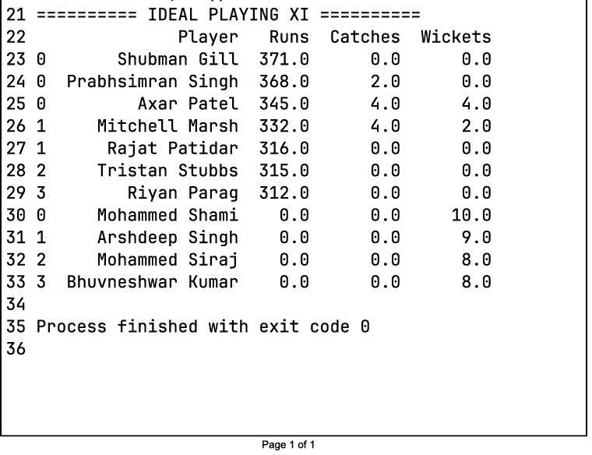

Slide 46
The program selects the Ideal Playing XI by comparing players' performances using runs, catches, and wickets. It chooses the best batsmen, all-rounders, and bowlers to form a balanced team.
Example: Shubman Gill is selected because he scored 371 runs. Axar Patel is selected as an all-rounder because he scored 345 runs, took 4 catches, and claimed 4 wickets.
Mohammed Shami is selected as a bowler because he took 10 wickets.

