Slide 1
StoreIt
a safe home for your boxes!

Slide 2
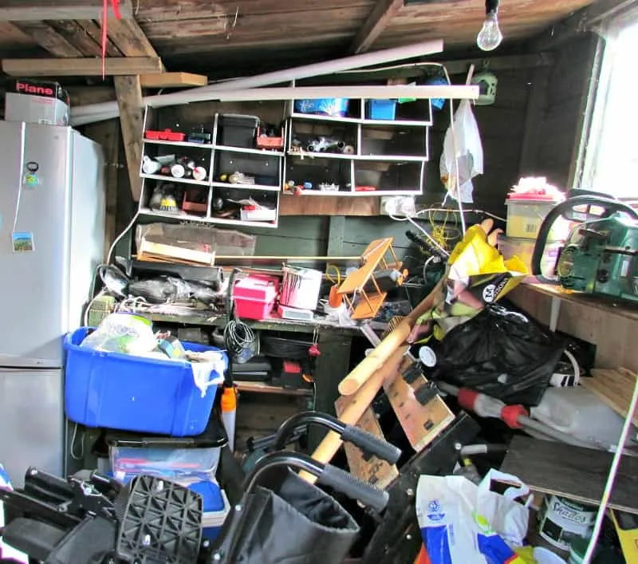
Physical storage is a mess.

Slide 3
In 2021…
$40 Billion
$190/mo, $2280/yr
Self-storage revenue
Average rent of a storage unit
Notes:
Hidden fees
Unreasonable terms
Lack of cleanliness
Wrongful auctions

Slide 4
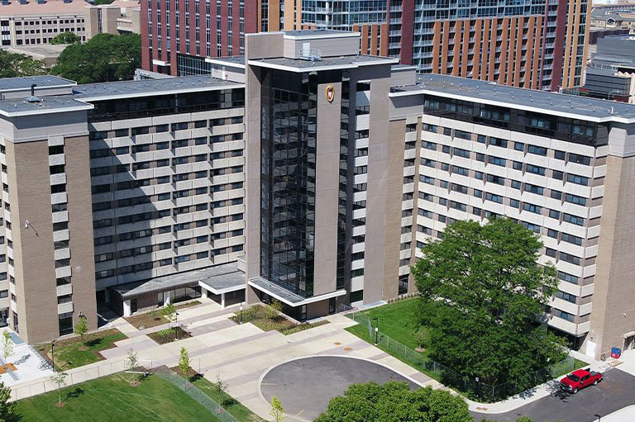

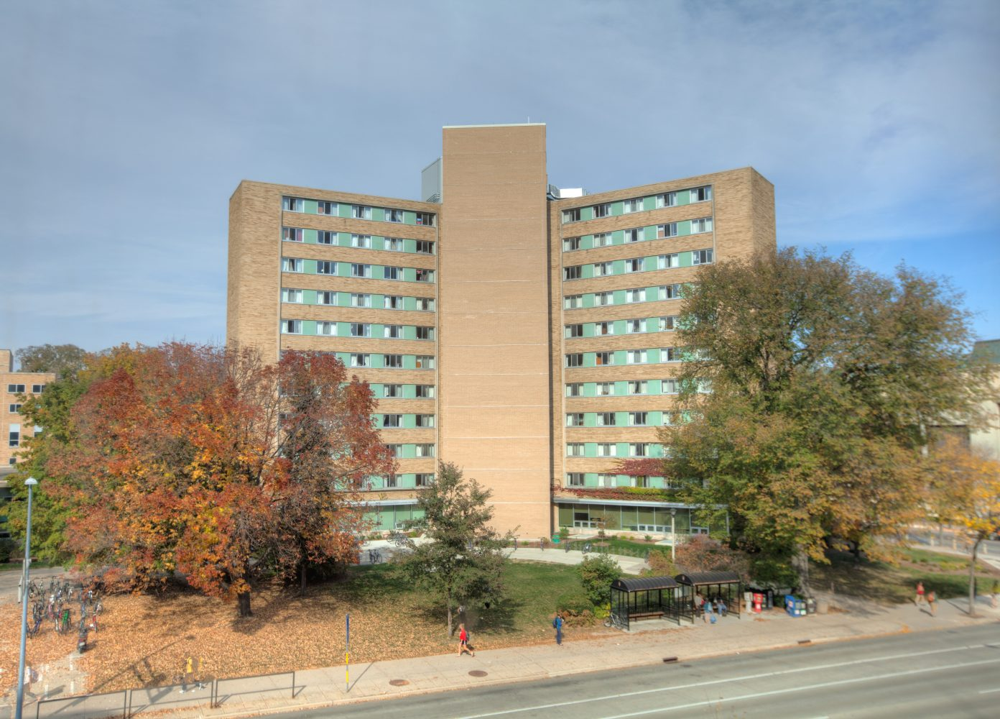
Let’s Dial it Down a Little.

Slide 5

The problem.
LazyBones Laundry & Storage
Minimum Price ~ $100
Extra Large Box ~ $79/box
15% late fee
Insecurity over belongings
Our story

Slide 6
StoreIt Process
Search for a home for your box
Message the boxkeeper an offer
Drop off box
Pick it up in 3-4 months!

Slide 7
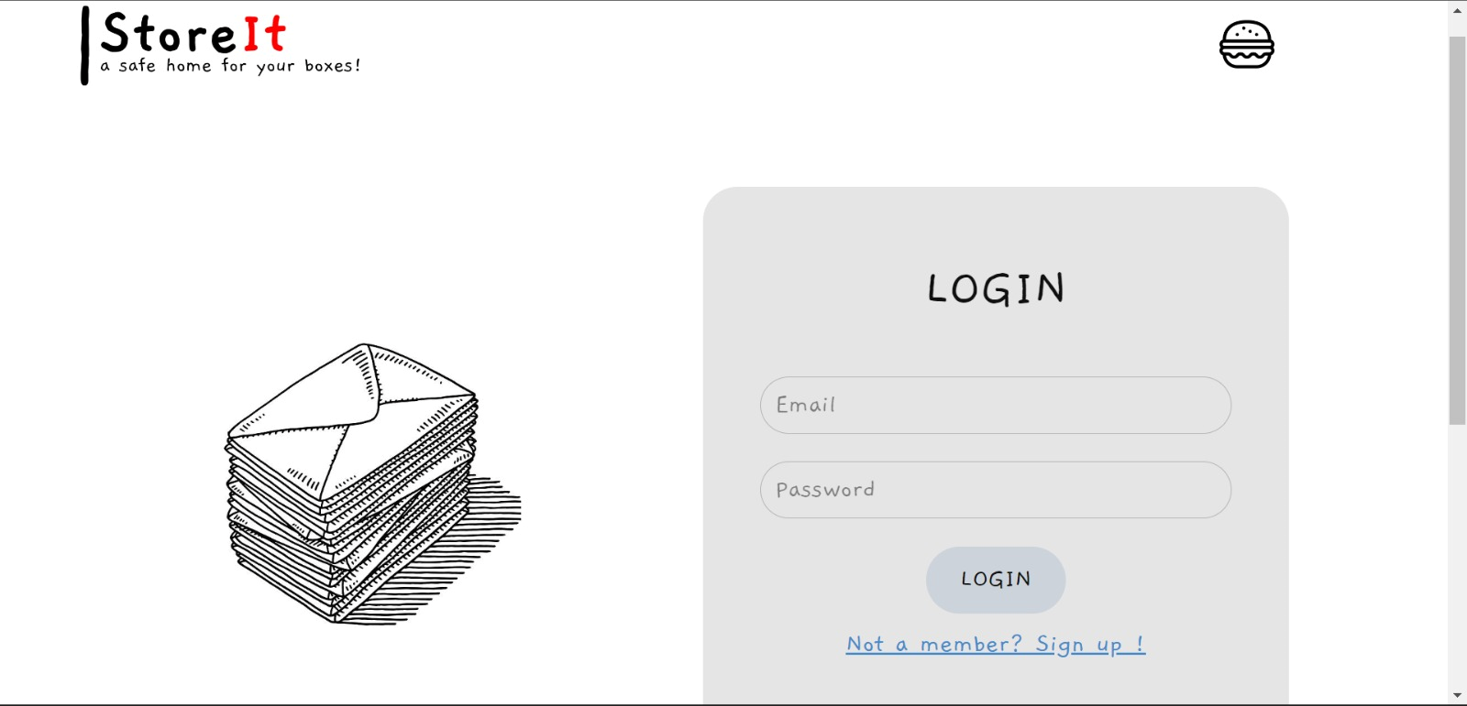
DEMO

Slide 8
Technical Advantages
Entire interaction takes place over a chat-based messaging system, not time-consuming communications like email
Written in Python Flask; flexible, lightweight
Easily accessible design relative to other storage services
Can easily leverage services like Amazon S3 due to Flask’s flexibility to scale up

Slide 9
Revenue Opportunity
We take a 10% commission on each transaction, plus ad revenue.
4,000
$15
$60,000
50% of total dorm pop.
(in UW-Madison)
10% of half of an average LazyBones fee ($275)
(a conservative estimate)
THIS IS SCALABLE.

Slide 10
Questions?

