Slide 1
UNIX Commands

Slide 2
Contents
Shell Intro
Command Format
Shell I/O
Command I/O
Command Overview

Slide 3
Shell Intro
A system program that allows a user to execute:
  shell functions (internal commands)
  other programs (external commands)
  shell scripts
Linux/UNIX has a bunch of them, the most common are
  tcsh, an expanded version of csh (Bill Joy, Berkley, Sun)
  bash, one of the most popular and rich in functionality shells, an expansion of sh (AT&T Bell Labs)
  ksh, Korn Shell
  zhs
  ...

Slide 4
Command Format
Format: command name and 0 or more arguments:
% commandname [arg1] ... [argN]
By % sign I mean prompt here and hereafter.
Arguments can be
  options (switches to the command to indicate a mode of operation) ; usually prefixed with a hyphen (-) or two (--) in GNU style
  non-options, or operands, basically the data to work with (actual data, or a file name)

Slide 5
Shell I/O
Shell is a “power-user” interface, so the user interacts with the shell by typing in the commands.
The shell interprets the commands, that may produce some results, they go back to the user and the control is given back to the user when a command completes (in general).
In the case of external commands, shell executes actual programs that may call functions of the OS kernel.
These system commands are often wrapped around a so-called system calls, to ask the kernel to perform an operation (usually privileged) on your behalf.

Slide 6
Command I/O
Input to shell:
  Command name and arguments typed by the user
Input to a command:
  Keyboard, file, or other commands
Standard input: keyboard.
Standard output: screen.
These STDIN and STDOUT are often together referred to as a terminal.
Both standard input and standard output can be redirected from/to a file or other command.
File redirection:
  < input
  > output
  >> output append

Slide 7
Commands

Slide 8
man
Manual Pages
The first command to remember
Contains info about almost everything
  other commands
  system calls
  c/library functions
  other utils, applications, configuration files
To read about man itself type:
% man man

Slide 9
chsh
Change Login Shell
Login shell is the shell that interprets commands after you logged in by default.
You can change it with chsh (provided that your system admin allowed you to do so).
To list all possible shells, depending on implementation:
% chsh -l
% cat /etc/shells
% chsh with no arguments will prompt you for the shell.

Slide 10
General Commands

Slide 11
passwd
Change your login password.
A very good idea after you got a new one.
It’s usually a paranoid program asking your password to have at least 6 chars in the password, at least two alphabetical and one numerical characters. Some other restrictions (e.g. dictionary words or previous password similarity) may apply.
Depending on a privilege, one can change user’s and group passwords as well as real name, login shell, etc.
% man passwd

Slide 12
date
Displays dates in various formats
% date
% date -u
  in GMT
% with arguments(format specifiers)
date “+%a”→abb day
date “+%D”→ mm/dd/yy

Slide 13
cal
Calendar
  for month
  entire year
Years range: 1 - 9999
No year 0
Calendar was corrected in 1752 - removed 11 days
% cal current month
% cal 2 2000 Feb 2000, leap year
% cal 2 2100 not a leap year
% cal 2 2400 leap year
% cal 9 1752 11 days skipped
% cal 0 error
% cal 2002 whole year

Slide 14
who
The who command prints information about all users who are currently logged in.
Syntax: who [ OPTION ]... [ FILE ] [ am i ]
Example:
who- displays the login details of users
who –u→ displays the usage details
who –uH → displays the usage details with headers
who am i →displays the current users information

Slide 15
clear
Clears the screen
There’s an alias for it: Ctrl+L
Example sequence:
  % cal
  % clear
  % cal
  Ctrl+L

Slide 16
echo
echo is commonly used in shell scripts to display a message or output the results of other commands.
The syntax for the echo command is as follows:
echo [-neE] [ARGUMENTS]
When the -n option is used, the trailing newline is suppressed.
If the -e option is given, the following backslash-escaped characters will be interpreted:
  \\ - Displays a backslash character.
  \a - Alert (BEL)
  \b - Displays a backspace character.
  \c - Suppress any further output

Slide 17
echo continued
  \e - Displays an escape character.
  \f - Displays a form feed character.
  \n - Displays a new line.
  \r - Displays a carriage return.
  \t - Displays a horizontal tab.
The -E option disables the interpretation of the escape characters. This is the default.

Slide 18
sleep
“Sleeping” is doing nothing for some time.
Usually used for delays in shell scripts.
% sleep 2 2 seconds pause

Slide 19
Command Grouping
Semicolon: “;”
Often grouping acts as if it were a single command, so an output of different commands can be redirected to a file:
% (date; cal; date) > out.txt

Slide 20
alias
Defined a new name for a command
% alias
  with no arguments lists currently active aliases
% alias newcommand oldcommand
  defines a newcommand
% alias cl cal 2003
% cl

Slide 21
exit / logout
Exit from your login session.
% exit
% logout

Slide 22
shutdown
Causes system to shutdown or reboot cleanly.
May require superuser privileges
% shutdown -h now - stop
% shutdown -r now - reboot

Slide 23
bc command
Arithmetic operations are the most common in any kind of programming language.
Unix or linux operating system provides the bc command and expr command for doing arithmetic calculations.
We can use these commands in bash or shell script also for evaluating arithmetic expressions

Slide 24
The bc command supports the following features.
Arithmetic operators
Increment and decrement operators
Assignment operators
Comparision or Relational Operators
Logical or Boolean operators
Math Functions
Conditional statements
Iterative statements
Functions

Slide 25
Working :
$ bc
$ 2+5
7
4>5
0
4||5
1
0||0
0
0&&0
0
Ctrl+d ///to exit the bc

Slide 26
Floating point calcuations
3/4
0
scale=2
3/4
.75
scale=3
3/4
.750

Slide 27
Arithmetic base calculations in bc
1111
1111
obase=16
1111
457
obase=8
1111
2127
ibase=10
obase=2
23
10111

Slide 28
One more way to use bc
$ echo "3+5"|bc
8
$ echo "4&&0"|bc
0

Slide 29
lpr command
Used to print the jobs using a line printer
Syntax:
$ lpr file1 file2 file3
Examples:
$ lpr myfile
$ lpr resume.txt profile.txt
// to print the documents using a specific printer( using –P option)
$ lpr –Plp2 file8 file9

Slide 30
tty and stty commands
tty-
  anything in UNIX is considered as a file.
  Same holds for the terminal we use.
  To see what terminal we are using tty command is used
Usage:
$ tty
/dev/pty0
2. stty: used to set or reset a terminal. It shows the current settings if used as a simple command. It takes two options –a and –g .

Slide 31
File System

Slide 32
Naming Convention
Important to be able to find files after they’re created
Every file has at least one name
Name can be Human-accessible: “my photo”, “Go Panthers!”,
  Machine-usable: 4502, 33481
Case may or may not matter -Depends on the file system
Dot(.) does not have special meaning. Can be used for extension(.txt, .cpp, etc)
Do not start a file name with dot as it is considered as a system file
Name may include information about the file’s contents
  Certainly does for the user (the name should make it easy to figure out what’s in it!)
  Computer may use part of the name to determine the file type

Slide 33
The Unix file system
hierarchical organization of files
  contains directories and files
basic commands to list and manipulate files
  independent of physical file system organization
  always single tree
typical Unix file system types
  ext3 (formerly ext2) , reiserfs, vfat
  ntfs (now read & write)

Slide 34
Unix file system Layout
root (/)
bin
home
boot
dev
etc
lib
media
X11
opt
mnt
opt
var
proc
usr
root
sbin
srv
tmp
lib
bin
include

Slide 35
Common Unix directories
bin Essential command binaries
boot Static files of the boot loader
dev Device files
etc Host-specific system configuration
lib Essential shared libraries and kernel modules
media Mount point for removable media
mnt Mount point for temporary file systems
opt Add-on application software packages
proc data on running system
root home directory for system administrator
sbin Essential system binaries
srv Data for services provided by this system
tmp Temporary files
usr Secondary hierarchy
var Variable data

Slide 36
Home directories on turing
/home
ftp
sample
a132436
z2134567
z1544567
z1234467
z1265467

Slide 37
Directory Terminology
Root Directory: /
  top-most directory in any UNIX file structure
Home Directory: ~
  directory owned by a user
  default location when user logs in
Current Directory: .
  default location for working with files
Parent Directory: ..
  directory immediately above the current directory

Slide 38
Directory content
regular files
  text, data
  binaries, executables
  links to other files or directories
system files
  device files: character or block special
  networking endpoints:
    sockets
    FIFO
directories

Slide 39
Paths and Pathnames
path: list of directories separated by “/”
Absolute Pathname
  Traces a path from root to a file or a directory
  Always begins with the root (/) directory
  Example: /home/sample/cse/unix/assign1.txt
Relative Pathname
  Traces a path from the current directory
  No initial forward slash (/)
    dot (.) refers to current directory
    two dots (..) refers to one level up in directory hierarchy
  Example: unix/assign1.txt

Slide 40
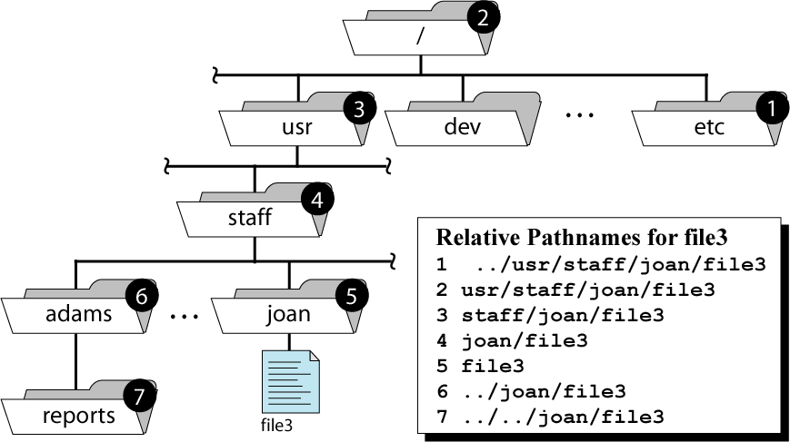
Pathnames for file3
Absolute Pathname: /usr/staff/joan/file3

Slide 41
File system commands
Provide information
  pwd
  ls
Change view
  cd
Change
  mkdir
  rmdir

Slide 42
PATH TO CURRENT DIRECTORY
“pwd” gives the full pathname of the current working directory
pwd = print working directory
  Example:
  % pwd
  /home/sample/cse/unix

Slide 43
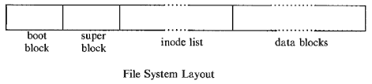
File System Implementation
Each file system contains:
a boot block located in the first few sectors of a file system. The boot block contains the initial bootstrap program used to load the operating system.
  Typically, the first sector contains a bootstrap program that reads in a larger bootstrap program from the next few sectors, and so forth.

Slide 44
  2. a super block describes the state of the file system: the total size of the partition, the block size, pointers to a list of free blocks, the inode number of the root directory, magic number, etc.
3. a linear array of inodes (short for ``index nodes''). There is a
one to one mapping of files to inodes and vice versa. An inode
is identified by its ``inode number'', which contains the
information needed to find the inode itself on the disk .Thus,
while users think of files in terms of file names, Unix thinks of
files in terms of inodes.
  4. data blocks blocks containing the actual contents of files

Slide 45
Contents of Inodes:
Owner
Group
Type
Permission
Time
Address

Slide 46
Linking Files
Allows one file to be known by different names
A link is:
  A reference to a file stored elsewhere on the system
  A way to establish a connection to a file to be shared
Two types:
  Hard link
  Symbolic link (a.k.a. “soft link”)

Slide 47
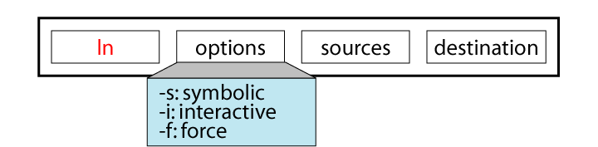
The ln command
hard link:
ln shared-file link-name
symbolic link:
ln –s shared-file link-name
Note that the long listing (ls -l) of a soft link does not accurately reflect its associated permissions. To view the permissions of the file or directory that the symbolic link references, use the -L option of the ls command.

Slide 48
Link illustration
create entry “bb” in “dir3” as link to file “aa” in “dir1”
home
z036473
dir1
dir2
aa
dir3
bb

Slide 49
Hard Link example
Contents of dir1
.
. | 1076
.. | 2083
aa | 2407
home
2406
2407
z036473
2408
.
dir1
dir2
.
Contents of dir3
aa
dir3
. | 1070
.. | 2050
bb | 2407
file data
bb

Slide 50
Symbolic Link example
Contents of dir1
.
. | 1076
.. | 2083
aa | 2407
home
2598
2599
z036473
2600
.
dir1
dir2
.
Contents of dir3
aa
dir3
. | 1070
.. | 2050
bb | 2599
home/z036473/
dir1/aa
bb

Slide 51
Hard Link vs. Symbolic Link
Hard Link Advantages | Symbolic Link Advantages
Checks for the existence of the original file The original file continues to exist as long as at least one directory contains it | Can use either relative or absolute path to access the original file Can cross physical file systems

Slide 52
Hard Link vs. Symbolic Link
Hard Link Disadvantages | Symbolic Link Disadvantages
Cannot link to a file in a different file system Prevents deleting file if another link is exists | Created without checking the existence of the shared file Cannot access the shared file if its path has restricted permissions Can be circular linked to another symbolic linked file

Slide 53
Operations unique to directories
Locate →pwd
List →ls
Make →mkdir
Change →cd
Remove →rmdir

Slide 54
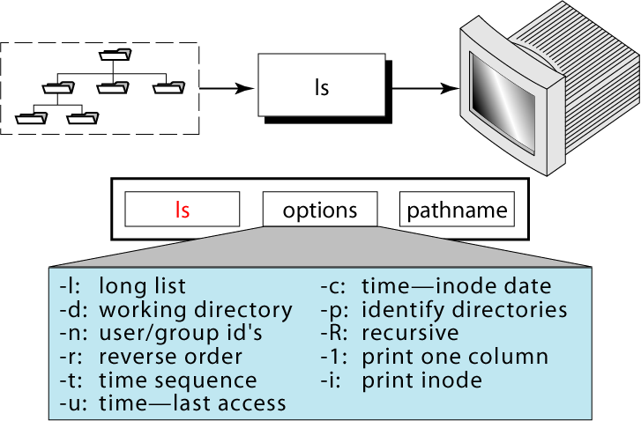
List directory content

Slide 55
USEFUL DIRECTORY OPTIONS
ls -Alst | less
  -A: include hidden files
    “dot files” start with .
    -A lists all except . and ..
    -a lists all including . and ..
  -l:long format
  -s :show size of each file in blocks
    1K blocks on some systems
    1/2 K blocks on other systems
  -t: in reverse time sequence (most recent first)
  piping into less prevents running off end of screen

Slide 56
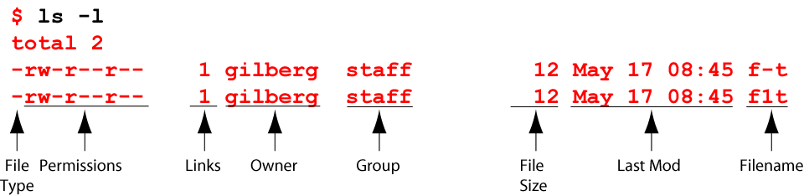
Long List Option

Slide 57
List everything in directory
List contents of the current directory in long format
. is current dir.
.. is parent dir.
% ls -la
total 126
drwxr-xr-x 13 ray csci 1024 Apr 26 15:49 .
drwxr-xr-x 15 root root 512 Apr 24 15:18 ..
-rwx------ 1 ray csci 1120 Apr 12 13:11 .cshrc
-rwxr--r-- 1 ray csci 885 Dec 2 13:07 .login
-rw-r--r-- 1 ray csci 141 Mar 14 13:42 .logout
-rwx------ 1 ray csci 436 Apr 12 11:59 .profile
drwx------ 7 ray csci 512 May 17 14:11 330
drwx------ 3 ray csci 512 Mar 19 13:31 467
drwx------ 2 ray csci 512 Mar 31 10:16 Data
-rw-r--r-- 1 ray csci 80 Feb 27 12:23 quiz.txt
dot (.) names are hidden files
directories
plain file

Slide 58
List all in a specific directory
% ls -l unix/grades
total 10
-rwxr-xr-x 3 ray csci 72 Jan 19 19:12 330assign-graderun
-rwxr-xr-x 1 ray csci 70 Jan 19 19:13 330exam-graderun
-rwxr-xr-x 2 ray csci 70 Jan 19 19:12 330quiz-graderun
-r-x------ 1 ray csci 468 Feb 1 11:55 test-330grade
-r-x------ 1 ray csci 664 Feb 1 11:55 test-330grade,v

Slide 59
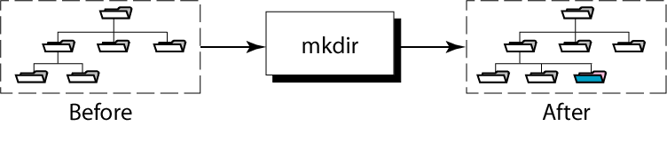
Creating a New Directory
Syntax:
mkdir [ -p ] directory-list

Slide 60
mkdir examples
Can create one or more directories at a time
-p = creates intermediate directories if necessary
  Examples:
  % mkdir csci330
  % mkdir dirOne dirTwo
  % mkdir /home/turing/ray/unix/demo
  (intermediate directories must already exist)
  % mkdir –p /home/turing/ray/unix/demo
  (creates intermediate directories if needed)

Slide 61
File and Directory Names
Use the following characters:
  Uppercase letters (A-Z)
  Lowercase letters (a-z)
  Numbers (0-9)
  Underscore ( _ )
  Period/dot ( . )

Slide 62
File and Directory Names
avoid the following characters:
& | * | \ | | | [ ] | {}
$ | <> | () | # | ? | /
“ | ‘ | ; | ^ | ! | ~
Space | Tab

Slide 63
Example: Create a Directory
to create directory called Data under csci330
Absolute Pathname:
Relative Pathname:
dev
etc
home
usr
tty
null
skel
turing
ux
bin
local
ucb
You are here
z036473
csci330
unix
demo
Temp
Data
mkdir /home/turing/z036473/csci330/Data
mkdir csci330/Data

Slide 64
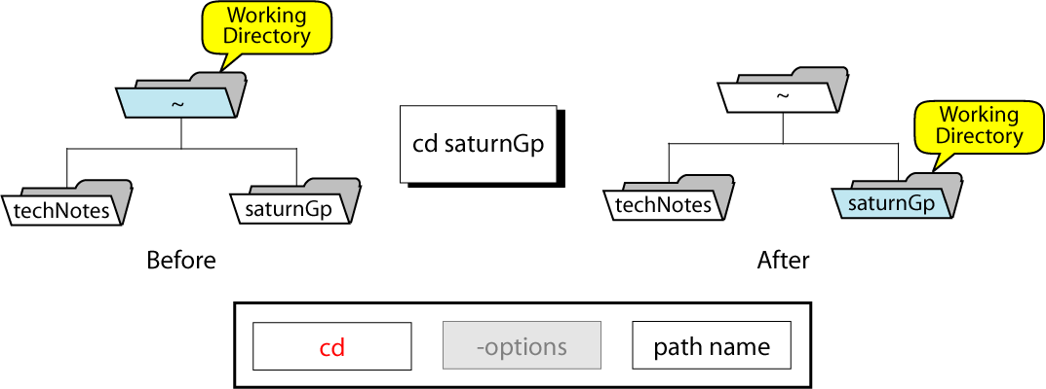
CHANGING DIRECTORY
(just changes the view!)

Slide 65
Changing Directory
from the Data directory, go to home directory
Absolute Pathname:
Relative Pathname:
dev
etc
home
usr
tty
null
skel
turing
ux
bin
local
ucb
z036473
csci330
unix
demo
Temp
You are here
Data
cd /home/turing/z036473
cd ~
cd
cd ../..

Slide 66
Remove Directories
If empty, use “rmdir”
  Example: To remove an empty directory called “test”
  % rmdir test
if non-empty, use “rm -r”
  Example: To remove non-empty directory “old-data”
  % rm -r old-data
  Safer to just delete the contents first

Slide 67
Operations unique to Regular files
Create →vi, gedit, etc
Edit → vi, gedit, etc
Display →cat , more/less
Print →lpr

Slide 68
cat
Display and concatenate files.
% cat
  Will read from STDIN and print to STDOT every line you enter.
% cat file1 [file2] ...
  Will concatenate all files in one and print them to STDOUT
% cat > filename
  Will take whatever you type from STDIN and will put it into the file filename
To exit cat or cat > filename type Ctrl+D to indicate EOF (End of File).

Slide 69
more / less
Pagers to display contents of large files page by page or scroll line by line up and down.
Have a lot of viewing options and search capability.
Interactive. To exit: ‘q’

Slide 70
less
less ("less is more") a bit more smart than the more command
to display contents of a file:
  % less filename
To display line numbers:
  % less -N filename
To display a prompt:
  % less -P"Press 'q' to quit" filename
Combine the two:
  % less -NP"Blah-blah-blah" filename
For more information:
  % man less

Slide 71
Operations Common to Both
Copy →cp
Move →mv
Rename →mv
Link →ln
Remove →rm
Find →find

Slide 72
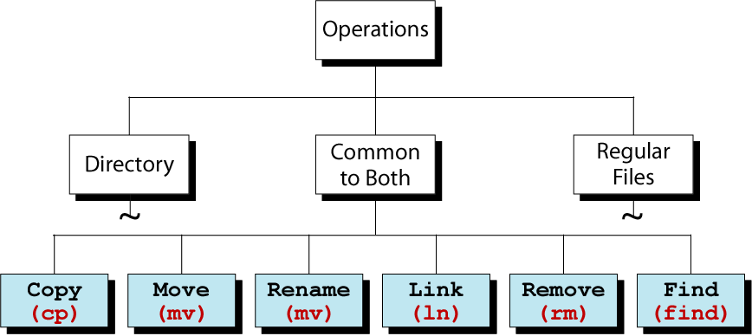
File System Commands

Slide 73
Copying Files
To copy a file, use “cp”
Syntax: cp source-file target
Commonly used options:
  -i if “target” exists, the command cp prompts for confirmation before overwriting
  -i is not the default, but should be
  you can make -i the default
  -p preserve permissions and modification times
  -p is not the default, but should be
  you can make -p the default
  -r recursively copy files and subdirectories

Slide 74
Copying a file
Make a copy of a file
% cp assign1.txt assign1.save
Copy “assign1.txt” to a different directory
% cp assign1.txt ~/archive
% cp assign1.txt ~/archive
but suppose archive isn’t a directory
suppose it doesn’t exist
Copy “assign1.txt” to a new name in a different directory
% cp assign1.txt ~/archive/assign1.save

Slide 75
Copying multiple Files
Syntax: cp source-files destination-directory
  % cp assign1.txt assign2.txt ~/archive
  % cp assign?.txt ~/archive
Files will have same name in destination directory

Slide 76
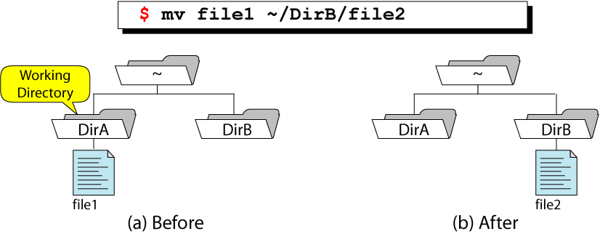
Moving Files
To move files from one directory to another directory, or to re-name a file, use: “mv”

Slide 77
Moving a file
Move “assign1.txt” a different directory
  If the destination file exists, “mv” will not overwrite exiting file:
  % mv assign1.txt ~/archive
Move “assign1.txt” a different directory and rename it to “assign1.save”
% mv assign1.txt ~/archive/assign1.save

Slide 78
Moving multiple Files
Syntax: mv source-files destination-directory
  % mv assign1.txt assign2.txt ~/archive
  % mv assign?.txt ~/archive
Files will have same name in destination directory

Slide 79
Renaming files or directories
use “mv”
Example: rename file “unix” to “csci330”
  % mv unix csci330
Caveat: what if “csci330” exists and is a directory ?

Slide 80
Deleting files
Syntax: rm file-list
Commonly used options:
  -f force remove regardless of permissions
  -i prompt for confirmation before removing
  -r removes everything under the indicated directory
Example: remove file “old-assign”
  % rm unix/assign/old-assign

Slide 81
Finding Files
The command named “find” can be used to locate a file or a directory
Syntax: find pathname-list -name expression
“find” recursively descends through pathname-list and applies expression to every file

Slide 82
Finding Files
Example 1: Find all files, in your directory hierarchy, that have name ending with “.bak”
  % find ~ -name “*.bak” -print
Example 2: Find all files, in your directory hierarchy, that were modified yesterday
  % find ~ -mtime -1 -print

Slide 83
touch
By touching a file you either create it if it did not exists (with 0 length).
Or you update it’s last modification and access times.
There are options to override the default behavior.
% touch file
% man touch

Slide 84
Some more examples
cp
Copies files / directories.
% cp [options] <source> <destination>
% cp file1 file2
% cp file1 [file2] … /directory
Useful option: -i to prevent overwriting existing files and prompt the user to confirm.

Slide 85
mv
Moves or renames files/directories.
% mv <source> <destination>
  The <source> gets removed
% mv file1 dir/
% mv file1 file2
  rename
% mv file1 file2 dir/
% mv dir1 dir2

Slide 86
rm
Removes file(s) and/or directories.
% rm file1 [file2] ...
% rm -r dir1 [dir2] ...
% rm -r file1 dir1 dir2 file4 ...

Slide 87
ln
Symbolic link or a “shortcut” in M$ terminology.
% ln –s <real-name> <fake-name>

Slide 88
find
Looks up a file in a directory tree.
% find . -name name
% find . \(-name ‘w*’ -or -name ‘W*’ \)

Slide 89
PERMISSIONS: TERMINOLOGY
user
  any one who has account on the system
  recognized via a number called “user id”
super user
  “root” user, also known as system administrator
  has user id “0”
  has the maximum set of privileges in the system, i.e. no restrictions apply to what “root” can do
group
  users are organized into groups
  user can belong to multiple groups

Slide 90
PERMISSIONS: CORE CONCEPTS
user info is stored in file /etc/passwd
  userid, user name, group, home directory, shell
  passwords is listed in separate file: /etc/shadow
group info is stored in file /etc/group
  groupid, group name
  additional group members
To find out group information, use the command named: groups user-id
Example:
  % groups z036473
  student csci

Slide 91
Security Levels
There are three levels of security in UNIX: system, directory and file
System security
  controlled by the super user
Directory and file
  controlled by the user who owns them

Slide 92
Access Permission Types
3 general types of access permissions:
  r read
  w write
  x execute
  - permission denied

Slide 93
Access Permission Types
Access Type | Meaning on File | Meaning on Dir.
r (read) | View file contents (open, read) | List directory contents
w (write) | Change file contents | Change directory contents
x (execute) | Run executable file | Make it current directory Access files in it
- | Permission denied | Permission denied

Slide 94
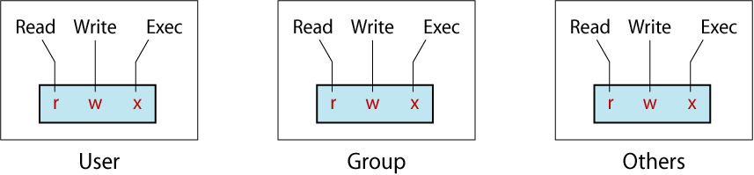
Categories of Users
3 categories of users want access

Slide 95
Checking Permissions
To check the permissions of an existing file or an existing directory, use the command: ls -l
Example:
  % ls -l unix
  total 387
  drwxr--r-- 1 z036473 student 862 Feb 7 19:22 grades
  -rw-r--r-- 1 z036473 student 0 Jun 24 2007 uv.nawk
  -rw-r--r-- 1 z036473 student 0 Jun 24 2007 wx.nawk
  -rw-r--r-- 1 z036473 student 0 Jun 24 2007 yz.nawk

Slide 96
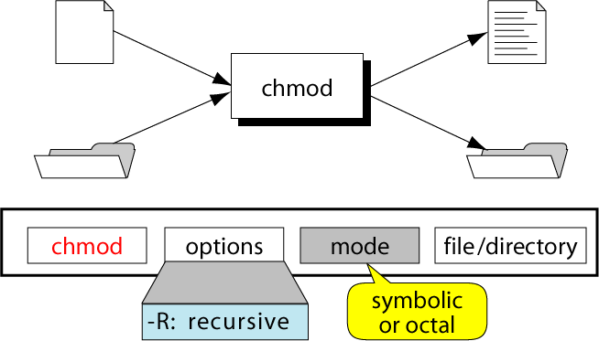
The chmod Command

Slide 97
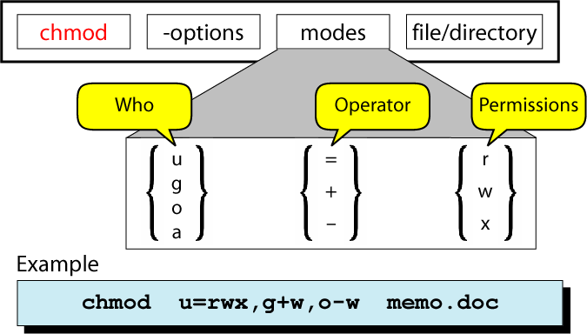
Changing Permissions:
Symbolic Mode

Slide 98
Changing Permissions:
Symbolic Mode
chmod who operation permissions filename
Examples:
% chmod ug=rwx,o=rx sort.c
% chmod ugo+rx,go+w sort.c
u for user
g for group
o for others
a for all
+ for add
- for remove
= for assign
r for read
w for write
x for execute

Slide 99
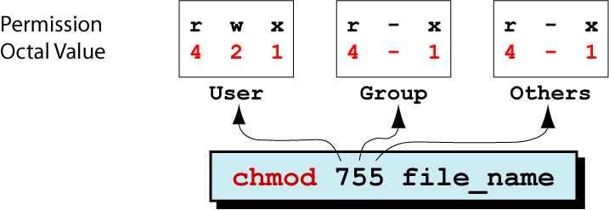
The chmod Command: Octal Mode

Slide 100
Changing Permissions: Octal Mode
Step | Perform… | Settings
1 | List the desired setting
2 | Assign binary: 1 for access; 0 for no access
3 | List octal values for the corresponding binary 1’s
4 | Convert the octal values to a 3-digit number
5 | Write the command
% ls -l sort.c
-rwxrwxr-x 1 ege csci 80 Feb 27 12:23 sort.c
rwx|rwx|r-x
111|111|101
421|421|401
7 | 7 | 5
chmod 775 sort.c

Slide 101
Changing Permissions: example
Goal: set mode of file “myfile”
  Read, write, and execute permissions to owner
  Read and execute permissions to group
  Execute permission to others
We want: rwx|r-x|--x
1) Using Symbolic Mode: __________________________________
2) Using Octal Mode: __________________________________
chmod u=rwx,g=rx,o=x myfile
chmod 751 myfile

Slide 102
Permission default
umask (user mask)
  governs default permission for files and directories when created.
umask –S umask
u=rwx,g=rx,o=rx 0022
in octal form is subtracted from:
  777 for a directory
  666 for a file
can be set to individual value
  Example:
  % umask 011

Slide 103
User Mask values
User mask Value | Directory Default: 777 | File Default: 666
000 | 777 (rwx rwx rwx) | 666 (rw- rw- rw-)
111 | 666 (rw- rw- rw-) | 666 (rw- rw- rw-)
222 | 555 (r-x r-x r-x) | 444 (r- - r- - r- -)
333 | 444 (r- - r- - r- -) | 444 (r- - r- - r- -)
444 | 333 (-wx –wx –rx) | 222 (-w- -w- -w-)
555 | 222 (-w- -w- -w-) | 222 (-w- -w- -w-)
666 | 111 (- -x - -x - -x) | 000 (--- --- --- )
777 | 000 (--- --- --- ) | 000 (--- --- --- )

Slide 104
File Name Expansion
Wildcard characters allow to select files that satisfy a particular name pattern
Character | Description | Example
* | Match zero or more char. | ls *.c
? | Match any single character | ls conf.?
[list] | Match any single character in list | ls conf.[co]
[lower-upper] | Match any character in range | ls lib-id[3-7].o
str{str1,str2,…} | Expand str with contents of { } | ls c*.{700,300}

Slide 105
ls
List directory contents
Has whole bunch of options, see man ls for details.
% ls
  all files except those starting with a “.”
% ls -a
  all
% ls -A
  all without “.” and “..”
% ls -F
  append “/” to dirs and “*” to executables
% ls -l
  long format
% ls -al
% ls -lt
  sort by modification time (latest - earliest)
% ls -ltr
  reverse

Slide 106
mkdir
Creates a directory.
% mkdir newdir
Often people make an alias of md for it.

Slide 107
cd
Changes your current directory to a new one.
% cd /some/other/dir
  Absolute path
% cd subdir
  Assuming subdir is in the current directory.
% cd
  Returns you to your home directory.

Slide 108
pwd
Displays personal working directory, i.e. your current directory.
% pwd

Slide 109
rmdir
Removes a directory.
% rmdir dirname
Equivalent:
  % rm -r dirname

Slide 110
chmod
Changes file permissions
Possible invocations
  % chmod 600 filename
  -rw------- 1 user group 2785 Feb 8 14:18 filename
  (a bit not intuitive where 600 comes from)
  % chmod u+rw filename
  (the same thing, more readable)
  For the assignment:
    % chmod u+x myshellscript
    (mysshellscript is now executable)
    -rwx------ 1 user group 2785 Feb 8 14:18 myshellscript

Slide 111
grep
Searches its input for a pattern.
The pattern can be a simple substring or a complex regular expression.
If a line matches, it’s directed to STDOUT; otherwise, it’s discarded.
% echo “blah-foo” | grep blah
  Will print the matching line
% echo “blah-foo” | grep zee
  Will not.
See a separate grep tutorial.

Slide 112
Pipes
What's a pipe?
  is a method of interprocess communication (IPC)
  in shells a '|' symbol used
  it means that the output of one program (on one side of a pipe) serves as an input for the program on another end.
  a set of "piped" commands is often called a pipeline
Why it's useful?
  Because by combining simple OS utilities one can easily solve more complex tasks

Slide 113
File and Directory Wildcards
When you have a number of files named in series (for example, chap1 to chap12) or filenames with common characters (like aegis, aeon, and aerie), you can use wildcards (also called metacharacters) to specify many files at once. These special characters are * (asterisk), ? (question mark), and [ ] (square brackets). When used in a filename given as an argument to a command:
*An asterisk is replaced by any number of characters in a filename. For example, ae* would match aegis, aerie, aeon, etc. if those files were in the same directory. You can use this to save typing for a single filename (for example, al* for alphabet.txt) or to name many files at once (as in ae*).
?A question mark is replaced by any single character (so h?p matches hop and hip, but not help).
[]Square brackets can surround a choice of characters you’d like to match. Any one of the characters between the brackets will be matched. For example, [Cc]hapter would match either Chapter or chapter, but [ch]apter would match either capter or hapter. Use a hyphen (-) to separate a range of consecutive characters. For example, chap[13] would match chap1, chap2, or chap3.

Slide 114
The examples below demonstrate the use of wildcards.
The first command lists all the entries in a directory, and the rest use wildcards to list just some of the entries. The last one is a little tricky; it matches files whose names contain two (or more) a’s.
% ls
chap10 chap2 chap5 cold chap1a.old chap3.old chap6 chap1b chap4 chap7 oldjunk
% ls chap?
chap2 chap5 chap7 chap4 chap6 % ls chap[5-8] chap5 chap6 chap7
% ls chap??
chap10 chap1b

Slide 115
% ls *old
chap1a.old chap3.old cold
% ls *a*a* chap1a.old haha
Wildcards are useful for more than listing files. Most UNIX commands accept more than one filename, and you can use wildcards to put multiple files on the command line.
For example, the command more is used to display a file on the screen. Let’s say you want to display files chap3.old and chap1a.old. Instead of specifying these files individually, you could enter the command as:

Slide 116
% more *.old
This is equivalent to "more chap1a.old chap3.old“.
Wildcards match directory names, too. For example, let’s say you have subdirectories named Jan, Feb, Mar, and so on. Each has a file named summary. You could read all the summary files by typing "more */summary“. That’s almost equivalent to "more Jan/summary Feb/summary ...” but there’s one important difference: The names will be alphabetized, so Apr/summary would be first in the list.

