Slide 1
REGULAR EXPRESSIONS
Notes:
CSCI 330 - The UNIX System
NIU - Department of Computer Science

Slide 2
REGULAR EXPRESSION
A pattern of special characters used to match strings in a search
Typically made up from special characters called metacharacters
The string matches the regular expression if it contains the substring.
Regular expressions are used throughout UNIX:
  Editors: ed, vi
  Utilities: grep, egrep, sed, and awk

Slide 3
METACHARACTERS
any non-metacharacter matches itself
RE Metacharacter | Matches…
. | Any one character, except new line
[a-z] | Any one of the enclosed characters (e.g. a-z)
* | Zero or more of preceding character
? or \? | Zero or one of the preceding characters
+ or \+ | One or more of the preceding characters

Slide 4
MORE METACHARACTERS
RE Metacharacter | Matches…
^ | beginning of line
$ | end of line
\char | Escape the meaning of char following it
[^] | One character not in the set
\< | Beginning of word anchor
\> | End of word anchor
( ) or \( \) | Tags matched characters to be used later (max = 9)
| or \| | Or grouping
x\{m\} | Repetition of character x, exactly m times (m = integer)
x\{m,\} | Repetition of character x, at least m times
x\{m,n\} | Repetition of character x between m and n times

Slide 5
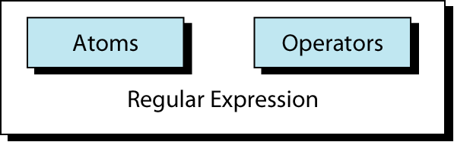
Regular Expression
An atom specifies what text is to be matched and where it is to be found.
An operator combines regular expression atoms. It is not a mandatory requirement in regexs.

Slide 6
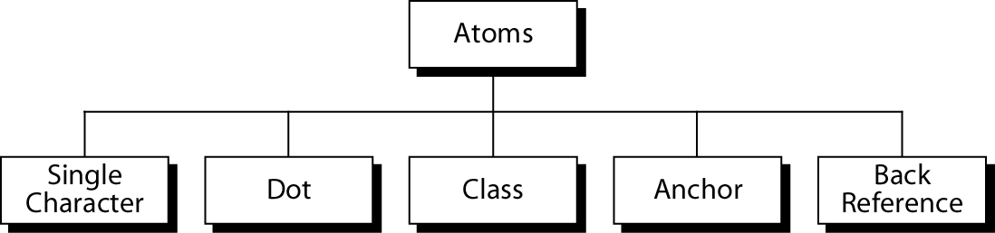
Atoms
An atom specifies what text is to be matched and where
it is to be found.
Following are the different atoms that can be used

Slide 7
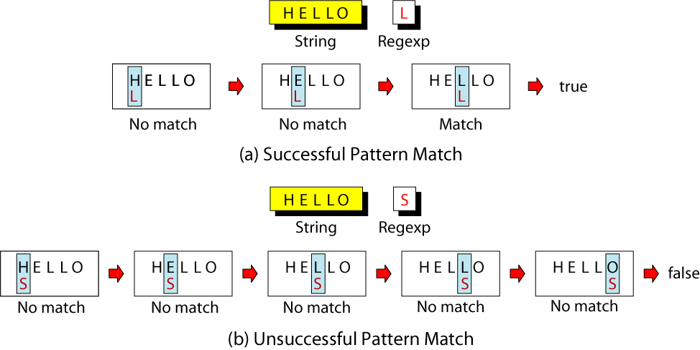
Single-Character Atom
A single character regex matches itself. If the character in string matches the regex then the regex returns true else return false .

Slide 8
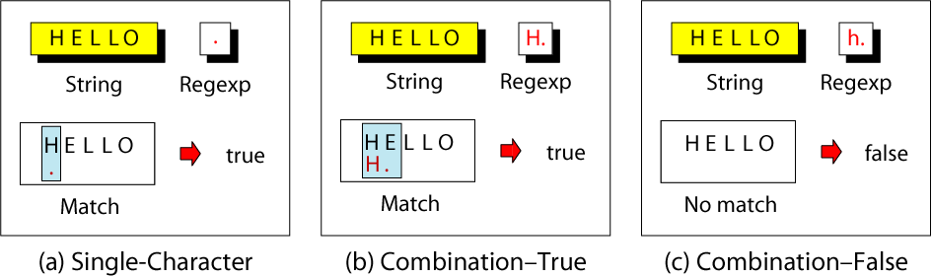
Dot Atom
Matches any single character except for a new line character (\n).
It is one of the most powerful atom.
Unfortunately a dot(.) cannot exist individually in a regex to exercise its power.
It proves its strength when used with operators.

Slide 9
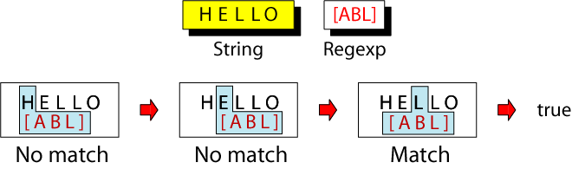
Class Atom
Matches only single character that can be any of the characters defined in a set:
Example: [ABC] matches either A, B, or C.
We can also specify the range in a class by using a hyphen(-) token. Ex: [a-e]
We can also omit some characters in class by using not operator token i.e. caret(^) symbol: Ex: [^AEIOU] to omit the vowels.
The third token that can be used is the escape character( \ ). This is used when we need to match one of the other tokens meaning either this or that. Ex: [AB\ab]

Slide 10
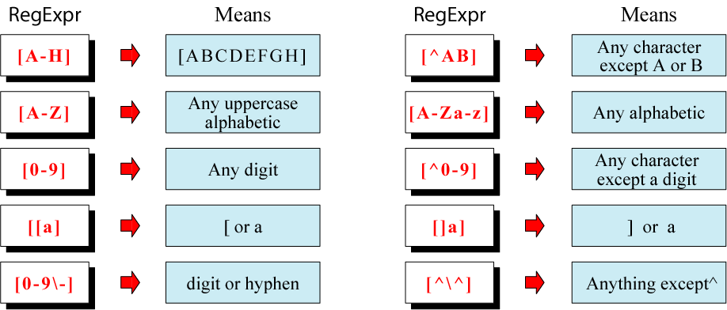
Example: Classes

Slide 11
SHORT-HAND CLASSES
[:alnum:]
[:alpha:]
[:upper:]
[:lower:]
[:digit:]
[:space:]

Slide 12
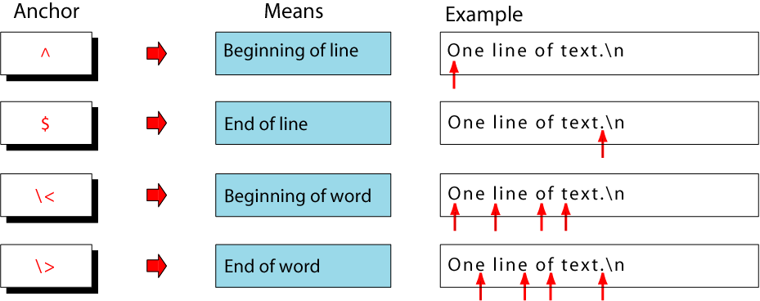
Anchors
Anchors tell where the next character in the pattern must
be located in the text data.

Slide 13
BACK REFERENCES: \N
used to retrieve saved text in one of nine buffers
can refer to the text in a saved buffer by using a back reference:
ex.: \1 \2 \3 ...\9
more details on this later

Slide 14
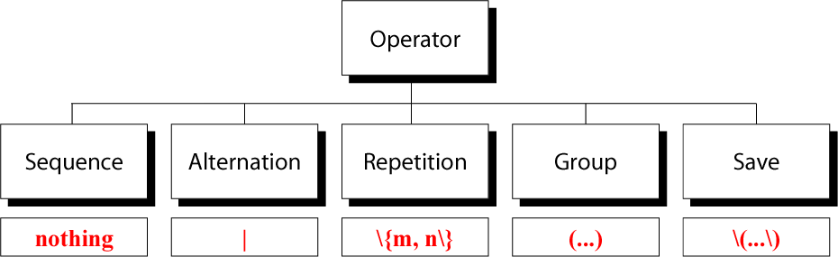
Operators
Makes the regex more powerful by combining the operators with atoms.
It is just like having operators with operands in a mathematical expression

Slide 15
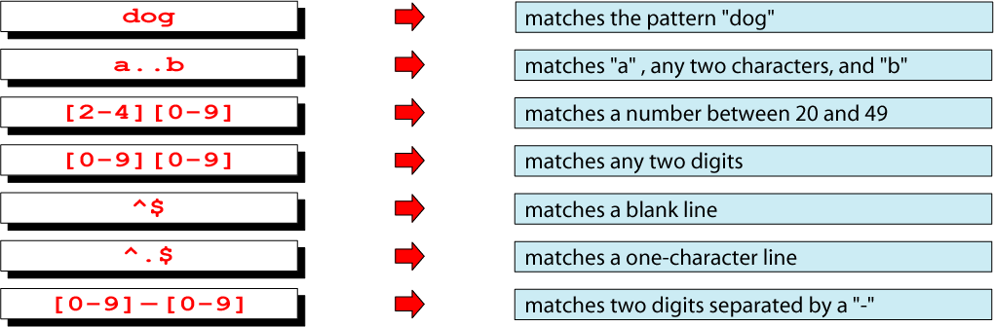
Sequence Operator
In a sequence operator, if a series of atoms are shown in
a regular expression, there is no operator between them.

Slide 16

Alternation Operator: | or \|
operator (| or \| ) is used to define one
or more alternatives
Note: depends on version of “grep”

Slide 17
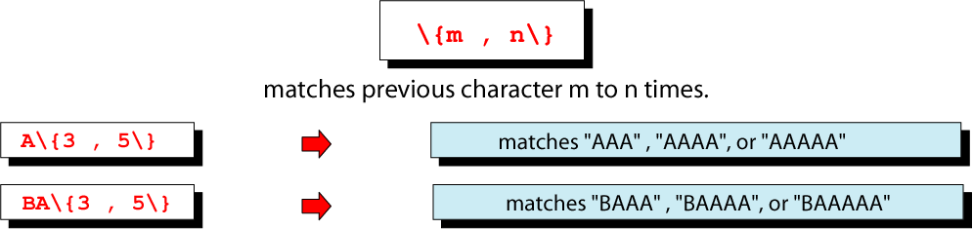
Repetition Operator: \{…\}
The repetition operator specifies that the atom or expression immediately before the repetition may be
repeated.

Slide 18
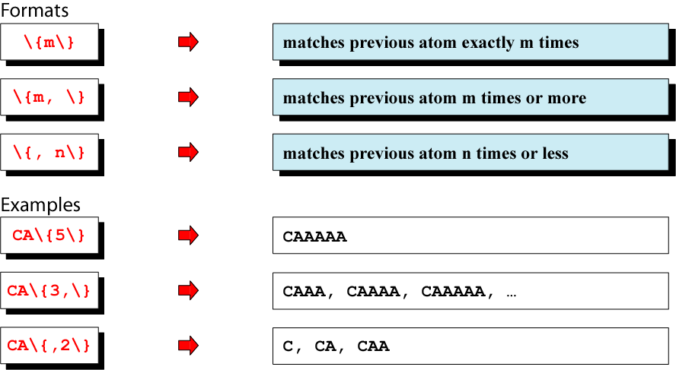
Basic Repetition Forms

Slide 19
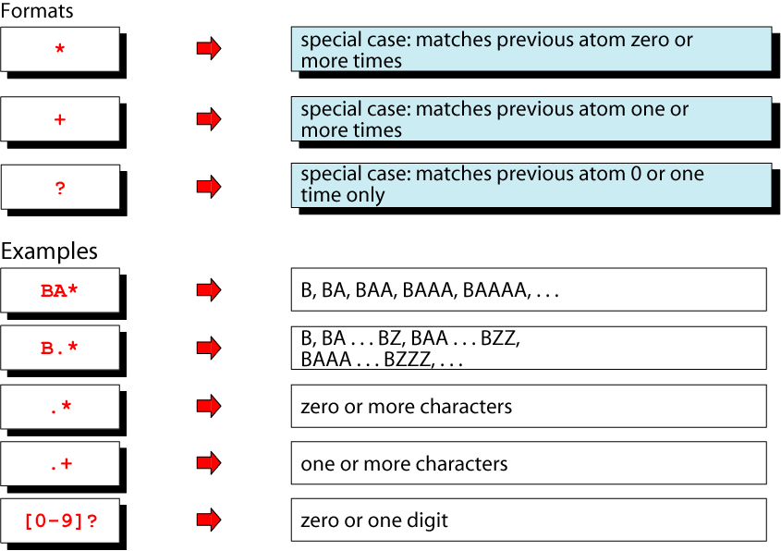
Short Form Repetition Operators: * + ?

Slide 20
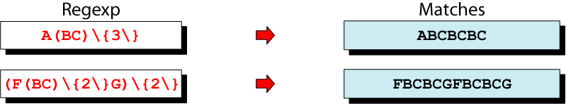
Group Operator
In the group operator, when a group of characters is
enclosed in parentheses, the next operator applies to the
whole group, not only the previous characters.
Note: depends on version of “grep”
use \( and \) instead

Slide 21
REGULAR EXPRESSIONS
There are three operators used to build regular expressions. Let R and S be regular expressions and L(R) the set of strings that match R.
  Union
    R|S L(R|S) = L(R) ∪ L(S)
  Concatenation
    RS L(RS) = {rs, r ∈ R and s ∈ S}
  Closure
    R* L(R*) = {ε,R,RR,RRR,…}

Slide 22
REGULAR EXPRESSIONS
a|(ab)
(a|(ab))|(c|(bc))
a*
a*b*
(ab)*
a|bc*d
letter = a|b|c|…|z|A|B|C|…|Z|_
digit = 0|1|2|3|4|5|6|7|8|9
letter(letter|digit)*

Slide 23
UNIX SYNTAX FOR REGULAR EXPRESSIONS
Many Unix commands (grep, egrep, awk, editors) use regular expressions for denoting patterns. The notation is similar amongst commands, though there are a few differences (see man pages)
It pays to get comfortable using regular expressions (see examples at the end)

Slide 24
EXAMPLES ON REGEX

Slide 25
regular expression
c k s
UNIX Tools rocks.
match
UNIX Tools tricks.
match
UNIX Tools is okay.
no match

Slide 26
REGULAR EXPRESSIONS
A regular expression can match a string in more than one place.
regular expression
a p p l e
Scrapple from the apple.
match 1
match 2

Slide 27
REGULAR EXPRESSIONS
The . regular expression can be used to match any character.
regular expression
o .
For me to loop on.
match 1
match 2

Slide 28
CHARACTER CLASSES
Character classes [] can be used to match any specific set of characters.
regular expression
b [eor] a t
beat a brat on a boat
match 1
match 2
match 3

Slide 29
NEGATED CHARACTER CLASSES
Character classes can be negated with the [^] syntax.
regular expression
b [^eo] a t
beat a brat on a boat
match

Slide 30
MORE ABOUT CHARACTER CLASSES
  [aeiou] will match any of the characters a, e, i, o, or u
  [kK]orn will match korn or Korn
Ranges can also be specified in character classes
  [1-9] is the same as [123456789]
  [abcde] is equivalent to [a-e]
  You can also combine multiple ranges
    [abcde123456789] is equivalent to [a-e1-9]
  Note that the - character has a special meaning in a character class but only if it is used within a range,
  [-123] would match the characters -, 1, 2, or 3

Slide 31
NAMED CHARACTER CLASSES
Commonly used character classes can be referred to by name (alpha, lower, upper, alnum, digit, punct, cntrl)
Syntax [:name:]
  [a-zA-Z] [[:alpha:]]
  [a-zA-Z0-9] [[:alnum:]]
  [45a-z] [45[:lower:]]
Important for portability across languages

Slide 32
ANCHORS
Anchors are used to match at the beginning or end of a line (or both).
^ means beginning of the line
$ means end of the line

Slide 33
regular expression
^ b [eor] a t
beat a brat on a boat
match
regular expression
b [eor] a t $
beat a brat on a boat
match
^word$
^$

Slide 34
REPETITION
The * is used to define zero or more occurrences of the single regular expression preceding it.

Slide 35
regular expression
y a * y
I got mail, yaaaaaaaaaay!
match
regular expression
o a * o
For me to loop on.
match
.*

Slide 36
REPETITION RANGES
Ranges can also be specified
  {n,m} notation can specify a range of repetitions for the immediately preceding regex
  {n} means exactly n occurrences
  {n,} means at least n occurrences
  {n,m} means at least n occurrences but no more than m occurrences
Example:
  .{0,} same as .*
  a{2,} same as aaa*

Slide 37
SUBEXPRESSIONS
If you want to group part of an expression so that * applies to more than just the previous character, use ( ) notation
Subexpresssions are treated like a single character
  a* matches 0 or more occurrences of a
  abc* matches ab, abc, abcc, abccc, …
  (abc)* matches abc, abcabc, abcabcabc, …
  (abc){2,3} matches abcabc or abcabcabc

Slide 38
GREP
grep comes from the ed (Unix text editor) search command “global regular expression print” or g/re/p
This was such a useful command that it was written as a standalone utility
There are two other variants, egrep and fgrep that comprise the grep family
grep is the answer to the situations where you know you want the file that contains a specific phrase but you can’t remember its name

Slide 39
FAMILY DIFFERENCES
grep - uses regular expressions for pattern matching
fgrep - file grep, does not use regular expressions, only matches fixed strings but can get search strings from a file
egrep - extended grep, uses a more powerful set of regular expressions but does not support backreferencing, generally the fastest member of the grep family
agrep – approximate grep; not standard

Slide 40
SYNTAX
Regular expression concepts we have seen so far are common to grep and egrep.
grep and egrep have different syntax
  grep: BREs
  egrep: EREs
Major syntax differences:
  grep: \( and \), \{ and \}
  egrep: ( and ), { and }

Slide 41
PROTECTING REGEX METACHARACTERS
Since many of the special characters used in regexs also have special meaning to the shell, it’s a good idea to get in the habit of single quoting your regexs
  This will protect any special characters from being operated on by the shell
  If you habitually do it, you won’t have to worry about when it is necessary

Slide 42
ESCAPING SPECIAL CHARACTERS
Even though we are single quoting our regexs so the shell won’t interpret the special characters, sometimes we still want to use an operator as itself
To do this, we “escape” the character with a \ (backslash)
Suppose we want to search for the character sequence ‘a*b*’
  Unless we do something special, this will match zero or more ‘a’s followed by zero or more ‘b’s, not what we want
  ‘a\*b\*’ will fix this - now the asterisks are treated as regular characters

Slide 43
EGREP: ALTERNATION
Regex also provides an alternation character | for matching one or another subexpression
  (T|Fl)an will match ‘Tan’ or ‘Flan’
  ^(From|Subject): will match the From and Subject lines of a typical email message
    It matches a beginning of line followed by either the characters ‘From’ or ‘Subject’ followed by a ‘:’
Subexpressions/grouping are used to limit the scope of the alternation
  At(ten|nine)tion then matches “Attention” or “Atninetion”, not “Atten” or “ninetion” as would happen without the parenthesis - Atten|ninetion

Slide 44
EGREP: REPETITION SHORTHANDS
The * (star) has already been seen to specify zero or more occurrences of the immediately preceding character
+ (plus) means “one or more”
  abc+d will match ‘abcd’, ‘abccd’, or ‘abccccccd’ but will not match ‘abd’
  Equivalent to {1,}

Slide 45
EGREP: REPETITION SHORTHANDS CONT
The ‘?’ (question mark) specifies an optional character, the single character that immediately precedes it
  July? will match ‘Jul’ or ‘July’
  Equivalent to {0,1}
  Also equivalent to (Jul|July)
The *, ?, and + are known as quantifiers because they specify the quantity of a match
Quantifiers can also be used with subexpressions
  (a*c)+ will match ‘c’, ‘ac’, ‘aac’ or ‘aacaacac’ but will not match ‘a’ or a blank line

Slide 46
GREP: BACKREFERENCES
Sometimes it is handy to be able to refer to a match that was made earlier in a regex
This is done using backreferences
  \n is the backreference specifier, where n is a number
For example, to find if the first word of a line is the same as the last:
  ^\([[:alpha:]]\{1,\}\).*\1$
  The \([[:alpha:]]\{1,\}\) matches 1 or more letters

Slide 47
PRACTICAL REGEX EXAMPLES
Variable names in C
  [a-zA-Z_][a-zA-Z_0-9]*
amount in rupees with optional paisas
  \Rs[0-9]+(\.[0-9][0-9])?
Time of day
  (1[012]|[1-9]):[0-5][0-9] (am|pm)
HTML headers <h1> <H1> <h2> …
  <[hH][1-4]>

Slide 48
GREP FAMILY
Syntax
  grep [-hilnv] [-e expression] [filename]
  egrep [-hilnv] [-e expression] [-f filename] [expression] [filename]
  fgrep [-hilnxv] [-e string] [-f filename] [string] [filename]
  -h Do not display filenames
  -i Ignore case
  -l List only filenames containing matching lines
  -n Precede each matching line with its line number
  -v Negate matches
  -x Match whole line only (fgrep only)
  -e expression Specify expression as option
  -f filename Take the regular expression (egrep) or a list of strings (fgrep) from filename

Slide 49
GREP EXAMPLES
grep 'men' GrepMe
grep 'fo*' GrepMe
egrep 'fo+' GrepMe
egrep -n '[Tt]he' GrepMe
fgrep 'The' GrepMe
egrep 'NC+[0-9]*A?' GrepMe
fgrep -f expfile GrepMe
Find all lines with signed numbers
  $ egrep ’[-+][0-9]+\.?[0-9]*’ *.c
  bsearch. c: return -1;
  compile. c: strchr("+1-2*3", t-> op)[1] - ’0’, dst,
  convert. c: Print integers in a given base 2-16 (default 10)
  convert. c: sscanf( argv[ i+1], "% d", &base);
  strcmp. c: return -1;
  strcmp. c: return +1;
egrep has its limits: For example, it cannot match all lines that contain a number divisible by 7.

Slide 50
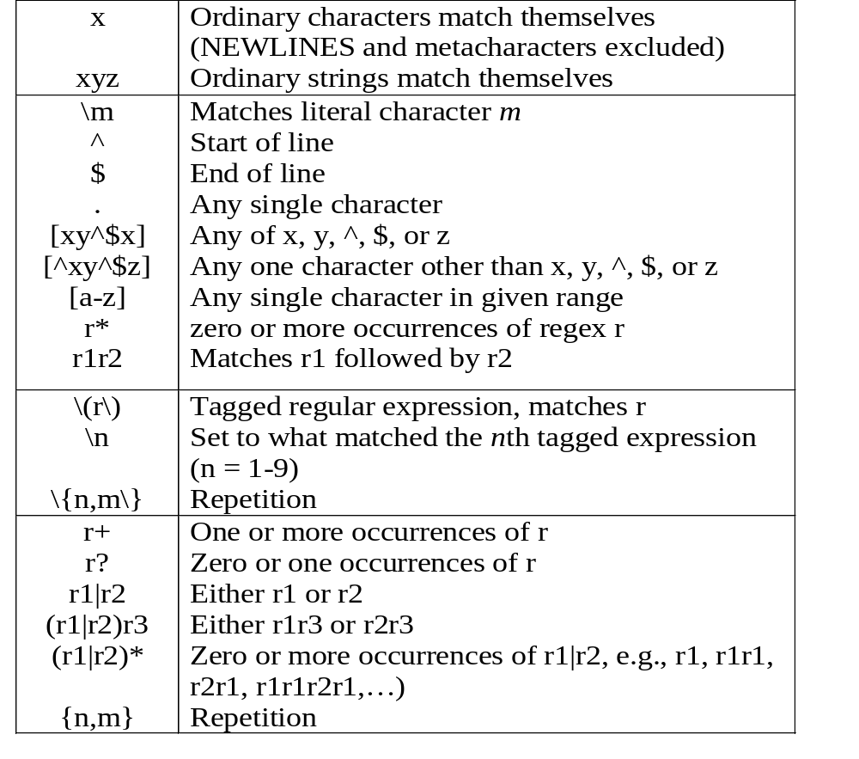
This is one line of text
input line
o.*o
regular expression
fgrep, grep, egrep
grep, egrep
grep
egrep
Quick
Reference

Slide 51
GREP AND EGREP REGULAR EXPRESSIONS
(DECREASING ORDER OF PRECEDENCE)
c any non-special character matches itself
\c turn off any special meaning of character c
^ beginning of line
$ end of line
. any single character
[…] any one of the characters in …; ranges like a-z are legal
[^…] any single character not in …; ranges are legal
\n what the nth character \(…\) matched (grep only)
r* zero or more occurrences of regular expression r
r+ one or more occurrences of regular expression r
r1r2 regular expressions r1 followed by r2
r1|r2 regular expressions r1 or r2 (egrep only)
\(r\) tagged regular expression r (grep only); can be nested
( r) regular expression r (egrep only); can be nested
No regular expression matches a new line

Slide 52
GREP DETAIL AND EXAMPLES
grep is family of commands
  grep
  common version
  egrep
  understands extended REs
  (| + ? ( ) don’t need backslash)
  fgrep
  understands only fixed strings, i.e. is faster
  rgrep
  will traverse sub-directories recursively
Notes:
CSCI 330 - The UNIX System
NIU - Department of Computer Science

Slide 53
COMMONLY USED “GREP” OPTIONS:
-c | Print only a count of matched lines.
-i | Ignore uppercase and lowercase distinctions.
-l | List all files that contain the specified pattern.
-n | Print matched lines and line numbers.
-s | Work silently; display nothing except error messages. Useful for checking the exit status.
-v | Print lines that do not match the pattern.

Slide 54
EXAMPLE: GREP WITH PIPE
% ls -l | grep '^d'
drwxr-xr-x 2 krush csci 512 Feb 8 22:12 assignments
drwxr-xr-x 2 krush csci 512 Feb 5 07:43 feb3
drwxr-xr-x 2 krush csci 512 Feb 5 14:48 feb5
drwxr-xr-x 2 krush csci 512 Dec 18 14:29 grades
drwxr-xr-x 2 krush csci 512 Jan 18 13:41 jan13
drwxr-xr-x 2 krush csci 512 Jan 18 13:17 jan15
drwxr-xr-x 2 krush csci 512 Jan 18 13:43 jan20
drwxr-xr-x 2 krush csci 512 Jan 24 19:37 jan22
drwxr-xr-x 4 krush csci 512 Jan 30 17:00 jan27
drwxr-xr-x 2 krush csci 512 Jan 29 15:03 jan29
% ls -l | grep -c '^d'
10
Pipe the output of the “ls –l” command to grep and list/select only directory entries.
Display the number of lines where the pattern was found. This does not mean the number of occurrences of the pattern.

Slide 55
EXAMPLE: GREP WITH \< \>
% cat grep-datafile
northwest NW Charles Main 300000.00
western WE Sharon Gray 53000.89
southwest SW Lewis Dalsass 290000.73
southern SO Suan Chin 54500.10
southeast SE Patricia Hemenway 400000.00
eastern EA TB Savage 440500.45
northeast NE AM Main Jr. 57800.10
north NO Ann Stephens 455000.50
central CT KRush 575500.70
Extra [A-Z]****[0-9]..$5.00
Print the line if it contains the word “north”.
% grep '\<north\>' grep-datafile
north NO Ann Stephens 455000.50

Slide 56
EXAMPLE: GREP WITH A\|B
% cat grep-datafile
northwest NW Charles Main 300000.00
western WE Sharon Gray 53000.89
southwest SW Lewis Dalsass 290000.73
southern SO Suan Chin 54500.10
southeast SE Patricia Hemenway 400000.00
eastern EA TB Savage 440500.45
northeast NE AM Main Jr. 57800.10
north NO Ann Stephens 455000.50
central CT KRush 575500.70
Extra [A-Z]****[0-9]..$5.00
Print the lines that contain either the expression “NW” or the expression “EA”
% grep 'NW\|EA' grep-datafile
northwest NW Charles Main 300000.00
eastern EA TB Savage 440500.45
Note: egrep works with |

Slide 57
EXAMPLE: EGREP WITH +
% cat grep-datafile
northwest NW Charles Main 300000.00
western WE Sharon Gray 53000.89
southwest SW Lewis Dalsass 290000.73
southern SO Suan Chin 54500.10
southeast SE Patricia Hemenway 400000.00
eastern EA TB Savage 440500.45
northeast NE AM Main Jr. 57800.10
north NO Ann Stephens 455000.50
central CT KRush 575500.70
Extra [A-Z]****[0-9]..$5.00
Print all lines containing one or more 3's.
% egrep '3+' grep-datafile
northwest NW Charles Main 300000.00
western WE Sharon Gray 53000.89
southwest SW Lewis Dalsass 290000.73
Note: grep works with \+

Slide 58
EXAMPLE: EGREP WITH RE: ?
% cat grep-datafile
northwest NW Charles Main 300000.00
western WE Sharon Gray 53000.89
southwest SW Lewis Dalsass 290000.73
southern SO Suan Chin 54500.10
southeast SE Patricia Hemenway 400000.00
eastern EA TB Savage 440500.45
northeast NE AM Main Jr. 57800.10
north NO Ann Stephens 455000.50
central CT KRush 575500.70
Extra [A-Z]****[0-9]..$5.00
Print all lines containing a 2, followed by zero or one period, followed by a number.
% egrep '2\.?[0-9]' grep-datafile
southwest SW Lewis Dalsass 290000.73
Note: grep works with \?

Slide 59
EXAMPLE: EGREP WITH ( )
% cat grep-datafile
northwest NW Charles Main 300000.00
western WE Sharon Gray 53000.89
southwest SW Lewis Dalsass 290000.73
southern SO Suan Chin 54500.10
southeast SE Patricia Hemenway 400000.00
eastern EA TB Savage 440500.45
northeast NE AM Main Jr. 57800.10
north NO Ann Stephens 455000.50
central CT KRush 575500.70
Extra [A-Z]****[0-9]..$5.00
Print all lines containing one or more consecutive occurrences of the pattern “no”.
% egrep '(no)+' grep-datafile
northwest NW Charles Main 300000.00
northeast NE AM Main Jr. 57800.10
north NO Ann Stephens 455000.50
Note: grep works with \( \) \+

Slide 60
EXAMPLE: EGREP WITH (A|B)
% cat grep-datafile
northwest NW Charles Main 300000.00
western WE Sharon Gray 53000.89
southwest SW Lewis Dalsass 290000.73
southern SO Suan Chin 54500.10
southeast SE Patricia Hemenway 400000.00
eastern EA TB Savage 440500.45
northeast NE AM Main Jr. 57800.10
north NO Ann Stephens 455000.50
central CT KRush 575500.70
Extra [A-Z]****[0-9]..$5.00
Print all lines containing the uppercase letter “S”, followed by either “h” or “u”.
% egrep 'S(h|u)' grep-datafile
western WE Sharon Gray 53000.89
southern SO Suan Chin 54500.10
Note: grep works with \( \) \|

Slide 61
EXAMPLE: FGREP
% cat grep-datafile
northwest NW Charles Main 300000.00
western WE Sharon Gray 53000.89
southwest SW Lewis Dalsass 290000.73
southern SO Suan Chin 54500.10
southeast SE Patricia Hemenway 400000.00
eastern EA TB Savage 440500.45
northeast NE AM Main Jr. 57800.10
north NO Ann Stephens 455000.50
central CT KRush 575500.70
Extra [A-Z]****[0-9]..$5.00
Find all lines in the file containing the literal string “[A-Z]****[0-9]..$5.00”. All characters are treated as themselves. There are no special characters.
% fgrep '[A-Z]****[0-9]..$5.00' grep-datafile
Extra [A-Z]****[0-9]..$5.00

Slide 62
EXAMPLE: GREP WITH ^
% cat grep-datafile
northwest NW Charles Main 300000.00
western WE Sharon Gray 53000.89
southwest SW Lewis Dalsass 290000.73
southern SO Suan Chin 54500.10
southeast SE Patricia Hemenway 400000.00
eastern EA TB Savage 440500.45
northeast NE AM Main Jr. 57800.10
north NO Ann Stephens 455000.50
central CT KRush 575500.70
Extra [A-Z]****[0-9]..$5.00
Print all lines beginning with the letter n.
% grep '^n' grep-datafile
northwest NW Charles Main 300000.00
northeast NE AM Main Jr. 57800.10
north NO Ann Stephens 455000.50

Slide 63
EXAMPLE: GREP WITH $
% cat grep-datafile
northwest NW Charles Main 300000.00
western WE Sharon Gray 53000.89
southwest SW Lewis Dalsass 290000.73
southern SO Suan Chin 54500.10
southeast SE Patricia Hemenway 400000.00
eastern EA TB Savage 440500.45
northeast NE AM Main Jr. 57800.10
north NO Ann Stephens 455000.50
central CT KRush 575500.70
Extra [A-Z]****[0-9]..$5.00
Print all lines ending with a period and exactly two zero numbers.
% grep '\.00$' grep-datafile
northwest NW Charles Main 300000.00
southeast SE Patricia Hemenway 400000.00
Extra [A-Z]****[0-9]..$5.00

Slide 64
EXAMPLE: GREP WITH \CHAR
% cat grep-datafile
northwest NW Charles Main 300000.00
western WE Sharon Gray 53000.89
southwest SW Lewis Dalsass 290000.73
southern SO Suan Chin 54500.10
southeast SE Patricia Hemenway 400000.00
eastern EA TB Savage 440500.45
northeast NE AM Main Jr. 57800.10
north NO Ann Stephens 455000.50
central CT KRush 575500.70
Extra [A-Z]****[0-9]..$5.00
Print all lines containing the number 5, followed by a literal period and any single character.
% grep '5\..' grep-datafile
Extra [A-Z]****[0-9]..$5.00

Slide 65
EXAMPLE: GREP WITH [ ]
% cat grep-datafile
northwest NW Charles Main 300000.00
western WE Sharon Gray 53000.89
southwest SW Lewis Dalsass 290000.73
southern SO Suan Chin 54500.10
southeast SE Patricia Hemenway 400000.00
eastern EA TB Savage 440500.45
northeast NE AM Main Jr. 57800.10
north NO Ann Stephens 455000.50
central CT KRush 575500.70
Extra [A-Z]****[0-9]..$5.00
Print all lines beginning with either a “w” or an “e”.
% grep '^[we]' grep-datafile
western WE Sharon Gray 53000.89
eastern EA TB Savage 440500.45

Slide 66
EXAMPLE: GREP WITH [^]
% cat grep-datafile
northwest NW Charles Main 300000.00
western WE Sharon Gray 53000.89
southwest SW Lewis Dalsass 290000.73
southern SO Suan Chin 54500.10
southeast SE Patricia Hemenway 400000.00
eastern EA TB Savage 440500.45
northeast NE AM Main Jr. 57800.10
north NO Ann Stephens 455000.50
central CT KRush 575500.70
Extra [A-Z]****[0-9]..$5.00
Print all lines ending with a period and exactly two non-zero numbers.
% grep '\.[^0][^0]$' grep-datafile
western WE Sharon Gray 53000.89
southwest SW Lewis Dalsass 290000.73
eastern EA TB Savage 440500.45

Slide 67
EXAMPLE: GREP WITH X\{M\}
% cat grep-datafile
northwest NW Charles Main 300000.00
western WE Sharon Gray 53000.89
southwest SW Lewis Dalsass 290000.73
southern SO Suan Chin 54500.10
southeast SE Patricia Hemenway 400000.00
eastern EA TB Savage 440500.45
northeast NE AM Main Jr. 57800.10
north NO Ann Stephens 455000.50
central CT KRush 575500.70
Extra [A-Z]****[0-9]..$5.00
Print all lines where there are at least six consecutive numbers followed by a period.
% grep '[0-9]\{6\}\.' grep-datafile
northwest NW Charles Main 300000.00
southwest SW Lewis Dalsass 290000.73
southeast SE Patricia Hemenway 400000.00
eastern EA TB Savage 440500.45
north NO Ann Stephens 455000.50
central CT KRush 575500.70

Slide 68
EXAMPLE: GREP WITH \<
% cat grep-datafile
northwest NW Charles Main 300000.00
western WE Sharon Gray 53000.89
southwest SW Lewis Dalsass 290000.73
southern SO Suan Chin 54500.10
southeast SE Patricia Hemenway 400000.00
eastern EA TB Savage 440500.45
northeast NE AM Main Jr. 57800.10
north NO Ann Stephens 455000.50
central CT KRush 575500.70
Extra [A-Z]****[0-9]..$5.00
Print all lines containing a word starting with “north”.
% grep '\<north' grep-datafile
northwest NW Charles Main 300000.00
northeast NE AM Main Jr. 57800.10
north NO Ann Stephens 455000.50

Slide 69
SED- STREAM EDITOR

Slide 70
WHAT IS SED?
A non-interactive stream editor
Interprets sed instructions and performs actions
Use sed to:
  Automatically perform edits on file(s)
  Simplify doing the same edits on multiple files
  Write conversion programs

Slide 71
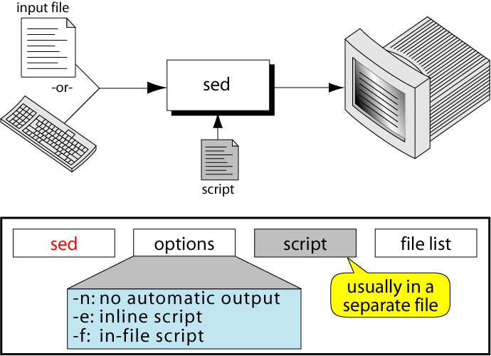
THE SED COMMAND

Slide 72
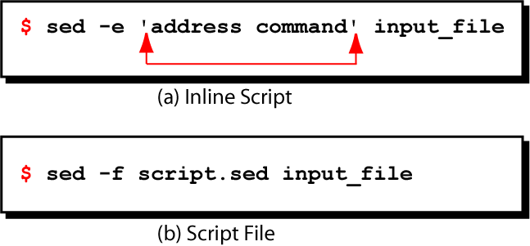
SED COMMAND SYNTAX

Slide 73
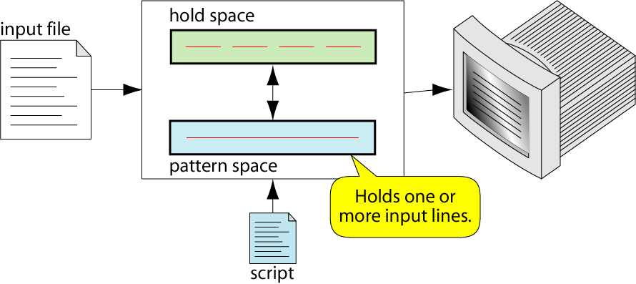
SED OPERATION

Slide 74
HOW DOES SED WORK?
sed reads line of input
  line of input is copied into a temporary buffer called pattern space
  editing commands are applied
    subsequent commands are applied to line in the pattern space, not the original input line
    once finished, line is sent to output
    (unless –n option was used)
  line is removed from pattern space
sed reads next line of input, until end of file
Note: input file is unchanged

Slide 75
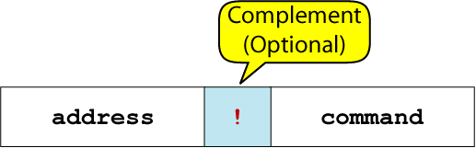
SED INSTRUCTION FORMAT
address determines which lines in the input file are to be processed by the command(s)
  if no address is specified, then the command is applied to each input line
address types:
  Single-Line address
  Set-of-Lines address
  Range address
  Nested address

Slide 76
SINGLE-LINE ADDRESS
Specifies only one line in the input file
  special: dollar sign ($) denotes last line of input file
Examples:
  show only line 3
  sed -n -e '3 p' input-file
  show only last line
  sed -n -e '$ p' input-file
  substitute “endif” with “fi” on line 10
  sed -e '10 s/endif/fi/' input-file

Slide 77
SET-OF-LINES ADDRESS
use regular expression to match lines
  written between two slashes
  process only lines that match
  may match several lines
  lines may or may not be consecutives
Examples:
  sed -e ‘/key/ s/more/other/’ input-file
  sed -n -e ‘/r..t/ p’ input-file

Slide 78
RANGE ADDRESS
Defines a set of consecutive lines
Format:
start-addr,end-addr (inclusive)
Examples:
  10,50 line-number,line-number
  10,/R.E/ line-number,/RegExp/
  /R.E./,10 /RegExp/,line-number
  /R.E./,/R.E/ /RegExp/,/RegExp/

Slide 79
EXAMPLE: RANGE ADDRESS
% sed -n -e ‘/^BEGIN$/,/^END$/p’ input-file
Print lines between BEGIN and END, inclusive
      BEGIN
      Line 1 of input
      Line 2 of input
      Line3 of input
      END
      Line 4 of input
      Line 5 of input
addr1
addr2
These lines are printed

Slide 80
NESTED ADDRESS
Nested address contained within another address
Example:
print blank lines between line 20 and 30
    20,30{
      /^$/ p
    }

Slide 81
ADDRESS WITH !
address with an exclamation point (!):
instruction will be applied to all lines that do not match the address
Example:
print lines that do not contain “obsolete”
sed -e ‘/obsolete/!p’ input-file

Slide 82
ADDRESS AND COMMAND EXAMPLES
d deletes the all lines
6d deletes line 6
/^$/d deletes all blank lines
1,10d deletes lines 1 through 10
1,/^$/d deletes from line 1 through the first blank line
/^$/,$d deletes from the first blank line through the last line of the file
/^$/,10d deletes from the first blank line through line 10
/^ya*y/,/[0-9]$/d deletes from the first line that begins
with yay, yaay, yaaay, etc. through
the first line that ends with a digit

Slide 83
MULTIPLE COMMANDS
Braces {} can be used to apply multiple commands to an address
[/pattern/[,/pattern/]]{
command1
command2
command3
}
Strange syntax:
  The opening brace must be the last character on a line
  The closing brace must be on a line by itself
  Make sure there are no spaces following the braces

Slide 84
USING !
If an address is followed by an exclamation point (!), the associated command is applied to all lines that don’t match the address or address range
Examples:
1,5!d would delete all lines except 1 through 5
/black/!s/cow/horse/ would substitute “horse” for “cow” on all lines except those that contained “black”
“The brown cow” -> “The brown horse”
“The black cow” -> “The black cow”

Slide 85
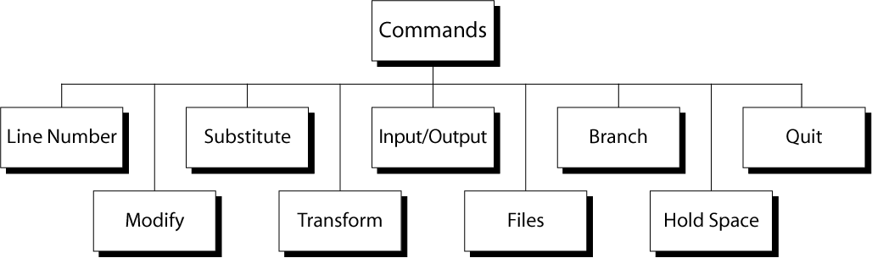
SED COMMANDS

Slide 86
LINE NUMBER
line number command (=) writes the current line number before each matched/output line
Examples:
  sed -e '/Two-thirds-time/=' tuition.data
  sed -e '/^[0-9][0-9]/=' inventory

Slide 87
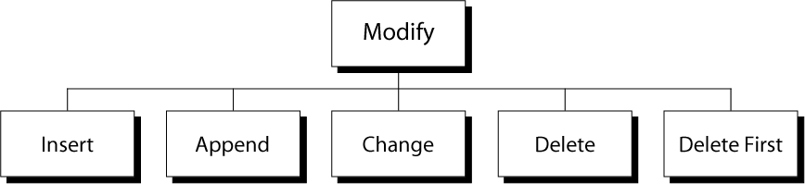
MODIFY COMMANDS
Substitute

Slide 88
INSERT COMMAND: I
adds one or more lines directly to the output before the address:
  inserted “text” never appears in sed’s pattern space
  cannot be used with a range address; can only be used with the single-line and set-of-lines address types
Syntax:
  [address] i\
  text

Slide 89
EXAMPLE: INSERT COMMAND (I)
% cat tuition.insert.sed
1 i\
Tuition List\
% cat tuition.data
Part-time 1003.99
Two-thirds-time 1506.49
Full-time 2012.29
% sed -f tuition.insert.sed tuition.data
Tuition List
Part-time 1003.99
Two-thirds-time 1506.49
Full-time 2012.29
Sed script to insert “Tuition List” as report title before line 1
Input data
Output after applying
the insert command

Slide 90
APPEND COMMAND: A
adds one or more lines directly to the output after the address:
  Similar to the insert command (i), append cannot be used with a range address.
  Appended “text” does not appear in sed’s pattern space.
Syntax:
  [address] a\
  text

Slide 91
EXAMPLE: APPEND COMMAND (A)
% cat tuition.append.sed
a \
--------------------------
% cat tuition.data
Part-time 1003.99
Two-thirds-time 1506.49
Full-time 2012.29
% sed -f tuition.append.sed tuition.data
Part-time 1003.99
--------------------------
Two-thirds-time 1506.49
--------------------------
Full-time 2012.29
--------------------------
Sed script to append
dashed line after
each input line
Input data
Output after applying
the append command

Slide 92
CHANGE COMMAND: C
replaces an entire matched line with new text
accepts four address types:
  single-line, set-of-line, range, and nested addresses.
Syntax:
  [address1[,address2]] c\
  text

Slide 93
EXAMPLE: CHANGE COMMAND (C)
% cat tuition.change.sed
1 c\
Part-time 1100.00
% cat tuition.data
Part-time 1003.99
Two-thirds-time 1506.49
Full-time 2012.29
% sed -f tuition.change.sed tuition.data
Part-time 1100.00
Two-thirds-time 1506.49
Full-time 2012.29
Sed script to change
tuition cost from
1003.99 to 1100.00
Input data
Output after applying
the change command

Slide 94
DELETE COMMAND: D
deletes the entire pattern space
  commands following the delete command are ignored since the deleted text is no longer in the pattern space
Syntax:
  [address1[,address2]] d

Slide 95
EXAMPLE: DELETE COMMAND (D)
Remove part-time data from “tuition.data” file
% cat tuition.data
Part-time 1003.99
Two-thirds-time 1506.49
Full-time 2012.29
% sed –e '/^Part-time/d' tuition.data
Two-thirds-time 1506.49
Full-time 2012.29
Input data
Output after applying delete command

Slide 96
SUBSTITUTE COMMAND (S)
Syntax:
[addr1][,addr2] s/search/replace/[flags]
replaces text selected by search string with replacement string
search string can be regular expression
flags:
  global (g), i.e. replace all occurrences
  specific substitution count (integer), default 1

Slide 97
REGULAR EXPRESSIONS: USE WITH SED
Metacharacter | Description/Matches…
. | Any one character, except new line
* | Zero or more of preceding character
^ | A character at beginning of line
$ | A character at end of line
\char | Escape the meaning of char following it
[ ] | Any one of the enclosed characters
\( \) | Tags matched characters to be used later
x\{m\} | Repetition of character x, m times
\< | Beginning of word
\> | End of word

Slide 98
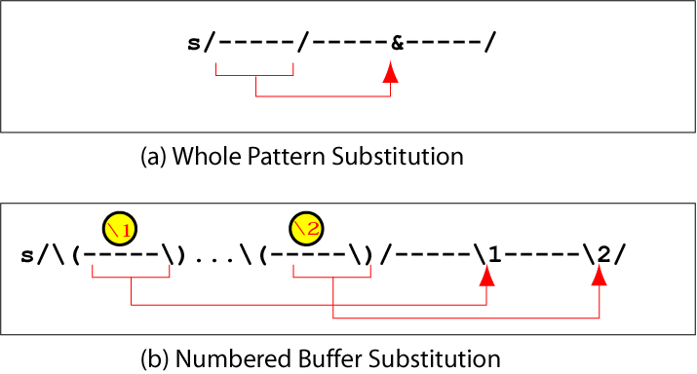
SUBSTITUTION BACK REFERENCES

Slide 99
EXAMPLE: REPLACEMENT STRING &
$ cat datafile
Charles Main 3.0 .98 3 34
Sharon Gray 5.3 .97 5 23
Patricia Hemenway 4.0 .7 4 17
TB Savage 4.4 .84 5 20
AM Main Jr. 5.1 .94 3 13
Margot Weber 4.5 .89 5 9
Ann Stephens 5.7 .94 5 13
$ sed -e ‘s/[0-9][0-9]$/&.5/’ datafile
Charles Main 3.0 .98 3 34.5
Sharon Gray 5.3 .97 5 23.5
Patricia Hemenway 4.0 .7 4 17.5
TB Savage 4.4 .84 5 20.5
AM Main Jr. 5.1 .94 3 13.5
Margot Weber 4.5 .89 5 9
Ann Stephens 5.7 .94 5 13.5

Slide 100
EXAMPLE: BACK REFERENCE
$ cat filedata
/home/ux/user/z156256
/home/ux/user/z056254
/home/lx/user/z106253
/home/ux/user/z150252
/home/mp/user/z056254
/home/lx/user/z106253
$ sed -e 's,/home/\(..\)/user/\(z[0-9]\{6\}\),/usr/\2/\1,g' filedata
/usr/z156256/ux
/usr/z056254/ux
/usr/z106253/lx
/usr/z150252/ux
/usr/z056254/mp
/usr/z106253/lx

Slide 101
TRANSFORM COMMAND (Y)
Syntax:
[addr1][,addr2]y/a/b/
  translates one character 'a' to another 'b'
  cannot use regular expression metacharacters
  cannot indicate a range of characters
  similar to “tr” command
Example:
  $ sed -e ‘1,10y/abcd/wxyz/’ datafile
Must have same number of characters

Slide 102
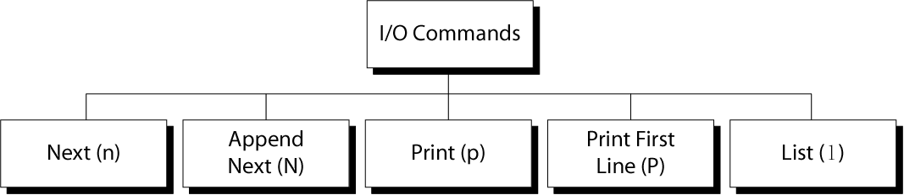
SED I/O COMMANDS

Slide 103
INPUT (NEXT) COMMAND: N AND N
Forces sed to read the next input line
  Copies the contents of the pattern space to output
  Deletes the current line in the pattern space
  Refills it with the next input line
  Continue processing
N (uppercase) Command
  adds the next input line to the current contents of the pattern space
  useful when applying patterns to two or more lines at the same time
Notes:
The sed Utility
Copyright Department of Computer Science, Northern Illinois University,2004
Clears the pattern space before inputting the next line

Slide 104
OUTPUT COMMAND: P AND P
Print Command (p)
  copies the entire contents of the pattern space to output
  will print same line twice unless the option “–n” is used
Print command: P
  prints only the first line of the pattern space
  prints the contents of the pattern space up to and including a new line character
  any text following the first new line is not printed

Slide 105
LIST COMMAND (L)
The list command: l
  shows special characters (e.g. tab, etc)
The octal dump command (od -c) can be used to produce similar result

Slide 106
HOLD SPACE
temporary storage area
used to save the contents of the pattern space
4 commands that can be used to move text back and forth between the pattern space and the hold space:
h, H
g, G

Slide 107
HOLD COMMANDS: H AND H
The lowercase hold (and replace) command (h) copies the current contents of the pattern space to the hold space and replaces any text currently in the hold space
The uppercase hold (and append) command (H) appends the current contents of the pattern space to the hold space

Slide 108
THE GET COMMANDS: G AND G
The lowercase get (and replace) command (g) copies the text in the hold space to the pattern space and replaces any text currently in the pattern space
The uppercase get (and append) command (G) appends the current contents of the hold space to the pattern space

Slide 109
THE ‘H’ AND ‘G’ COMMANDS
Syntax: [addr1][,addr2]h
  copies the contents of the pattern space to a hold space; replaces any text currently in the hold space
Syntax: [addr1][,addr2]G
  gets what was in the hold space and copies it into the pattern space, appending to what was there
h
Pattern Space
(append)
Hold Space
G

Slide 110
EXAMPLE: THE ‘H’ AND ‘G’ COMMANDS
% sed -e ‘/northeast/h’ -e ‘$G’ datafile
northwest NW
western WE
southwest SW
southern SO
southeast SE
eastern EA
northeast NE
north NO
central CT
northeast NE
% cat datafile
northwest NW
western WE
southwest SW
southern SO
southeast SE
eastern EA
northeast NE
north NO
central CT

Slide 111
THE ‘G’ COMMAND
Syntax: [addr1][,addr2]g
  Gets what was in the hold space and copies it into the pattern space, overwriting what was there
h
Pattern Space
(overwrite)
Hold Buffer
g

Slide 112
EXAMPLE: THE ‘H’ AND ‘G’ COMMANDS
% sed -e ‘/northeast/h’ -e ‘$g’ datafile
northwest NW
western WE
southwest SW
southern SO
southeast SE
eastern EA
northeast NE
north NO
northeast NE
% cat datafile
northwest NW
western WE
southwest SW
southern SO
southeast SE
eastern EA
northeast NE
north NO
central CT

Slide 113
FILE COMMANDS
allows to read and write from/to file while processing standard input
read: r command
write: w command

Slide 114
READ FILE COMMAND
Syntax: r filename
  queue the contents of filename to be read and inserted into the output stream at the end of the current cycle, or when the next input line is read
    if filename cannot be read, it is treated as if it were an empty file, without any error indication
  single address only

Slide 115
WRITE FILE COMMAND
Syntax: w filename
  Write the pattern space to filename
  The filename will be created (or truncated) before the first input line is read
  all w commands which refer to the same filename are output through the same FILE stream

Slide 116
BRANCH COMMAND (B)
Change the regular flow of the commands in the script file
Syntax: [addr1][,addr2]b[label]
  Branch (unconditionally) to ‘label’ or end of script
  If “label” is supplied, execution resumes at the line following :label; otherwise, control passes to the end of the script
Branch label
  :mylabel
Can be up to 7 characters
Must be on a line by itself
Must begin with a colon
No spaces after it and after the colon

Slide 117
EXAMPLE: BRANCH (B) COMMAND
Example:
If the string ‘soph’ is found on a line, write the matched line to a file called “soph.students”; otherwise, write unmatched lines to a file called ‘others’:
/soph/b save
w others
b
:save
w soph.students

Slide 118
SED ADVANTAGES
Regular expressions
Fast
Concise

Slide 119
SED DRAWBACKS
Hard to remember text from one line to another
Not possible to go backward in the file
No way to do forward references like /..../+1
No facilities to manipulate numbers
Cumbersome syntax

