Slide 1


BANSAL INSTITUTE OF SCIENCE AND TECHNOLOGY BHOPAL (M.P)
DEPARTMENT OF COMPUTER SCIENCE AND ENGINEERING
Confessify
B.Tech. In Computer Science and Engineering
Submitted by :-
Abhishek Kumar (0112CS191009)
Drashi Jain (0112CS191043)
Gyanendra Kumar(0112CS191043)
Koyna Khare (0112CS1911034)
Sandhya (0112CS191074)
HOD
Prof. Manish Saxena
(Asst. Professor, Dept. of CSE, B.I.S.T., Bhopal)
GUIDE BY:
Prof. Anshu Tiwari
(Asst. Professor, Dept. of CSE,
B.I.S.T., Bhopal)

Slide 2

Presentation Flow
Tools
and
Tech.
Abstract
Introduction
Screenshot
Conclusion and
Scope
Thank You

Slide 3
Abstract
Anonymous confession apps are a relatively new type of social media application that has become increasingly popular in recent years.
Confessify project aims to provide a safe and non-judgmental space for users to share their personal experiences and seek support.
It has given us a better understanding of React JS, React Redux , Authentication, MongoDB, Expresss JS, Node JS.

Slide 4
Introduction
Confessify is an Social media application.It is single page Application made using MERN.
There is Login/Logout feature with jwt.
User can post confession as anonymous or as normal user too.
User can edit, delete and update the post and has like and comment features.
User can follow other user and unfollow user.

Slide 5





Tools and Technology
React. js is an open-source JavaScript library that is used for building user interfaces specifically for single-page applications. It's used for handling the view layer for web and mobile apps. React also allows us to create reusable UI components.
React. js is an open-source JavaScript library that is used for building user interfaces specifically for single-page applications. It's used for handling the view layer for web and mobile apps. React also allows us to create reusable UI components.
React. js is an open-source JavaScript library that is used for building user interfaces specifically for single-page applications. It's used for handling the view layer for web and mobile apps. React also allows us to create reusable UI components.
React js
React js
React js
Redux is used mostly for application state management. Redux can be used as a data store for any UI layer.
Redux
Node.js is an open-source Chrome’s Javascript runtime environment – allows you to develop scalable web applications effortlessly.
Node.js is an open-source Chrome’s Javascript runtime environment – allows you to develop scalable web applications effortlessly.
Node JS
Node JS
JavaScript is a light-weight object-oriented programming language that is used by several websites for scripting the webpages. It is used to create dynamic and interactive web content.
JavaScript is a light-weight object-oriented programming language that is used by several websites for scripting the webpages. It is used to create dynamic and interactive web content.
MongoDB
The Firebase Realtime Database lets you build rich, collaborative applications by allowing secure access to the database directly from client-side code.
Express.js is a minimal and flexible Node.js web application framework that provides a robust set of features for web and mobile applications.
Express JS

Slide 6
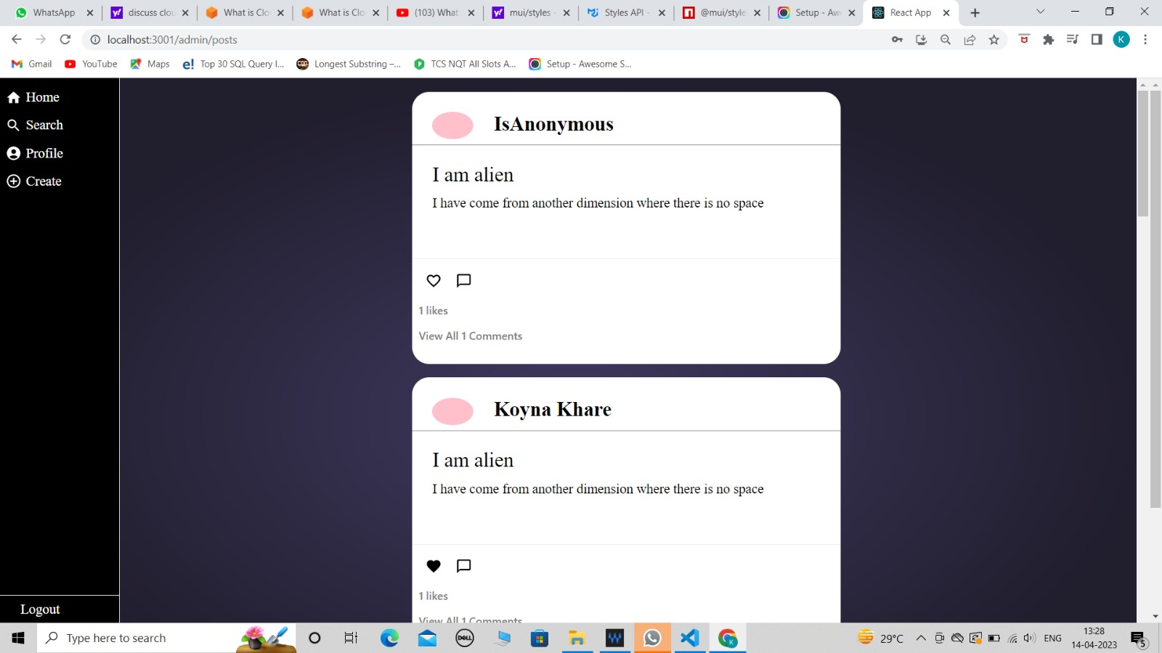
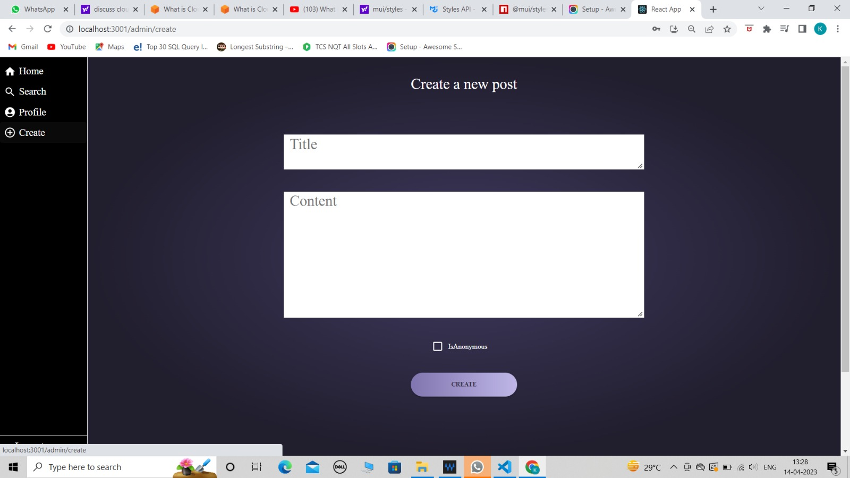
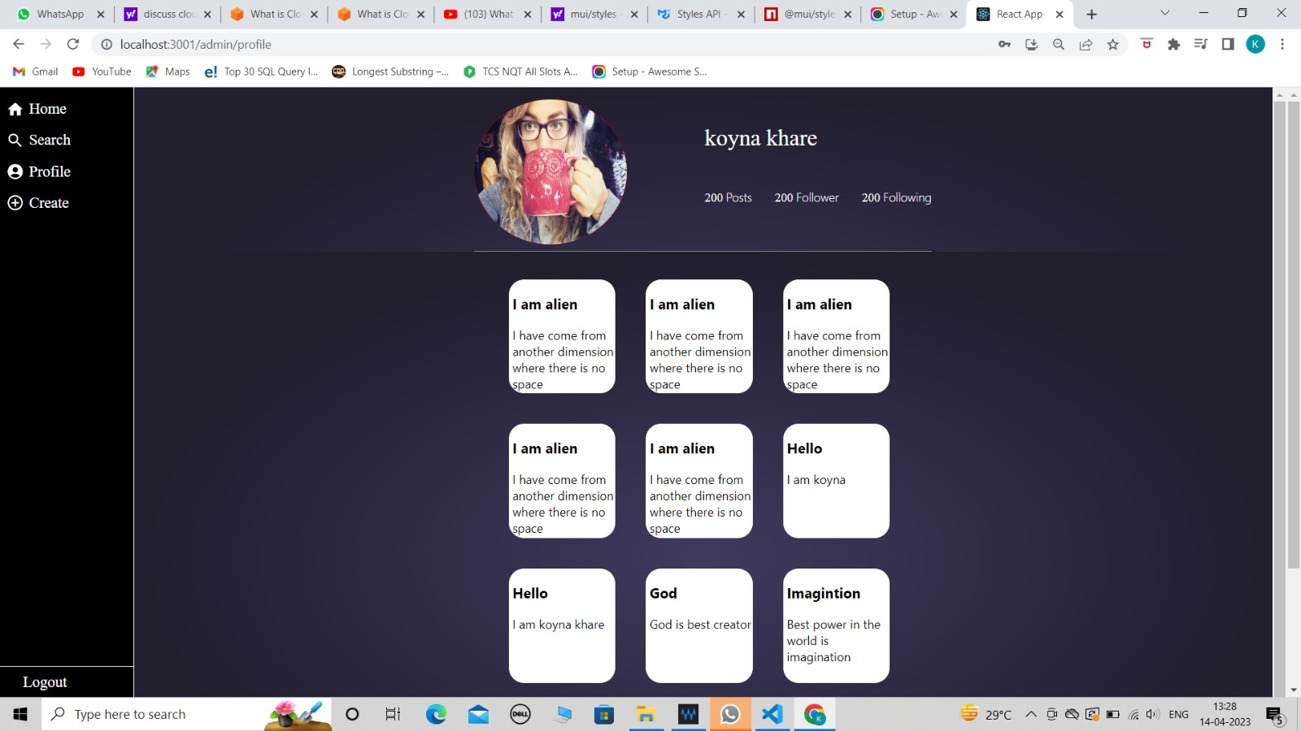
Screenshot

Slide 7
Conclusion
The confession app is designed to allow users to submit anonymous confessions and to read and react to the confessions of others.
Anonymous Confession Submission
User Profile
Confession Feed
Commenting System
Search Functionality
Reporting Functionality
Admin Dashboard

Slide 8
Scope
There is always a room for improvement in any application but most important thing should be flexible to accept further modification right now we are just dealing with authentication, roles, state management.
In future this application may be extended to include features such as:
We can enable to post photo too.
Anonymous comment.
Expand Platform Support:
Anonymous Chat Functionality
Advanced Search
Improved User Interface
Integration with Mental Health Resources

Slide 9

THANK YOU

