Slide 1
SQL Final Capstone

Slide 2
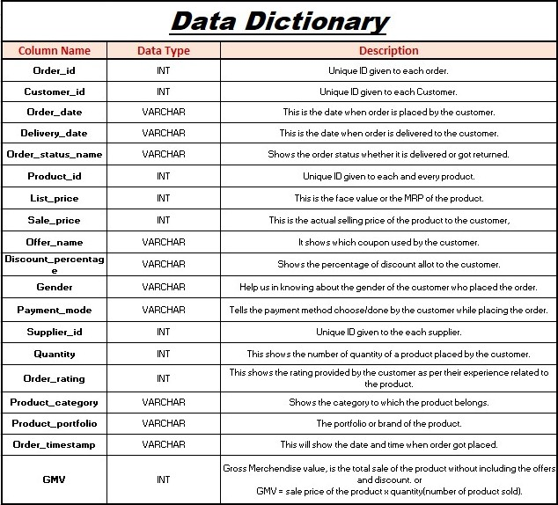

Slide 3
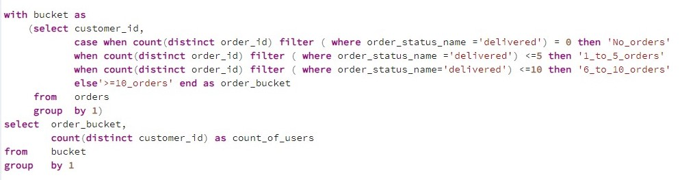
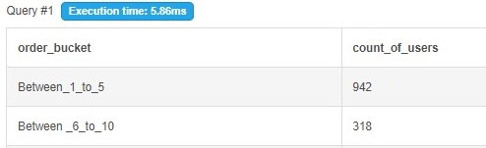
Ques 1 – Write an SQL query to find the count of users in each order bucket based on their order history. The order buckets are categorized as 'No_orders' for customers with no delivered orders, '1_to_5_orders' for those with 1 to 5 delivered orders, '6_to_10_orders' for 6 to 10 delivered orders, and '>=10_orders' for customers with more than 10 delivered orders. The result should display the order bucket and the corresponding count of users.
Query →
Output →

Slide 4
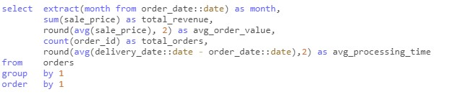
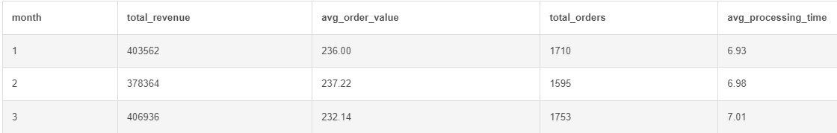
Ques 2 – Fetch the below matrics for month on month comparison of : 1- Total Revenue, 2- Avg order value, 3-Total Orders, 4-Avg Processing Time
Query →
Output →

Slide 5
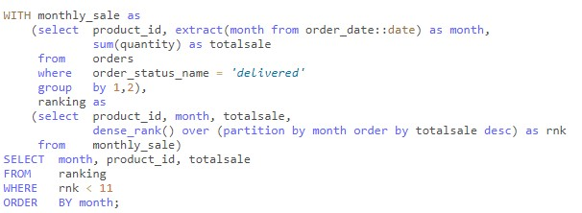
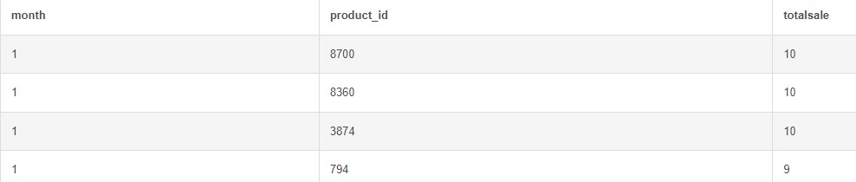
Ques 3 (a)– Month on month comparison of top 10 highest selling products.
Query →
Output →

Slide 6

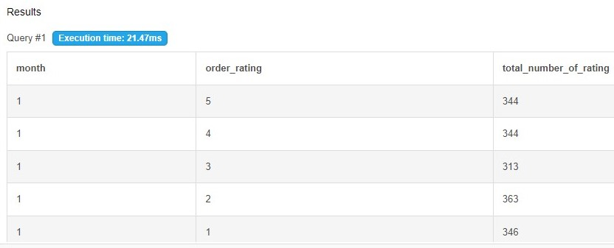
Ques 3 (b)– Month on month comparison of Bucket distribution of different ratings and count of orders in it.
Query →
Output →

Slide 7
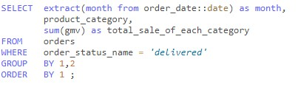
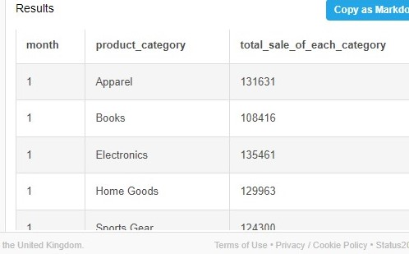
Ques 3 (c)– Month on month comparison of Sales by Product Category.
Query →
Output →

Slide 8
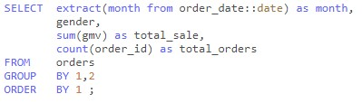
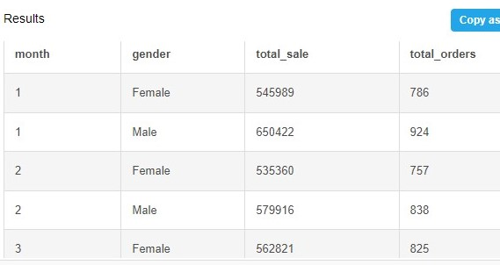
Ques 3 (d)– Month on month comparison of Sales and Orders by Gender.
Query →
Output →

Slide 9
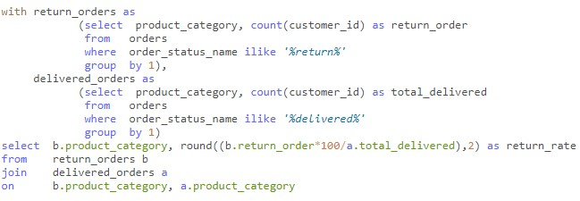
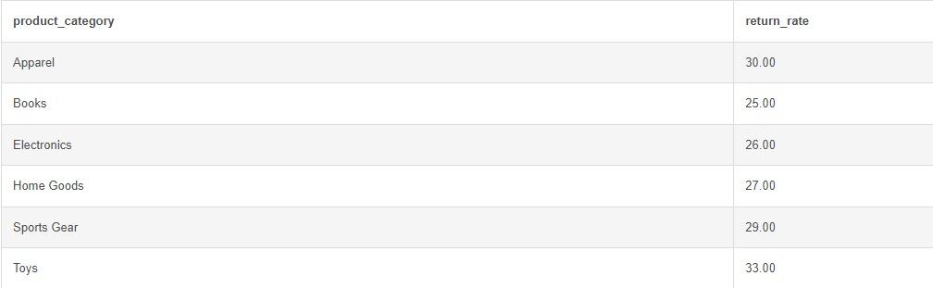
Ques 4 – Calculate the return rate for each product category. The return rate is defined as the percentage of orders that have been returned out of the total delivered orders for each product category.
Query →
Output →

Slide 10
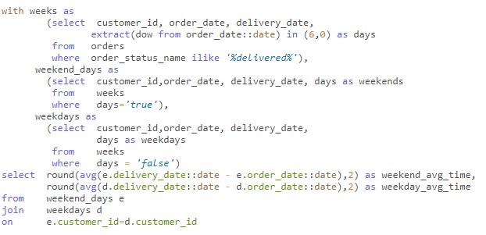

Ques 5 – Write a query to find what is the Average delivery time for orders placed on weekdays versus weekends.
Query →
Output →

Slide 11
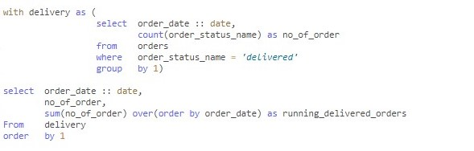
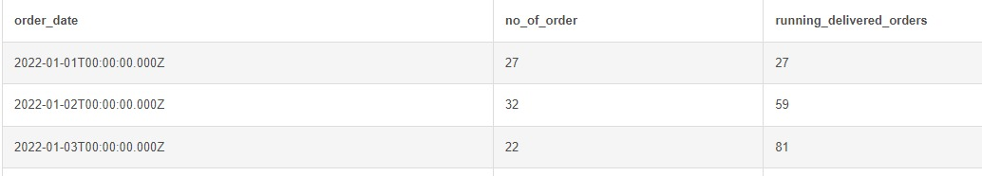
Ques 6 – Write a query to Calculate the running total of orders delivered time to identify trends in the order delivery volume.
Query →
Output →

Slide 12

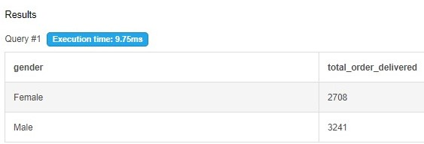
Ques 7 – Evaluate the distribution of orders delivered based on gender to understand any gender-related trends.
Query →
Output →

Slide 13
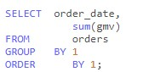
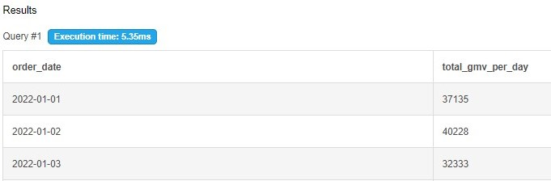
Ques 8– Day over Day trend of GMV.
Query →
Output →

