Slide 1
Systems Software
Chapter 1
Assembler

Slide 2


Slide 3
ASSEMBLER
Introduction, Cross Assembler, Micro Assembler, Meta Assembler, Single pass Assembler, Two Pass Assembler, Design of Operation code table, Symbol table, Literal table.
MACRO PROCESSOR
Introduction of Macros, Macro processor design, Forward reference, Backward reference, positional parameters, keyword parameters, conditional assembly, Macro calls within Macros, Implementation of macros within Assembler.
Designing Macro name table, Macro Definition table, Kew word
parameter table, Actual parameter table, Expansion time variable storage.

Slide 4
RUN TIME ENVIRONMENT
Absolute loader, Relocation - Relocating loader, Dynamic loader, Bootstrap loader, Linking-loader, Program relocatibility, Design of Absolute Loader, Design of direct-linking editor, other Loader scheme e.g. (Binders, Linking Loaders, Overlays, Dynamic Binders).
Books
1) D. M. Dhamdhere: “ System Programming and Operating System”.TMH
2). A.V.Aho, R.Sethi & J D.Ullman, “Compilers-Principles, Techniques and Tools”. Pearson. 3). Leland L. Beck ,” System Software -An Introduction to System Programming”, 3/E, Addision Wesley,reprint 2003 4). Louden , Kenneth C :” Compiler Construction-Principles and Practice”,1/E, Thomson, 1997 5). Houlb : Compiler Design in C, PHI, EEE, 1995

Slide 5
Assembler Definition
An assembly language is a low-level programming language for microprocessors and other programmable devices.
Each assembly language is specific to a particular computer architecture.
Assembly language is machine dependent, low-level programming language which is specified to a certain computer system(or a family of computer system).

Slide 6
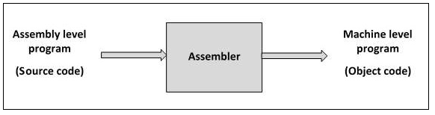
Assembly language is converted into executable machine code by a utility program(according to computer infrastructure) referred to as an assembler.

Slide 7
Types of Assembler
Cross Assembler
Micro Assembler
Meta Assembler

Slide 8
Cross Assembler
A cross assembler is a program which generates machine code for a processor other than the one it is currently run on.
An assembler is a program that converts assembly language into the actual binary processor specific machine code.
Normally the machine code generated is for the processor used in the machine it is run on. A cross assembler takes this conversion process a step further by allowing you to generate machine code for a different processor than the one the compiler is run on.

Slide 9
Cross-assembling facilitates the development of programs for systems that do not have the resources to support software development, such as an embedded system. In such a case, the resulting object code must be transferred to the target system, either via read-only memory (ROM, EPROM, etc.)

Slide 10
Microassembler
A microassembler is a computer program that helps prepare a microprogram, called firmware(permanent software programmed into a read-only memory.), to control the low level operation of a computer in much the same way an assembler helps prepare higher level code for a processor.
The difference is that the microprogram is usually only developed by the processor manufacturer and works intimately with the computer hardware.
The use of a microprogram allows the manufacturer to fix certain mistakes, including working around hardware design errors, without modifying the hardware.

Slide 11
Meta Assembler
meta-assembler A program that accepts the syntactic and semantic description of an assembly language, and generates an assembler for that language.

Slide 12
Basic three features for simplify programming
Mnemonic operation codes(mnemonic opcodes ):
Assembly language uses a mnemonic to represent each low-level machine instruction or operation
Eliminates to memorize numerical opcodes.
Provides helpful diagnostics.

Slide 13
Symbolic operands
Symbolic names can be associated with data or instructions
It can also be used as operands in assembly language.
Specify the data required by the operation
Executable instructions can have zero to three operands
Operands can be registers, memory variables, or constants

Slide 14
Data Declaration
Data can be declared in verity of notations
Avoids manual conversation of constants into their internal machine representation.

Slide 15
Statement Format
Assembly language statement format
[label] <Opcode> <Operand spec>[, <Operand spec>..]
Anything Between this [..] is optional field.
When label is their then it contains symbolic name

Slide 16
<Operand spec> has following syntax:
<symbolic name> [+<displacement>][(index register)]
examples

Slide 17
Statement Format:
[Label] <Opcode> <operand spec> [,<operand spec>…]
<operand spec> format:
<Symbolic name> [+<displacement>][(<index register>)]
Ex. AREA+5(4)
Example’s specification is a combination of previous two.
Memory word with which
name AREA is associated
Displacement /offset from AREA
Operand address is obtained by adding the contents of index register 4 to the address of AREA

Slide 18
Instruction opcode | Assembly mnemonic
00 | STOP | Stop execution
01 | ADD
02 | SUB | First operand is modified
03 | MULT
04 | MOVER | Register memory move
05 | MOVEM | memory Register move
06 | COMP
07 | BC | Branch on condition
08 | DIV | Analog to SUB
09 | READ | First operand is
10 | PRINT | not used

Slide 19
Simple assembly languages
In Assembly language each statement has 2 operands
First operand is always a register
Second is memory word using a symbolic name & optional displacement
MOVER: Second operand is source& first is target
MOVEM: opposite to MOVER
All arithmetic is performed in a registe.
Condition code can be tasted by a Branch on Condition (BC) instruction.
BC <condition code spec>, <memory address>
Transfers control to the memory word with memory address> if current value of condition code matches <condition code spec>.

Slide 20
Conditional Code
It can be tested by Branch on condition (BC) instruction.
Format:
BC <conditional code spec> ,<memory address>
Conditional codes are LE,EQ,GE,LT,GT,ANY

Slide 21
Machine instruction format
Machine instruction format
In this format all the addresses and constants are shown in decimal rather than octal or hexadecimal.
Sign opcode Reg Memory
operand operand

Slide 22
 | START | 101
 | READ | N | 101) | + 09 0 113
 | MOVER | BREG,ONE | 102) | + 04 2 115
 | MOVEM | BREG, TERM | 103) | + 05 2 116
AGAIN | MULT | BREG, TERM | 104) | + 03 2 116
 | MOVER | CREG, TERM | 105) | + 04 3 116
 | ADD | CREG, ONE | 106) | + 01 3 115
 | MOVEM | CREG, TERM | 107) | + 05 3 116
 | COMP | CREG, N | 108) | + 06 3 113
 | BC | LE, AGAIN | 109) | + 07 2 104
 | MOVEM | BREG, RESULT | 110) | + 05 2 114
 | PRINT | RESULT | 111) | + 10 0 114
 | STOP |  | 112) | + 00 0 000
N | DS | 1 | 113)
RESULT | DS | 1 | 114)
ONE | DC | ‘1’ | 115)
TERM | DS | 1 | 116) | + 00 0 001
 | END
Assembly and equivalent machine language

Slide 23
Assembly language statements
Assembly program contains three kindes of statements
Imperative statements
Declaration Statements
Assembler Directives

Slide 24
Imperative statements:
Actions to be performed during the execution of assembled program.
Imperative statements represent machine instructions in symbolic form.
For example, add means an addition instruction and mov denotes a data transfer instruction.

Slide 25
Declaration Statements:
Syntax of declaration statement
[Label] DS <constant>
[Label] DC ‘<Value>’
DS (declare storage) :
Reserves area of memory and associated name with them

Slide 26
Statements are
X DS 1
Z DS 100
First statement reserves 1 word with the name X.
Second statement ?

Slide 27
DC (Declare Constant)
It constructs memory words containing constans
XYZ DC ‘1’
It assigns memory word containing the value ‘1’ to XYZ

Slide 28
Constants
DC doesn’t implement constants its only initialize block with the value.
This value can be changed
MOVEM CREG , XYZ
Constants can be implemented in two ways
Immediate operands
Literals

Slide 29
For ex
ADD AREG , 5
Note: simple assembly language doesn’t support this ,but intel 8086 supports it.
Literal
It is operand with =‘<value>’ syntax
Its differ from constant because its location cannot be specified in assembly program.
Its value cannot be changed during the execution of program

Slide 30
ADD BREG , =’50’
Assembler Directives
It instruct the assembler to perform certain action during program
START <constants>
Starts the target program with particular address
END
end of source program

Slide 31
Advantages of assembly language:
Use of symbolic operand specifications:
insertion of one statement in assembly program leads to changes in address of constants and reserved memory areas.
So addresses used in most instructions of the program had to change.
Such changes are not needed in assembly program.

Slide 32
 | START | 101
 | READ | N | 101) | + 09 0 114
 | MOVER | BREG,ONE | 102) | + 04 2 116
 | MOVEM | BREG, TERM | 103) | + 05 2 117
AGAIN | MULT | BREG, TERM | 104) | + 03 2 117
 | MOVER | CREG, TERM | 105) | + 04 3 117
 | ADD | CREG, ONE | 106) | + 01 3 116
 | MOVEM | CREG, TERM | 107) | + 05 3 117
 | COMP | CREG, N | 108) | + 06 3 114
 | BC | LE, AGAIN | 109) | + 07 2 104
 | DIV | BREG, TWO | 110) | + 08 2 118
 | MOVEM | BREG, RESULT | 111) | + 05 2 115
 | PRINT | RESULT | 112) | + 10 0 115
 | STOP |  | 113) | + 00 0 000
N | DS | 1 | 114)
RESULT | DS | 1 | 115)
ONE | DC | ‘1’ | 116) | + 00 0 001
TERM | DS | 1 | 117)
TWO | DC | ‘2’ | 118) | + 00 0 001
 | END

Slide 33
Design Specifications of an assembler:
Identify the information necessary to perform a task
Design a suitable data structure to record the information
Determine the processing necessary to obtain and maintain the information
Determine the processing necessary to perform a task
The fundamental info requirements arise in the synthesis phase.

Slide 34
Synthesis Phase
Consider the assembly statement
MOVER BREG, ONE
We must have the following information to synthesize the machine instruction
Address of the memory word with which ONE is associated
It depends on source program
So, it must be made available by analysis phase.
Machine operation code corresponding to the mnemonic MOVER
Does not depend on source program, but depend upon assembly language
Hence the synthesis phase can determine this information Itself.

Slide 35
During synthesis phase, two data structures are used:-
Symbol Table
symbol table’s each entry has two fields:-
name and address.
This table is built by analysis phase and used during synthesis.
Mnemonics Table
An entry in the mnemonics table has two fields:-
mnemonic and opcode.
fixed table and merely accessed by analysis and synthesis phases.
By using symbol table, synthesis phase obtains the machine address with which name is associated.
By using Mnemonics table, synthesis phase obtains machine opcode corresponding to a mnemonic.

Slide 36
Analysis phase
The primary function performed by the analysis phase is the building of the symbol table.
For this, it must determine the addresses with which symbolic names used in a program are associated.
Some addresses can be determined directly (Eg. Address of first instruction in program) while some other must be inferred. (Eg. In prog. for determining address of N, we must fix address of all program elements preceding it.) This is called memory allocation.

Slide 37
Location Counter
Location Counter (LC) is a data structure which use to implement memory allocation
The location counter contains the address of the next memory word in the target program.
LC is initialized to the constant specified in the START statement.
To update the contents of LC, analysis phase needs to know the lengths of different instructions.
This info. Depends on the assembly language.
To include this Mnemonic table can be extended and a new field called as length is used
The processing involved to maintain the LC is called LC processing.

Slide 38
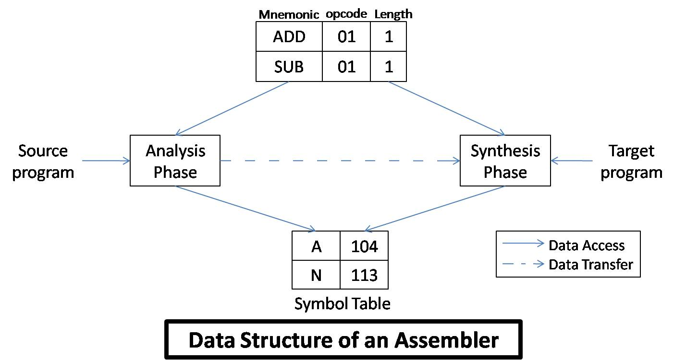

Slide 39
Tasks performed by Analysis Phases:-
Isolate the label, mnemonic opcode and operand fields of a statement.
If a label is present, enter the pair (symbol,<LC contents>) in a new entry of symbol table.
Check validity of mnemonic opcode by look-up in Mnemonics table.
Perform LC processing i.e. update value contained in LC.

Slide 40
Tasks performed by Synthesis Phase:-
Obtain the machine opcode corresponding to mnemonics from mnemonics table.
Obtain address of memory operand from symbol table.
Synthesize the machine form of a constant, if any.

Slide 41
Pass Structure of Assemblers
The pass of a language processor is one complete scan of the source program.
There are mainly tow assembly schemes:-
Two pass assembly scheme
One pass assembly scheme.

Slide 42
Two Pass Translator / Two Pass Assembler
can handle forward references easily.
The LC processing is performed in the first pass and symbols defined in the program are entered into the symbol table in this pass.
The first pass performs analysis of the source program while the second pass performs the synthesis of the target program.
The first pass constructs an intermediate representation (IR) of the source program for use by the second pass.
This representation consists of two main components
data structures e.g. Symbol table
a processed form of source program. Also called as Intermediate Code (IC).

Slide 43
Single Pass Translation / Single Pass Assembler
In a single pass assembler, the LC processing and construction of symbol table proceeds as in two pass assembler.
The problem of forward references is tackled using a process called back patching.
Initially, operand field of an instruction containing a forward reference is left blank.
When the definition of forward referenced symbol in encountered, its address is put into this field which is left blank initially.

Slide 44
ONE is a forward reference.
The instruction opcode and address of BREG will be assembled to reside in location 101 and the insertion of second operand’s address at a later stage can be indicated by adding an entry of the Table of Incomplete Instructions.(TII)
This entry is a pair ([instruction address], [symbol]).
e.g. (101, ONE) in this case.
By the time, the END statement is processed, the symbol table would contain the addresses of all symbols defined in the source program and TII would contain info. describing forward references.

Slide 45
Design of a Two Pass Assembler

Slide 46
PASS 1:-
Separate the symbol, mnemonic opcode and operand fields.
Build the symbol table.
Perform LC processing.
Construct intermediate representation
PASS 2:-
1. synthesize the target program
The Pass 1 performs analysis of the source program and synthesis of the intermediate representation
while Pass 2 processes the intermediate representation (IR) to synthesize the target program.

Slide 47
Advanced Assembler Directives
(i) ORIGIN:-
The syntax of this directive is ORIGIN [address spec]
where [address spec] is an [operand spec] or [constant].
This directive indicates that LC should be set to the address given by [address spec].
The ‘ORIGIN’ statement is useful when the target program does not consist of consecutive memory words. The ability to use an [address spec] in the ORIGIN statement provides the ability to perform LC processing in a relative manner rather than absolute manner.

Slide 48
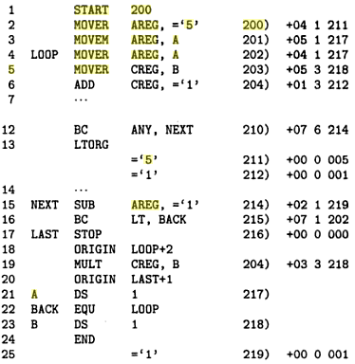

Slide 49
(ii) EQU:-
The syntax of this directive is
[symbol] EQU [address spec] where [address spec] is an [operand spec] or [constant].
The EQU statement defines the symbol to represent [address spec].
BACK EQU LOOP

Slide 50
LTORG:-
The LTORG statement permits a programmer to specify where literals should be placed.
By default, assembler places the literals after the END statement.
At every LTORG statement, the assembler allocates memory to the literals of a literal pool.
This pool contains all the literals used in the program.

Slide 51
Pass 1 of the Assembler
Pass 1 uses the following data structures:
OPTAB: - A table of mnemonic opcodes and related info.
SYMTAB: - Symbol Table. (contains the fields address and length)
LITTAB: - A table of literals used in the program.(contains the fields literal and address.)

Slide 52
OPTAB: Static table: The content will never change
contains the fields mnemonic opcode, class and mnemonic information.
The ‘class’ field indicates whether the opcode corresponds to
an imperative statement (IS),
a declaration statement (DL) or
an assembler directive (AD)
If an imperative statement is present,
then the mnemonic info. field contains the pair (machine opcode, instruction length)
else it contains the pair id of a routine to handle the declaration or directive statement.

Slide 53
In pass 1, OPTAB is used to look up and validate mnemonics in the source program.
In pass 2, OPTAB is used to translate mnemonics to machine instructions.
SYMTAB
Include the label name and value (address) for each label in the source program
Dynamic table (I.e., symbols may be inserted, deleted, or searched in the table)

Slide 54
The LITTAB is used to collect all literals used in the program. The awareness of different literals pools in maintained by an auxiliary table POOLTAB. This table contains the literal no. of starting literal of each literal pool.

Slide 55
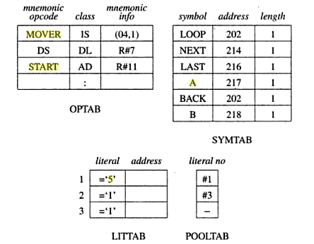
Data Structure of Assembler pass 1

Slide 56
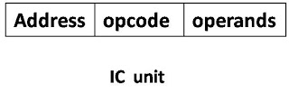
Intermediate Code forms
The intermediate code consists of a set of IC units, each IC unit consisting of following three fields: -
Address
Representation of mnemonic op code
Representation of operands

Slide 57
There are generally two criteria for choice of intermediate code (IC)
processing efficiency
memory economy.
Arise of some variants forms of intermediate code mainly operand and address fields is due to trade off between processing efficiency and memory economy.

Slide 58
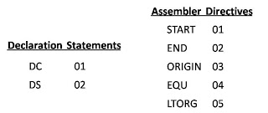
The mnemonic field contains a pair of the form
(statement class, code)
Here, statement class can be one of the imperative (IS) (DL) (AD).
For (IS), code is the instruction opcode in machine language.
For DL and AD, code in an ordinal number within class.

Slide 59
Intermediate Code for Imperative Statement

Slide 60
Variant I:
The first operand is represented by a single digit number which is a code for register (i.e. 1-4 for AREG – DREG) or condition code itself (1-6 for LT-ANY)
The second operand, which is memory operand, is represented by a pair of form (operand class, code)
where operand class is one of C, S and L standing for constant, symbol and literal resp.
For a constant, code field contains internal representation of constant itself.
For symbol or literal, code field contains the ordinal no. of operand’s entry in SYMTAB or LITTAB.

Slide 61
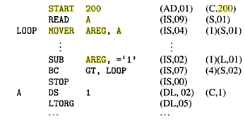
Intermediate Code- Variant I

Slide 62
Variant II:
This variant differs from variant 1 in that the operand fields of source statements are replaced by their processed forms.
For declarative statements and assembler directives, processing of operand fields contain processed forms.
For imperative statements, the operand field is processed only to identify literal references.

Slide 63
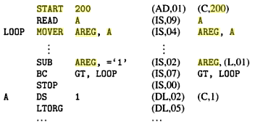
Variant 2 reduces the work of Pass 1 by transferring burden of operand processing from Pass 1 to pass 2.

