Slide 1


VISVESVARAYA TECHNOLOGICAL UNIVERSITY
“Jnana Sangama”, Belagavi, Karnataka - 590018
VII SEM : PROJECT WORK PHASE -1 ( 18EEP78 )
Bilinear Arm using Principle of Double Pendulum.
Under the Guidance of
ARJUN GHATE D (1RN19EE004)
GAURAV JAGDEESH (1RN19EE014)
NISCHITH N SHETTY (1RN19EE030)
Internal Guide
Name :Mr. MD. AMEEN SADIQ
Designation :
Organisation :
External Guide
Name :
Designation :
Organisation :
DEPARTMENT OF ELECTRICAL AND ELECTRONICS ENGINEERING
RNS INSTITUTE OF TECHNOLOGY
(AICTE Approved, VTU Affiliated and NAAC ‘A’ Grade Accredited)
(UG programs – CSE, ECE, ISE, EIE and EEE are Accredited by NBA up to 30.6.2025)
Channasandra, Dr. Vishnuvardhan Road, Bengaluru - 560 098

Slide 2
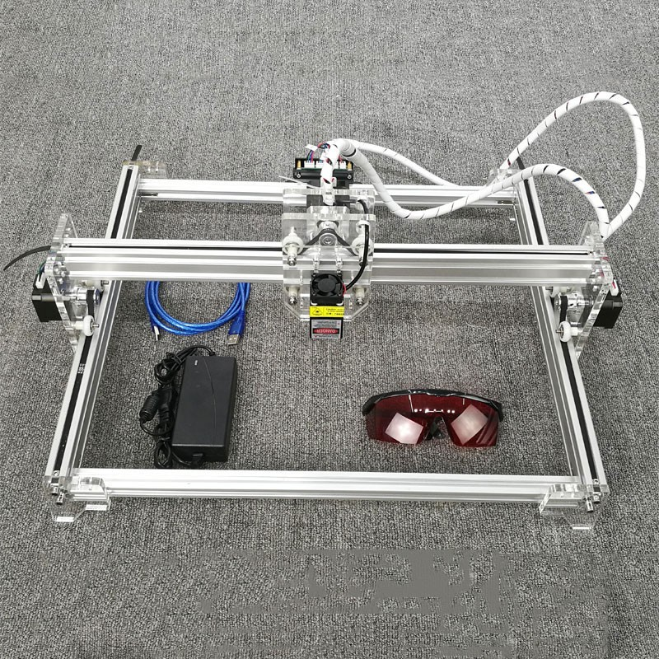
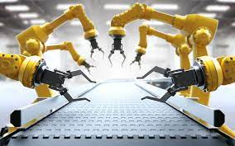
Abstract
With the leading technological development of machine-based industrial automation, robotic arms have played a key role in this aspect.
Generic designs revolve around overhead implementation. But it is not the most efficient way to implement it in small scale chip designing areas.
This is due to the fact the larger arms are designed for heavier lifting operations.
To overcome the faults in the system, we are demonstrating a more efficient design.

Slide 3
Introduction
To have motion across plane, we need to define two one-dimensional motion and thus will have a two-dimensional system.
We propose the implementation of a mechanism which is similar to a double pendulum. This design holds good cause occupies less space, and easy to operate.
Over the commonly used 2 linear axis movement we use a rotating double pendulum system.

Slide 4
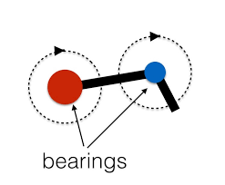
The above figure shows the basic design of a double pendulum.
By this arrangement of arms, we acquire the same range of motion as a conveyor system.
The bearings represent two 360 degree-servo motors that are used to move the arms. We intend to demonstrate this system in an automatic chess board.

Slide 5
Working
Hardware
Two servo motor are connected via an arm like structure and this establishes an arm like structure.
This allows for traversing a plane using this two motor system.
The tip of the arm is used as the reference to move the arm as a single unit.
Basic coordinate system is used to define and navigate the arm.

Slide 6
working
Software
The code calculates the angle the arms has to be so that the tip of the arm is moved towards the originating coordinates.
This calculation is done using kinematics and inverse kinematics.
When the end point is specified the code calculates the rate at which the servo motors should turn in coordination so that the tip of the arm moves in a straight line.
The calculated values help the controller to command the servo motors to rotate enabling the arms to move such that the tip of the arm moves in a straight line.

Slide 7
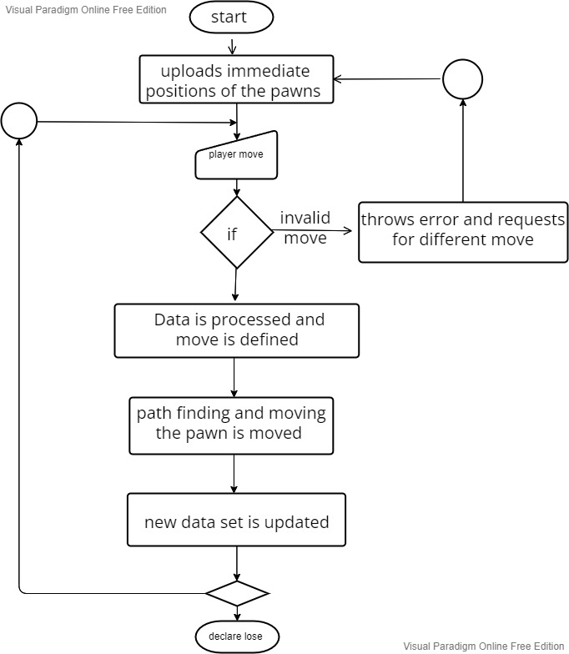

Slide 8
Current status of project
The software part of the project is partially done. Integration with the inverse kinematic software to the chess algorithm has to be accomplished. The overall online connectivity of the code for communication is established.
Rudimentary idea for the implementation of the hardware to the software is being studied in the current stages

Slide 9
Approximate cost of project
Components | Quantity | Cost
Raspberry Pi 3 Model B | 1 | 6000
360° servo motor | 2 | 400
Arm material | 1 sq/m | 300
Chess pawns | 1 set | 200
Touch pad | 1 | 2000

Slide 10
applications
This system can be used in 3D printing.
Due to its small scale, its easier to transport and hence applications in space is possible.
Multi-tier chip manufacturing van be developed. Since the system can be stacked.
Possible application in medical field.

