Slide 1
How to make a CRUD REST API in 20 mins
(Using Django)

Slide 2
HELLO!
I am Gaurav Jain
I am here because I love am a Python lover(Of course I am ).
You can find me at
Github@GauravJain98
Telegram:@CuberDude
Email:gauravcdj.98@gmail.com
Website: gauravjain98.github.io

Slide 3
What you need to know?
How Django works?
How SQL works?
What is JSON?

Slide 4
What is are we gonna do today?
Learn what is an API ? and its needs
Define the model
We will work on a single model project
Write the required serializer
Creating the viewset

Slide 5
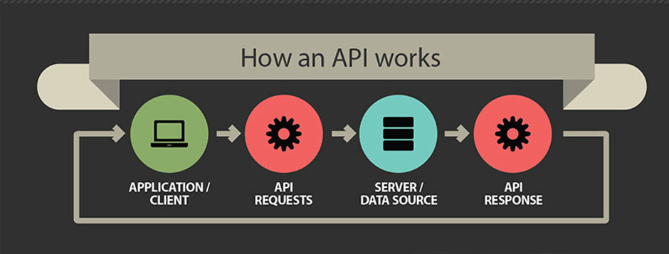
What is an API?
API Interface

Slide 6

What is Django REST Framework ?

Slide 7
Our Model
from django.db import models
from django.contrib.auth.models import User
class Product(models.Model):
name = models.CharField(max_length=20,null=False)
amount = models.IntegerField(default = 0)
def __str__(self):
return self.name

Slide 8
Our Serializer
from .models import *
from rest_framework import serializers
class ProductSerializer(serializers.ModelSerializer):
class Meta:
model= Product
fields = ('id',’name’,’amount’)

Slide 9
View
@api_view(['GET'])
def product(request):
p = Product.objects.all()
s = ProductSerializer(p,many=True)
return Response(s.data)

Slide 10
What is Viewset and how is it different?

Slide 11
Our Router(url.py)
from django.contrib import admin
from django.conf.urls import url, include
from rest_framework.routers import DefaultRouter
from * import mainApp.views
router = DefaultRouter()
router.register(r'product', views.ProductViewSet)
urlpatterns = [
url(r'^admin/', admin.site.urls),
url(r'^', include(router.urls))
]

Slide 12
Viewsets
class UserViewSet(viewsets.ViewSet):
def list(self, request): #GET
pass #Used to get a list of dataset
def create(self, request): #POST
pass #Used to add data
def retrieve(self, request, pk=None): #GET
pass #Used to get data from pk
def update(self, request, pk=None): #PUT
pass #Used to update from pk
def partial_update(self, request, pk=None): #PATCH
pass #Used to partial update from pk
def destroy(self, request, pk=None): #DELETE
pass #Used to delete items

Slide 13
Model Viewsets
class ProductViewSet(viewsets.ModelViewSet):
serializer_class = ProductSerializer
queryset = Product.objects.all()
Yes it’s that easy

Slide 14
THANKS!
Any questions?
Find me at:
Github@GauravJain98
Telegram:@CuberDude
Email:gauravcdj.98@gmail.com
Website: gauravjain98.github.io

