Slide 1
C# Selenium Automation Framework E2E Setup
Tools used
VisualStudio,.NetFramework,Nunit,Nuget,Selenium,Jenkins,MSBuild

Slide 2
Download Visual Studio 2019
First download visual studio 2019 from Below link and install.
https://www.visualstudio.com/downloads/
For detailed steps fellow below link:
https://www.guru99.com/download-install-visual-studio.html

Slide 3
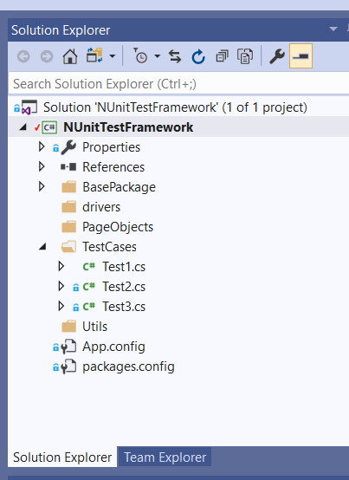
Create a project in Visual studio
Create a Project in Visual studio.
Create a console application project using .NetFramework.
Open solution explorer from Views tab
Ignore the file listed in the image.

Slide 4

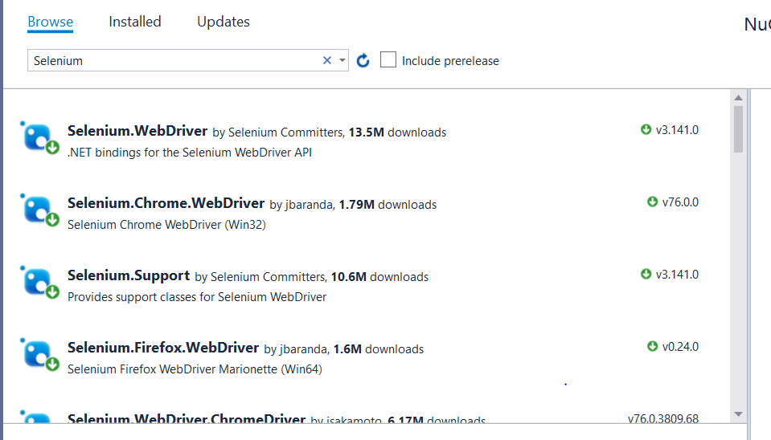
Add references[Dependencies we call in Java]
Now we need to add references in our project
For that right click on project name in solution explorer and select manage nugget packages
Now you will get a window like a [eclipse marketplace] .

Slide 5
Dowload listed refernces :
Please follow detail steps from
https://www.guru99.com/selenium-csharp-tutorial.html
List of references
Selenium webdriver,Chromedriver,Firefoxdriver,Nunit,Nunit adapter
Above list is a basic requirement you can download more as per your needs and config

Slide 6
Mapping tools with Java automation framework
C#==Java
Visualstudio==Eclipse
Nunit==Junit
Msbuild==Java compiler
Nuget == Maven
Jenkins==Jenkins

Slide 7
Now you need to run your Code which you have developed using Visual studio
Environment variable to set
Nuget/Nunit-console/Msbuild
Download nugget https://www.nuget.org/downloads
Give variable path of nugget directory
Download nunit-console.exe
https://github.com/nunit/nunit-console/releases/tag/v3.10
Extract the file and add nuget3-console.exe directory path to env variables
If we have installed Visualstudio than give path of MSBUILD.EXE
[I am working on to run project without Visual studio]Coming soon…
Test version of everything with console.

Slide 8
Start jenkins
Open Jenkins add msbuild plugin in Jenkins
Create a freestyle job to it
Go to build tab and add a build step on that and select Execute window batch command
And use Command : "C:\nuget\nuget.exe" restore NUnitTestFramework.sln ->Path of nugget.exe and it restore[download all dependencies]
Go to build tab and add a build step on that and select Solution of msbuild [Before this you need to define MSBUILD path in global configuration of jenkins]

Slide 9
Give path of your .csproj file in Build file option
Now add build steps of Window batch
Add command for Nunit test : "C:\NUnit\bin\net20\nunit3-console.exe" NUnitTestFramework.sln
We can also give framework dll file path to nunit which is present under debug
We can also pass csproj file path to MSBuild
We can also pass package.config path to Nuget

Slide 10
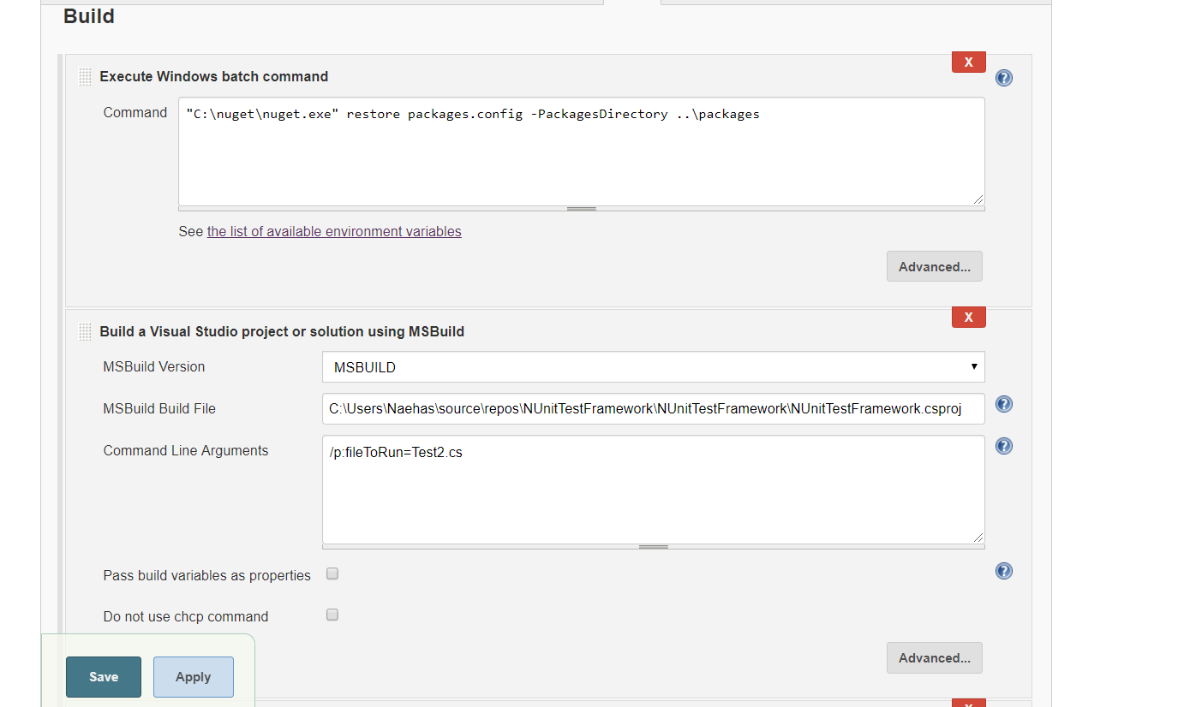
Jenkins configs

Slide 11
