Slide 1

Hyperparameter Selection
Every ML model has some hyperparameters that need to be tuned, e.g.,
K in KNN or $ε$ in $ε$-NN
Choice of distance to use in LwP or nearest neighbors
Would like to choose h.p. values that would give best performance on test data

Slide 2
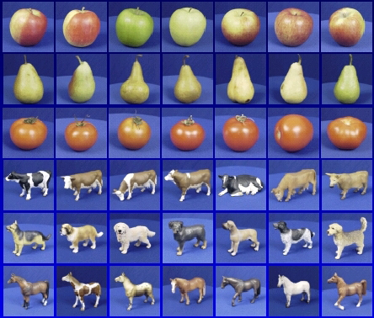

Generalization
Training set (labels known)
Test set (labels unknown)
How well does a learned model generalize from the data it was trained on to a new test set?
Slide credit: L. Lazebnik

Slide 3
Generalization
Components of generalization error
Bias: Assumptions made by a model to make a function easier to learn. It is actually the error rate of the training data. When the error rate has a high value, we call it High Bias and when the error rate has a low value, we call it low Bias.
Variance: The error rate of the testing data is called variance. When the error rate has a high value, we call it High variance and when the error rate has a low value, we call it Low variance.
Underfitting: model is too “simple” to represent all the relevant class characteristics
Overfitting: model is too “complex” and fits irrelevant characteristics (noise) in the data
Slide credit: L. Lazebnik

Slide 4
Reasons for Underfitting:
High bias and low variance
The size of the training dataset used is not enough.
The model is too simple.
Training data is not cleaned and also contains noise in it.
Techniques to reduce underfitting:
Increase model complexity
Increase the number of features, performing feature engineering
Remove noise from the data.
Increase the number of epochs or increase the duration of training to get better results.
Slide credit: L. Lazebnik

Slide 5
Reasons for Overfitting are as follows:
High variance and low bias
The model is too complex
The size of the training data
Techniques to reduce overfitting:
Increase training data.
Reduce model complexity.
Early stopping during the training phase (have an eye over the loss over the training period as soon as loss begins to increase stop training).
Ridge Regularization and Lasso Regularization
Use dropout for neural networks to tackle overfitting.
Slide credit: L. Lazebnik

Slide 6
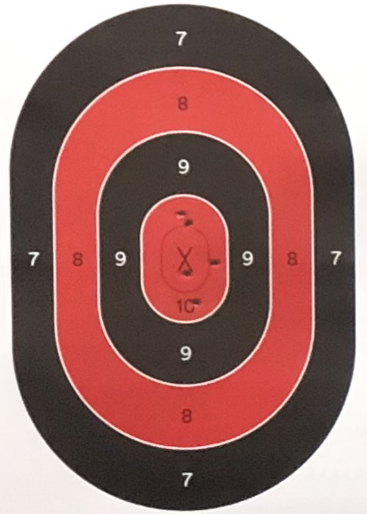
Bias-Variance Trade-off
Low Bias
High Bias
Low Variance
High Variance

Slide 7
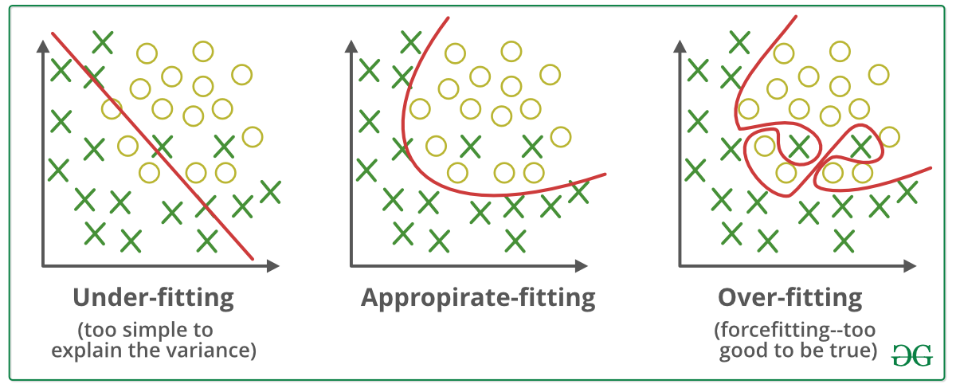
Bias-Variance Trade-off
E(MSE) = noise² + bias² + variance
Error due to variance of training samples
Unavoidable error
Error due to incorrect assumptions
Image credit: geeksforgeeks.com
Slide credit: D. Hoiem
Notes:
From the link above:
You can only get generalization through assumptions.
Thus in order to minimize the MSE, we need to minimize both
the bias and the variance. However, this is not trivial to do this. For instance, just
neglecting the input data and predicting the output somehow (e.g., just a constant), would definitely minimize the variance of our predictions: they would be
always the same, thus the variance would be zero—but the bias of our estimate
(i.e., the amount we are off the real function) would be tremendously large. On
the other hand, the neural network could perfectly interpolate the training data,
i.e., it predict y=t for every data point. This will make the bias term vanish entirely, since the E(y)=f (insert this above into the squared bias term to verify this),
but the variance term will become equal to the variance of the noise, which may
be significant (see also Bishop Chapter 9 and the Geman et al. Paper). In general,
finding an optimal bias-variance tradeoff is hard, but acceptable solutions can be
found, e.g., by means of cross validation or regularization.

Slide 8
Bias-variance tradeoff
Underfitting
Overfitting
Error
Test error
Training error
High Bias
Low Variance
Complexity
Low Bias
High Variance
Slide credit: D. Hoiem

Slide 9
Bias-variance tradeoff
Few training examples
Test Error
Many training examples
High Bias
Low Variance
Complexity
Low Bias
High Variance
Slide credit: D. Hoiem
Notes:
Note: these figures don’t work in pdf

Slide 10


Cross-Validation
No peeking while building the model
Training Set (assuming bin. class. problem)
Test Set
Note: Not just h.p. selection; we can also use CV to pick the best ML model from a set of different ML models (e.g., say we have to pick between two models we may have trained - LwP and nearest neighbors. Can use CV to choose the better one.
Class 1
Class 2
Actual Training Set
Randomly Split
Validation Set
Randomly split the original training data into actual training set and validation set. Using the actual training set, train several times, each time using a different value of the hyperparam. Pick the hyperparam value that gives best accuracy on the validation set
What if the random split is unlucky (i.e., validation data is not like test data)?
If you fear an unlucky split, try multiple splits. Pick the hyperparam value that gives the best average CV accuracy across all such splits. If you are using N splits, this is called N–fold cross validation

