Slide 1
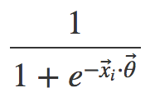
X₁₁
X₁₂
X₁
.
.
.
y₁
X_{1d}
Neural Net Metaphor
Neuron
Synapse
Activation function

Slide 2
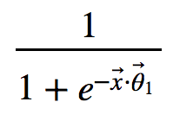
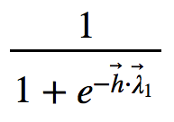
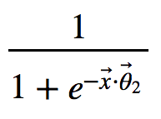
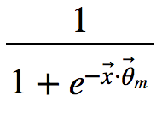
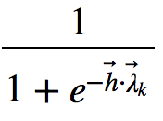
X₁
𝛉₁₁
h₁
ƛ₁₁
X₂
𝛉₂₁
h₂
ƛ₂₁
y₁
.
.
.
X
.
.
.
h_{m}
ƛ_{mk}
y_{k}
X_{d}
𝛉_{dm}
input layer
hidden layer
output layer

