Slide 1

Segmenting Consumers of Bath Soap
By: CRISA

Slide 2
01
02
03
04
Table of contents
Overview & Objective
Methodology
Analytical Process
Key Findings
05
Recommendation

Slide 3
Overview & Objective
Primary Goal:
Support the Indian retail sector identify their customers.
Develop a comprehensive marketing strategy in order to reach those consumers.
Find the optimal target groups by tracking purchase behavior and the basis of purchase so that it can be beneficial for IMRB to increase the market share.

Slide 4
Methodology
Used Market Segmentation to define and better understand target audiences and ideal customers
The method we used is called ‘k-means clustering’
K clusters assigned to each customer so we can minimize a spread within the cluster or segment
Our goal was to find that Segment so that we could apply better marketing strategy

Slide 5
Analytical Process
Data Cleanup
Select Segmentation Variables
Define Similarity Measure
Visualize Pairwise Distances
Interpreted the Segments
Notes:
1) Data Cleanup: We used box plots to find the outliers
2) Segmentation Variables: We segmented the variables

Slide 6
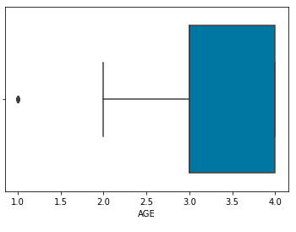
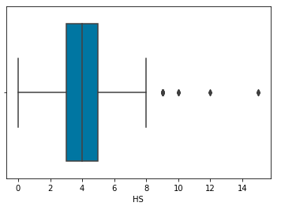
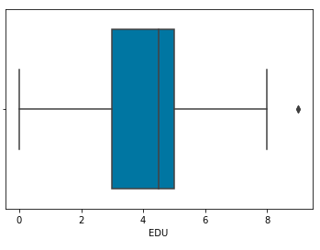
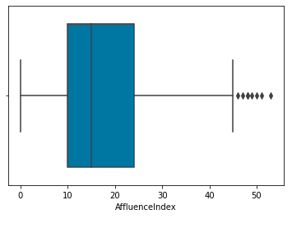
Data Exploration
The Boxplot of Variable: Age
The Boxplot of Variable: Household Size
The Boxplot of Variable: Education
The Boxplot of Variable: Affluence Index

Slide 7
Segmentation
Purchase Behavior | Basis of Purchase | Variables that describe both purchase behavior and basis of purchase
Volume Frequency Susceptibly to discounts Brand loyalty | Price Selling Proposition
Notes:
Divided the variables into clusters or segments based on:
1. Purchase behavior: volume, frequency, susceptibly to discounts, and brand loyalty
2. Basis of purchase: price, selling proposition
3. Variables that describe both purchase behavior and basis of purchase
Now to analyze which of these three segmentations is considered the most appropriate decision factor for our specific marketing strategy a clustering process has been used.
Furthermore, we focused on each cluster separately and examine which one is most suitable for the direct marketing strategy

Slide 8
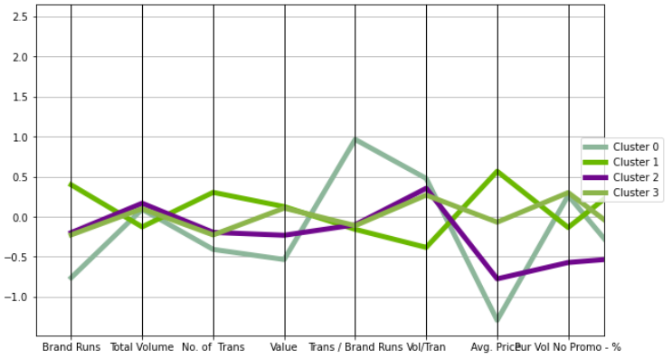
Cluster Analysis
Group 1 : Informal Buyers
In Education, homemakers seems to be literate, but no formal schooling was given to them which shows that least expenditure occurred
Expenditure on televisions are minimum and cable channels are not much watched by this group.
Affluence Index is highly influenced in this group which depicts high purchasing of brand products even with no promotion, however its least as compared to other clusters.
Notes:
1) In terms of education, Homemakers seems to be literate, but no formal schooling was given to them which shows that least expenditure has occurred on education
2) Also, people do not prefer watching cable or broadcasted television that much of this group
3) Affluence Index is highly influenced in this group which depicts people prefer high purchasing of branded products even with no promotion, however its least as compared to other clusters.

Slide 9
Cluster Analysis (Cont.)
Group 2 : Smart Shopaholic
Konkani language is on dominated side in the group, however the same is homogeneous among the MT demographic.
Education in school of homemakers are between 5 to 9 years in total which is highest among other 3 groups
Branded goods are being preferred by people
Affluence Index illustrates aggressive side which shows people of this groups spends the most on brands even if the they runs no promotion on their products
Notes:
1) Konkani language is on dominated side in the group, however the same is homogeneous among the Native language demographic

Slide 10
Cluster Analysis (Cont.)
Group 3 : Fun Malabar
Food eating habits are more towards Vegetarian preference which is also highest among other clusters
Preferable language is Malayalam and highly influenced as compared to other groups
In this group, people love to watch television through the means of cable or broadcast
Affluence Index depicts uniformity with group 2 in terms of high spending even if brands runs no promotion
Notes:
1) Population of this group prefer Vegeterian food and not eggs
2) Majority of the people speak Malayalam and its highly influenced compared to other groups

Slide 11
Cluster Analysis (Cont.)
Group 4 : Label Crazy
Here as well Affluence index showcase its belligerent nature and is equivalent to group 2 and 3, is high
Keen nature on purchasing branded products can also be seen among this group’s population

Slide 12

88%
Accuracy of our prediction model

Slide 13
Key Findings
Population are keen to purchase and spend more on branded products even if they runs promotion or not
Majority of the people have only completed 5 to 9 years of schooling
Almost everyone has cable and broadcast television sets at their place
3 languages depicts analogous mixture among all groups which are Kashmiri, Konkani and Malayalam
A great number of people have Vegetarian food eating habit, but they prefer eggs as well
Age segmentation illustrates that mass population is in between 35-45 years

Slide 14
Recommendations
Since most of our clusters prefer consuming content over the television, we recommend that the brand should advertise in Kashmiri, Konkani and Malayalam with brand ambassadors from the same industry
The clusters are also least attracted by promotions/ offers, so we can curate loyalty programs to increase engagement
To engage informal buyers, we can promote using print media or billboards

Slide 15
Thank You!

