Slide 1
Sprint Planner
Team-2

Slide 2

Sprint Planning: Collaborative Effort for Agile Development Success
Problem Domain
Sprint planning is a crucial aspect of project planning
Sprints involve breaking down a project into smaller, manageable chunks
Planning sprints can be complex, especially with multiple developers and stories with dependencies
Sprint planning is crucial in software
development for breaking down projects into
manageable chunks and setting a timeframe.

Slide 3

Proposed Solution: A comprehensive plan to increase the efficiency of the planning process.
Proposed Solution
Story Management: Stories that need to be completed, including their dependencies on each other
Developer Management: Developers who are available to work on the project, along with their individual capacities
Sprint Planning: It will consider the dependencies between stories, as well as the availability of developers.
Visualization: The stories can be visualized using two interactive chart options (Gantt Chart, Dependency Chart)
Story and developer management, sprint planning, and interactive chart visualization

Slide 4

Story Management: Organizing project stories for improved project planning and execution.
Story Management
Efficient project management: It enables project owners to input stories and dependencies, prioritize tasks and assign responsibilities
Choose developer assignment: The Product owner has the option to select from the list of developers to assign to a specific story or leave it to the algorithm to assign randomly.
Efficient project management with easy story input and developer assignment options.

Slide 5

Developer Management: Assigning Tasks and Calculating Required Developers
Developer Assignment
Developer assignment: The tool assigns developers to specific tasks based on their availability and capacity
Maximize efficiency: The tool takes into consideration the overall capacity of each developer and ensures that tasks are assigned to them in a way that maximizes their productivity
Required developers: Algorithm can provide the ideal number of developers required to complete the project on time.
The tool assigns developers based on availability and capacity, maximizing efficiency. Algorithm also calculates required developers for timely completion.

Slide 6
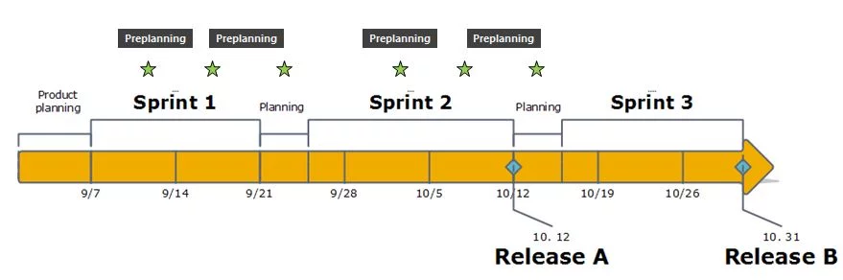
Sprint Planning: Efficient Project Planning and Management Simplified.
Sprint Planning
It uses a graph algorithm to determine the best order for implementing stories, based on their dependencies.
The sprint planning feature of our tool also provides features for prioritizing tasks.
Algorithm helps detect project bottlenecks and allows for adjustments to stay on track.
Tool uses an algorithm to find the optimal story order, prioritize tasks, and identify bottlenecks/blockers for efficient project management.

Slide 7
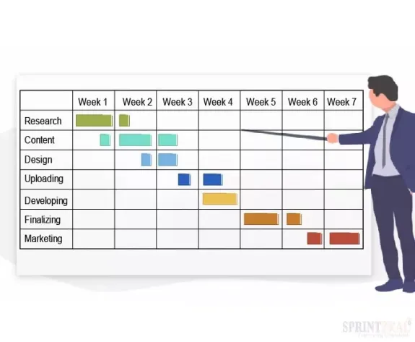
Visualisation: Enhancing Project Management through Dependency Graph and Gantt Chart
Visualization
It generates a dependency graph to illustrate task relationships and dependencies
It generates a Gantt chart to display task start and end dates, as well as the project timeline
It enables teams to spot delays and dependency issues, so they can make necessary adjustments to keep the project on track
The tool generates a dependency graph and Gantt chart view to identify potential delays, improving project efficiency and productivity.Text

