Slide 1

A mobile-first navigator for cancer patients
HAPENS
Healthcare Associated Patient Enrolment and Navigation System
The HAPPENS application reduces queue dependence by moving registration, appointments, diagnostic requests, reports, payments and hospital navigation into one patient dashboard.
Patient app + Admin console + HAPENS AI
Hospital Navigator | Cancer Care
Team Leader – Dr. Kinjalka Ghosh
Doctor Partner – Dr. Shrikant Raut
Technical Lead – Mr. Gaurav Sriram

Slide 2
HAPENS
02
Cancer-care visits still depend on queues
Patients often reach the hospital before they know exactly where to go, which counter to visit, or whether a slot is available.
Impact
Uncertainty creates early arrivals, crowding, repeated queries and stress for patients already dealing with cancer care.
Registration and enrolment repeat information across desks.
OPD appointments, tokens and room calling remain hard to track.
Diagnostics availability is not visible until the patient asks.
Reports and payment status sit in separate desks which require transit and inquiries.
Patients are often lost between the crowding and various departments/sections in the hospital vicinity.

Slide 3
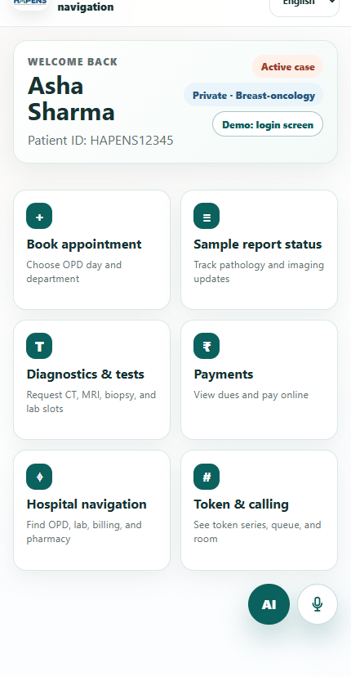
HAPENS
03
HAPENS gives patients digital access
The dashboard of HAPENS combines the recurring tasks that usually send patients between counters, phone numbers and receipts.
Create or update the patient profile
Request OPD slots by category and disease group
Request diagnostics and see latest availability
Track report status and download ready reports
Use HAPENS AI for automated tasks, voice talkback and booking of slots.
Guidance to locations using the geotag based checkpoint navigation.

Slide 4
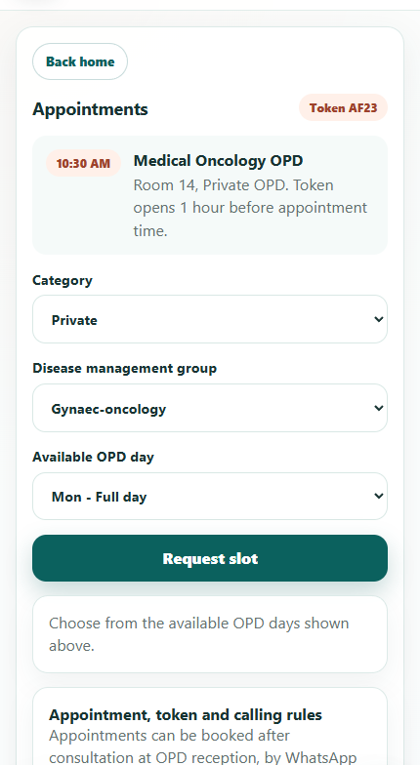
HAPENS
04
Patient journey with HAPENS
1
Login or register
Patient enters the app and creates a profile if new
2
Choose service
Appointments, diagnostics, reports, payments or navigation
3
Check availability
The app searches slots and shows the earliest option
4
Confirm request
Patient confirms the appointment or test request
5
Visit with guidance
Token, room and report status with navigational assistance

Slide 5
HAPENS
05
Functional Capabilities
Patient-facing app
Admin console
Guided support
Registration with documents and category selection
Registration lookup and activation controls
HAPENS AI for assistive help
Appointment slot search with confirmation
Disease group assignment
Book appointments, diagnostic slots, etc.
Diagnostics and test request flow
OPD booking on behalf of patients
Voice talkback option in multiple languages
Report status with download when ready
Diagnostic booking by doctors or staff
Provide seamless and secure support

Slide 6
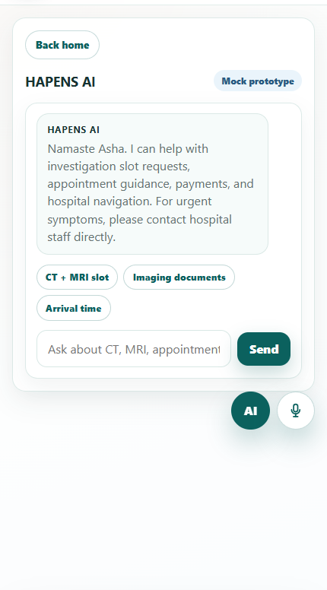
HAPENS
06
HAPENS AI
The assistant provides help with common operational. Truly consolidating the salient features of the application into one interactive chat-box.
Patients can ask and book CT, MRI, documents, OPD arrival time and payments and more.
The assistant can surface available slots from the prototype schedule and book based on patient approval.
Voice talkback is included as an icon-level mockup for accessibility.
Urgent or clinical decisions remain outside the AI assistant.

Slide 7
HAPENS
07
Purpose of HAPENS
HAPENS aims to make the hospital management process seamless for the patient by providing a digital interface to manage most operations online.
Patients
Less queueing, clearer instructions, fewer unnecessary early arrivals
OPD staff
Fewer repeated queries and better token discipline
Diagnostics
Clear visibility of available test slots
Navigation
A geotag based system to assist movement inside the healthcare facility
Preliminary application mock-up available at:- https://gauravs-1503.github.io/HAPENS/

Slide 8
