Slide 1
Rent It Mate Group 3 By Aishwarya, Gaurav, Hema & Zixu

Slide 2
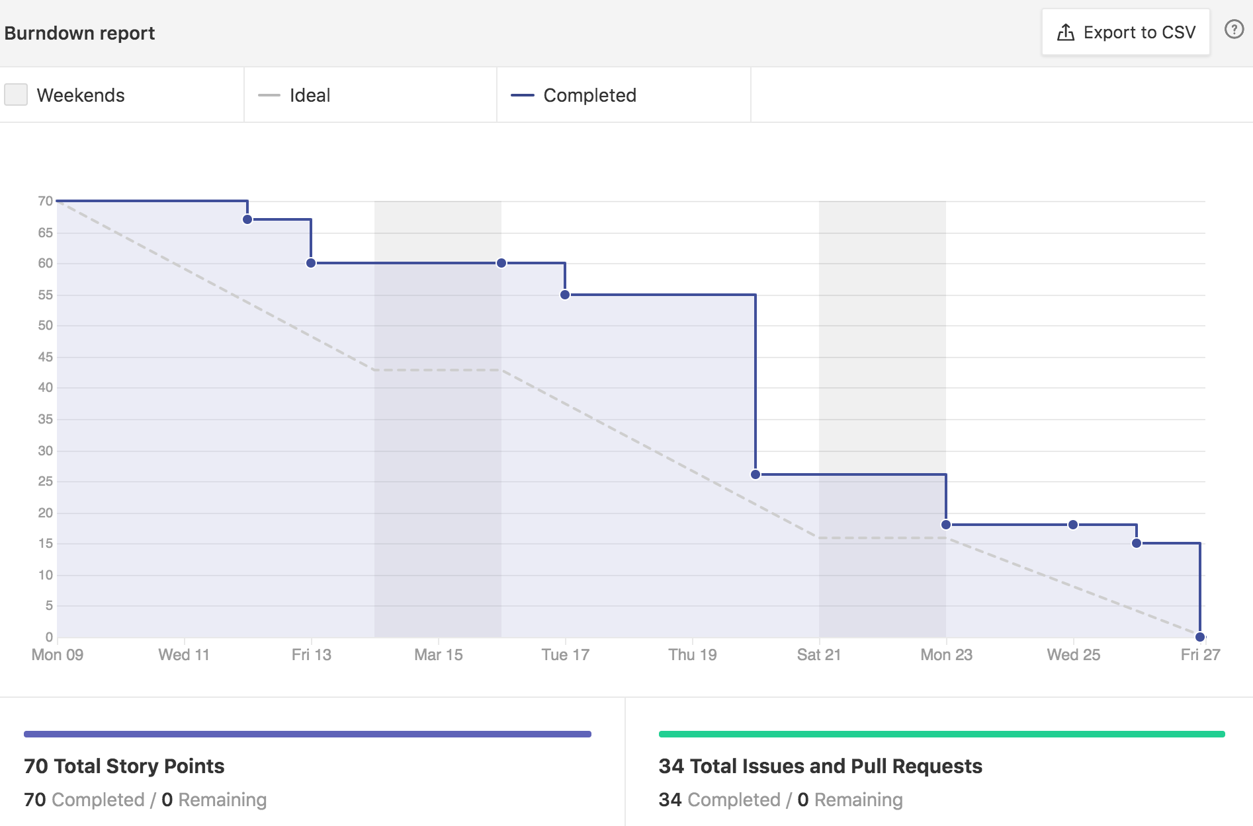
Performance Chart: Burndown Chart

Slide 3
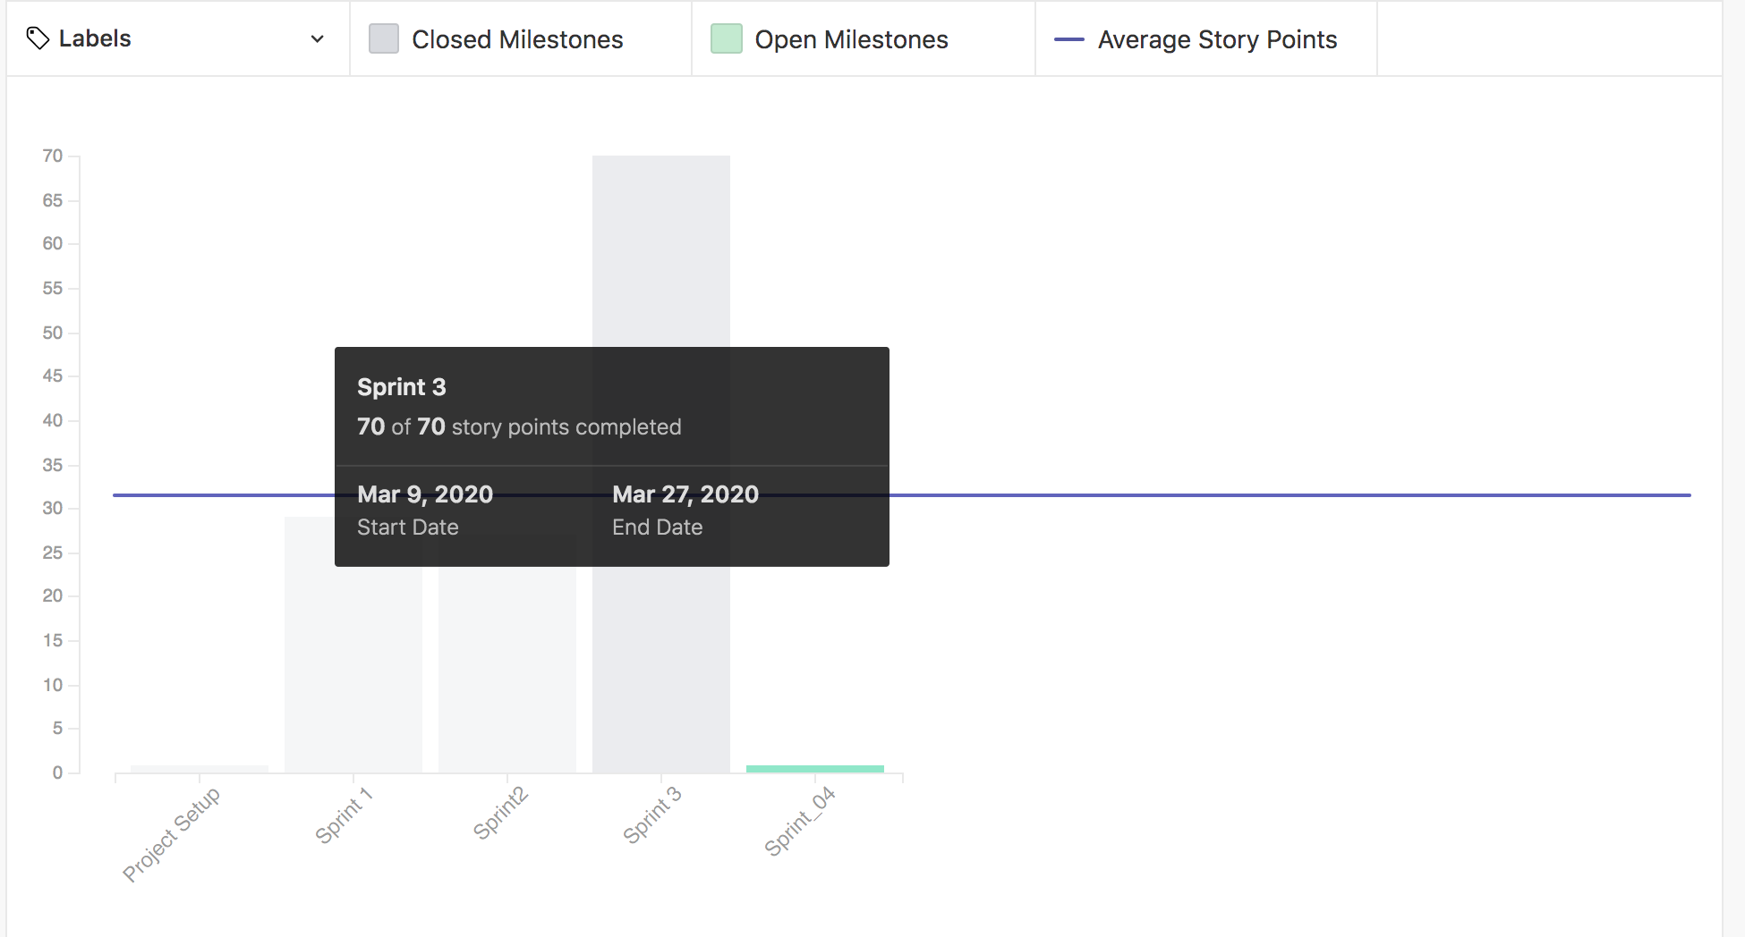
Performance Chart: Velocity Tracking

Slide 4
Things that has been done: Client-Side
Enhanced landing page, Dashboard for the user
CRUD forms for the profile of the user.
Alert on register page when passwords do not match.
Cypress testing for all the front-end screens.
Istanbul plugin for code coverage is installed and integrated with the client
Yet to work on CRUD forms for product and category.

Slide 5
Things that has been done: Server-Side
Connected to MongoDB
Register and login user has been done along with JWT token verification and session management.
Created models for product, category and profile
CRUD API's for profile, category and product along with unit testing code.

Slide 6
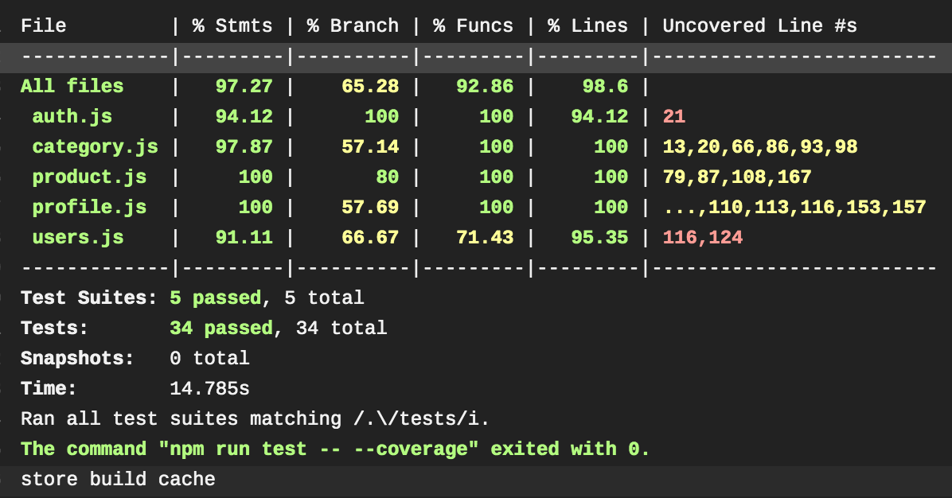
Code Coverage-Jest

Slide 7
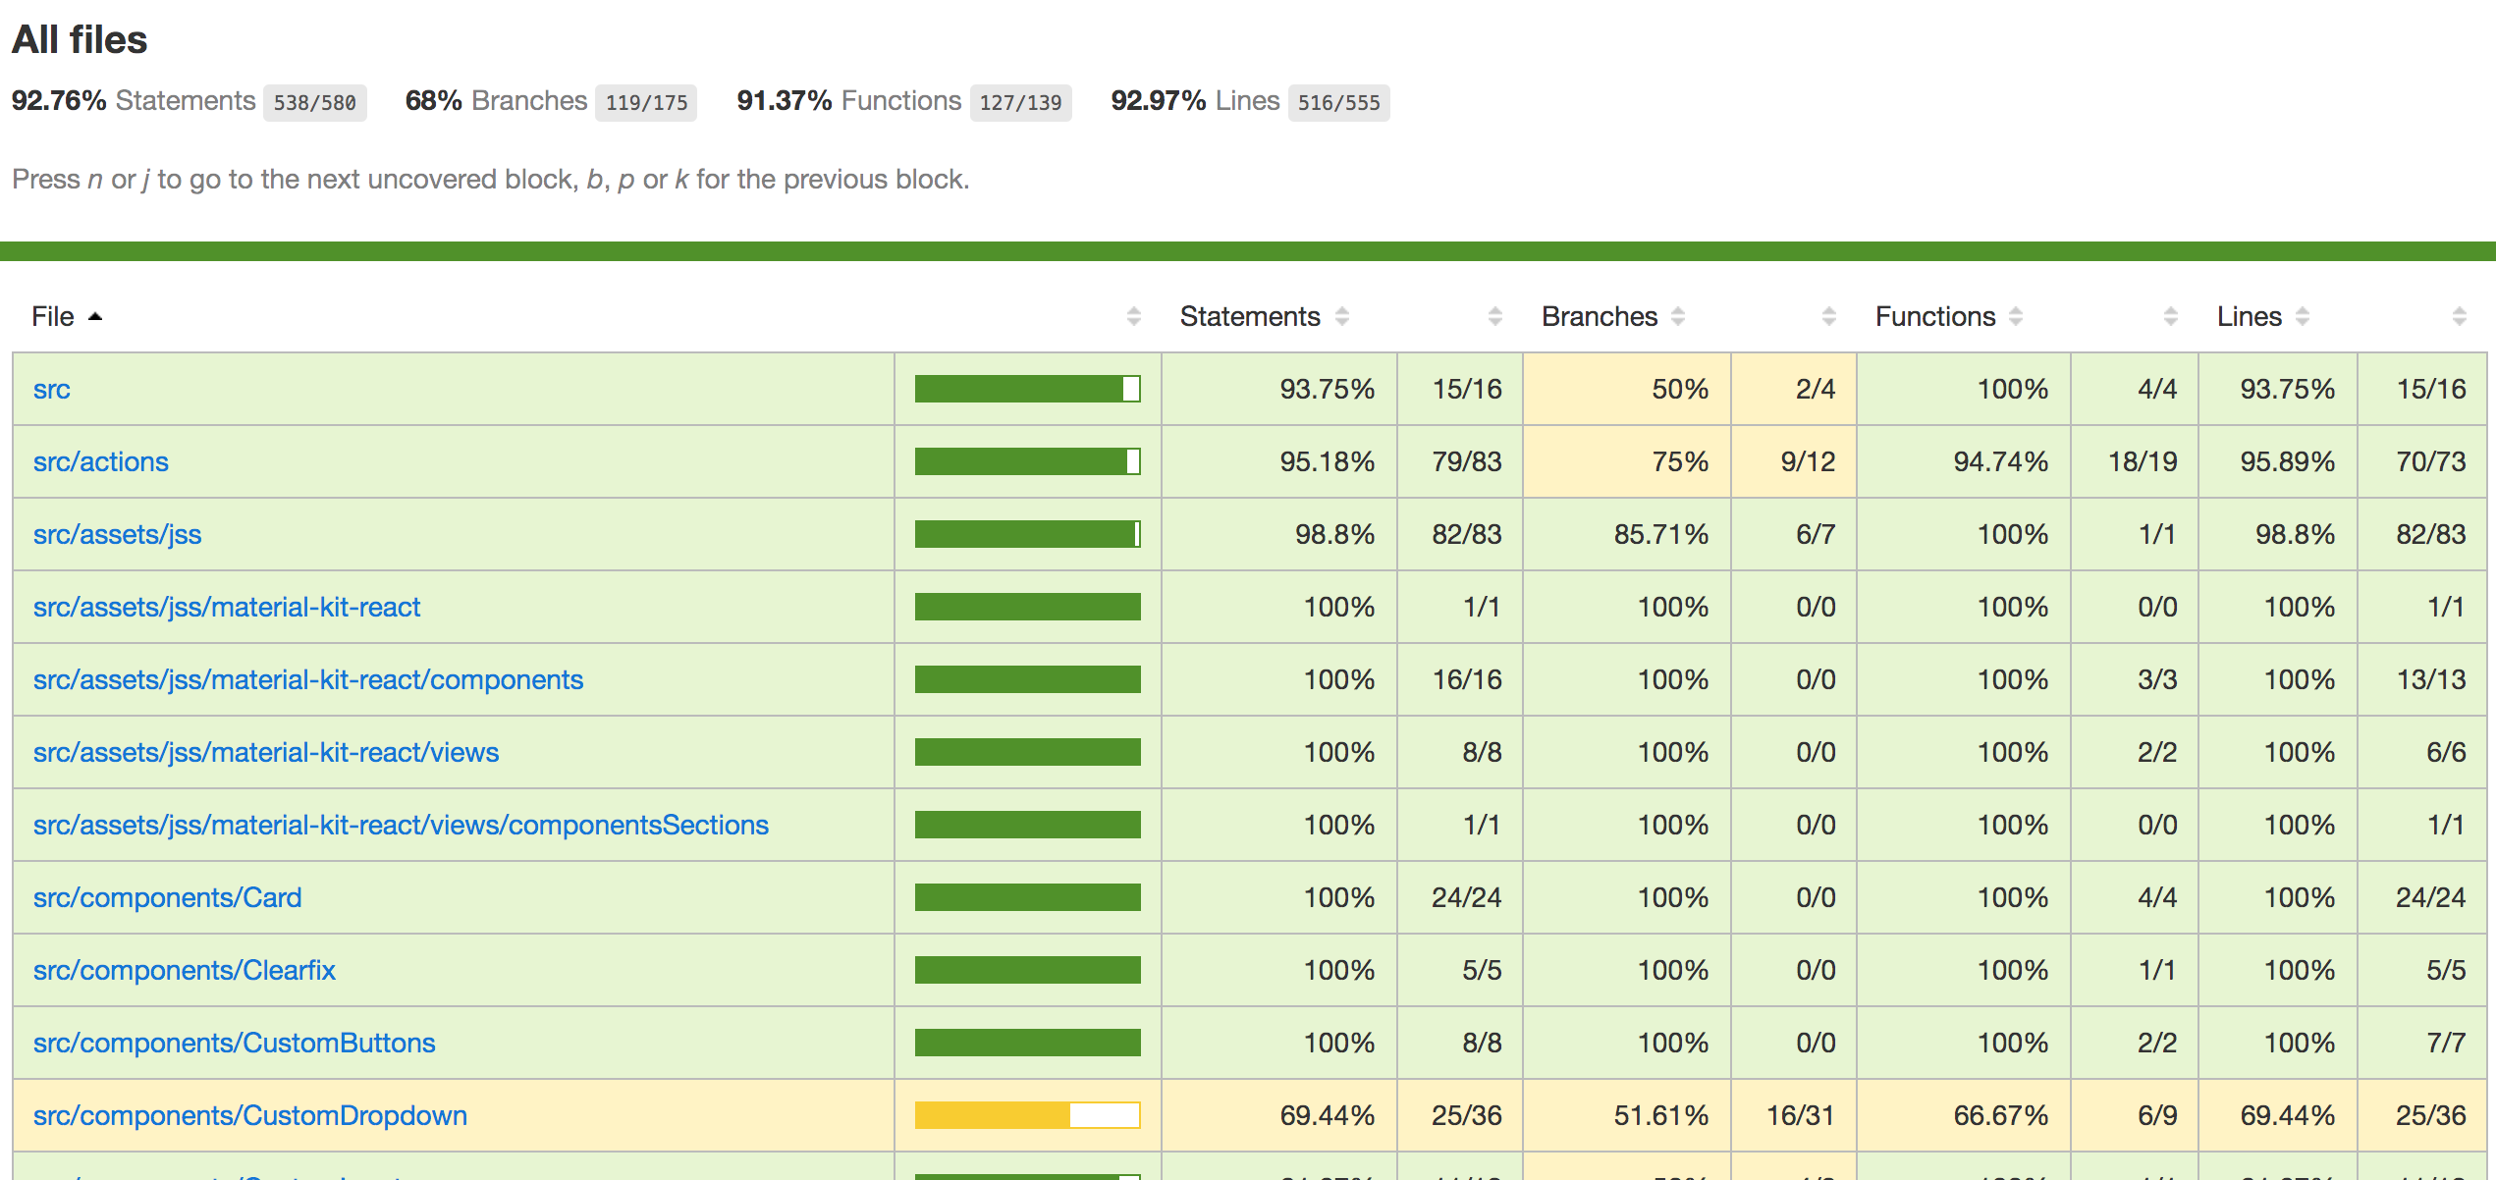
Code Coverage- Cypress

Slide 8
Things that went well for the third sprint:
We had daily scrum updates over the weekdays regularly on the slack and online meetings whenever necessary
We had a good pair programming that helped us to solve many issues.
Increase in velocity compared to previous sprints.
Well tested code for the backend and frontend and a better overall test coverage
More often commits and push to github to keep track of work of each team member.
Most of the Pull requests were created in the decided format unlike last sprints.

Slide 9
Things to be improved:
Merge to master for every week, to avoid merge conflicts at the end due to large number of commits.
If a person encounters that a work cannot be done by the estimated time, either ask for help or reassign it to another person.
No changes in UI towards the last day of the sprint.

Slide 10
Code-life Cycle (creating story, development, merging)
We assign the issue to a member, estimate story points based on the effort needed and the learning curve
We create a separate branch for each issue such as <issue name-#issue number>.
We commit and push changes to respective issue branches, once it is done, we create a pull request, merge it to development. Move the issue to done pipeline.
By end of the sprint, we have a final check on development branch and push it to master
Deploy in heroku and move the issues to closed pipeline.

Slide 11
Team Structure
For Sprint 2
Aishwarya Sharma (Developer/Product Owner)
Gaurav S Jawla (Developer)
Hema Ramachandran (Developer)
Zixu Wang (Frontend Developer/Scrum master)

