Slide 1

Progress Review and Testing
Overview
Group 3

Slide 2
Demo

Slide 3
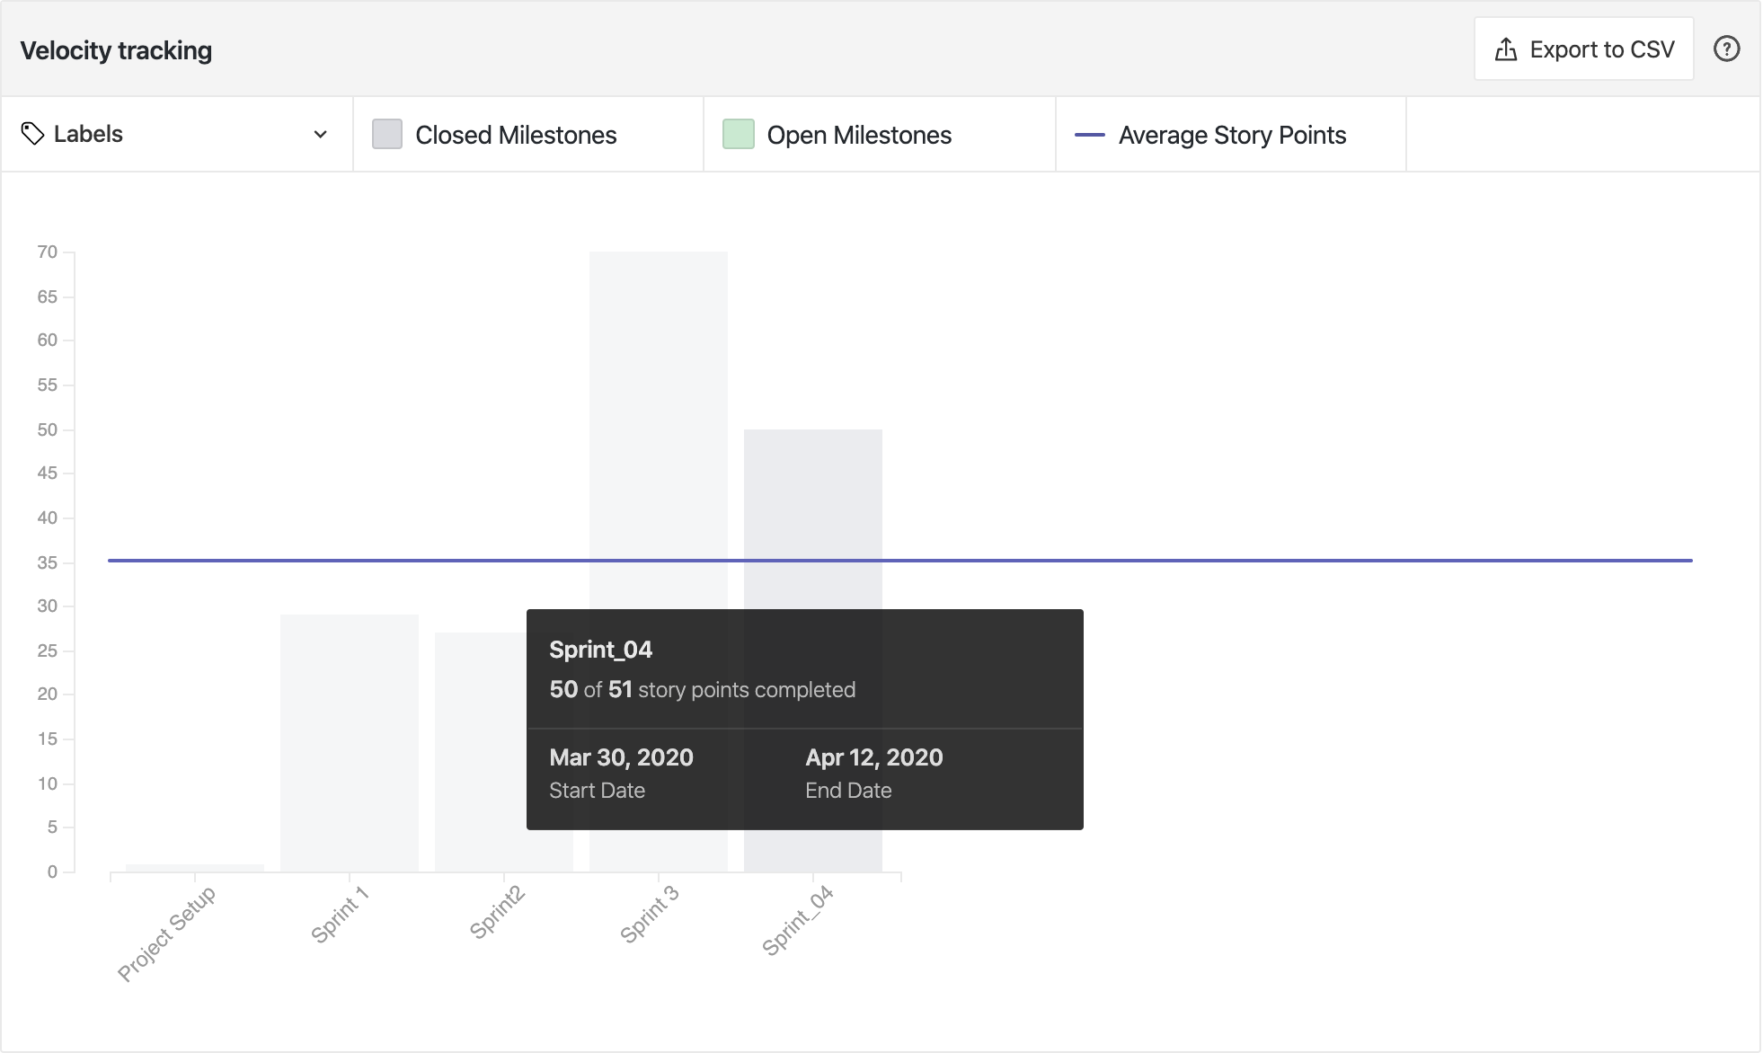
PROGRESS
Velocity Chart

Slide 4
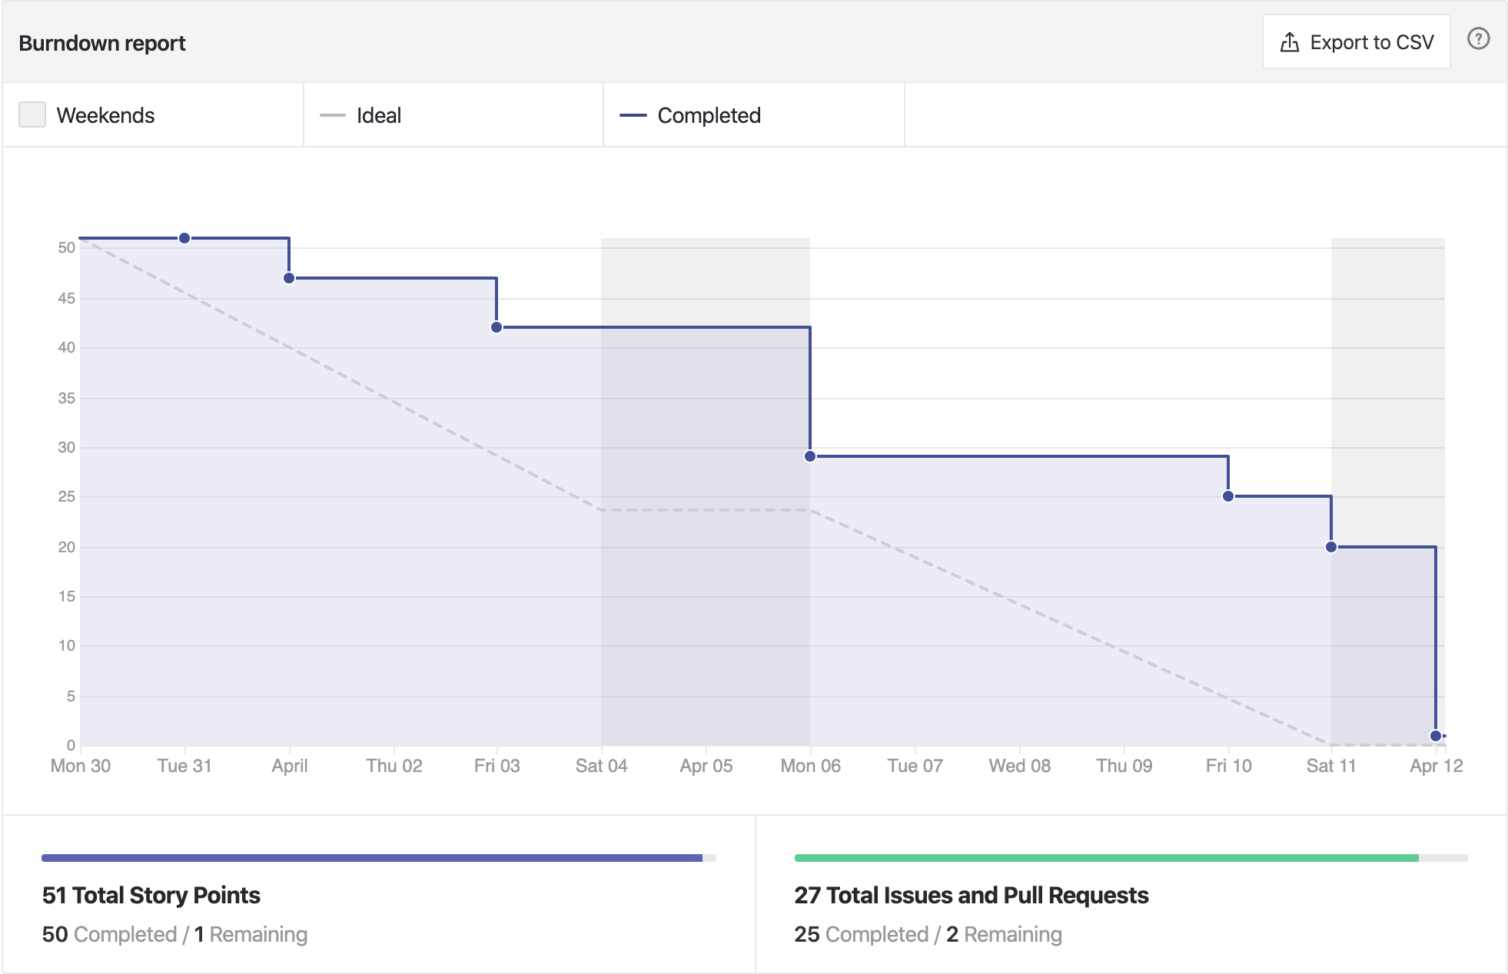
PROGRESS
Burndown Chart

Slide 5
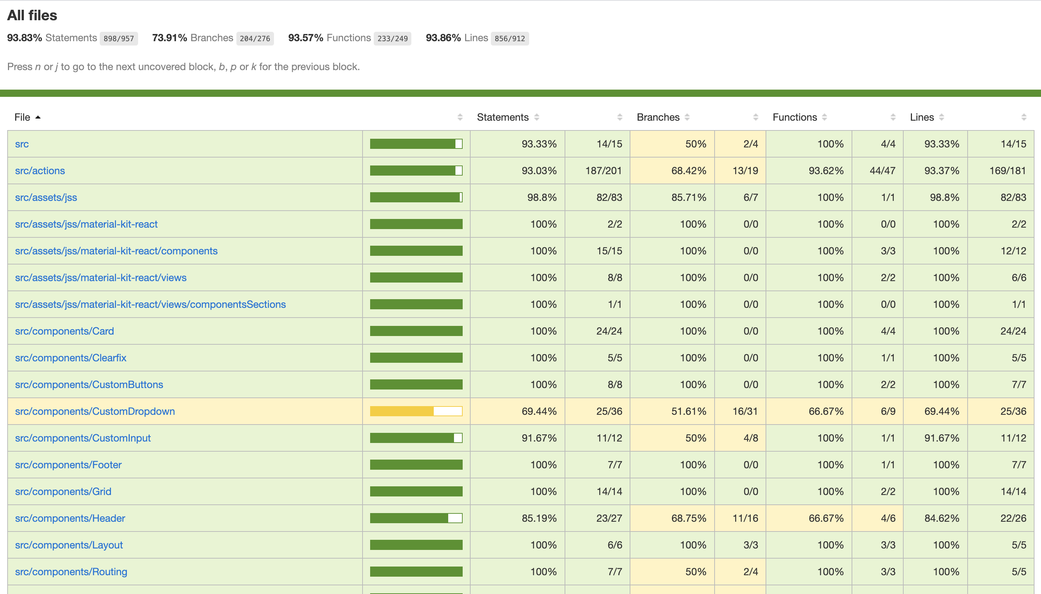
Testing Results (Cypress Coverage)

Slide 6
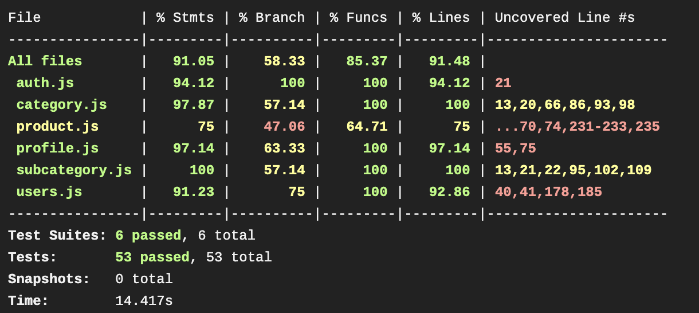
Testing Result (Jest Coverage)

Slide 7
Completed features for this Sprint
Create, delete, view products on the frontend
Frontend of CRUD operations of category
Enhanced landing page with pictures displayed from our Database
Alert on login and register pages for invalid credentials and if username and email already exists
CRUD operations on subcategory API
Frontend for Create and view subcategories
Frontend on Admin dashboard

Slide 8
Best part of this Sprint
Better solving and sharing problems
Mutual decision to delay sprint.
Even after roadblocks like interviews, midterms and others we completed our story points.
Team effort and coordination improved a lot comparatively with previous sprints.
No conflicts with master.

Slide 9
To be improved
Even though we are doing a lot, we feel like still there are many other features to be implemented.
Focus on issues in such a manner that we get a lot done.
Continue the best things like team coordination and others.

Slide 10
Roadblocks
One of our team-mate is really sick for past one and half weeks and so cannot contribute much to our project right now.
Four team member is kind of reduced to three team member.

Slide 11

The end. Questions?

