Slide 1

Sprint Retrospective
Group 3

Slide 2
Important Questions
What went well | What didn't work well | What new things to start
Team collaboration | Scrum meetings | Better & thorough planning
Learning velocity | Miscommunication | Proactively communicating issues as soon as they arrive or in sprint meetings every day.
Flexibility during development | Frequent merge conflicts | Effectively using Github issue tracking to keep track of status of issues in progress.
Completed MVP | Overestimating user stories for the sprint | Moving issues to correct pipelines in timely manner.
Testing on Back-end was good with 87% coverage | Lack of front-end testing due to time constraint | To promote more TDD from next sprint

Slide 3
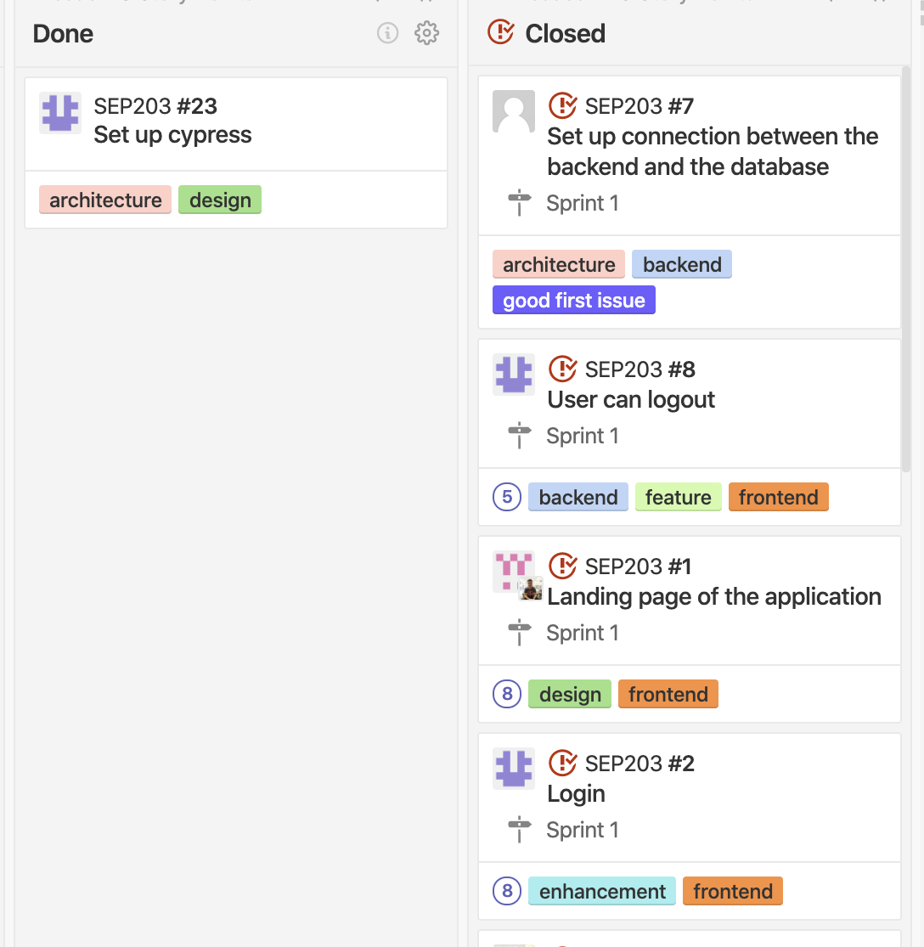
OBSERVATIONS
Completed 29 story points
Story Point estimate for Sprint 1: 50.
Some stories are pushed to backlog(21 story points).

Slide 4
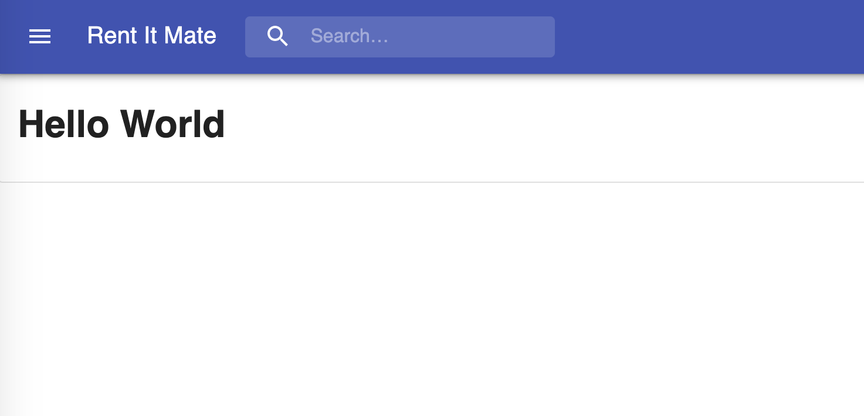
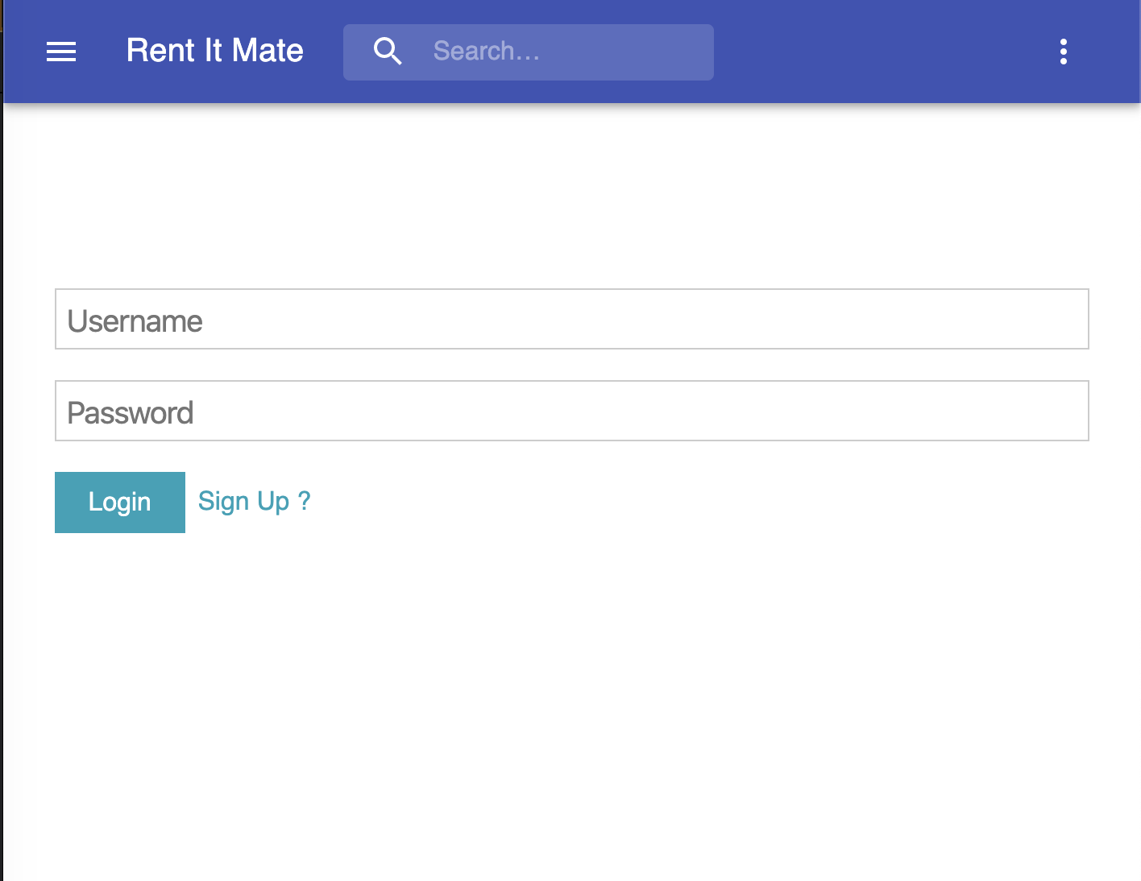
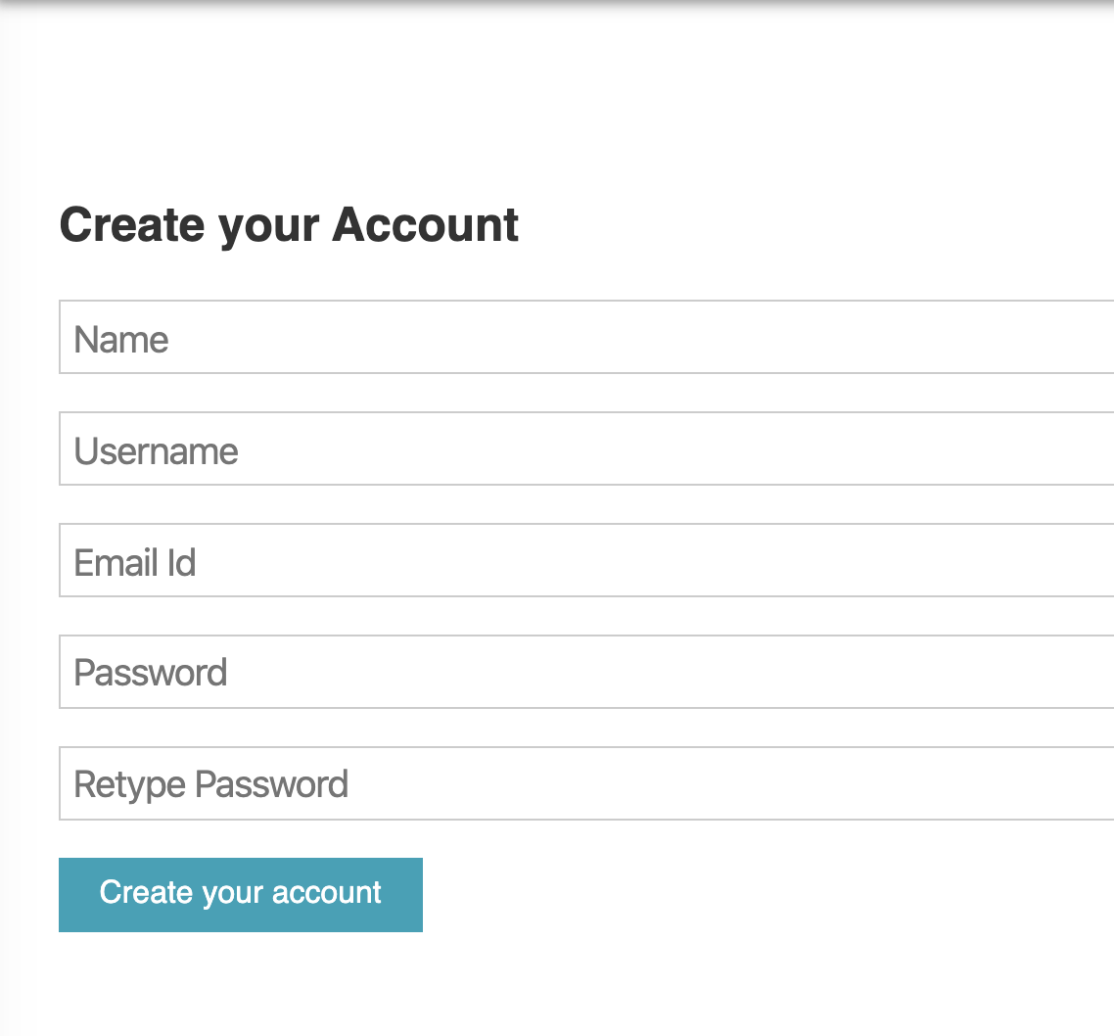
INITIAL SCREENS

Slide 5
EXPECTATIONS
Expectations from this sprint were:
Completing the landing page(layout).
Give layouts for login and registration(layout).
Functionally complete login and registration.
Implement JWT authentication.
Testing for end to end.

Slide 6
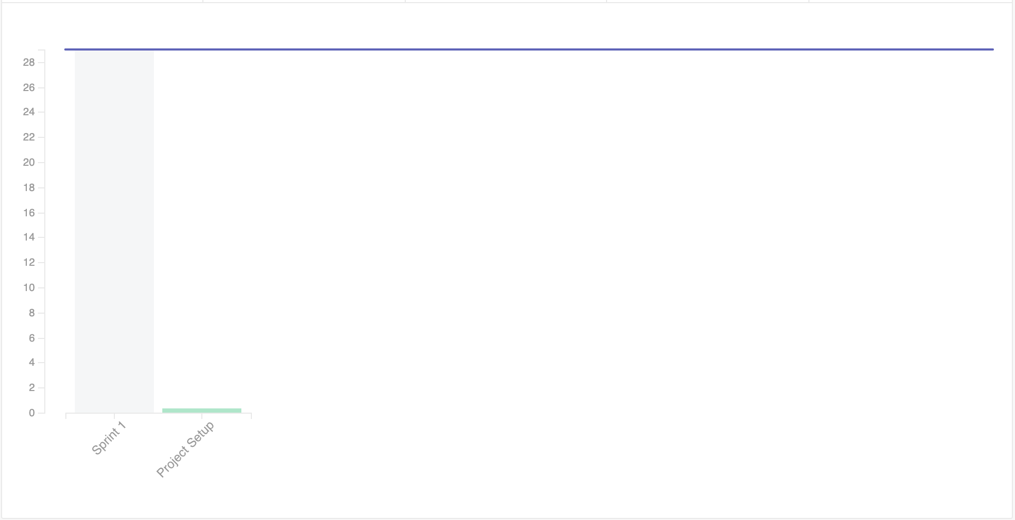
PROGRESS
A lot of expectations were met, and the rest were pushed in backlog.
Velocity Chart

