Slide 1
Rent It Mate Group 3 By Aishwarya, Gaurav, Hema & Zixu

Slide 2
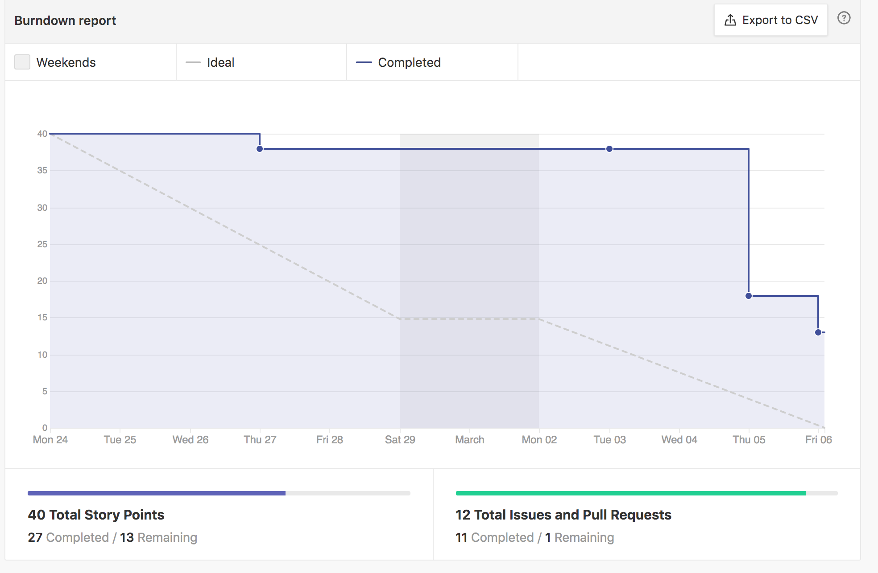
Performance Chart: Burndown Chart

Slide 3
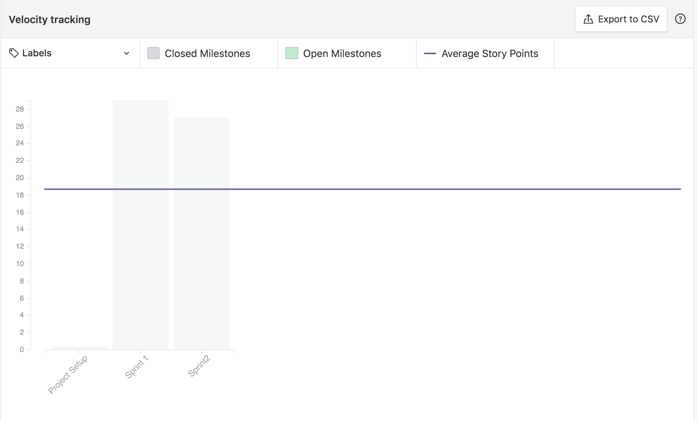
Performance Chart: Velocity Tracking

Slide 4
Things that has been done: Client-Side
We created a skeleton layout for our landing, registration and login pages during our first sprint.
We enhanced the layout of all our existing pages for the second sprint.
Added client-side validation for the pages.
Added cypress testing for the register and login pages.
Yet to work on testing for landing page, since we are still improvising the page.

Slide 5
Things that has been done: Server-Side
Connected to MongoDB
Register user is done along with email verification. Generated token expires in 24 hours.
User login along with JWT token for authentication and session management
The token will expire in an hour and user has log in again.
Created models for product and category.

Slide 6
CI/CD
We use Travis for CI/CD, but our cypress tests were failing in Travis build every time, even though it passed in our local.
We are still figuring out on if any changes to be made with the script.
We have also decided on not to work solely on the CI/CD setup and work alongside, since it took like a week for us to set up CI/CD during our sprint 2.

Slide 7
Things that went well for the second sprint:
We had daily scrum updates over the weekdays, which we did not follow on sprint 1.
We had a good pair programming that helped us to solve many issues.
Well tested code for the backend and frontend
Less merge conflicts by adding a Development branch

Slide 8
Things to be improved:
Have daily commits and push by end of the day, so that other team members can see our work
Come upfront immediately, if a roadblock is received and not to wait on solving it by our own for long time.
Communication within the team.
We will link the issues that can be closed while creating a pull request.

Slide 9
Code-life Cycle (creating story, development, merging)
We assign the issue to a member, estimate story points based on the effort needed and the learning curve
We create a separate branch for each issue such as <issue name-#issue number>.
We commit and push changes to respective issue branches, once it is done, we create a pull request, merge it to development. Move the issue to done pipeline.
By end of the sprint, we have a final check on development branch and push it to master
Deploy in heroku and move the issues to closed pipeline.

Slide 10
Team Structure
For Sprint 2
Aishwarya Sharma (Developer)
Gaurav S Jawla (Developer/Scrum Master)
Hema Ramachandran (Developer/Product Owner)
Zixu Wang (Frontend Developer)

