Slide 1
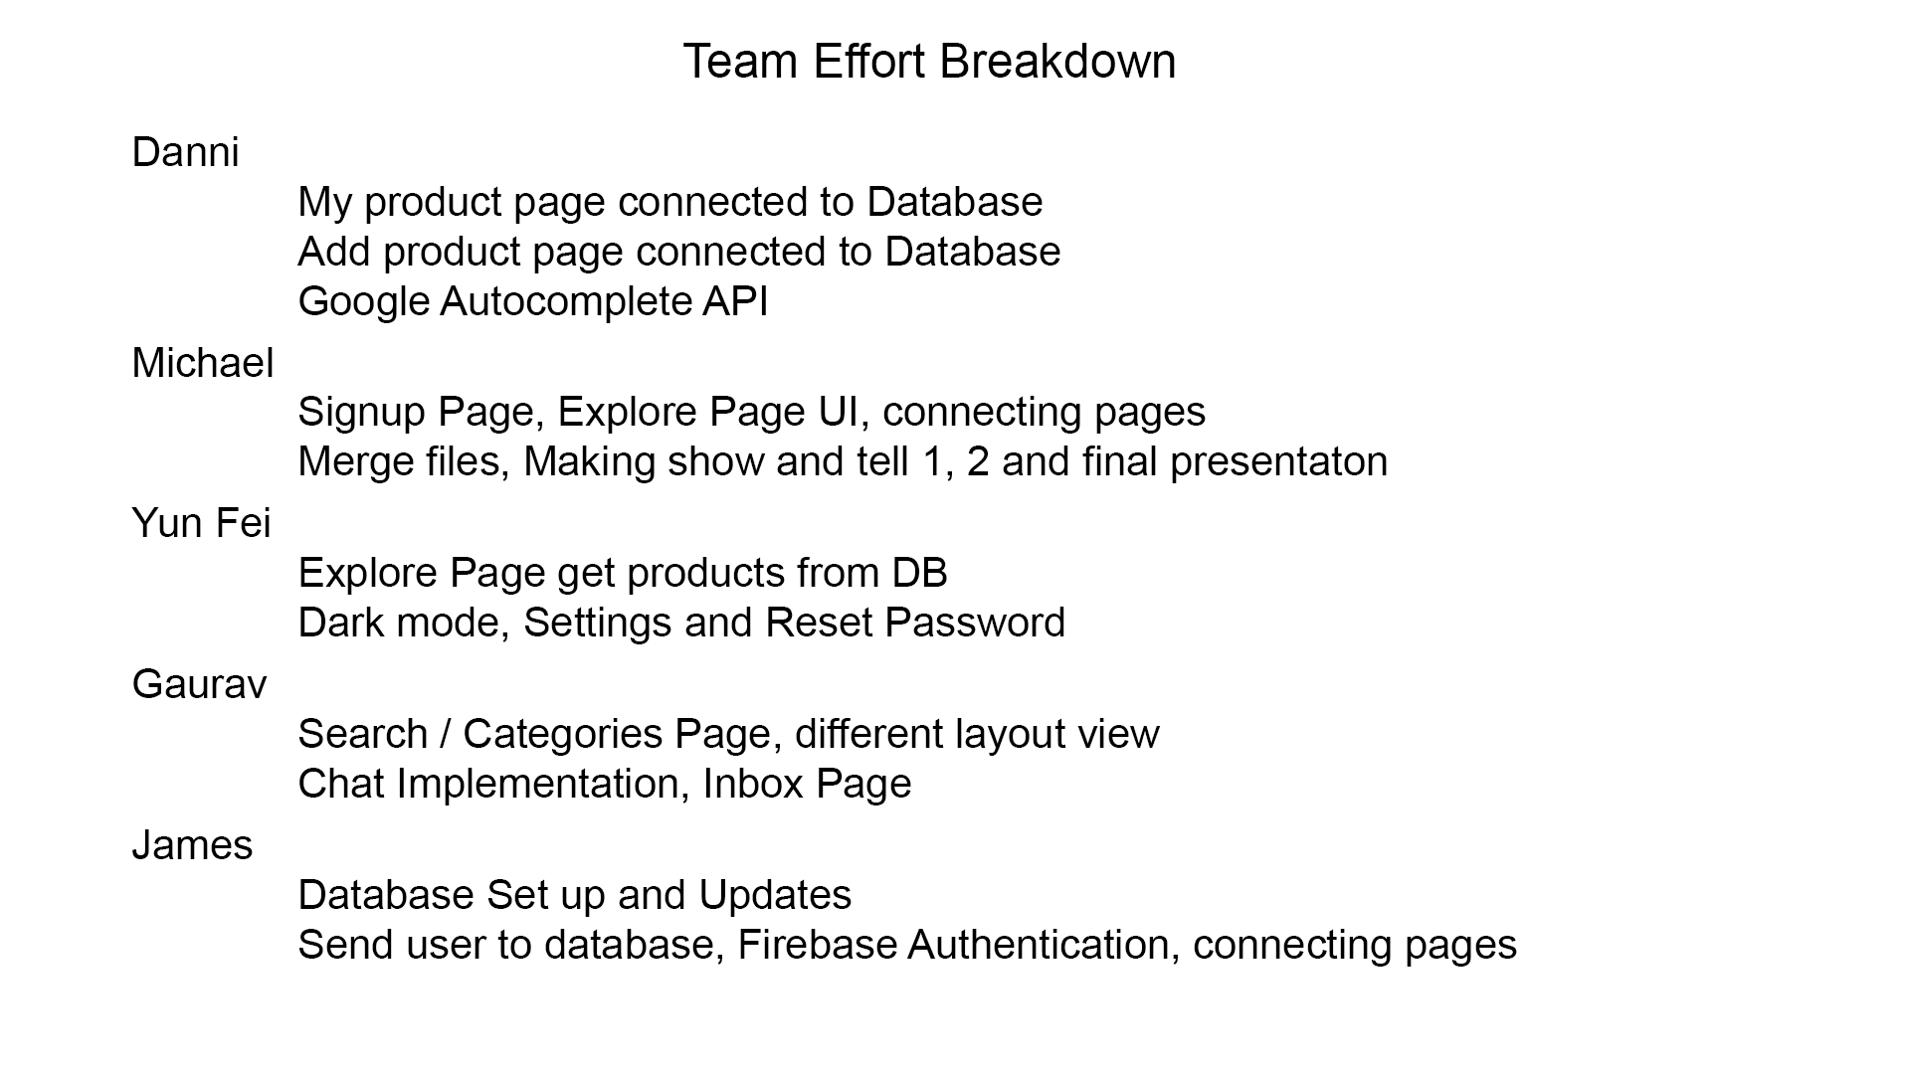
, Results page, Product Details page

