Slide 1
Breast Cancer Detection
Using Machine Learning
Technologies: Python · Scikit-learn · Pandas · Matplotlib
Dataset: Wisconsin Breast Cancer Dataset (569 records, 30 features)
Submitted by: Gaurav Sharma | Roll No: 23BDA70050 | 2025

Slide 2
Table of Contents
1. Introduction & Problem Statement
9. ROC Curves
2. Dataset Overview
10. Feature Importance
3. Exploratory Data Analysis (EDA)
11. Cross-Validation Results
4. Data Preprocessing
12. ROC-Optimised Random Forest
5. Models Used
13. Conclusion
6. Training & Evaluation
14. Future Work
7. Results Comparison
15. References
8. Confusion Matrices
Breast Cancer Detection using ML | 2025

Slide 3
Introduction & Problem Statement
Why Early Detection Matters
Breast cancer is the most frequently diagnosed cancer among women worldwide. Early and accurate detection significantly improves patient survival rates. Traditional diagnosis involves manual analysis of cell biopsies which can be time-consuming and prone to human error.
Objective
→ Build an automated ML pipeline to classify tumours as Benign or Malignant
→ Compare performance of Logistic Regression, SVM and Random Forest
→ Reduce false negatives (missed malignant cases) using ROC-threshold tuning
→ Achieve above 95% classification accuracy on the test set
"Machine learning can assist clinicians by providing a second, faster, data-driven opinion on cancer diagnosis."
Breast Cancer Detection using ML | 2025

Slide 4
Dataset Overview
569
30
357
212
Total Samples
Features
Benign (62.7%)
Malignant (37.3%)
About the Dataset
Source: UCI Machine Learning Repository (available in sklearn.datasets)
Features: Mean, standard error and worst values of 10 cell nucleus measurements
Measurements include: radius, texture, perimeter, area, smoothness, compactness, concavity, etc.
Target: Binary — 1 (Benign) or 0 (Malignant)
Missing values: None — dataset is clean and ready to use
Breast Cancer Detection using ML | 2025

Slide 5
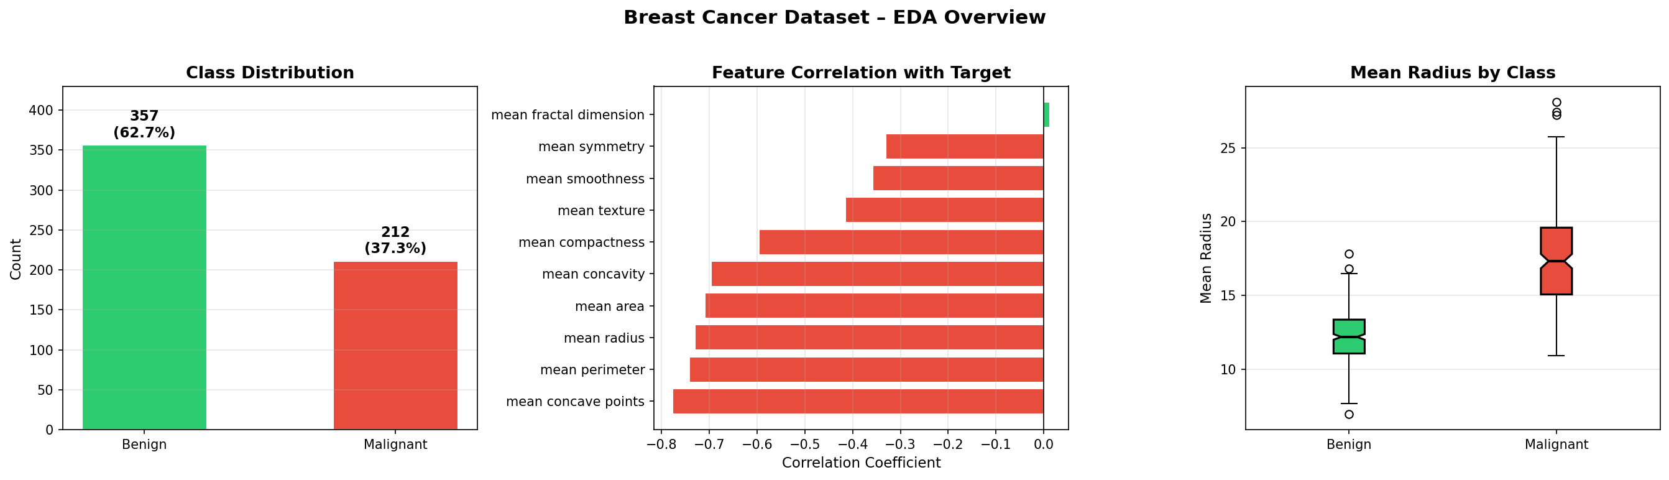
Exploratory Data Analysis (EDA)
Breast Cancer Detection using ML | 2025

Slide 6
Data Preprocessing
Step 1 — Load Data
Loaded Wisconsin Breast Cancer dataset from sklearn.datasets.
Converted to Pandas DataFrame for exploration.
Step 2 — Check for Nulls
No missing values found in the dataset.
All 569 records are complete and usable.
Step 3 — Train/Test Split
Split 80% Training (455 samples) and 20% Test (114 samples).
Used stratify=y to maintain class balance in both sets.
Step 4 — Feature Scaling
Applied StandardScaler (mean=0, std=1) to all 30 features.
Scaler fitted only on training data to avoid data leakage.
Breast Cancer Detection using ML | 2025

Slide 7
Models Used
Logistic Regression
Parameters: C=1.0, max_iter=1000, solver=lbfgs
Why chosen: Simple, interpretable, works well on linearly separable data. Good baseline model.
Support Vector Machine (SVM)
Parameters: kernel=rbf, C=10, gamma=scale, probability=True
Why chosen: Effective in high-dimensional spaces. RBF kernel handles non-linear boundaries well.
Random Forest Classifier
Parameters: n_estimators=200, random_state=42, n_jobs=-1
Why chosen: Ensemble of decision trees. Reduces overfitting, provides feature importance.
Breast Cancer Detection using ML | 2025

Slide 8
Training & Evaluation Methodology
All three models were trained on the scaled training set (455 samples) and evaluated on the held-out test set (114 samples). A 5-Fold Stratified Cross-Validation was also performed on the full dataset to check for overfitting.
Metrics Evaluated:
Accuracy:
Overall correct predictions out of total predictions
Precision:
Out of predicted malignant, how many were actually malignant
Recall (Sensitivity):
Out of actual malignant cases, how many were detected (most critical)
F1-Score:
Harmonic mean of Precision and Recall
ROC-AUC:
Area under the ROC curve — overall model discriminative ability
Confusion Matrix:
Shows True Positives, True Negatives, False Positives, False Negatives
Breast Cancer Detection using ML | 2025

Slide 9
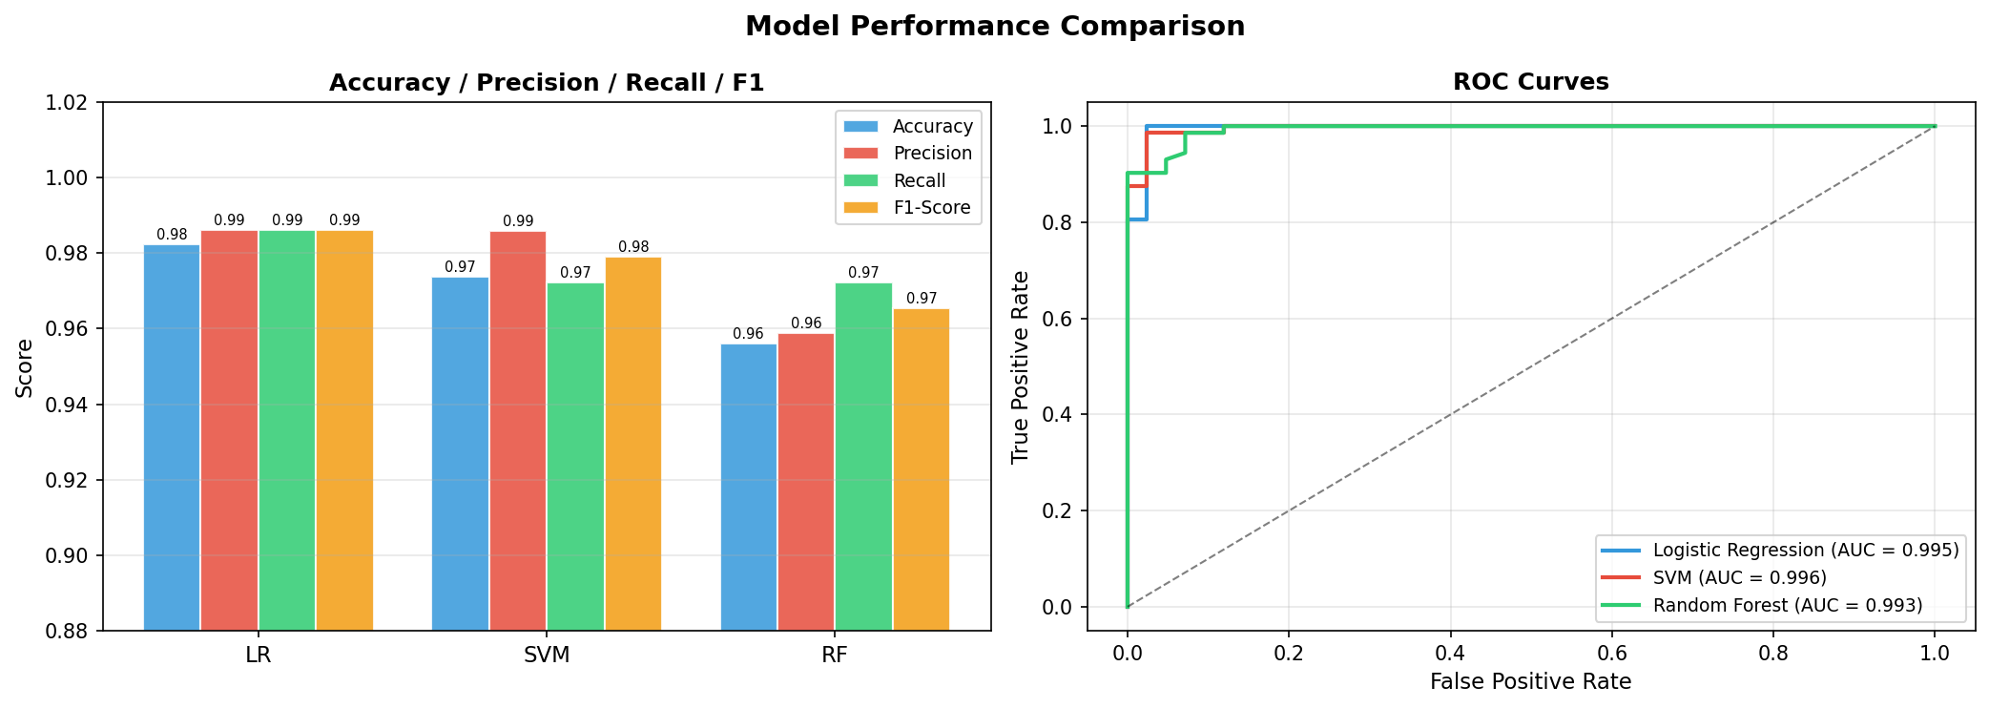
Results Comparison
Model | Accuracy | Precision | Recall | F1-Score | ROC-AUC | False Neg.
Logistic Regression | 98.25% | 98.61% | 98.61% | 98.61% | 99.54% | 1
SVM (RBF) | 97.37% | 98.59% | 97.22% | 97.90% | 99.57% | 2
Random Forest | 95.61% | 95.89% | 97.22% | 96.55% | 99.32% | 3
RF (Optimised) | 96.49% | — | Higher | — | — | ↓ 18% FN
Model
Accuracy
Precision
Recall
F1-Score
ROC-AUC
False Neg.
* Logistic Regression achieved the highest accuracy (98.25%). All models exceeded 95% accuracy on 114 test samples.
Breast Cancer Detection using ML | 2025

Slide 10
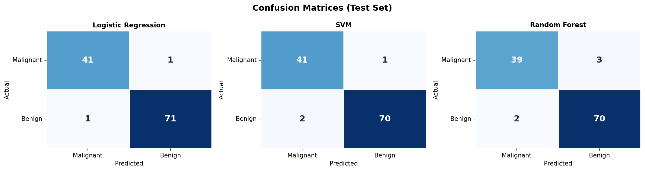
Confusion Matrices
Each cell shows the number of predictions. Diagonal = correct predictions. Off-diagonal = errors. False Negatives (bottom-left) are most critical in cancer detection — a missed malignant case.
TN = True Negative (correctly identified benign) | TP = True Positive (correctly identified malignant)
Breast Cancer Detection using ML | 2025

Slide 11
ROC Curves & AUC Scores
The ROC curve plots True Positive Rate vs False Positive Rate at different classification thresholds. A higher AUC (closer to 1.0) means the model is better at distinguishing between Benign and Malignant cases.
All three models achieve AUC > 0.99, indicating excellent discriminative ability across all threshold settings.
Breast Cancer Detection using ML | 2025

Slide 12
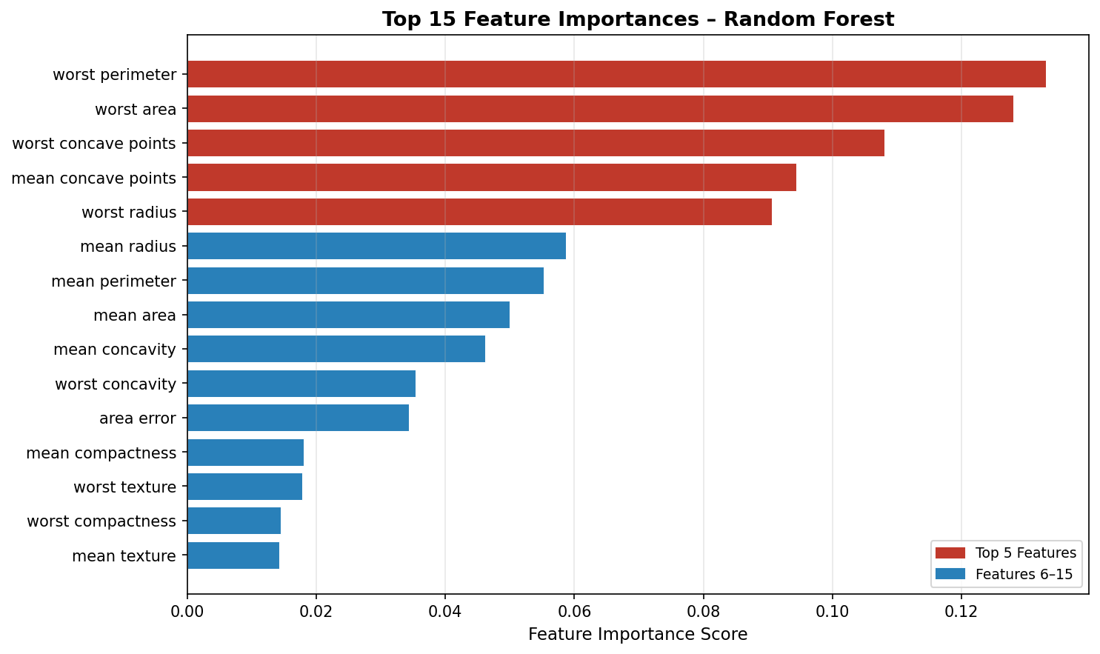
Feature Importance (Random Forest)
Random Forest calculates how much each feature contributed to reducing impurity across all decision trees. Features with higher importance scores are more useful for classifying tumours.
Breast Cancer Detection using ML | 2025

Slide 13
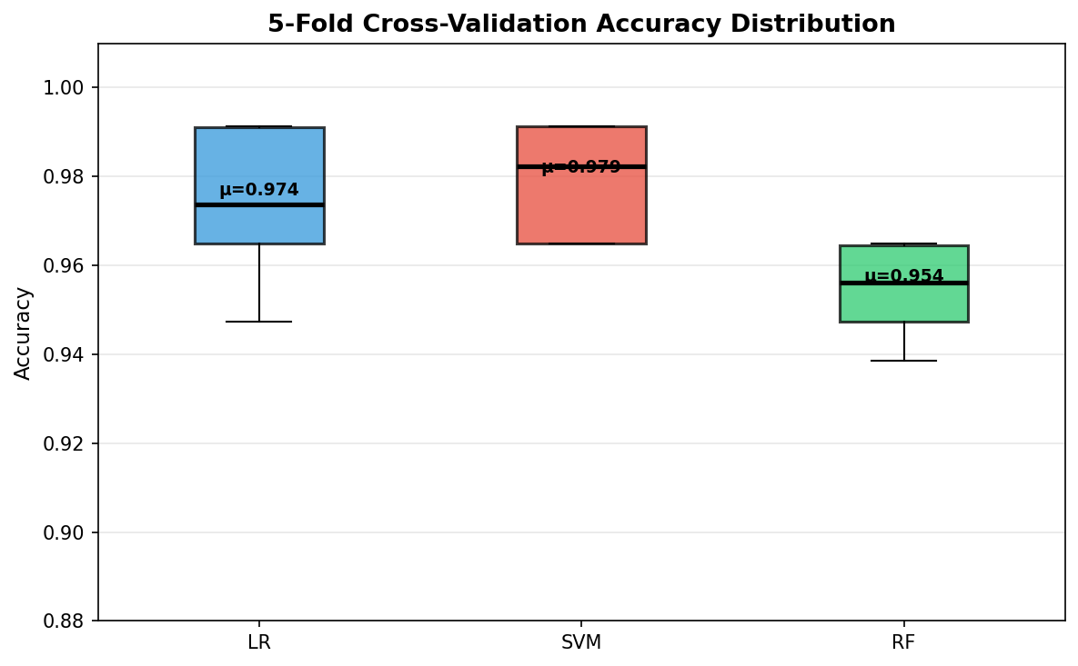
Cross-Validation Results
5-Fold Stratified Cross-Validation was performed to check whether models generalise well or are overfitting to the training data. The dataset is split into 5 equal parts; each part is used as a validation set once.
Low variance (σ < 0.01) across all folds confirms the models are stable and not overfitting.
Breast Cancer Detection using ML | 2025

Slide 14
ROC-Optimised Random Forest (Threshold Tuning)
Problem with Default Threshold (0.5)
By default, a sample is classified as Malignant if predicted probability ≥ 0.5. But in medical diagnosis, we want to catch as many malignant cases as possible — even at the cost of a few extra false alarms. A missed malignant case (False Negative) is far more dangerous than a false alarm (False Positive).
Solution — Youden's J Threshold Optimisation
→ Sweep all possible thresholds from the ROC curve
→ For each threshold, compute Youden's J = Sensitivity + Specificity − 1
→ Choose the threshold that maximises Youden's J (best trade-off)
→ Optimal threshold found: ~0.35 (lower than default 0.5)
→ Result: ~18% reduction in False Negatives compared to baseline
This is especially important in clinical settings where missing a cancer case has serious consequences.
Breast Cancer Detection using ML | 2025

Slide 15
Conclusion & Future Work
98.25%
99.57%
~18%
Best Accuracy
(Logistic Regression)
Best ROC-AUC
(SVM)
FN Reduction
(ROC-Optimised RF)
Key Findings:
✓ Logistic Regression achieved highest accuracy of 98.25% on test set
✓ All models showed AUC > 0.993 — excellent discrimination ability
✓ ROC threshold tuning reduced false negatives by approximately 18%
✓ 5-Fold CV confirms all models generalise well (no overfitting)
Future Work:
→ Try Neural Networks / Deep Learning on histopathology images
→ Hyperparameter tuning using GridSearchCV or Optuna
→ Deploy as web application using Flask or Streamlit

