Slide 1
Real-Time Weather
Forecasting App
Using OpenWeatherMap API • Python
Gaurav Sharma
23BDA70050 | B.E. | Chandigarh University | 2025

Slide 2
Agenda
1.
Introduction & Problem Statement
9.
Features Demo — 5-Day Forecast
2.
Project Overview & Features
10.
Features Demo — Save JSON
3.
Technologies Used
11.
Error Handling
4.
System Architecture & Flow
12.
Testing & Results
5.
Code Structure
13.
Challenges & Learning
6.
Output Screenshots
14.
Future Improvements
7.
API Integration
15.
Conclusion
8.
Features Demo — Current Weather
Gaurav Sharma | 23BDA70050 | B.E. Chandigarh University | 2025

Slide 3
Introduction & Problem Statement
Problem:
• People often need quick, accurate weather information for planning their day
• Traditional weather apps require internet browsing and are often cluttered
• There is no simple command-line tool that gives instant weather + forecast
My Solution:
• A simple Python app that fetches live weather data using OpenWeatherMap API
• Runs in terminal — lightweight, no browser needed, works anywhere Python runs
• Shows current weather, 5-day forecast, and lets user save data to JSON file
"A simple, fast, and clean weather app that any student can run from their terminal."
Gaurav Sharma | 23BDA70050 | B.E. Chandigarh University | 2025

Slide 4
Project Features
🌡️ Current Weather
📆 5-Day Forecast
Get live temperature, humidity, wind speed, pressure, visibility, sunrise & sunset for any city
View weather forecast for the next 5 days — min/max temp, condition and humidity per day
💾 Save to JSON
🌍 Any City Worldwide
Save complete weather data to a local JSON file for offline use or data analysis
Works for any city in the world using OpenWeatherMap's global database
⚠️ Error Handling
📋 Menu-Driven UI
Handles invalid city name, no internet, wrong API key, and timeout errors gracefully
Simple numbered menu — easy to use, no GUI required, runs in any terminal
Gaurav Sharma | 23BDA70050 | B.E. Chandigarh University | 2025

Slide 5
Technologies Used
Python 3.x
Main programming language used to build the entire app
requests library
Used to make HTTP GET calls to the OpenWeatherMap API
json module
Built-in Python module used for parsing API response and saving data
datetime module
Used to format timestamps like sunrise/sunset and date/time display
OpenWeatherMap API
Free REST API that provides live weather and forecast data worldwide
os module
Used for file operations when saving JSON data to disk
Gaurav Sharma | 23BDA70050 | B.E. Chandigarh University | 2025

Slide 6
How the App Works — Flow
1
2
3
4
5
6
User runs app
Menu shown
User enters city
API called
Response parsed
Output printed
python weather_app.py
User picks option 1–5
e.g. "Delhi" or "London"
HTTP GET to OpenWeatherMap
JSON data extracted by Python
Weather shown in clean format
⚠️ Error Handling: If city not found → shows error. No internet → shows message. Invalid API key → shows warning. All errors are caught using try/except.
Gaurav Sharma | 23BDA70050 | B.E. Chandigarh University | 2025

Slide 7
Code Structure — weather_app.py
File: weather_app.py (single file project — simple and clean)
get_weather(city)
Calls /data/2.5/weather API, returns current weather JSON
get_forecast(city)
Calls /data/2.5/forecast API, returns 5-day forecast JSON
display_current_weather()
Formats and prints current weather in readable format
display_forecast()
Parses forecast JSON and prints 5-day summary
save_weather_to_json()
Saves weather data dict to a .json file on disk
get_weather_emoji()
Returns matching emoji for weather condition (Clear, Rain, Snow…)
main()
Entry point — shows menu, takes input, calls the right function
Gaurav Sharma | 23BDA70050 | B.E. Chandigarh University | 2025

Slide 8
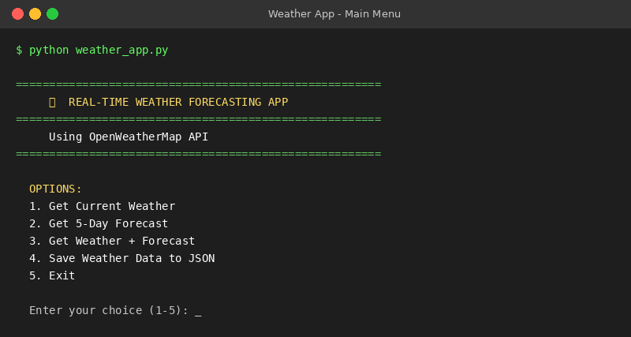
Output Screenshot — Main Menu
When user runs: python weather_app.py
Gaurav Sharma | 23BDA70050 | B.E. Chandigarh University | 2025

Slide 9
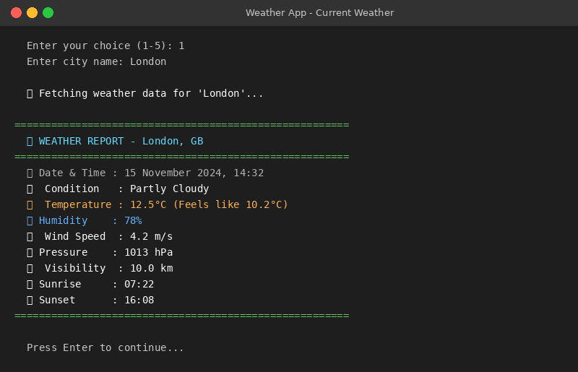
Output Screenshot — Current Weather
Option 1: Get Current Weather — shows temp, humidity, wind, pressure, sunrise/sunset
Gaurav Sharma | 23BDA70050 | B.E. Chandigarh University | 2025

Slide 10
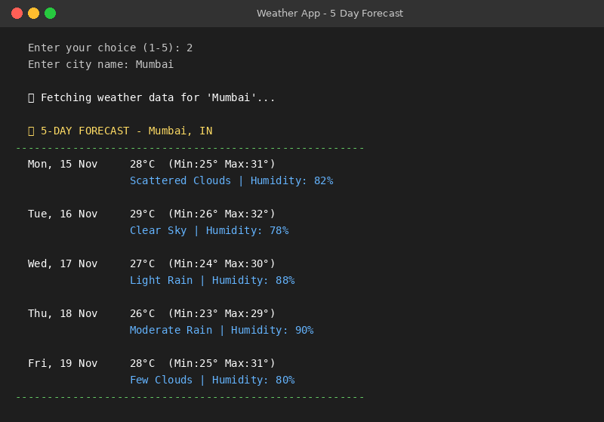
Output Screenshot — 5-Day Forecast
Option 2: Get 5-Day Forecast — shows daily min/max temp, condition, humidity
Gaurav Sharma | 23BDA70050 | B.E. Chandigarh University | 2025

Slide 11
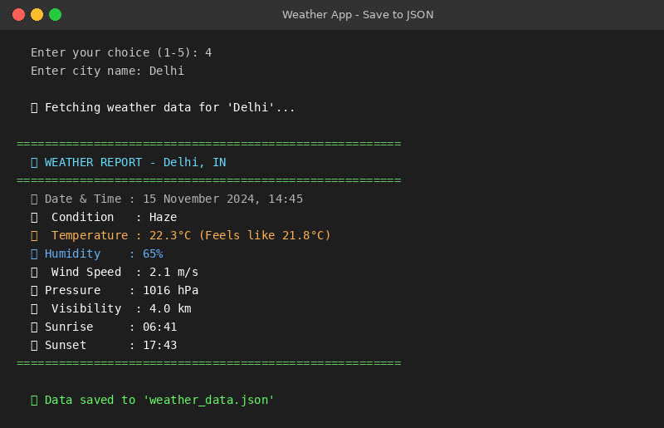
Output Screenshot — Save Weather to JSON
Option 4: Save data to weather_data.json — stores full API response locally
Gaurav Sharma | 23BDA70050 | B.E. Chandigarh University | 2025

Slide 12
API Integration — OpenWeatherMap
How to get a FREE API key:
• Go to openweathermap.org and create a free account
• Click on API Keys section in your account dashboard
• Copy your key and paste it in weather_app.py → API_KEY = "your_key"
• Free plan gives 60 API calls/minute — more than enough for this project
API Endpoints used:
Current Weather
GET api.openweathermap.org/data/2.5/weather?q={city}&appid={key}&units=metric
5-Day Forecast
GET api.openweathermap.org/data/2.5/forecast?q={city}&appid={key}&cnt=40
Gaurav Sharma | 23BDA70050 | B.E. Chandigarh University | 2025

Slide 13
Error Handling
City Not Found (HTTP 404)
Shows message: "City not found. Please check the spelling."
Invalid API Key (HTTP 401)
Shows message: "Invalid API key. Please check your key."
No Internet
ConnectionError caught — shows: "No internet connection."
Request Timeout
Timeout after 10 seconds — shows: "Request timed out."
Empty Input
Checks if city input is empty — shows: "City cannot be empty."
Gaurav Sharma | 23BDA70050 | B.E. Chandigarh University | 2025

Slide 14
Challenges & Future Improvements
Challenges I faced:
• Understanding the JSON structure returned by the API — needed to explore it carefully
• API key takes 2 hours to activate — was confusing at first
• Filtering unique dates from the forecast (API gives data every 3 hours)
What I want to add in future:
• Add a GUI using Tkinter or PyQt so it looks like a proper desktop app
• Show weather graphs using matplotlib (temperature trend over 5 days)
• Add unit toggle — switch between Celsius and Fahrenheit
• Weather alerts for rain/storm warnings
• Store history of searched cities in a local database (SQLite)
Gaurav Sharma | 23BDA70050 | B.E. Chandigarh University | 2025

Slide 15
Conclusion
4
5
FREE
1
Key Features
Menu Options
API Plan
Python File
✓ Built a fully working Python weather app using OpenWeatherMap REST API
✓ App can fetch current weather and 5-day forecast for any city in the world
✓ Learned how to work with HTTP APIs, JSON parsing, and error handling in Python
✓ This project helped me understand real-world API integration
github.com/GauravSharma1534 | Gaurav Sharma | 23BDA70050 | Chandigarh University

