Slide 1

Tatyasaheb Kore Institute of Engineering & Technology,Warananagar(An Autonomous Institute)
Voice Based Mood Recognition
GUIDED BY
Prof.R.C.Shikkeri.
PRESENTED BY
Sanket S. Naik.
Gaurav S. Patil.
Shubham P. Patil.
Vishwajeet V. Patil.

Slide 2
Contents :
Introduction
Motivation and Objective
Literature Review
Problem Statement
Project scope
Key points from Software Requirement Specification(SRS)
Proposed System Study
System Analysis And Design
Development Environment
References

Slide 3
Introduction:
Through all the available senses, humans can sense the emotional state of their communication partner. This emotional detection is natural for humans, but it is very difficult task for computers; although they can easily understand content based information, accessing the depth behind content is difficult and that’s what speech emotion recognition sets out to do. It is a system through which various audio speech files are classified into different emotions such as happy, sad, anger and neutral by computers.
Speech emotion recognition can be used in areas such as the medical field or customer call centers. The foundation of modeling began with feature selection. After extracting MFCCs, Chroma, and Mel spectrograms from the audio files we began assembling models readily available from Sci-kit Learn and other Python packages.
Speech includes calm, happy, sad, angry, fearful, surprise, and disgust expressions contain calm, happy, sad, angry, and fearful emotions.

Slide 4
Motivation and Objective:
Speech Emotion Recognition (SER) is the task of recognizing the emotion from speech irrespective of the semantic contents.
However, emotions are subjective and even for humans it is hard to notate them in natural speech communication regardless of the meaning. The ability to automatically conduct it is a very difficult task and still an ongoing subject of research.
In the past, emotions were considered to be hard to measure and were consequently not studied by computer scientists.
Although the field has recently received an increase in contributions, it remains a new area of study with a number of potential applications.
These include emotional hearing aids for people with autism; detection of an angry caller at an automated call centre to transfer to a human; or presentation style adjustment of a computerised e-learning tutor if the student is bored.

Slide 5
Literature Review:
2.1 Existing System Study
ASR-Automatic Speech Recognition
Automatic speech recognition (ASR) or speech-to-text system identifies spoken words in speech and converts them to written text ASR systems extract acoustic signal characteristics from speech and determine the words in it by pattern matching. Acoustic and language models are used in developing ASR systems. ASR systems are classified according to the parameters and features they use—vocabulary size, speaker mode. Mathematical Models for Speech Recognition -General-purpose speech recognition systems are based on statistical approaches for modelling both acoustics and language. A crucial issue for acoustic modelling is the selection of the speech units that represent the acoustic and linguistic information for the language.

Slide 6
Literature Review:
2.2 Proposed System Study
In the Proposed System, input will be recorded audio (to be uploaded by user) or live audio
Our desired output will be users accurate mood and text of a speech with that if users wants there is other international language than the English then output will be text in English language.

Slide 7
Problem Statement:
The study of emotion has advanced rapidly over the last decade, driven by low-cost smart technologies and broad interest from researchers in neuroscience, psychology, psychiatry, audiology, and computer science. Integral to these studies is the availability of validated and reliable expressions of emotion. To meet these needs, a growing number of emotion stimulus sets have become available. Most sets contain either static facial expressions or voice recordings. Clinically, there is growing recognition for the role of singing in understanding neurological disorders and facilitating rehabilitation.
Yet there are few validated sets of sung emotional expression. To address these needs, we are developing this project, a large validated set of audiovisual speech .
In this project we are going to take input as audio from user then features of that audio will be extracted using SNN and then we will maintain a list which will be according to sorted moods and the mood emoji will be displayed with that we are going to convert audio to text and conversion of any other international language to English

Slide 8
Project Scope:
From this project we are going to deliver mood recognition system according to voice of user it can be either recorded or live.
With that our system includes speech to text convertor.
As we are developing our project as purely web application it can be lag behind while integrating with other systems like robotics hardware or any other iot device.
As this is purely web development process our system will doesn’t concern about any kind of hardware . So while working with hardware systems there will be boundaries to our project.

Slide 9
Key points from Software Requirement Specification(SRS) :
All necessary technology exists to develop the system. This system is too flexible and it can be expanded further. This system can give guarantees of accuracy, ease of use, reliability and security of users data. This system can give instant responses to inquire. Our project is technically feasible because all the technology needed for our project is readily available.

Slide 10
Technical Feasibility:
The project Voice Based Mood Recognition and Speech to Text Convertor with language translator is web application
The main technologies and tools are associated –
Markup Language : HTML5
Style Sheet Language : CSS 2.1
Scripting Language : Python
Database : Flask
Framework : Python Flask
IDE : Spyder(version 5.1)
Diagramming Tools : Lucid Chart
By considering above points we can conclude that our project is technically feasible

Slide 11
Legal Feasibility:
The project “Voice Based Mood Recognition and Speech to Text Convertor with language translator ” is a complete Web Application
Project “Voice Based Mood Recognition and Speech to Text Convertor with language translator ” is absolutely legal and doable
It meets all legal and ethical requirements as per the Information Technology Act,2000 Govt.of India
Project uses freely available/open source software development tools
No threats to customer’s/institute’s/organization’s confidential data
From above, it is clear that project “ is legally feasible

Slide 12
Proposed System Study:
In the Proposed System, input will be recorded audio (to be uploaded by user) or live audio
Our desired output will be users accurate mood and text of a speech with that if users wants there is other international language than the English then output will be text in English language.
Models Used For Prediction:
1. Sequential NN
2. MLP Classifier

Slide 13
Proposed System Study:
1.Neural Networks:
A neural network is a series of algorithms that endeavors to recognize underlying relationships in a set of data through a process that mimics the way the human brain operates.
In this sense, neural networks refer to systems of neurons, either organic or artificial in nature. Neural networks can adapt to changing input; so the network generates the best possible result without needing to redesign the output criteria.
Neural networks are multi-layer networks of neurons (the blue and magenta nodes in the chart below) that we use to classify things, make predictions, etc..

Slide 14
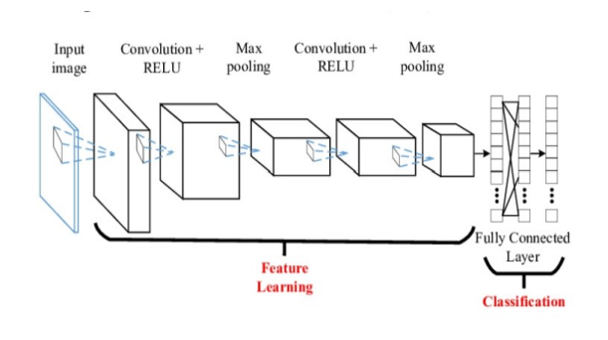
Proposed System Study:
Fig. Sequential neural network

Slide 15
Proposed System Study:
MLP Classifier :
Neural networks are multi-layer networks of neurons (the blue and magenta nodes in the chart below) that we use to classify things, make predictions, etc.
MLP Classifier stands for Multi-layer Perceptron classifier which in the name itself connects to a Neural Network. Unlike other classification algorithms such as Support Vectors or Naive Bayes Classifier.
MLP Classifier relies on an underlying Neural Network to perform the task of classification. It helps to convert the input into a more useful output.
Sigmoid activation function creates an output with values between 0 and 1. There can be other activation functions like Tanh, softmax and REL

Slide 16
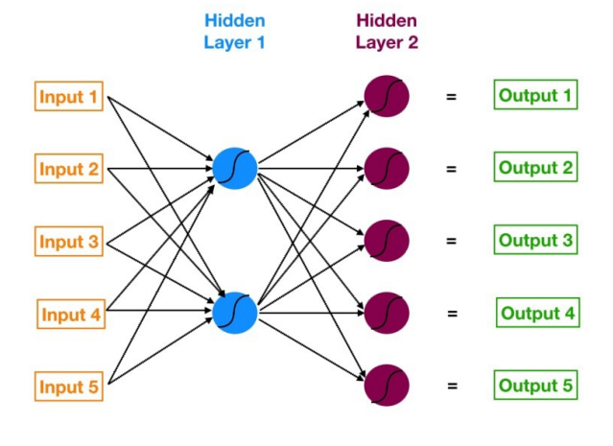
Proposed System Study:
Fig. MLP

Slide 17
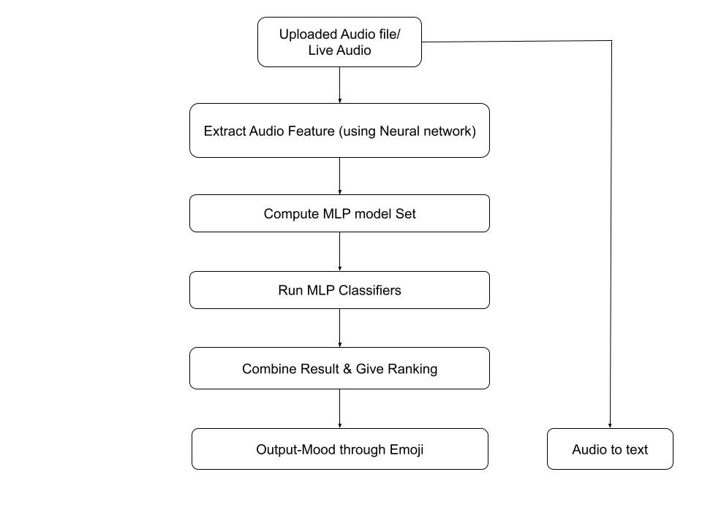
System Analysis And Design:
1.System Architecture:

Slide 18
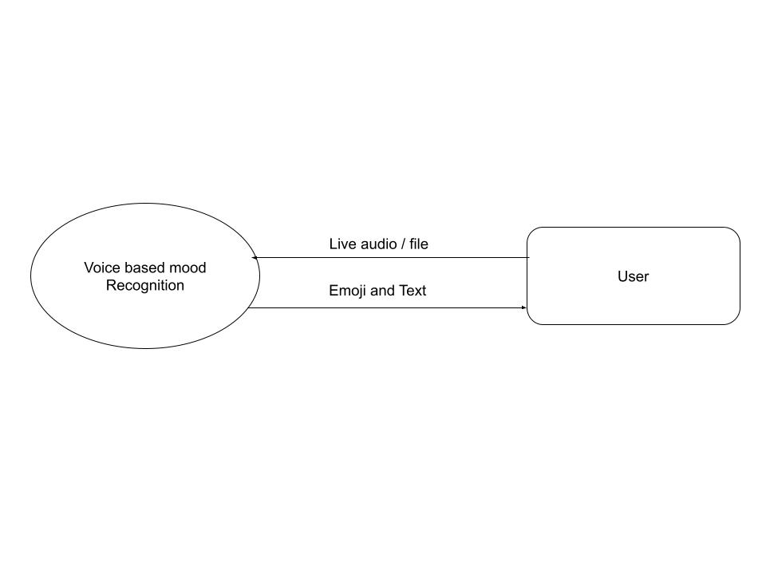
System Analysis And Design:
DFD 0:
18

Slide 19
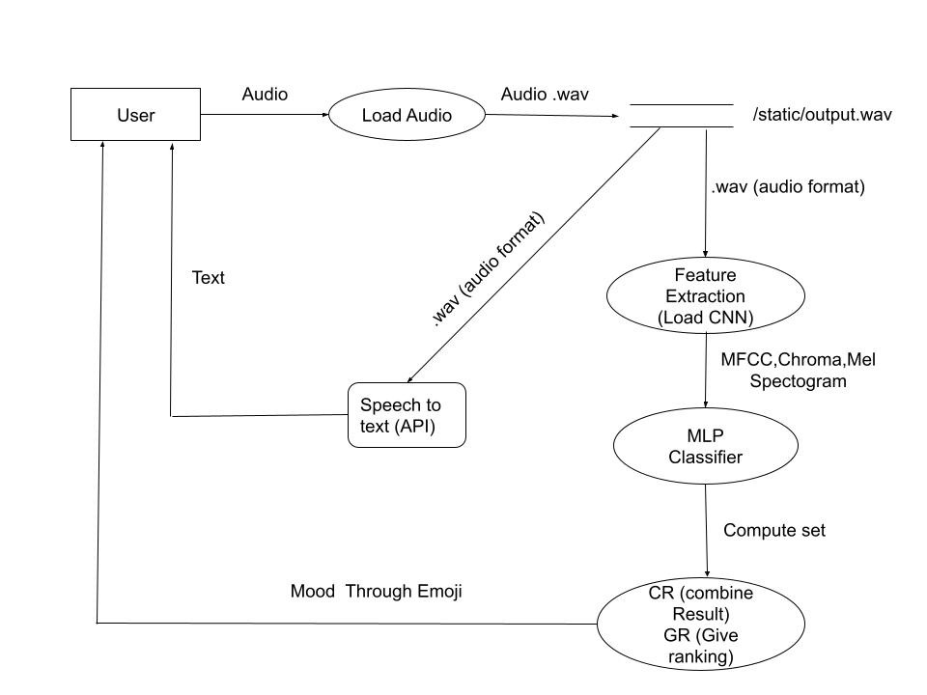
System Analysis And Design:
DFD 1:

Slide 20
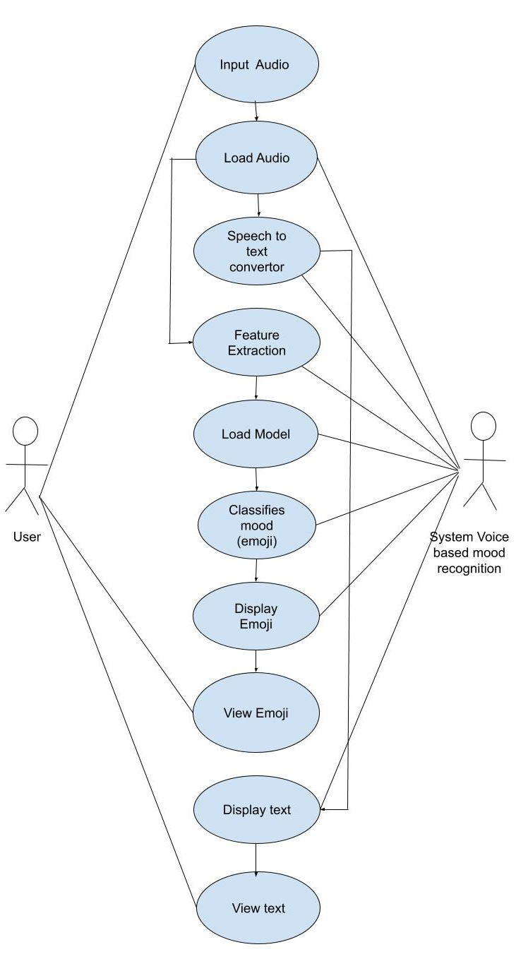
System Analysis And Design:
Use Case Diagram:

Slide 21
Development Environment:
Software Requirements :
IDE- Spyder(with numPy , Pandas , Librosa,Seaborn etc. packages installed )
Programming Language – Python
Package Distributor -MiniConda
Browser- Google Chrome
Hardware Requirements :
Operating System: 64 -bit Windows 10/11
Memory(RAM): 8 GB
Free Disk Space :8 GB
Processor: x86_64 CPU architecture; 5th generation Intel Core or newer
Screen Resolution: 1280 x 800 minimum screen resolution

Slide 22
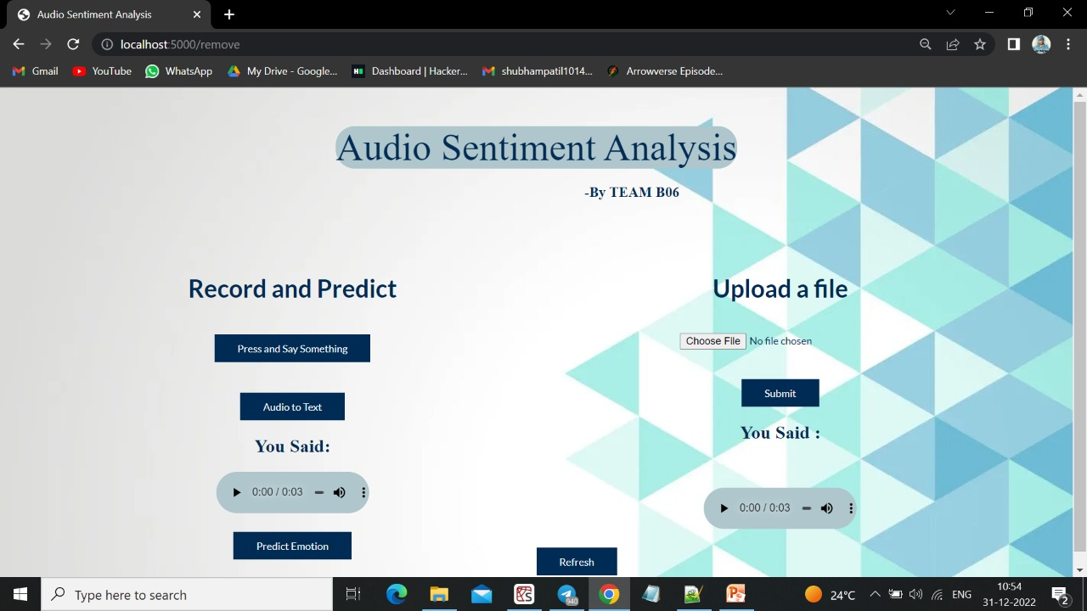
Screenshot :

Slide 23


