Slide 1



AI Agent for GitHub Workflow Automation
Jaypee University of Information Technology
Department of Computer Science and Engineering and Information Technology
Major Project - II (18B19CI891) | AY 2025-26
Mid-Term Evaluation | March 2026.
Group No.: 61
Team Member (s)
Gaurav Thakur (221030056)
Khwaja Abdul Razzaq (221030089)
Muskan Sharma (221030330)
Supervisor
Prof. Dr. Vivek Kumar Sehgal
Professor and Head of Dept., Dept. of CSE & IT

Slide 2
Outline
Introduction
Problem Statement
Objectives
Literature Review
Work Done (after MP-I)
Dataset
Project Design
Tools, Technologies and Languages
Implementation
Experimental Results and Evaluation
Publications
Future Work
Project Plan
Key Learnings
Work Contribution and Attendance
Supervisor Interactions
References

Slide 3
Introduction
GitHub is a widely used platform for collaborative software development and version control.
Developers manage repositories, issues, pull requests, and workflows to maintain software projects.
However, manually tracking repository activities and managing issues can be time-consuming and inefficient.
Our project introduces an AI-powered GitHub Agent that helps automate repository operations using natural language commands.
The system integrates GitHub APIs, backend services, and a chat-based interface to assist developers in managing repositories efficiently.
This approach improves productivity, automation, and repository insights for developers.

Slide 4
Problem Statement
Managing GitHub repositories, issues, and pull requests manually can be time-consuming for developers.
Developers often need to switch between multiple GitHub pages to track repository information, bugs, and workflows.
There is no simple natural language interface that allows users to interact with GitHub operations easily.
Analyzing bug trends, repository activity, and workflow data requires manual monitoring and effort.
Therefore, there is a need for an intelligent automated system that can simplify GitHub management and provide quick insights.

Slide 5
Objectives
Develop an AI-powered agent that understands natural language queries and performs GitHub operations such as issue creation, pull request management, and repository tracking.
Integrate Large Language Models (LLMs) with GitHub APIs (REST/GraphQL) to accurately interpret user requests and execute repository actions automatically.
Provide a user-friendly interface that allows users to interact with GitHub using simple natural language commands.
Automate code review processes including linting, formatting, and testing to improve code quality and development efficiency.
Analyze pull requests and commit messages using NLP to generate insights and improve collaboration within development teams.

Slide 6
Literature Review
S. No. | Author & Paper Title [Citation] | Journal/ Conference (Year) | Tools/ Techniques/ Dataset | Key Findings/ Results | Limitations/ Gaps Identified
1. | Anurag Pindoriya, Janki Velani — Advancements in GitHub Automation and Workflow: A Comprehensive Exploration | Not specified (2025) | Review-based study on GitHub automation & workflows | Highlights recent advancements in GitHub automation, explores workflow optimization techniques and tools | No experimental evaluation; limited to literature review insights
2. | Xinyu Zhang, Siddharth Muralee, Sourag Cherupattamoolayil, Aravind Machiry — On the Effectiveness of Large Language Models for GitHub Workflows | Purdue University / Preprint (2025) | Empirical evaluation of LLMs for CI/CD, workflow maintenance, code review automation | Shows LLMs can assist in workflow debugging, auto-fix, and action recommendations | Early-stage work; lacks large-scale industrial deployment evidence
3. | Man Fai Wong, Shangxin Guo, Ching Nam Hang, Siu Wai Ho, Chee Wei Tan — Natural Language Generation and Understanding of Big Code for AI-Assisted Programming: A Review | City University of Hong Kong, Univ. of Adelaide, NTU (2025) | Literature review of big code understanding, NL2Code, Code2NL, AI programming assistants | Summarizes methods enabling code summarization, generation, and comprehension using AI techniques | Review-only; no new framework proposed; future integration with modern LLMs suggested
4. | Kinsman, T.; Wessel, M.; Gerosa, M. A.; Treude, C. — How Do Software Developers Use GitHub Actions to Automate Their Workflows? | MSR 2021 (Mining Software Repositories) | Regression Discontinuity Design; analysis of 416,266 GitHub repos; commit & PR metric mining | Only ~0.7% of repos adopted GitHub Actions; adoption correlates with more rejected PRs and fewer commits in merged PRs | Sample is small; private repos excluded; possible confounding variables weren’t fully controlled

Slide 7
Literature Review (cont…)
S. No. | Author & Paper Title [Citation] | Journal/ Conference (Year) | Tools/ Techniques/ Dataset | Key Findings/ Results | Limitations/ Gaps Identified
5. | Zheng, L.; Li, S.; Huang, X.; Huang, J.; — Why Do GitHub Actions Workflows Fail? An Empirical Study | ACM / 2024 | Manual classification of 375 failed workflow runs across 260 Java projects (log mining, error taxonomy) | Focused on Java; only failed runs; ambiguous root causes in some cases; limited generalizability | Focused on Java; only failed runs; ambiguous root causes in some cases; limited generalizability
6. | Rostami Mazrae, P.; Decan, A.; Mens, T.; Wessel, M. — An Empirical Study of the Evolution of GitHub Actions Workflows | SSRN / to be published (2025) | Mixed-method: qualitative analysis of 439 modified workflows + quantitative over 31K+ repos with 131K+ workflow versions | Identified 7 conceptual change types; median 2 workflow files per repo; small changes are common; workflows change ~8.4% per week; need tooling for fine-grained maintenance, better debugging & validation | SSRN preprint (not peer reviewed yet); limited to open source public repos; may miss context of why changes were made
7. | Decan, A.; Mens, T.; Onsori Delicheh, H. — On the Outdatedness of Workflows in the GitHub Actions Ecosystem | Journal of Systems & Software, 2023 | Empirical analysis of ~1M workflows from 22K+ repos over Nov 2019–Sep 2022; metrics: technical lag and opportunity lag | Most workflows use outdated Action releases; median lag ~7 months; many workflows had opportunity to update but didn’t (~9 months) | Doesn’t deeply examine reasons for not updating; only public repos; doesn’t consider private / organizational constraints; potential tool support not fully explored
8. | Ceka, I.; Pujar, S.; Manotas, I.; Kaiser, G.; Ray, B.; Ramji, S. — How Does LLM Reasoning Work for Code? A Survey and a Call to Action | arXiv preprint (2025) | Survey of reasoning paradigms, taxonomy, benchmark analysis across tasks | Proposes taxonomy of reasoning techniques, highlights under-explored approaches, maps performance on common benchmarks | As a survey, lacks novel empirical validation; real-world deployment of reasoning techniques not deeply evaluated

Slide 8
Literature Review (cont…)
S. No. | Author & Paper Title [Citation] | Journal/ Conference (Year) | Tools/ Techniques/ Dataset | Key Findings/ Results | Limitations/ Gaps Identified
9. | Jin, H.; Chen, H.; Lu, Q.; Zhu, L. — Towards Advancing Code Generation with Large Language Models: A Research Roadmap | arXiv preprint (2025) | Framework of six layers (input, orchestration, development, validation, etc.); analysis of challenges | Presents layered roadmap for improving LLM-based code generation and discusses difficulties in robustness and trustworthiness | Conceptual roadmap; lacks concrete experiments or evaluation to validate layers
10. | Wang, J.; Zhang, Z.; He, Y.; et al. — Enhancing Code LLMs with Reinforcement Learning in Code Generation: A Survey | arXiv preprint (2024) | Systematic literature review of RL techniques applied to code generation; benchmark & dataset discussion | Highlights RL’s role in compiler optimization, resource allocation, tools; outlines challenges and future directions | As a survey, lacks new experiments; integrating RL in large codebases remains less explored
11. | Jiang, J.; Wang, F.; Shen, J.; Kim, S.; Kim, S. — A Survey on Large Language Models for Code Generation | arXiv preprint (2024) | Literature review; taxonomy of components such as data, tuning, evaluation; empirical comparison on benchmarks (HumanEval, MBPP) | Provides an up-to-date classification of techniques, empirical comparisons, identifies gaps like evaluation metrics, ethical concerns | Being a survey, it does not propose novel models; fast pace of field may mean some techniques are quickly outdated
12. | Xin Zhou, Kisub Kim, Ting Zhang, Martin Weyssow, Luís F. Gomes, Guang Yang, David Lo — An LLM-as-Judge Metric for Bridging the Gap with Human Evaluation in SE Tasks | arXiv preprint (2025) | Proposed metric “SWE-Judge” using LLMs as evaluators; compared against human judgments across SE tasks | SWE-Judge correlates better with human evaluations than existing metrics on tasks like code generation, program repair, summarization | Preprint (not peer reviewed); possible bias if LLM aligns too closely with human style; generalization to other domains needs testing

Slide 9
Literature Review (cont…)
S. No. | Author & Paper Title [Citation] | Journal/ Conference (Year) | Tools/ Techniques/ Dataset | Key Findings/ Results | Limitations/ Gaps Identified
13. | (No authors listed) — AI2Agent: An End-to-End Framework for Deploying AI Projects as Autonomous Agents | arXiv preprint (2025) | Framework combining guideline execution, self-adaptive debugging, case-based learning | Enables AI projects to run autonomously with less human intervention (agentic deployment) | Lacks large-scale empirical evaluation; complexity of debugging autonomous systems not fully explored
14. | Tula Masterman, Sandi Besen, Mason Sawtell, Alex Chao — The Landscape of Emerging AI Agent Architectures for Reasoning, Planning, and Tool Calling: A Survey | arXiv preprint (2024) | Literature survey of agent architectures, reasoning & planning, tool use | Provides taxonomy of agent designs (single / multi), highlights trade-offs and open challenges | Survey-only; lacks new architecture proposal; fast-paced field may quickly outdated parts
15. | Satyadhar Joshi — A Review of Generative AI and DevOps Pipelines: CI/CD, Agentic Automation, MLOps Integration, and Large Language Models | Preprints / 2025 | Review of ~50 works (2023–2025) on integration of generative AI with DevOps, CI/CD, IaC, agents | Summarizes trends: AI-driven pipeline automation, agentic workflows, cloud-native DevOps enhancements | As a review, it does not present new experiments; may miss very recent works; depth of each topic is limited by breadth coverage
16. | Pablo Valenzuela-Toledo, Alexandre Bergel, Timo Kehrer, Oscar Nierstrasz – The Hidden Costs of Automation: An Empirical Study on GitHub Actions Workflow Maintenance | 20th IEEE/ACM International Conference on Mining Software Repositories (MSR 2023) | Empirical study on 700+ OSS GitHub repositories using GitHub Actions workflows; data mining; statistical analysis. | Found that workflows require frequent maintenance (due to dependency updates, configuration changes, and deprecated features). Maintenance effort is often underestimated and comparable to code maintenance. | Limited to open-source projects on GitHub (may not generalize to private/enterprise repos). Study focuses only on GitHub Actions, not other CI/CD platforms.

Slide 10
Literature Review (cont…)
S. No. | Author & Paper Title [Citation] | Journal/ Conference (Year) | Tools/ Techniques/ Dataset | Key Findings/ Results | Limitations/ Gaps Identified
17. | (No authors listed) — AI2Agent: An End-to-End Framework for Deploying AI Projects as Autonomous Agents | arXiv preprint (2025) | Framework combining guideline execution, self-adaptive debugging, case-based learning | Enables AI projects to run autonomously with less human intervention (agentic deployment) | Lacks large-scale empirical evaluation; complexity of debugging autonomous systems not fully explored
18. | Tula Masterman, Sandi Besen, Mason Sawtell, Alex Chao — The Landscape of Emerging AI Agent Architectures for Reasoning, Planning, and Tool Calling: A Survey | arXiv preprint (2024) | Literature survey of agent architectures, reasoning & planning, tool use | Provides taxonomy of agent designs (single / multi), highlights trade-offs and open challenges | Survey-only; lacks new architecture proposal; fast-paced field may quickly outdated parts
19. | Satyadhar Joshi — A Review of Generative AI and DevOps Pipelines: CI/CD, Agentic Automation, MLOps Integration, and Large Language Models | Preprints / 2025 | Review of ~50 works (2023–2025) on integration of generative AI with DevOps, CI/CD, IaC, agents | Summarizes trends: AI-driven pipeline automation, agentic workflows, cloud-native DevOps enhancements | As a review, it does not present new experiments; may miss very recent works; depth of each topic is limited by breadth coverage
20. | Pablo Valenzuela-Toledo, Alexandre Bergel, Timo Kehrer, Oscar Nierstrasz – The Hidden Costs of Automation: An Empirical Study on GitHub Actions Workflow Maintenance | 20th IEEE/ACM International Conference on Mining Software Repositories (MSR 2023) | Empirical study on 700+ OSS GitHub repositories using GitHub Actions workflows; data mining; statistical analysis. | Found that workflows require frequent maintenance (due to dependency updates, configuration changes, and deprecated features). Maintenance effort is often underestimated and comparable to code maintenance. | Limited to open-source projects on GitHub (may not generalize to private/enterprise repos). Study focuses only on GitHub Actions, not other CI/CD platforms.

Slide 11
Work Done (after MP-I)
The project extends the previous semester’s GitHub AI Agent system by improving workflow automation, system reliability, and user interaction capabilities.
A hybrid NLP architecture combining rule-based processing and LLM-based reasoning was implemented for accurate intent detection and efficient GitHub command execution.
The backend was developed using Python and FastAPI, while the frontend was redesigned with a modern responsive conversational interface for better user experience.
Integration with GitHub REST and GraphQL APIs enabled repository operations such as issue management, pull request tracking, repository analysis, and activity summarization.
MongoDB integration was implemented for storing user information, chat sessions, analytics data, and workflow-related records.
Error handling, caching mechanisms, and API testing using Postman and pytest were incorporated to improve system stability, performance, and reliability.

Slide 12
Dataset
1. commit_pr_dataset.csv
Contains developer activity data from GitHub repositories
Includes:
Commit SHA
Author information
Commit message
Pull Request (PR) number
Timestamp of commits
Used to analyze code changes, developer contributions, and repository activity trends
2. workflow_log.csv
Contains GitHub Actions workflow execution data Includes:
Workflow name
Head commit SHA
Workflow status (queued / completed)
Conclusion (success / failure)
Workflow start time
Used to analyze CI/CD pipeline performance and automation behaviour

Slide 13
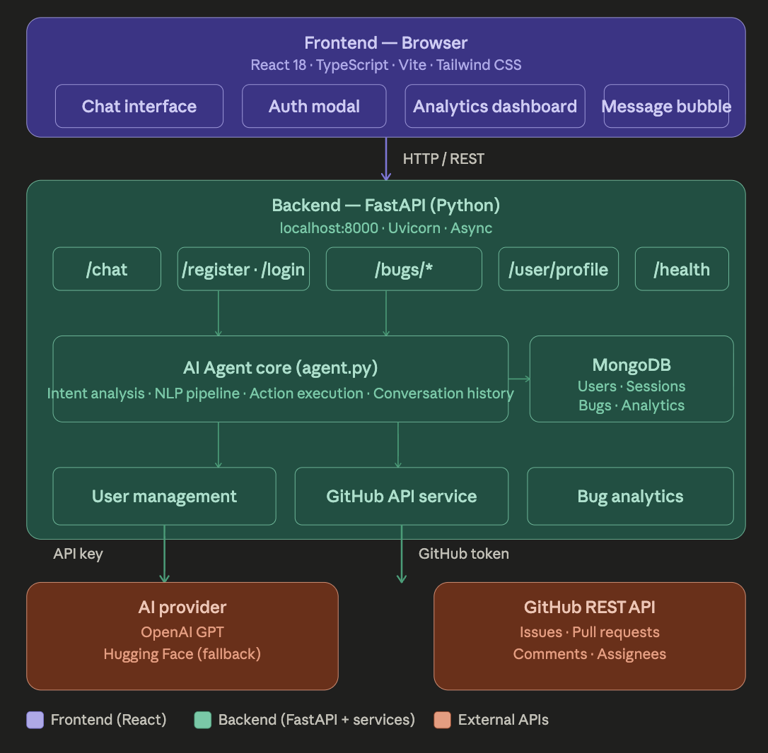
Project Design

Slide 14
Project Design (cont…)
Architecture Layer: Frontend Layer
React + TypeScript + Tailwind UI
Chat interface for natural language commands
Authentication & analytics dashboard
Displays AI responses interactively
Backend Layer (FastAPI)
Handles API requests and routing
Endpoints: /chat, /login, /bugs
Connects frontend with AI & GitHub APIs
Manages authentication and services
AI Agent Core
Intent detection & NLP processing
Extracts parameters from user queries
Converts natural language into GitHub actions
Maintains conversation context

Slide 15
Project Design (cont…)
MongoDB Layer
Stores users and chat sessions
Maintains repository-related data
AI Provider Layer
OpenAI GPT / Hugging Face integration
Generates summaries and intelligent responses
GitHub REST API Layer
Executes GitHub operations
Creates issues & manages pull requests
Fetches commits, comments, and analytics
Flow Example
User sends a GitHub command in chat
Frontend forwards request to FastAPI backend
AI Agent detects intent and extracts parameters
Backend calls GitHub REST API
MongoDB stores logs and conversation history
Response returned to user in chat interface

Slide 16
Tools, Technologies and Languages
Programming Languages
Python 3.12 – Backend development, API handling, and AI/LLM processing
TypeScript – Used in frontend development for building a scalable and type-safe application
JavaScript (React.js) – Used for developing interactive user interfaces
AI / Machine Learning Frameworks
OpenAI LLM API – Natural language understanding, intent extraction, and response generation
Hugging Face Transformers – NLP processing and text analysis
Scikit-learn – Machine learning models for classification and predictive analysis
Backend Framework
FastAPI – High-performance backend framework for building REST APIs

Slide 17
Tools, Technologies and Languages (cont…)
APIs & Workflow Integration
GitHub REST API – Managing repository data, issues, and pull requests
GitHub GraphQL API – Efficient querying of repository information
Database & Storage
MongoDB – Stores logs, message history, and metadata
Local JSON Datasets – Stores commit and pull request metadata
Development & Deployment Tools
Docker – Containerization and deployment of the AI Agent
Visual Studio Code (VS Code) – Main development environment
Postman – API testing and debugging
Git & GitHub – Version control and project collaboration

Slide 18
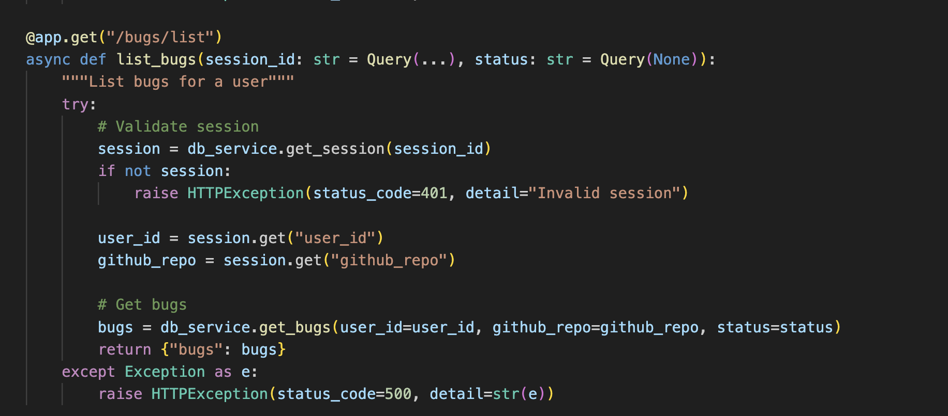
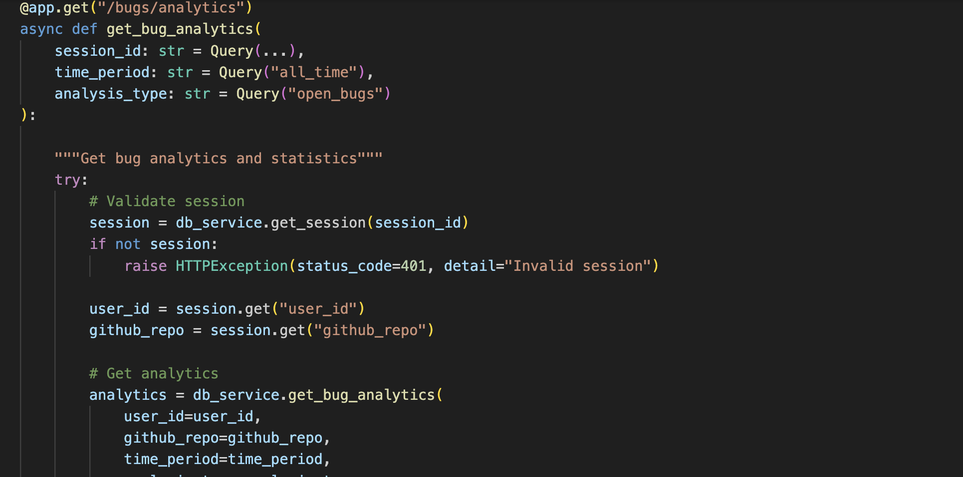
Implementation

Slide 19
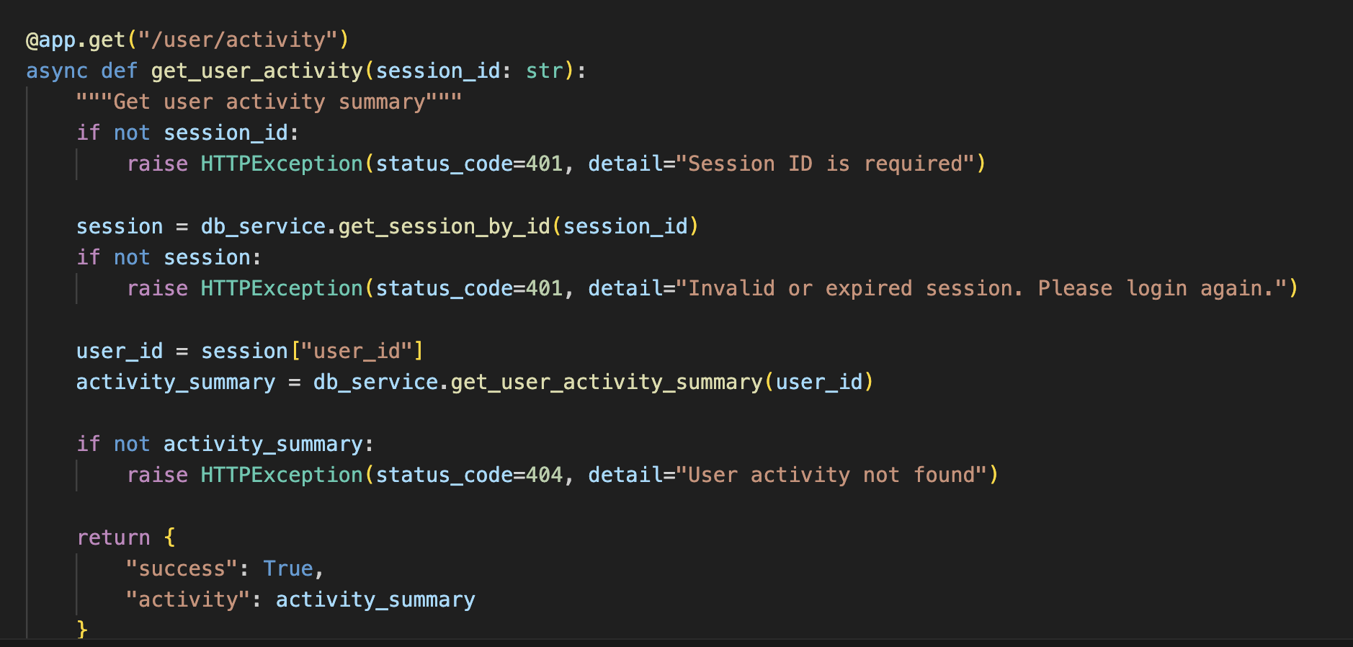
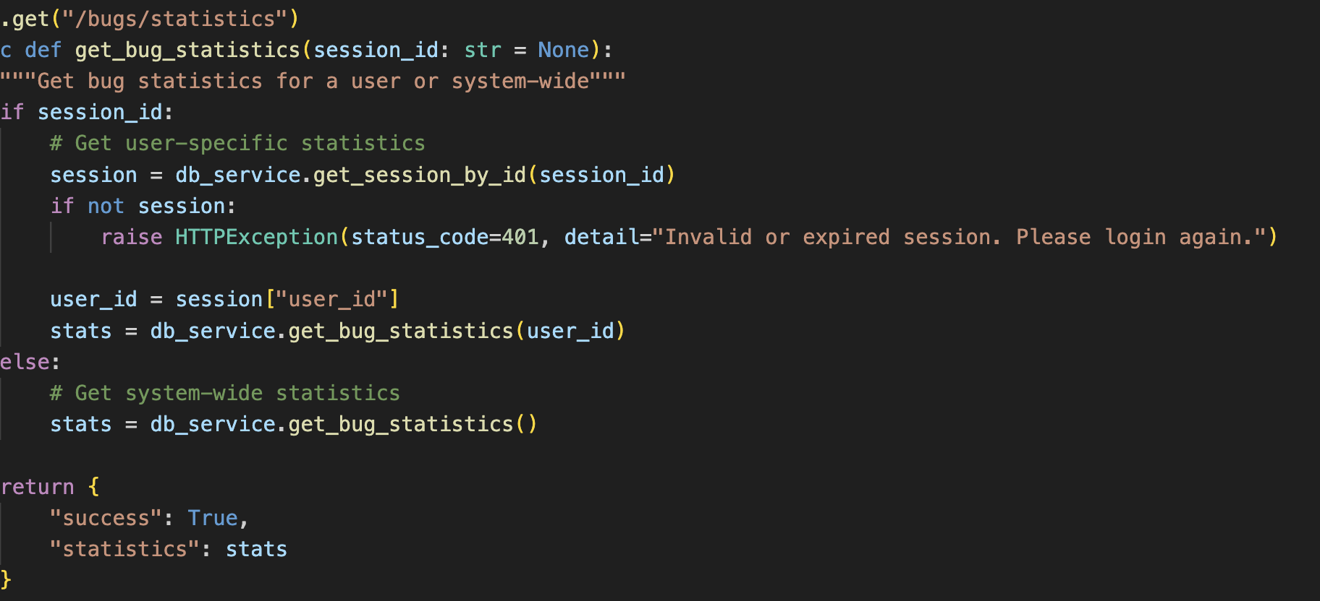
Implementation

Slide 20
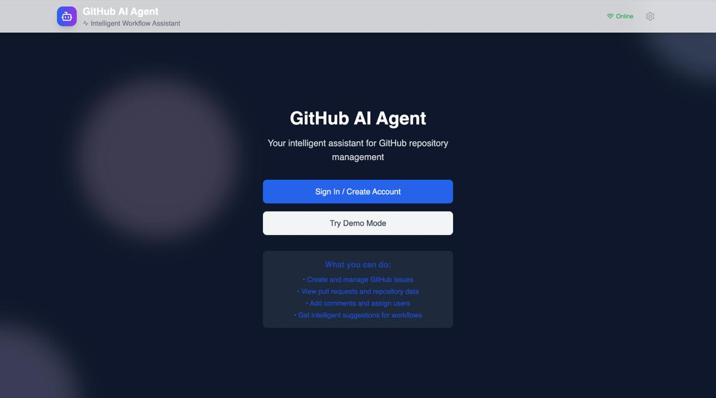

Slide 21
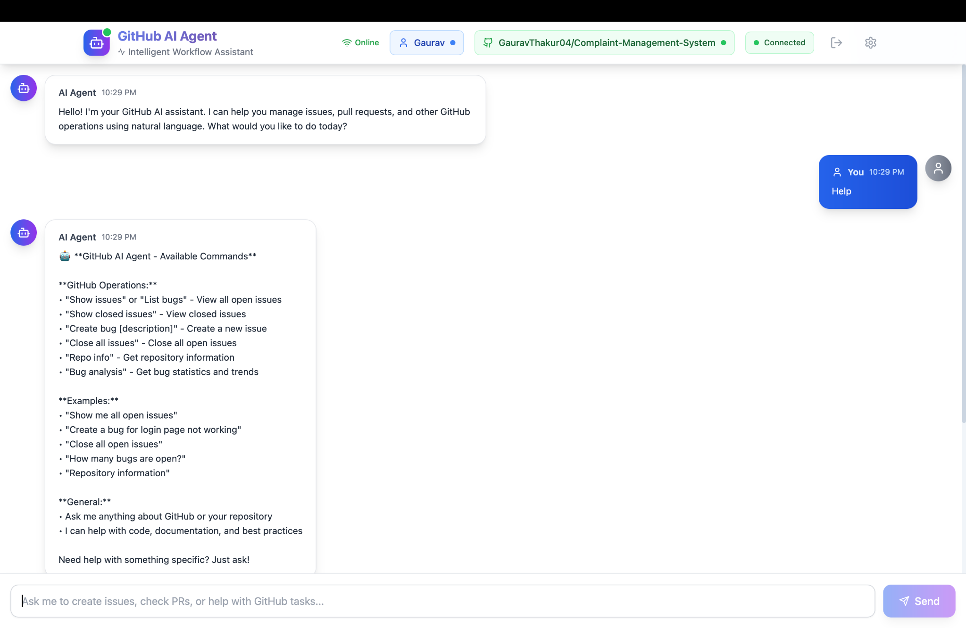
Implementation

Slide 22
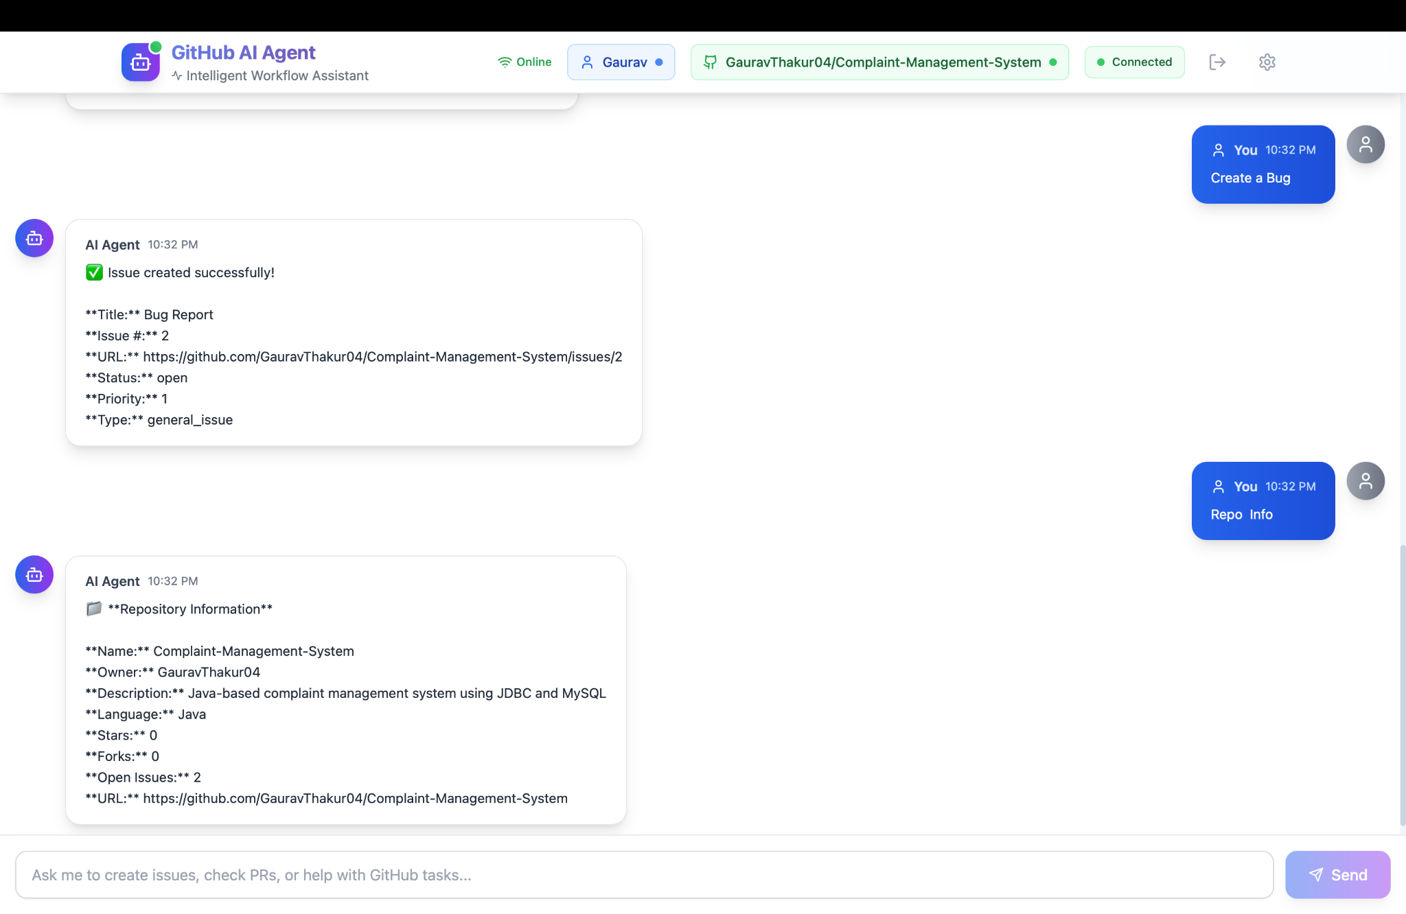
Implementation (cont…)

Slide 23
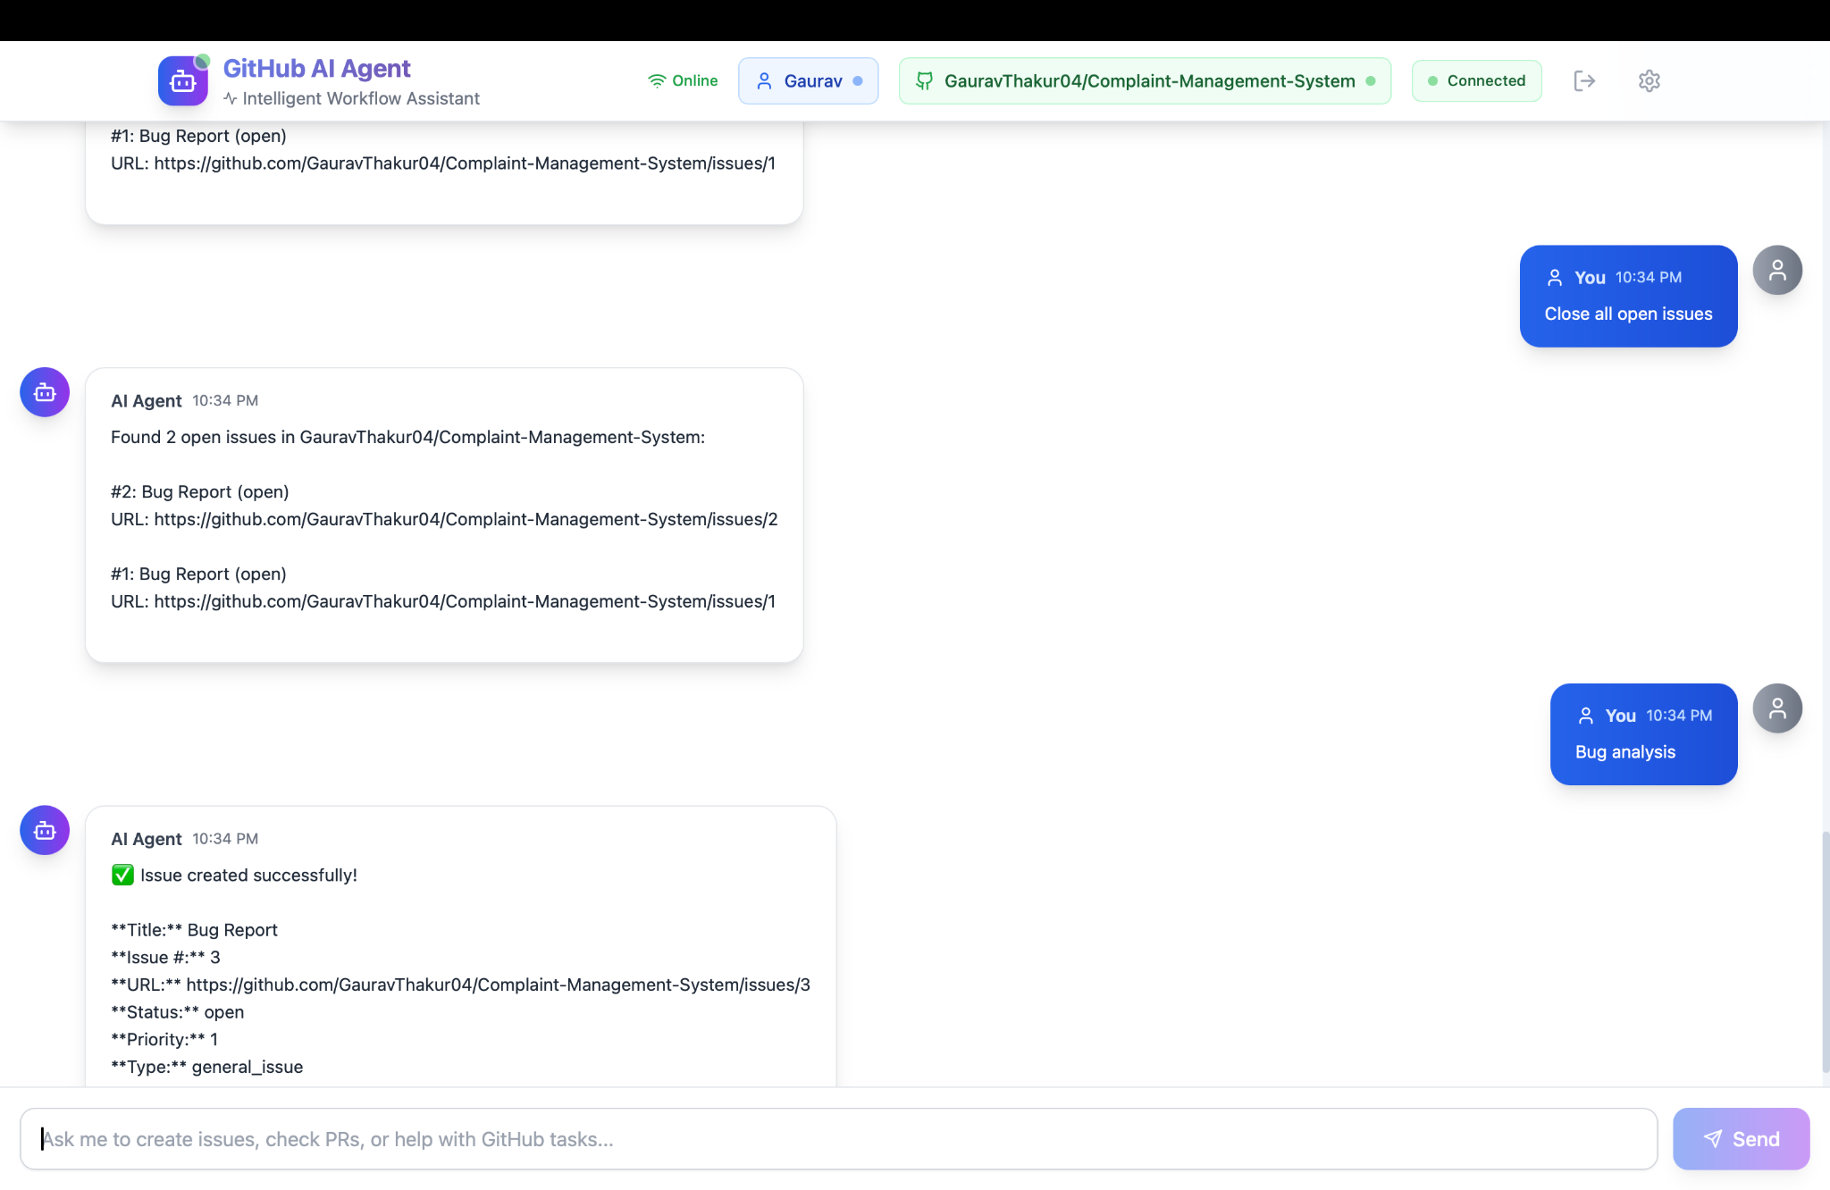
Implementation (cont…)

Slide 24
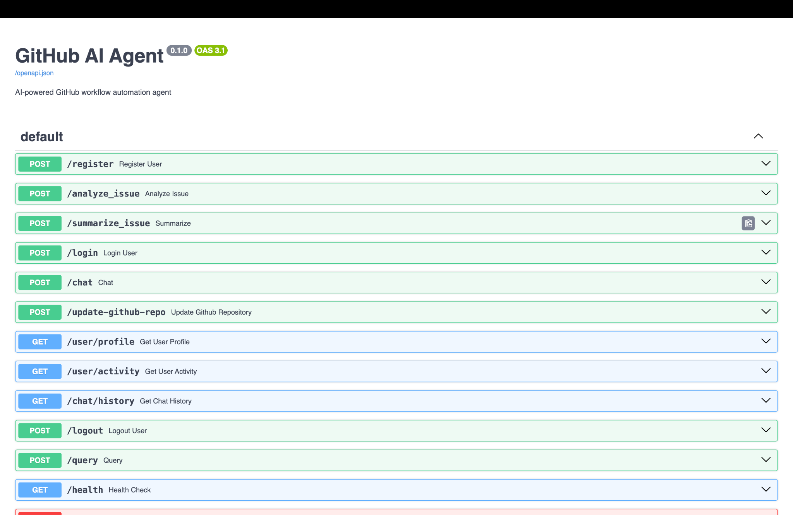
Implementation (cont…)

Slide 25
Experimental Results and Evaluation
Result Observed:
The AI agent successfully interpreted natural language queries and converted them into valid GitHub API actions.
Repository operations such as issue creation, issue updates, pull request tracking, and commit retrieval were executed successfully in real time.
The system demonstrated reliable performance with fast response times and efficient API communication.
Error handling and fallback mechanisms successfully managed invalid inputs, ambiguous queries, and API rate limits.
The conversational interface simplified GitHub workflow management for non-technical users.
Integration between FastAPI backend, MongoDB, AI services, and GitHub APIs worked efficiently during testing and evaluation

Slide 26
Experimental Results and Evaluation (cont…)
Experimental Results (Command Testing)
Command | Expected Output | Result
Show issues | Found open issues | Successfully retrieved issue list/ Found 3 open issues
Show closed issues | Display closed issues | No closed issues found
Create bug [description] | Create a GitHub issue | Issue created successfully
Close all issues | Close open issues | Issues closed via GitHub API
Repo info | Show repository details | Repository metadata displayed
Bug analysis | Show bug statistics | Correct issue statistics generated

Slide 27
Experimental Results and Evaluation (cont…)
Performance Insights
Most commands executed within 1–2 seconds.
The system handled multiple sequential queries efficiently.
GitHub API integration ensured real-time repository updates
The AI Agent correctly mapped natural language commands to GitHub API operations.
Commands were executed successfully with real-time repository data retrieval.
Evaluation-Comparison with Traditional GitHub Usage
Feature | Traditional GitHub | AI Agent
Issue Management | Manual navigation | Command-based
Bug Creation | Multiple Steps | Single Commands
Repository Insight | Seperate Page | Instant Command
User Interaction | GUI Based | Natural Language

Slide 28
Publications
Status: Under review

Slide 29
Future Work
Advanced NLP & Transformer Models for better intent detection, contextual understanding, and handling of complex conversational queries.
Voice-Based GitHub Assistant with speech-to-text and voice response capabilities for hands-free interaction.
Multi-Platform Integration with platforms like GitLab, Bitbucket, Jira, and CI/CD tools for unified workflow automation.
Real-Time Notifications & Collaboration through smart alerts for pull requests, issue updates, workflow failures, and team activities.
AI-Based Predictive Analytics to predict workflow failures, identify bottlenecks, estimate project risks, and recommend optimizations.
Enhanced Security & Authentication using OAuth-based authentication, role-based access control, and encrypted token management.
Self-Learning AI Agent that improves response accuracy over time using user interaction feedback mechanisms.

Slide 30
Project Plan
Activity | Year 2025 |  |  |  |  |  |  |  |  |  | Year 2026
 | Aug. |  | Sept. |  | Oct. |  | Nov. |  | Dec. |  | Jan. |  | Feb. |  | Mar. |  | Apr. |  | May
Literature Review
Analysis and Requirements
Project Design and Architecture
Implementation
Testing and Validation
Documentation and Write-up

Slide 31
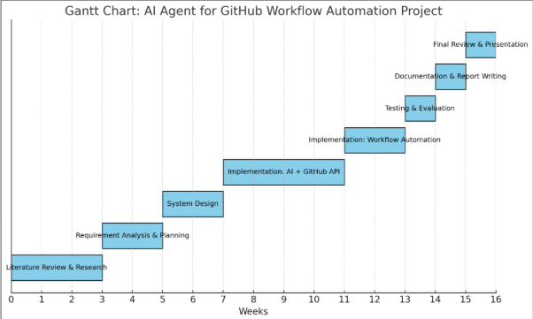
Project Plan

Slide 32
Key Learnings
Gained practical experience in integrating GitHub REST and GraphQL APIs for repository automation.
Learned to design and develop a full-stack AI-powered application using React, TypeScript, FastAPI, and MongoDB.
Developed understanding of hybrid NLP architecture combining rule-based processing with LLM-based intent detection.
Improved skills in natural language query processing, parameter extraction, and conversational AI workflows.
Learned API testing, validation, and debugging using Postman and FastAPI testing tools.
Gained experience in repository analytics, summarization, and GitHub workflow automation.
Enhanced knowledge of error handling, caching mechanisms, and scalable modular backend architecture.
Learned secure authentication and token-based GitHub API integration for real-time operations.

Slide 33
Work Contribution and Attendance
GitHub Repository URL:
Team Member | Roll No. | Work Done (provide complete details) | Work Contribution (%) | Lines of Code (if any) | Lab Attendance (%)
1. | 221030056 | Implemented API endpoints for interacting with the AI agent. Configured the Hugging Face transformer model for automated workflow analysis. Connected backend APIs with the frontend interface. | 33
2. | 2210300089 | Fixed missing modules and dependency issues. Documented project setup and execution steps. .Literature Review. | 33
3. | 2210303330 | Project architecture Design. Optimized project setup for smooth execution Assisted in Connected backend APIs with the frontend interface.. | 33

Slide 34
Supervisor Interactions (as mentioned in weekly log)
No. of Meetings with Supervisor:
Week No. | Duration | Remarks (as mentioned in the weekly log) | Incorporated (Yes/No)
1. | 02/012026 to 07/01/2026 | Member 1: Conducted literature survey and researched GitHub workflow automation. Member 2: Studied GitHub REST API documentation and authentication methods. Member 3: Prepared project requirements, objectives, and problem statement. | Yes
2. | 9/mm/2026 to 14/mm/2026 | Member 1: Designed UI wireframes and frontend structure. Member 2: Set up FastAPI backend and initial endpoints. Member 3: Configured MongoDB database and schema planning. | Yes
3. | 16/01/2026 to 21/01/2026 | Member 1: Developed React frontend components and routing. Member 2: Implemented GitHub API integration for repository operations. Member 3: Worked on backend-database connectivity. | Yes
4. | 23/01/2026 to 28/01/2026 | Member 1: Developed chat interface and dashboard layout. Member 2: Implemented NLP intent detection and regex matching. Member 3: Added authentication and API validation testing. | Yes
5. | 30/01/2026 to 04/02//2026 | Member 1: Integrated frontend with backend APIs. Member 2: Developed hybrid NLP architecture with LLM fallback. Member 3: Performed debugging and MongoDB optimization. | Yes

Slide 35
Supervisor Interactions (cont…)
Week No. | Duration | Remarks (as mentioned in the weekly log) | Incorporated (Yes/No)
6. | 06/02/2026 to 11/02/2026 |  | Yes
7. | 13/02/2026 to 18/02/2026 | Member 1: Developed analytics dashboard components. Member 2: Added repository summarization and reporting modules. Member 3: Conducted backend integration testing. | Yes
8. | 20/02/2026 to 25/02/2026 | Member 1: Enhanced user interaction and frontend navigation. Member 2: Improved API response generation and workflow execution. Member 3: Tested GitHub API operations and fixed bugs. | Yes
9. | 05/03/2026 to 10/03/2026 | Member 1: Finalized dashboard and activity visualization. Member 2: Optimized backend logic and NLP processing. Member 3: Prepared testing datasets and validation reports | Yes
10. | 12/03/2026 to 17/03/2026 | Member 1: Worked on frontend performance improvements. Member 2: Enhanced summarization and analytics features. Member 3: Performed API stress testing and debugging. | Yes
Member 1: Improved frontend responsiveness and UI styling. Member 2: Added issue creation and PR management features. Member 3: Implemented caching and error handling mechanisms.
Github Link: https://github.com/GauravThakur04/AI-Agent-for-Github-Workflow-Automation

Slide 36
References
[1] A. Pindoriya and J. Velani, "Advancements in GitHub Automation and Workflow: A Comprehensive Exploration," 2025.
[2] X. Zhang, S. Muralee, S. Cherupattamooleyl, and A. Machiry, "On the Effectiveness of Large Language Models for GitHub Workflows," Purdue University, Preprint, 2025.
[3] M. F. Wong, S. Guo, C. N. Ham, S. W. Ho, and C. W. Tan, "Natural Language Generation and Understanding of Big Code for AI-Assisted Programming: A Review," Technical Report, 2025.
[4] T. Kinsman, M. Wessel, M. A. Gerosa, and C. Treude, "How Do Software Developers Use GitHub Actions to Automate Their Workflows?," in Proc. Mining Software Repositories (MSR), 2021.
[5] L. Zheng, S. Li, X. Huang, and J. Huang, "Why Do GitHub Actions Workflows Fail? An Empirical Study," ACM, 2024.
[6] P. Rostami Mazrae, A. Decan, T. Mens, and M. Wessel, "An Empirical Study of the Evolution of GitHub Actions Workflows," SSRN preprint, 2025.
[7] A. Decan, T. Mens, and H. Onsori Delicheh, "On the Outdatedness of Workflows in the GitHub Actions Ecosystem," Journal of Systems and Software, 2023.
[8] I. Ceka et al., "How Does LLM Reasoning Work for Code? A Survey and a Call to Action," arXiv preprint, 2025.
[9] H. Jin et al., "Towards Advancing Code Generation with Large Language Models: A Research Roadmap," arXiv preprint, 2025.
[10] J. Wang et al., "Enhancing Code LLMs with Reinforcement Learning in Code Generation: A Survey," arXiv preprint, 2024.
[11] J. Jiang et al., "A Survey on Large Language Models for Code Generation," arXiv preprint, 2024.
[12] X. Zhou et al., "An LLM-as-Judge Metric for Bridging the Gap with Human Evaluation in SE Tasks," arXiv preprint, 2025.
[13] "AI2Agent: An End-to-End Framework for Deploying AI Projects as Autonomous Agents," arXiv preprint, 2025.
[14] T. Masterman, S. Besen, M. Sawtell, and A. Chao, "The Landscape of Emerging AI Agent Architectures for Reasoning, Planning, and Tool Calling: A Survey," arXiv preprint, 2024.

Slide 37
References (cont…)
[15] S. Joshi, "A Review of Generative AI and DevOps Pipelines: CI/CD, Agentic Automation, MLOps Integration, and Large Language Models," Preprints, 2025.
[16] P. Valenzuela-Toledo, A. Bergel, T. Kehrer, and O. Nierstrasz, "The Hidden Costs of Automation: An Empirical Study on GitHub Actions Workflow Maintenance," in Proc. 20th IEEE/ACM Int. Conf. on Mining Software Repositories (MSR), 2023.
[17] K. Liu et al., "ProjectEval: A Benchmark for Programming Agents Automated Evaluation on Project-Level Code Generation," arXiv preprint, 2025.
[18] D. G. Paul, H. Zhu, and I. Bayley, "Benchmarks and Metrics for Evaluations of Code Generation: A Critical Review," arXiv preprint, 2024.
[19] M. Baqar, S. Naqvi, and R. Khanda, "AI-Augmented CI/CD Pipelines: From Code Commit to Production with Autonomous Decisions," arXiv preprint, 2024.
[20] A. Yehudai et al., "Survey on Evaluation of LLM-based Agents," arXiv preprint, 2025.
[21] GitHub REST API Documentation. Available: https://docs.github.com/en/rest
[22] GitHub Archive Dataset (GH Archive). Available: https://www.gharchive.org
[23] Kalliamvakou, E., et al. (2016). An In-depth Study of the Promises and Perils of Mining GitHub

Slide 38

Thanks.

