Slide 1
Kerela Relief
There is no country on earth that can touch us in charitable efforts, in disaster relief efforts, in doing everything to help. We do not live under a suicide pact in the name of compassion; because you see what's incorporated in all this is that we're guilty of something. And we're not. We lead the world in goodness. So let’s prove it yet again by helping the victims of Kerala floods in one way or another.

Slide 2
OUR SOLUTIONS
BLOCKCHAIN FOR TRANSACTIONS
GOOGLE ASSISTANT APP USING ACTIONS ON GOOGLE

Slide 3
BLOCKCHAIN FOR TRANSACTIONS
Basically Blockchain is a Decentralised application for doing and receving transactions anonymously.
Sender and recipient don’t know about each other in this network.
Nobody can change any block of this blockchain because of it CONSENSUS ALGORITHM that synchronize all nodes.

Slide 4
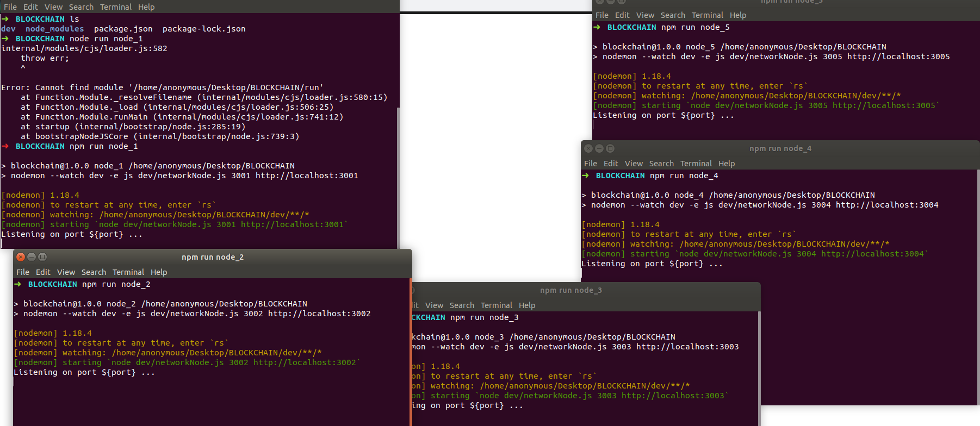
DECENTRALISATION
For decentralisation all the 5 nodes and run separately as shown

Slide 5
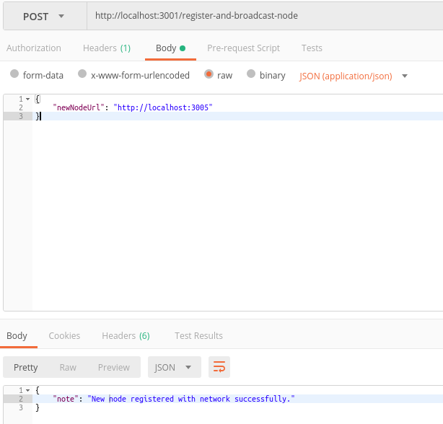
POSTMAN FOR SENDING POST REQUESTS TO EACH NODE

Slide 6
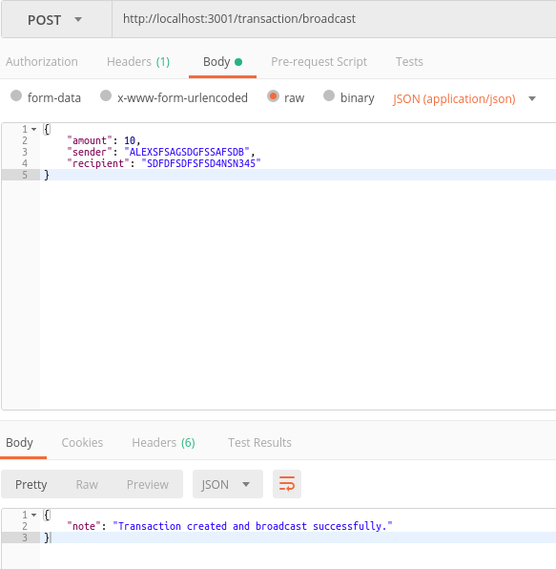
TRANSACTION IN BLOCKCHAIN

Slide 7
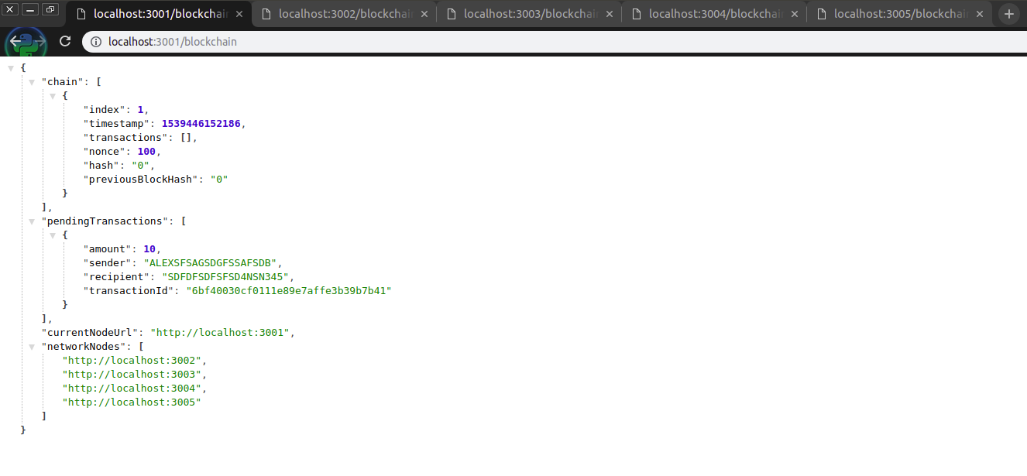
BLOCKCHAIN WITH PENDING TRANSACTION

Slide 8
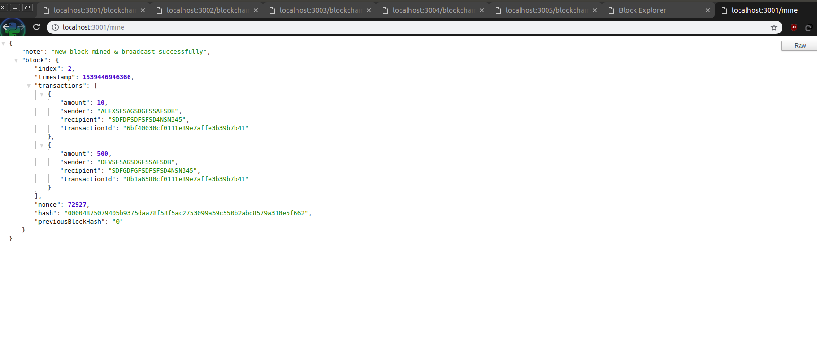
MINING IN BLOCKCHAIN

Slide 9
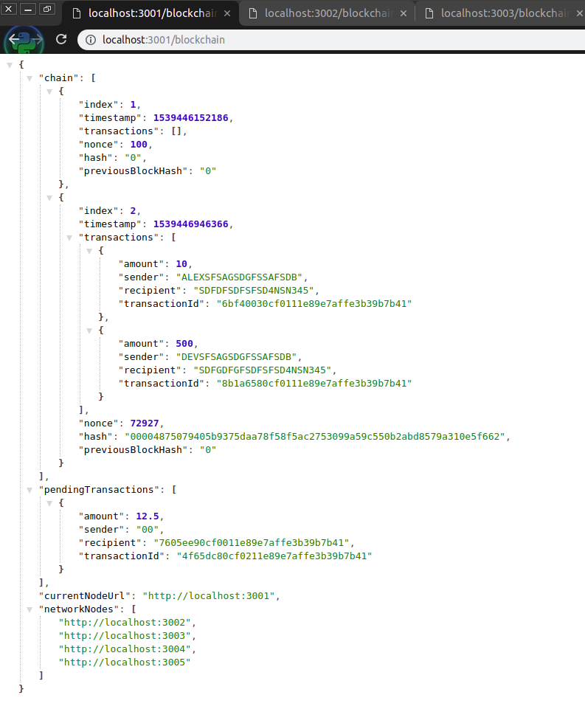
NEW BLOCKCHAIN WITH MINING REWARD

Slide 10
BLOCK EXPLORER TO CHECK BLOCKCHAIN
BLOCK HASH
TRANSACTION ID
ADDRESS

Slide 11
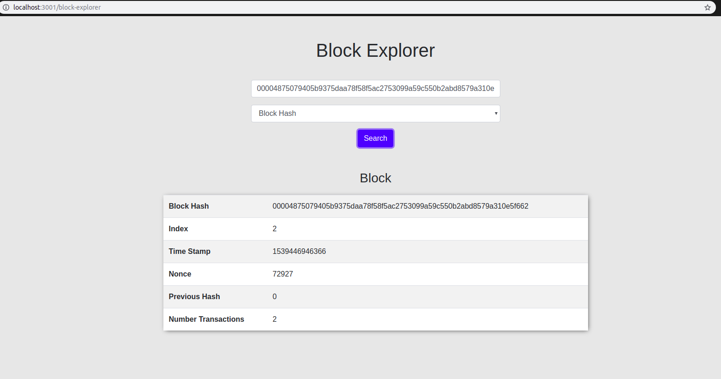
BLOCKHASH

Slide 12
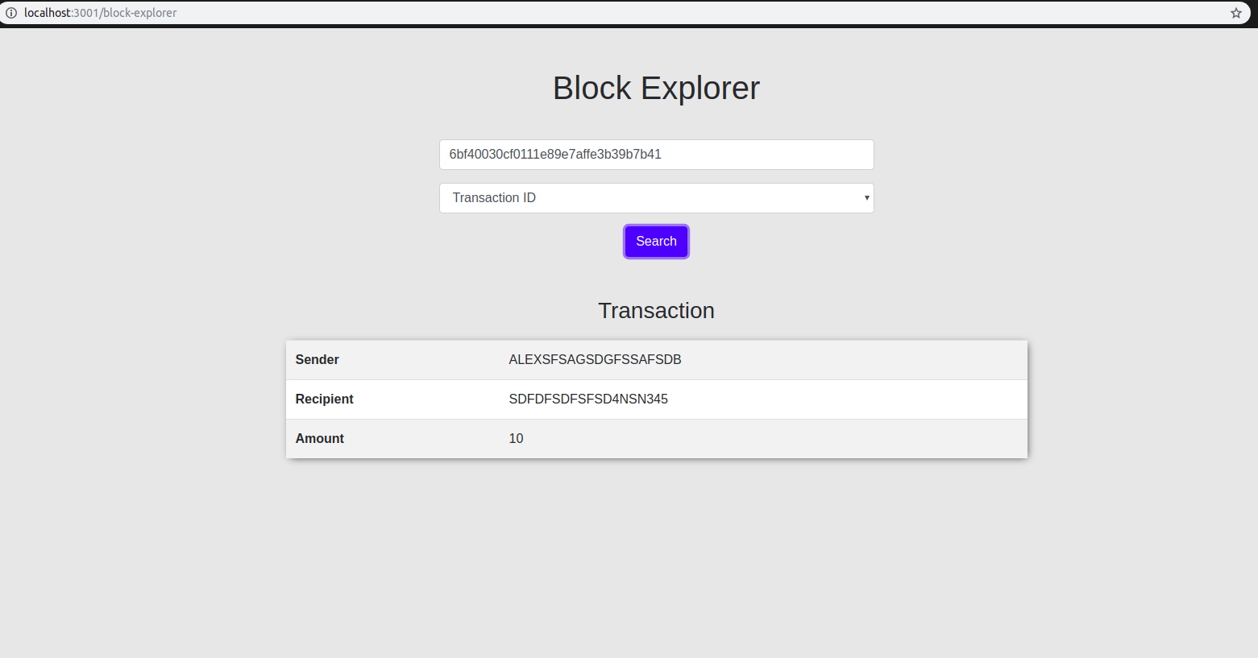
TRANSACTION ID

Slide 13
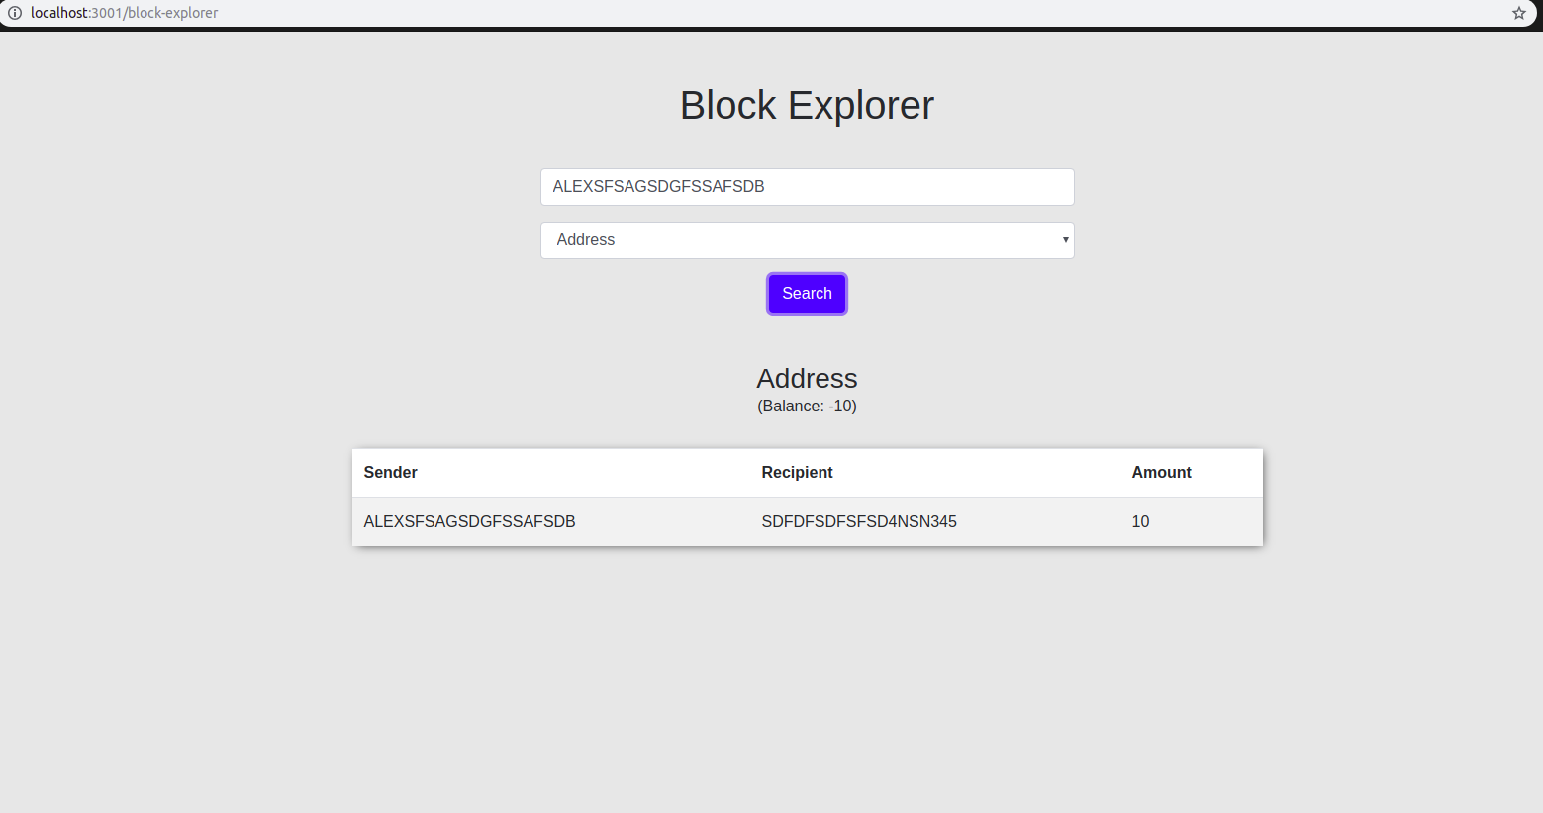
ADDRESS

Slide 14
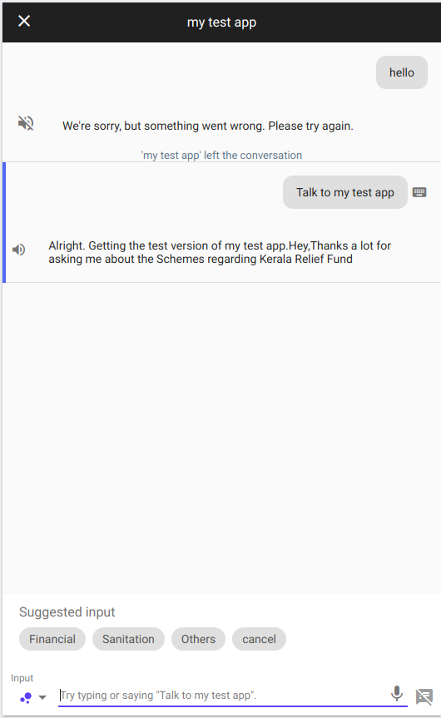
GOOGLE ASSISTANT APP
There are three types of schemes options are added which will tell you about the schemes organised by the govt.
FINANCIAL
SANITATION
OTHERS

Slide 15
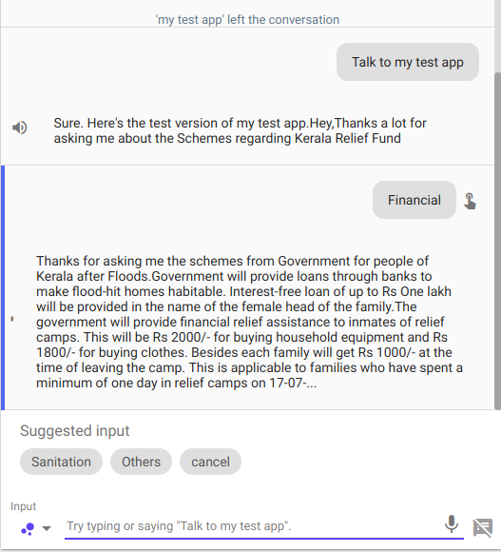
FINANCIAL

Slide 16
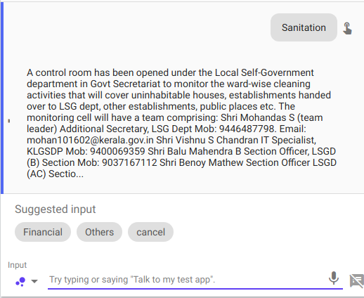
SANITATION

Slide 17
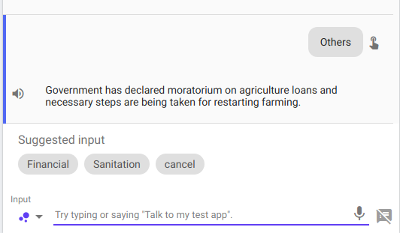
OTHERS

Slide 18
TECHNOLOGY USED
BLOCKCHAIN
JAVASCIPT
DIALOGUEFLOW

Slide 19
THANK YOU

