Slide 1
Setfit for text classification

Slide 2
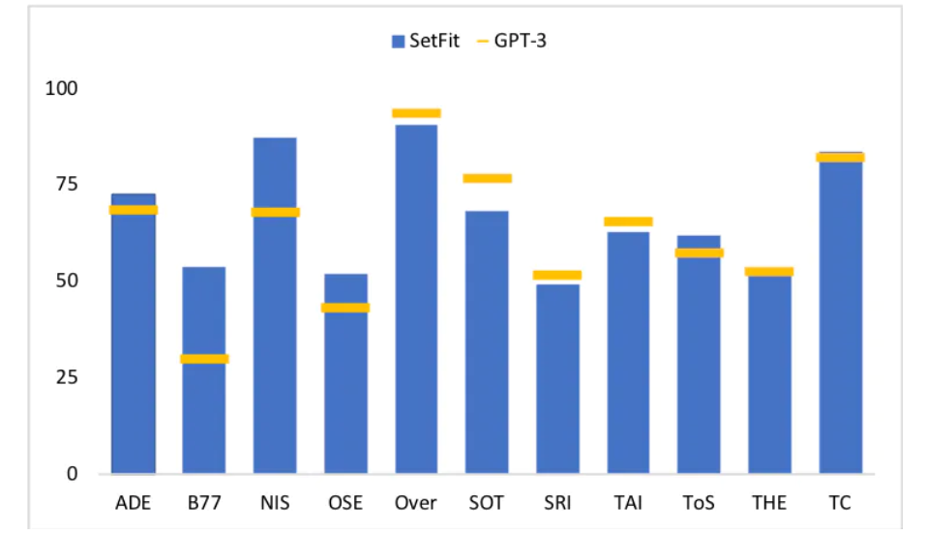
INTRODUCTION
SetFit stands for Sentence Transformer Fine Tuning.
A group of research led by Intel Labs and the , UKP Lab , Hugging Face released a new approach called setfit that can be used to create high accurate text classification models with limited labelled data .
SetFit is outperforming GPT-3 in 7 out of 11 tasks , while being 1600x smaller.

Slide 3
WHY SETFIT IS BETTER ?
No prompts or verbalisers : Current techniques for few-shot fine-tuning require handcrafted prompts. SetFit dispenses with prompts altogether by generating rich embeddings directly from text examples.
Fast to train : SetFit doesn't require large-scale models like GPT-3 to achieve high accuracy.
Multilingual Support : SetFit can be used with any Sentence Transformer on the Hub.

Slide 4
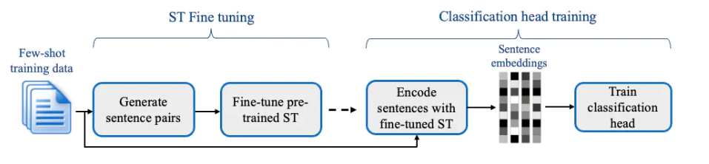
FINE-TUNE CLASSIFIER WITH SETFIT
When using SetFit we first fine-tune a Sentence Transformer model using our labeled data and contrastive training, where positive and negative pairs are created by in-class and out-class selection.
The second step a classification head is trained on the encoded embeddings with their respective class labels.

Slide 5
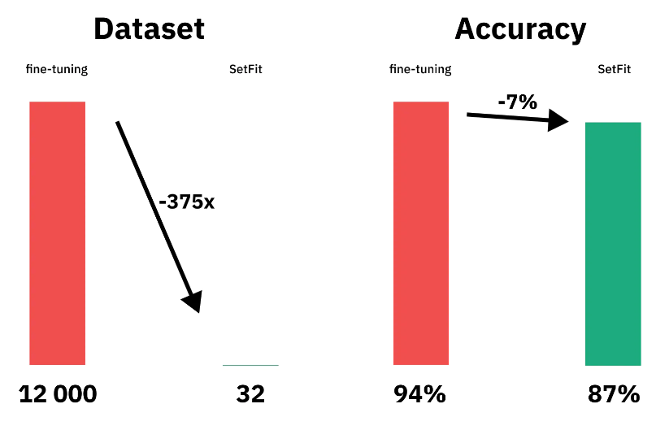
Conclusion
This is huge! SetFit will help so many companies to get started with text-classification and transformers, without the need to label a lot of data and compute power.
Compared to LLM training s SetFit classifier takes less than 1 hour on a small GPU to train or less than $1 so to speak.

