Slide 1


SMART INDIA HACKATHON 2025
TITLE PAGE
Problem Statement ID – SIH25094
Problem Statement Title- One-Stop
Personalized Career & Education Advisor
Theme- Smart Education
PS Category- Software
Team ID-
Team Name- SparkUP

Slide 2
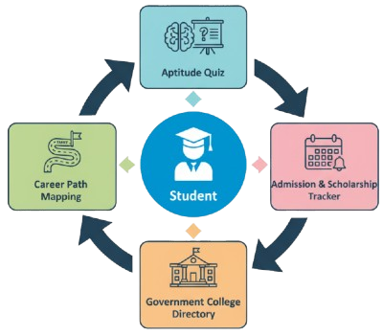
One-Stop Personalized Career & Education Advisor
SparkUP
Personalized web platform for career & education guidance.
Key Features
Career Path Mapping → stream → degree → exams.
Govt. College Directory → verified info on nearby colleges.
Admission & Scholarship Tracker → reminders for deadlines.
AI-driven personalized recommendations.

Slide 3
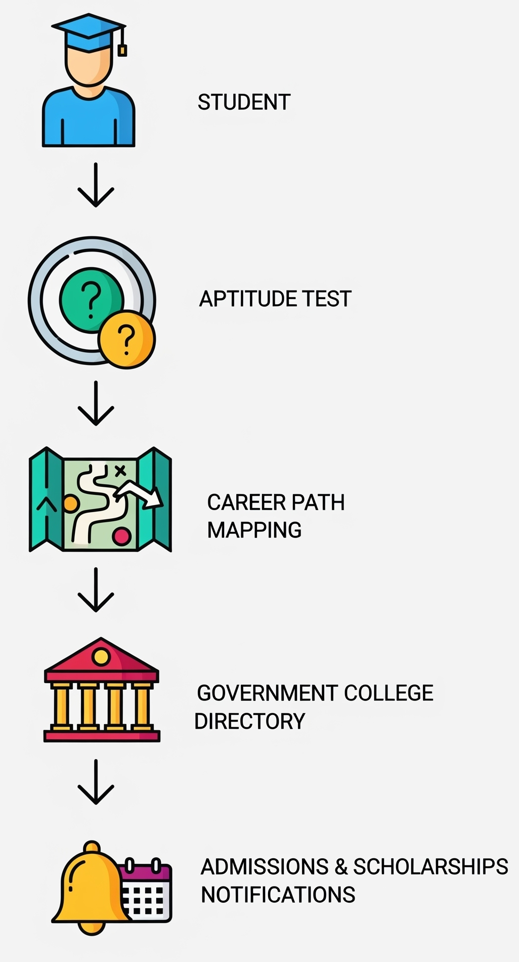
TECHNICAL APPROACH
SparkUP
Technologies to be Used
Frontend: React.js (responsive web design)
Backend: Node.js (Express) / Fast API (Python)
Database: Firebase (for MVP) → PostgreSQL/MySQL (for scalability)
AI/ML: Rule-based recommendation engine → scalable to ML (Scikit-learn/TensorFlow)
APIs & Tools: Google Maps API (college locator), Govt. Higher Education datasets, Cloud Hosting (AWS/Heroku), Docker (deployment)
Methodology & Process
Student Login & Profile Creation (via website)
Aptitude & Interest Quiz (web-based quiz module)
Recommendation Engine → suggests streams, courses, and careers(Scikit-learn/TensorFlow)
Career Path Visualization (roadmaps shown on dashboard)
Govt. College Directory (searchable list/map view)
Notifications Dashboard for Admissions & Scholarships

Slide 4
FEASIBILITY AND VIABILITY
SparkUP
Analysis of Feasibility
A functional web-based MVP (quiz, recommendations, college directory, basic notifications) can be built within the hackathon timeline.
Scalable from district-level pilot → state-wide rollout → national-level platform.
Uses widely available web technologies (React, Node.js, Firebase/PostgreSQL).
Technical Infrastructure.
Language and Cultural Barriers
Sunstainability & Maintenance
Use lightweight website first.
Instead of heavy multilingual, start with simple Hindi +English.
build on open source, community model or engage college student for ongoing support
Are
there any
challenges
?
Yes
Solutions

Slide 5
IMPACT AND BENEFITS
SparkUP
Access to career guidance for rural and low-income
students.
Reduces post-10th and 12th dropout rates.
IMPACT AND BENEFITS
Boosts Enrollment in government degree colleges.
Potential impact on the target audience
Economic: Creates an affordable and clear pathway to a stronger, more informed workforce.
Builds greater trust
in educational and career guidance among parents and students.

Slide 6
RESEARCH AND REFERENCES
SparkUP
Feature | One-Stop Advisor | Other Apps
Centralized Career + Education Guidance | Yes | Few other app have
Mentorship + Alumni Networking | Yes | Basic apps have
Gamification & Motivation Engine | Yes | None have
Scholarship & Funding Discovery | Yes | None have
Collaborative Research & Project Hub | Yes | None have
One-Stop Career + Education Ecosystem | Yes | None have
Research
https://www.polygence.org/research-opportunities/research-opportunities-for-high-school-students-in-india
https://setmycareer.com/ (it is totally based on private sector)
https://claude.ai/public/artifacts/f7967eba-e5c1-4bb2-a4ef-f928af1baf64
Reference
Career Guide
Shiksha.com
Private focused platforms that lack government credibility.
MHRD Report 2022: A key finding of a 17% dropout rate after Class 10 highlights the problem statement.

