Slide 1
Intro to Data Structures
Content:-
Data Structure and its importance
Time Complexity
Arrays
Linked Lists
Stacks
Queues
Vectors
Recursion

Slide 2
Data Structure
Data Structure is a way of collecting and organising data in such a way that we can perform operations on these data in an effective way.
In simple language, Data Structures are structures programmed to store ordered data, so that various operations can be performed on it easily. It represents the knowledge of data to be organized in memory. It should be designed and implemented in such a way that it reduces the complexity and increases the efficiency.

Slide 3
Types of Data Structure (Data Types):-
Built-in Data Type
Derived Data Type
Built-in Data Type
Those data types for which a language has built-in support are known as Built-in Data types. For example, most of the languages provide the following built-in data types.
Integers
Boolean (true, false)
Floating (Decimal numbers)
Character and Strings
Derived Data Type
Those data types which are implementation independent as they can be implemented in one or the other way are known as derived data types. These data types are normally built by the combination of primary or built-in data types and associated operations on them. For example −
List
Array
Stack
Queue

Slide 4
Basic Operations on Data Structures :-
The data in the data structures are processed by certain operations. The particular data structure chosen largely depends on the frequency of the operation that needs to be performed on the data structure.
Traversing
Searching
Insertion
Deletion
Sorting
Merging

Slide 5
An algorithm is said to be efficient and fast, if it takes less time to execute and consumes less memory space. The performance of an algorithm is measured on the basis of following properties :
Time Complexity
Space Complexity

Slide 6
Space Complexity
Its the amount of memory space required by the algorithm, during the course of its execution. Space complexity must be taken seriously for multi-user systems and in situations where limited memory is available

Slide 7
Time Complexity
Time complexity of an algorithm signifies the total time required by the program to run till its completion. The time complexity of algorithms is most commonly expressed using the big O notation.
Time Complexity is most commonly estimated by counting the number of elementary functions performed by the algorithm. And since the algorithm's performance may vary with different types of input data, hence for an algorithm we usually use the worst-case Time complexity of an algorithm because that is the maximum time taken for any input size.

Slide 8
Basic Problems on Time Complexity:-
for (int i=0 ; i < N ; i++){
constant number of operations
}
for (int i=0; i < N; i++){
for(int j=0 ; j < N ; j++){
constant number of operations
}
}

Slide 9
while(low <= high) {
mid = (low + high) / 2;
if (target < list[mid])
high = mid - 1;
else if (target > list[mid])
low = mid + 1;
else
break;
}

Slide 10
ARRAYS
Instead of declaring individual variables, such as number0, number1, ..., and number99, you declare one array variable such as numbers and use numbers[0], numbers[1], and ..., numbers[99] to represent individual variables. A specific element in an array is accessed by an index.
All arrays consist of contiguous memory locations. The lowest address corresponds to the first element and the highest address to the last element.

Slide 11
Problems in Arrays
Sort 0 1
You are given an Integer array A that contains only 0 and 1. Write a function to sort this array and you can scan the whole array once only (Extra array can’t be used)
Push Zeroes At End

Slide 12
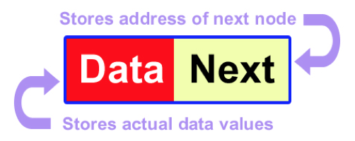
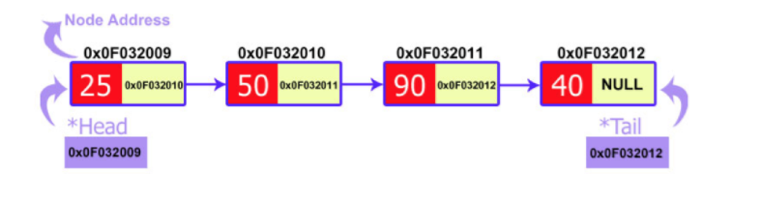
Linked List using Pointers
A linked list is a data structure that can store an indefinite amount of items. These items are connected using pointers in a sequential manner.

Slide 13
Questions on Linked List
Mid point of Linked List(Single Traversal preferred)
Palindrome LL
Reversal of LL

Slide 14
Stack
Stack is a data structure designed to operate in LIFO (Last in First out) context. In stack elements are inserted as well as get removed from only one end.
Reverse Stack using

Slide 15
Queue
Queue is a data structure designed to operate in FIFO (First in First out) context. In queue elements are inserted from rear end and get removed from front end.
Reverse Queue using Recursion

