Slide 1
ClaimGuard
Insurance Fraud Detection Under Delayed Feedback
Real-Time XGBoost Scoring, Delayed-Label Simulation & Promotion Guardrails
Team ClaimGuard: Gauravi, Rashi, Om • Production MLOps Capstone

Slide 2
CLAIMGUARD • MLOPS PLATFORM
The Real-World Problem: Delayed Ground Truth
1. Investigation Latency (10–30 Days)
Fraud is never known at submission. Adjusters, police reports, and legal inquiries take 10 to 30+ days to verify ground truth.
2. Catastrophic Naive Retraining (0.0000 Recall)
Assuming unobserved pending claims are legitimate causes 0.0000 recall across early cycles, missing 100% of positive fraud.
3. Model Staleness & Drift Vulnerability
Waiting months for complete settlement leaves models undefended against fast-drifting organized fraud syndicates.

Slide 3
CLAIMGUARD • MLOPS PLATFORM
The Approach: Decoupled Scoring & Chronological Replay
Subsystem A: Production Scoring
• Real-Time Inference: <10ms scoring via pre-trained XGBoost champion.
• Local Attribution: Tree SHAP explains exact risk drivers per claim.
• Audit Log: Immutable scores and frozen initial predictions stored in DB.
Subsystem B: Simulation Pipeline
• Discrete Time Engine: Simulated clock advances 7 days per step.
• Zero Target Leakage: Pending claims strictly hide true fraud labels.
• Settlement-Aware Retraining: Retrains on >=25 settled claims.
• Champion Promotion Gate: Deploys candidate only if holdout PR-AUC wins.

Slide 4
CLAIMGUARD • MLOPS PLATFORM
System Architecture: Production & MLOps Pipeline
React Frontend
(:3000 / :5173, SHAP Bars)
Clock & Queue Engine
(7-day steps, zero-leakage split)
Docker Compose & Monitoring
(Prometheus :9090, Grafana :3001)
XGBoost Champion + SHAP
(/api/claims, <10ms latency)
3-Candidate Retraining
(RF, LR, XGBoost every >=25 settled)
DVC Data Versioning
(.dvc, snapshot_settled.py)
Persistent Store
(PostgreSQL / SQLite claims DB)
Promotion Gate & MLflow
(Strict holdout PR-AUC comparison)
Airflow Retrain DAG
(dags/ — written, not run)
Solid blue border = Built & Live on main | Dashed red border = Designed only (written, not run in Airflow)

Slide 5
CLAIMGUARD • MLOPS PLATFORM
Dual Datasets: Real Ingestion & Synthetic Simulation
Real Automobile Dataset
• Source: data/processed/carclaims_processed.csv
• Records: 15,419 verified claims (14 features).
• Fraud Rate: 5.99% (923 positive fraud cases).
• Champion Model: XGBoost achieves 0.1872 PR-AUC (3.1x random) and 90.27% recall at threshold 0.40.
• Role: Immediate intake inference and SHAP local attribution (<10ms latency).
Delayed-Label Simulation
• Source: backend/data/claims_sim.csv
• Records: 1,000 synthetic claims (13 features).
• Fraud Rate: 24.7% (247 positive fraud cases).
• Delay: 10–30 days uniform window (mean 19.63 days, seed 42) per claim.
• Timeline: 2015-01-01 to 2015-03-01.
• Role: Temporal replay, backlog simulation, and retraining trigger evaluation.

Slide 6
CLAIMGUARD • MLOPS PLATFORM
Simulation Loop & Strict Zero-Leakage Contract
Simulated Clock Engine
Clock starts on 2015-01-01 and advances in 7-day increments (/api/sim/advance). Evaluates pending backlog vs settled cohorts dynamically at each step.
Strict Target Leakage Guard
Pending claims (/api/sim/pending) strictly hide is_fraud, investigation_days, and label_available_at. Zero target leakage guaranteed by contract.
Retrain Threshold (>= 25 Settled)
Retraining is locked until at least 25 claims settle. Prevents fitting degenerate estimators on unstable, single-class cohorts.

Slide 7
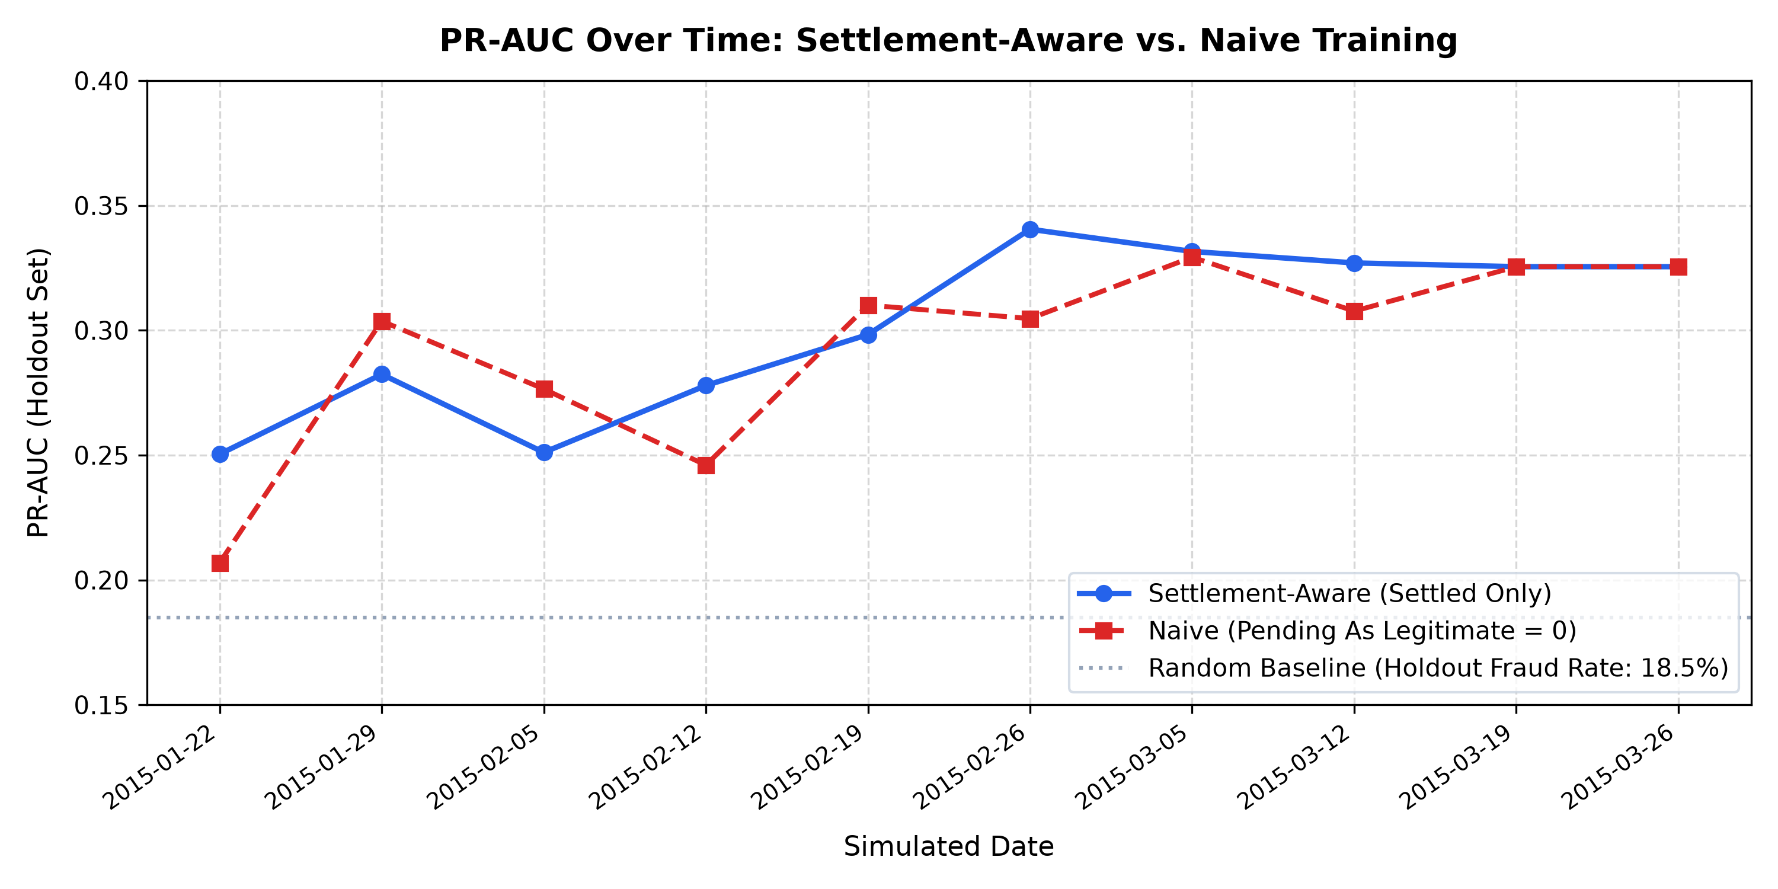
CLAIMGUARD • MLOPS PLATFORM
Model Comparison & Candidate Promotion Gate
Dry-Run Retraining & Promotion Sequence
• Jan 08 & 15: Settled < 25 -> No retrain (v0)
• Jan 22: 61 settled -> v1 promoted (PR-AUC 0.6325)
• Jan 29: 167 settled -> v2 promoted (0.6394 > 0.1910)
• Feb 05: 274 settled -> Rejected (0.5664 < 0.5971), stays v2
• Feb 12: 384 settled -> v3 promoted (0.5441 > 0.4394, RF)
• Feb 19 & 26: Candidates lose to champion -> Retain v3!
Rule: 6 retrains executed, exactly 3 promotions approved.

Slide 8
CLAIMGUARD • MLOPS PLATFORM
Observability: MLflow, Prometheus & Drift Monitor
MLflow Experiment Tracking (Port 5000)
Logs every retrain run: parameters (n_train, n_pending), candidate PR-AUC, champion PR-AUC, and binary promotion outcomes.
Prometheus Telemetry (/metrics) & Grafana (Port 3001)
Real-time gauges: claimguard_model_version, claimguard_settled_claims, claimguard_pending_backlog. Pre-provisioned Grafana dashboard on main.
Feature Drift (PSI) & DVC Versioning
PSI feature drift monitoring (status: ok | alert) and DVC cohort snapshotting (scripts/snapshot_settled.py) generating companion .dvc pointers.
Designed Only: Airflow Retraining DAG
Airflow DAG written and syntax-checked in dags/claimguard_retrain.py (DAG written and syntax-checked, not run in Airflow).

Slide 9
CLAIMGUARD • MLOPS PLATFORM
Live 5-Minute Demonstration Plan & Browser Flow
Tab 1: Simulation Dashboard (:3000 / :5173): Start at Day 0: 19 pending, 0 settled, model_version = 0 (no model yet).
Tab 2: Grafana Telemetry (:3001): Two signals side by side: holdout PR-AUC and pending backlog curves.
Tab 3: Prometheus Targets (:9090 / :8000): Scrape health verification at :9090/targets and raw /metrics exposition.
Tab 4: MLflow Tracking UI (:5000): Inspect retrain runs, holdout candidate comparisons, and promotion rejections.
Tab 5: Production Claims & SHAP (:3000 / :5173): Show intake adjudication and interactive Tree SHAP red/green contribution bars.
Tab 6: Interactive API Docs (:8000/docs): Inspect REST contract, /api/sim/drift status, and settlement endpoints.

Slide 10
CLAIMGUARD • MLOPS PLATFORM
Engineering Audit: Completed vs. Future Roadmap
Completed & Live on Main
✓ 14-feature real-data XGBoost scoring (<10ms).
✓ Tree SHAP local attribution & frontend UI bars.
✓ Delayed-label clock engine with zero leakage.
✓ 3-candidate retrain pipeline + promotion gate.
✓ Population Stability Index (PSI) drift monitoring.
✓ Docker Compose stack (Prometheus & Grafana).
✓ DVC dataset versioning & snapshot CLI (docs/DVC.md).
✓ 135 automated unit & integration tests passing.
Designed Only & Future Work
• Designed only: Airflow DAG (written, not run in Airflow).
• Future work: Automated PagerDuty/Slack drift alerts.
• Future work: Automated shadow-mode canary deployment.
• Future work: Production JWT / OAuth2 authentication.
• Future work: Comprehensive docs/DOCKER.md user guide.

