Slide 1
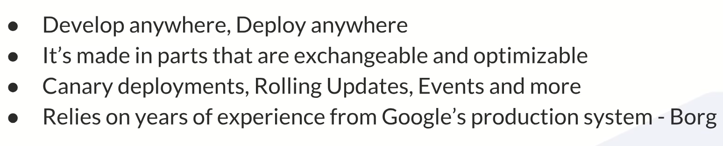
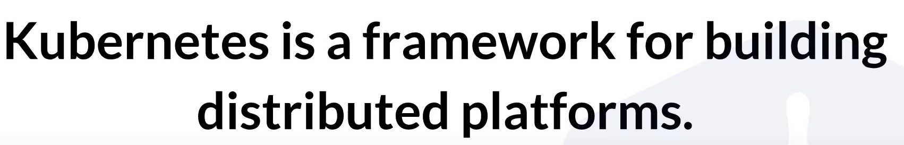
Kubernetes
Orchestration

Slide 2
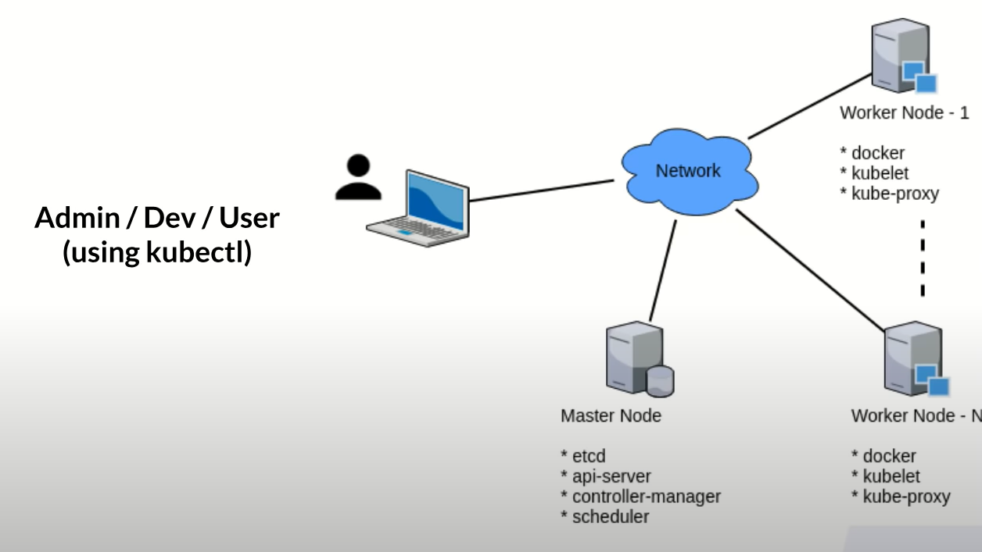
Basic K8s Cluster

Slide 3
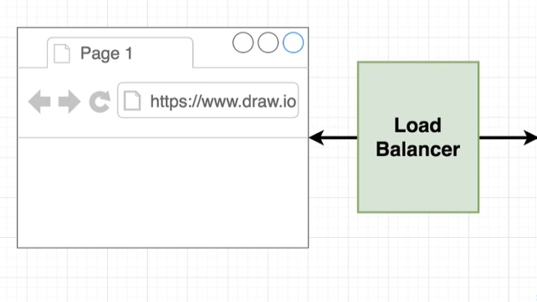
Azure Cloud
Worker node 1
Worker node 2
Worker node 3
Dot Net
/api
React
/
nginx
Dot Net
/api
/api
Dot Net
Kubernetes Cluster

Slide 4
Kubernetes Cluster
Worker node 1
Pods, Services, Persistence volume claim etc
Worker node 2
Pods, Services, Persistence volume claim etc
Azure SQL Server
Connected with endpoints
Master node manger the cluster
Azure File/ Storage
Master Node
Persistence volume access via Persistence volume claim

Slide 5
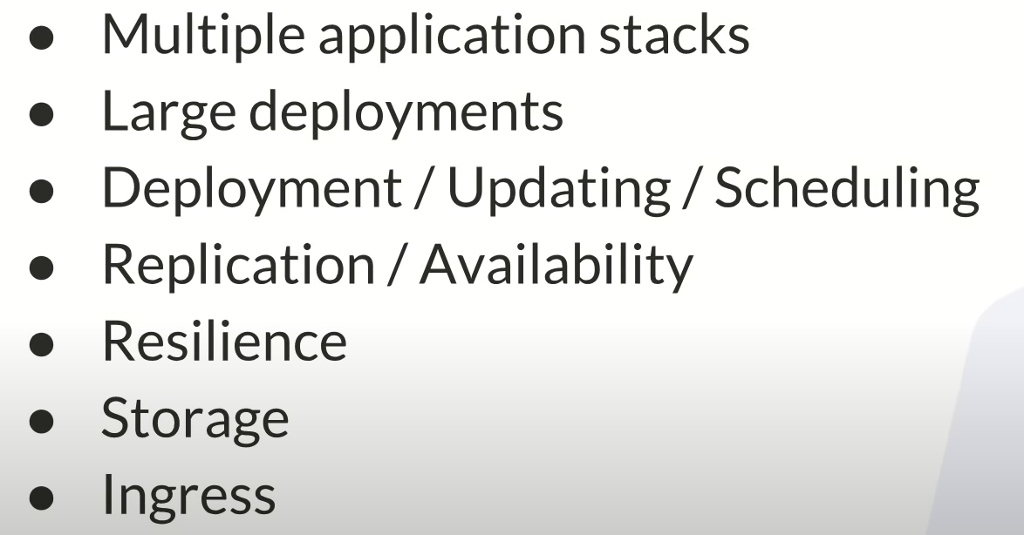
Docker limitations

Slide 6
