Slide 1
MID / FINAL DEFENSE PRESENTATION
PFM -- Personal Finance Manager
PFM -- Personal Finance Manager
Submitted by: Nirmal Sapkota, Gaurav Kumar Sah
Supervisor: Bishon Lamichhane
Tribhuvan University | Kathford International College | May 2026

Slide 2
TABLE OF CONTENTS
Presentation Outline
Introduction
Problem Statement
Project Objectives
Scope and Limitations
Background Study
Literature Review
Methodology and Timeline
System Diagrams
Algorithm Details
Implementation Tools
Implementation Modules
Testing
Modules Completed and Remaining
Conclusion and References
2 / 25

Slide 3
PROJECT OVERVIEW
Introduction
What is Personal Finance Manager?
Why expense tracking is important
Problem with traditional manual finance apps
3 / 25

Slide 4
IDENTIFIED PROBLEM
Problem Statement
Manual data entry is repetitive
Users abandon tracking over time
Existing apps lack smart categorization
Need for intelligent budget analysis
4 / 25

Slide 5
MAIN OBJECTIVES
Project Objectives
To develop a smart Personal Finance Manager that automates expense tracking and budget analysis using natural language processing.
5 / 25

Slide 6
PROJECT BOUNDARY
Scope and Limitations
Scope
Limitations
Expense tracking
NLP-based categorization
Budget optimization
Dashboard analytics
RAG-based financial assistant
No bank integration
No receipt scanning
No tax calculation
No multi-currency support
6 / 25

Slide 7
STUDY SUMMARY
Background Study
Existing finance apps depend on manual input
PFM uses NLP, RAG, and optimization
Full-stack web application using React, FastAPI, and Supabase
7 / 25

Slide 8
RELATED WORK
Literature Review
Splitwise
YNAB
Wallet by BudgetBakers
Automated text categorization
Retrieval-Augmented Generation
8 / 25

Slide 9
METHODOLOGY
Agile Methodology
Planning
Design
Development
Testing
Deployment
Review and Maintenance
9 / 25

Slide 10
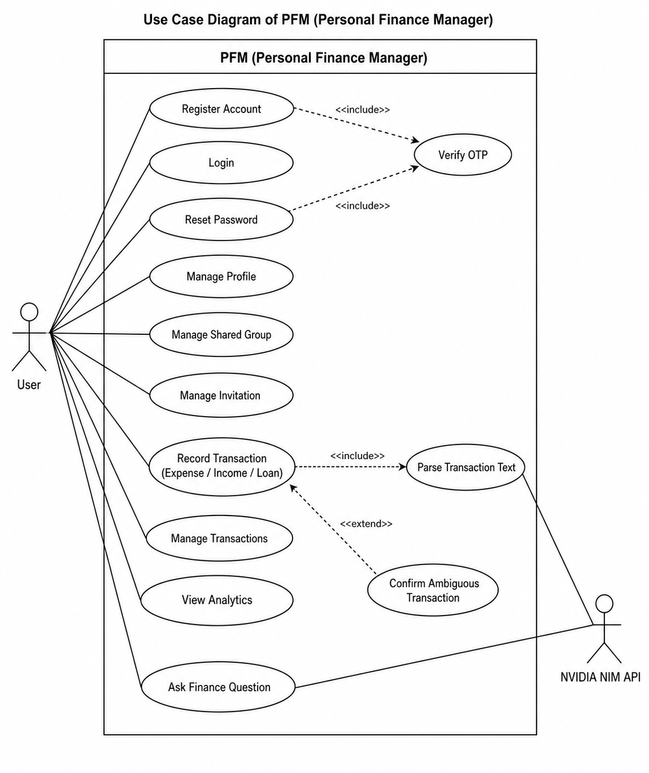
FIGURE 3.2: USE CASE DIAGRAM OF PFM
Use Case Diagram
Mention
User registration
Login
Manage profile
Record transaction
Manage transactions
View analytics
Finance question
NVIDIA NIM API interaction
10 / 25

Slide 11
GANTT CHART SUMMARY
Project Timeline
Project planning timeline
Designing phase
Development phase
Testing phase
Deployment phase
Review and maintenance phase
11 / 25

Slide 12
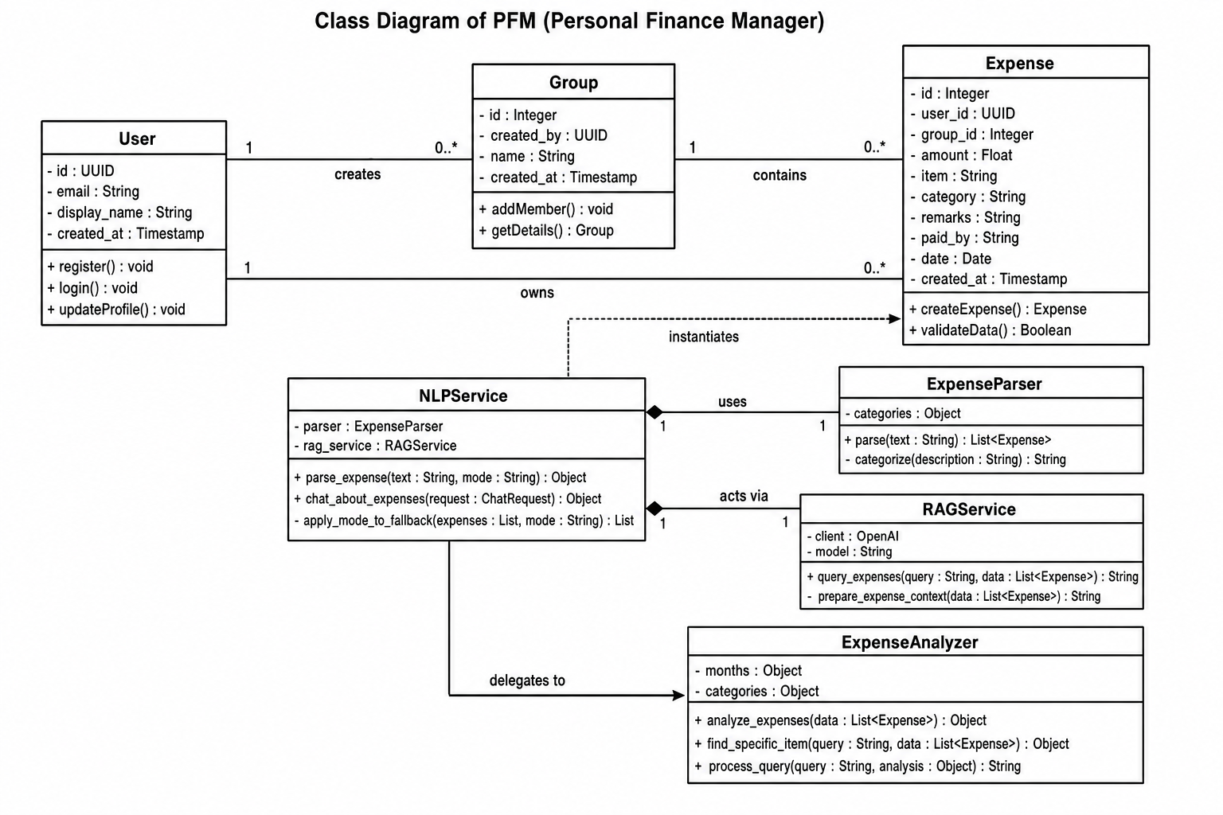
FIGURE 3.4: CLASS DIAGRAM OF PFM
Class Diagram
Mention
User class
Group class
Expense class
NLP Service
Expense Parser
RAG Service
Expense Analyzer
Relationships between system components
12 / 25

Slide 13
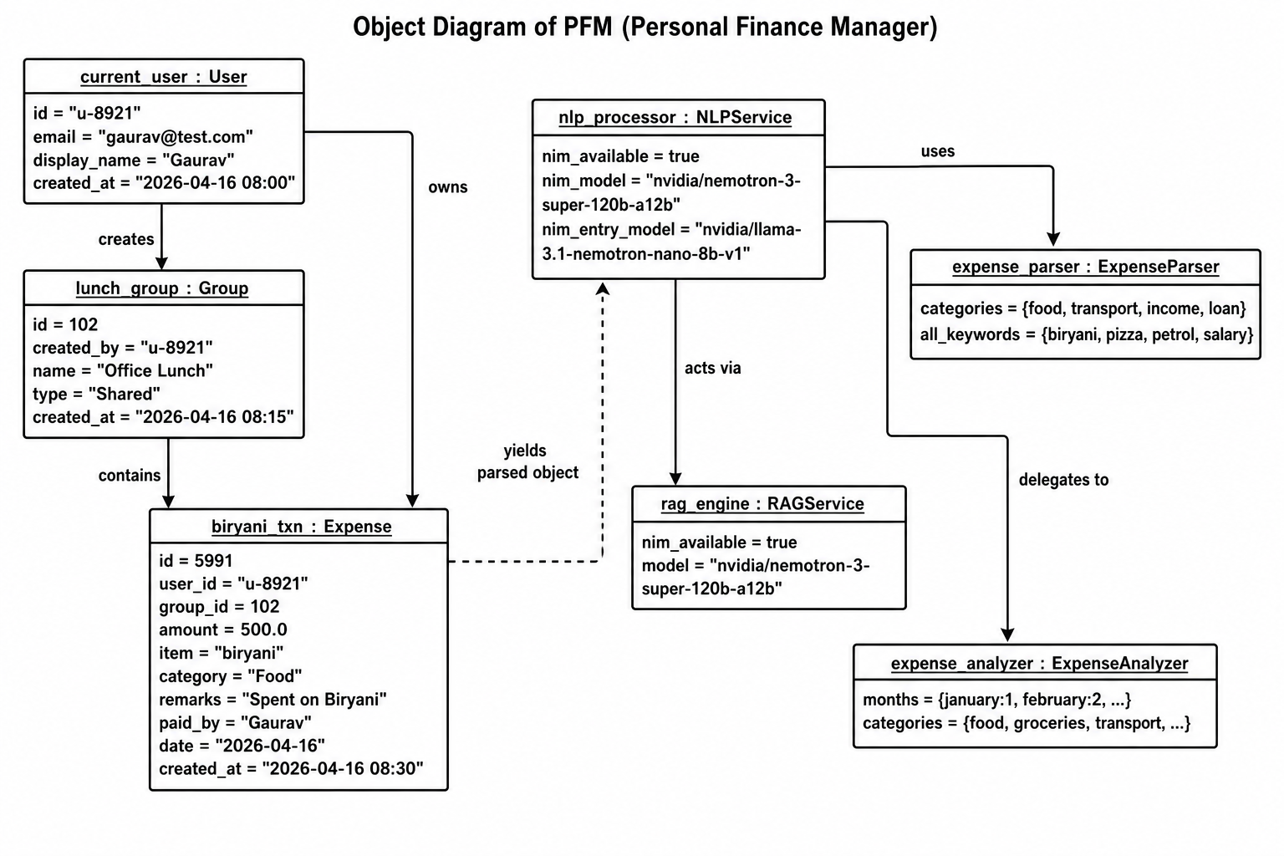
FIGURE 3.5: OBJECT DIAGRAM OF PFM
Object Diagram
Mention
Runtime example of system objects
Current user object
Group object
Expense object
NLP service object
RAG engine object
Expense parser and analyzer objects
13 / 25

Slide 14
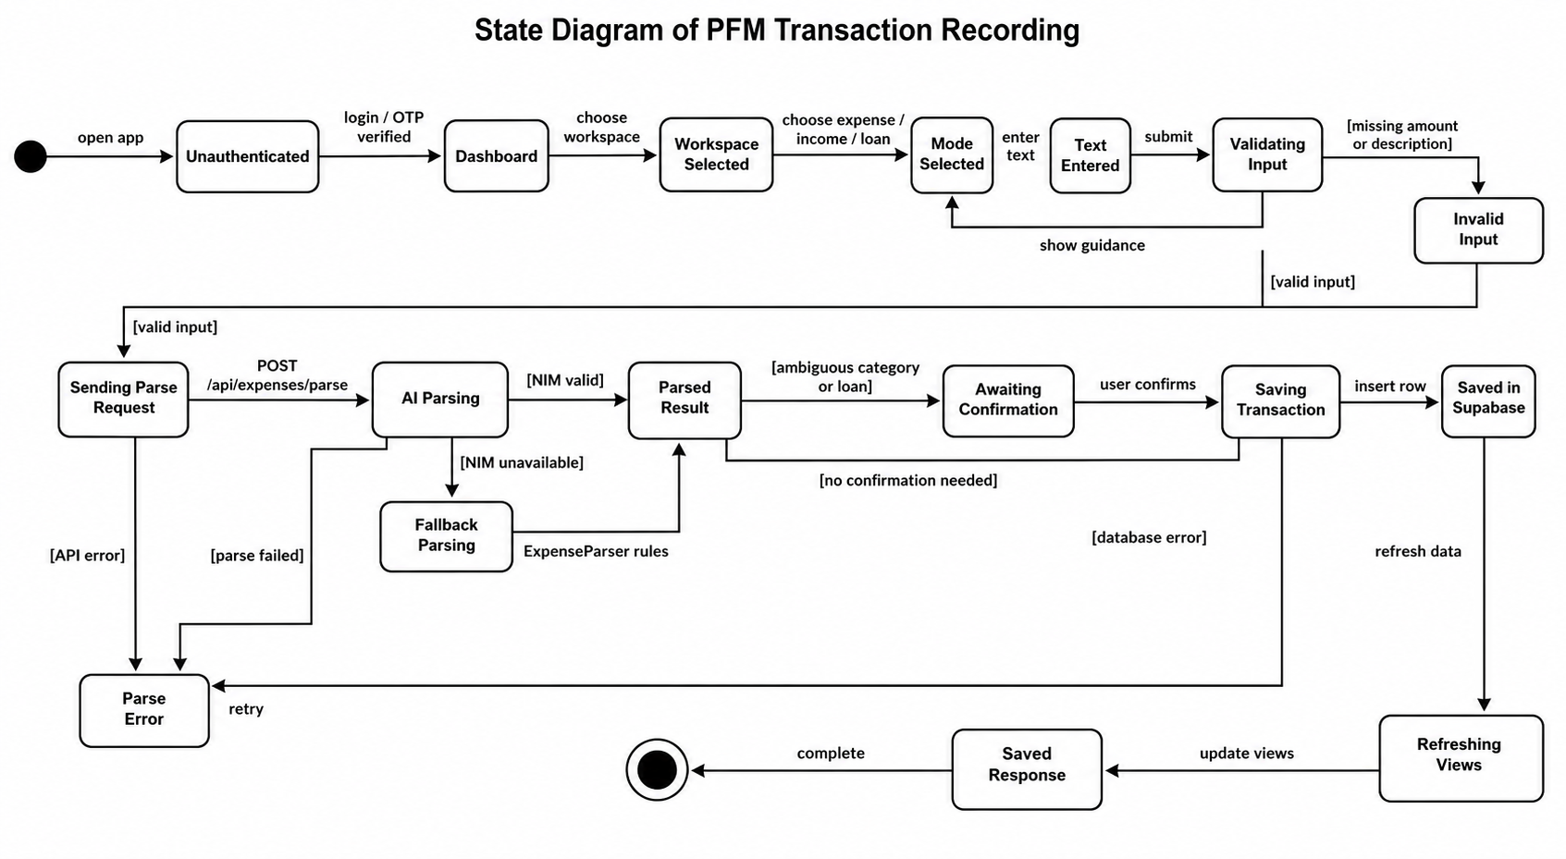
FIGURE 3.6: STATE DIAGRAM OF PFM
State Diagram
Mention
User authentication state
Dashboard state
Transaction input state
Parsing state
Confirmation state
Saving transaction state
Response and refresh state
14 / 25

Slide 15
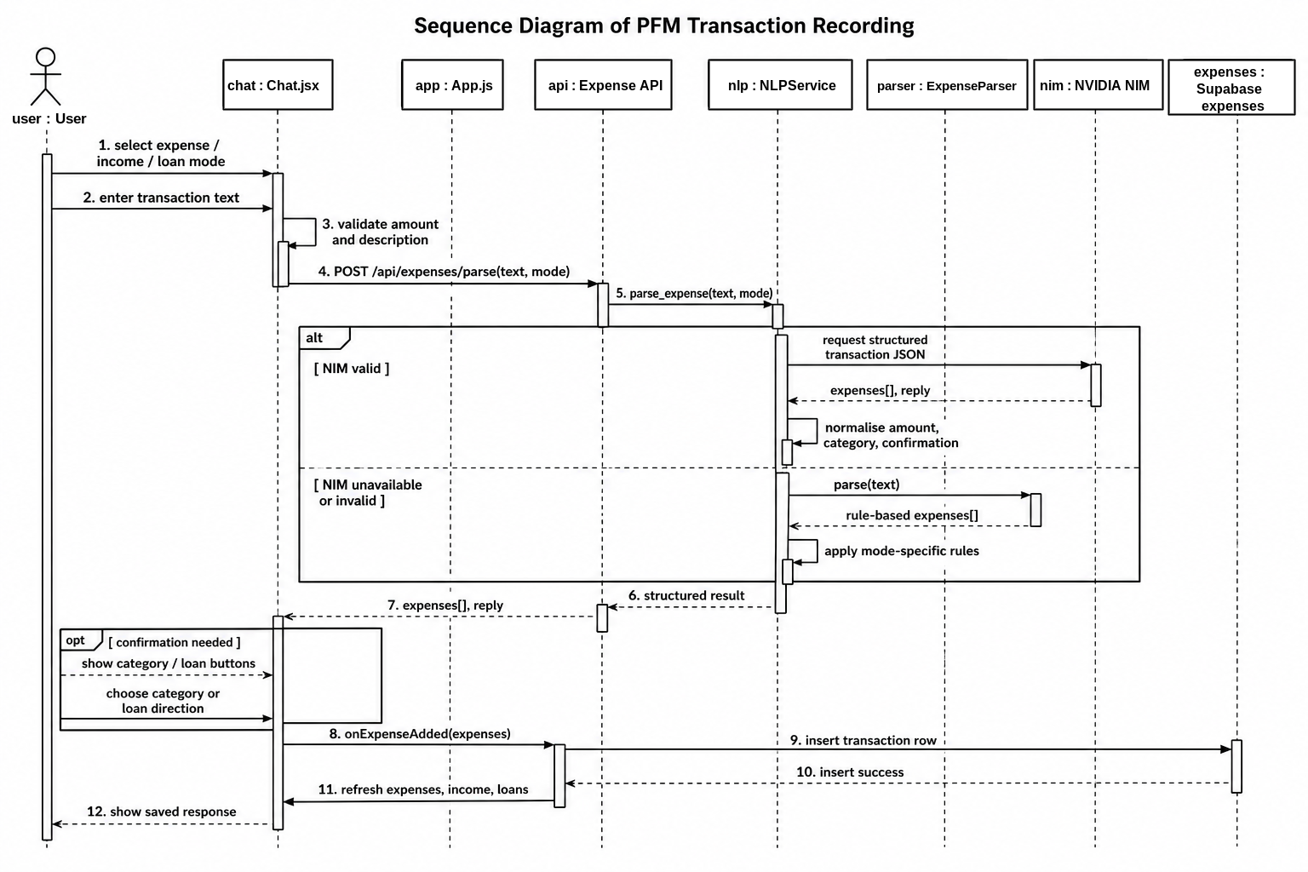
FIGURE 3.7: SEQUENCE DIAGRAM OF PFM
Sequence Diagram
Mention
User enters transaction text
Chat.js sends request
App.js validates input
Expense API communicates with NLP Service
Expense Parser or NVIDIA NIM processes input
Supabase stores transaction
Response is shown to user
15 / 25

Slide 16
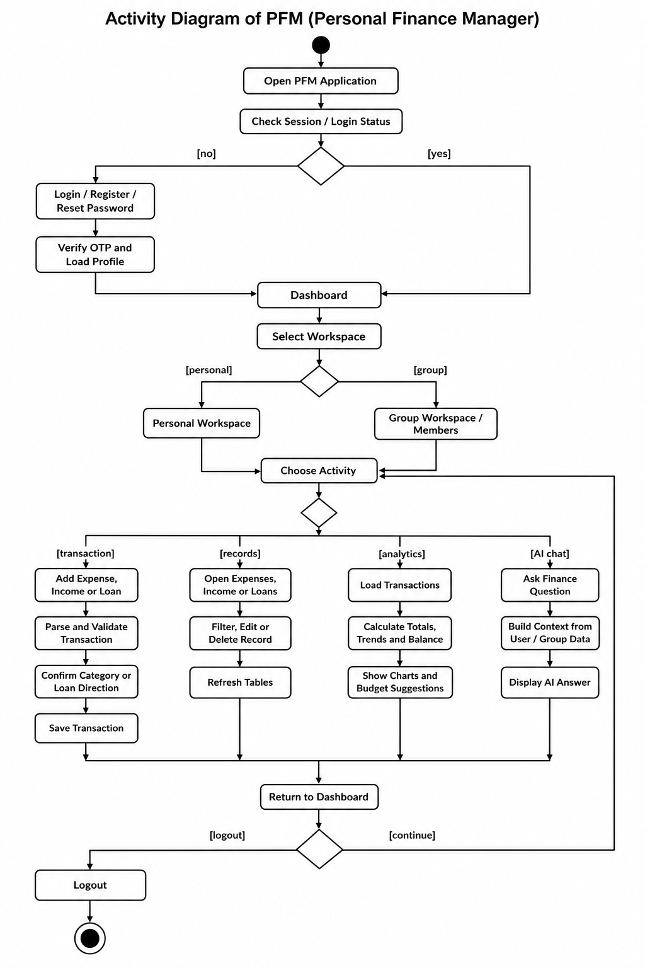
FIGURE 3.8: ACTIVITY DIAGRAM OF PFM
Activity Diagram
Mention
Application start
Authentication check
Dashboard display
Record transaction flow
Review/AI flow
Ask AI question flow
Save transaction
Logout
16 / 25

Slide 17
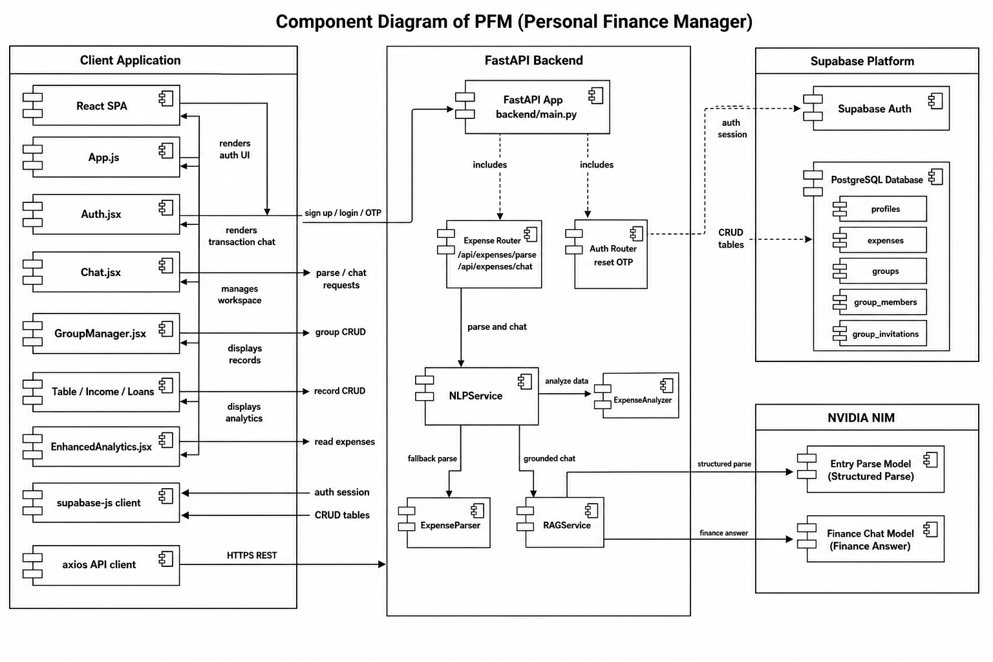
FIGURE 3.9: COMPONENT DIAGRAM OF PFM
Component Diagram
Mention
Client application
FastAPI backend
Supabase platform
PostgreSQL database
NVIDIA NIM API
NLP Service
RAG Service
Expense Analyzer
17 / 25

Slide 18
NLP EXPENSE PARSING ALGORITHM
Algorithm Details
Convert input text to lowercase
Extract amount using regex
Match keywords with expense categories
Select category with highest score
Return amount and category
18 / 25

Slide 19
TOOLS AND TECHNOLOGIES
Implementation Tools
Frontend: React.js, Tailwind CSS, Recharts
Backend: FastAPI
Database: Supabase PostgreSQL
AI/API: NIM API
CASE Tools: VS Code, Draw.io, Lucidchart, Figma
19 / 25

Slide 20
MAIN MODULES
Implementation Details of Modules
Registration Module
Login Module
Expense Management Module
NLP Expense Parsing Module
Budget Optimization Module
Dashboard and Analytics Module
Conversational Financial Assistant Module
20 / 25

Slide 21
UNIT TEST CASES
Testing
User registration
User login
Add expense
NLP expense parsing
Budget optimization
Dashboard analytics
Conversational query
Delete expense
Logout
21 / 25

Slide 22
COMPLETED WORK
Modules Completed
User Authentication
Expense Management Module
NLP Expense Parsing Module
Dashboard and Analytics Module
Budget Optimization Module
Frontend Development
Backend API Development
Database Integration
22 / 25

Slide 23
REMAINING WORK
Modules Remaining
Conversational Financial Assistant / RAG
Gemini API Optimization
System Testing and Debugging
Deployment and Performance Optimization
Report Documentation and Final Presentation
23 / 25

Slide 24
PROJECT CONCLUSION
Conclusion
PFM reduces manual expense entry
NLP makes tracking faster and easier
Dashboard helps users understand spending
Budget optimization supports better saving decisions
Remaining work focuses on RAG, testing, deployment, and final documentation
24 / 25

Slide 25
REPORT REFERENCES
References
Splitwise
YNAB
Wallet by BudgetBakers
Automated Text Categorization
Retrieval-Augmented Generation
25 / 25

