Slide 1
MACHINE LEARNING ASSIGNMENT
HR Analytics at ScaleneWorks
Predicting Candidate Joining Outcomes (Renege Prediction)
A start-to-end workflow: data exploration, cleaning, EDA, preprocessing, and classification model building.
Dataset: 12,333 candidate records • 16 predictive variables Target: Status — Joined vs. Not Joined (renege)
GitHub : Link
Case reference: IMB551, Indian Institute of Management Bangalore

Slide 2
THE BUSINESS PROBLEM
Why Renege Matters to ScaleneWorks
ScaleneWorks is a Bangalore-based talent acquisition consultancy. Even after a candidate accepts a job offer, a significant share never actually joins — this is called “renege.”
15–35%
Typical renege rate in IT services hiring
For one client rolling out 12,000 offers a year, a 30% renege rate means ~3,600 lost hires and roughly 54,000 wasted man-hours in recruitment effort.
10–15%
Increase in hiring cost due to reneged offers
Business questions to answer:
1
What key factors drive a candidate to join or not join?
2
What rules can predict renege in advance?
3
Can we build an algorithm to score join-probability?
HR Analytics at ScaleneWorks | Predicting Candidate Joining Outcomes
2

Slide 3
PART 1: DATA EXPLORATION
Loading the Dataset: 12,333 Rows, 17 Columns
INITIAL DATA INGESTION
PYTHON
Imported standard Python data-science libraries: pandas for dataframes, numpy for numeric operations, and matplotlib/seaborn for visuals.
# Import Required Libraries
import pandas as pd
import numpy as np
import matplotlib.pyplot as plt
# Load the Dataset
df = pd.read_excel("Assignment.xlsx")
# Check Dataset Shape
print(df.shape)
# Output: (12333, 17)
# Check Column Names & Data Types
print(df.columns)
df.info()
DATASET SCHEMA
• Shape: 12,333 rows x 17 columns
• Data types: 4 float64, 4 int64, 9 categorical columns
• Target: Status (Joined / Not Joined)
• Identifier: Candidate Ref — dropped, no predictive value
HR Analytics at ScaleneWorks | Predicting Candidate Joining Outcomes
3

Slide 4
PART 1: DATA CLEANING
Handling Missing Values & Duplicates
MISSING VALUES FOUND
PYTHON
Duration to accept offer
2,719
# Check Missing Values
print(df.isnull().sum())
# Impute Numerical Columns with Mean
df.fillna(df.mean(numeric_only=True),
inplace=True)
# Impute Categorical Columns with Mode
df.fillna(df.mode().iloc[0], inplace=True)
# Verify
print(df.isnull().sum().sum()) # 0
print(df.duplicated().sum()) # 0
# Drop Identifier Column
df.drop("Candidate Ref", axis=1,
inplace=True)
Percent difference CTC
851
Pct hike expected in CTC
747
Pct hike offered in CTC
596
STRATEGY
• Numerical columns → filled with column mean
• Categorical columns → filled with column mode
• Verified 0 missing values and 0 duplicate rows
• Dropped Candidate Ref → 17 → 16 columns
HR Analytics at ScaleneWorks | Predicting Candidate Joining Outcomes
4

Slide 5
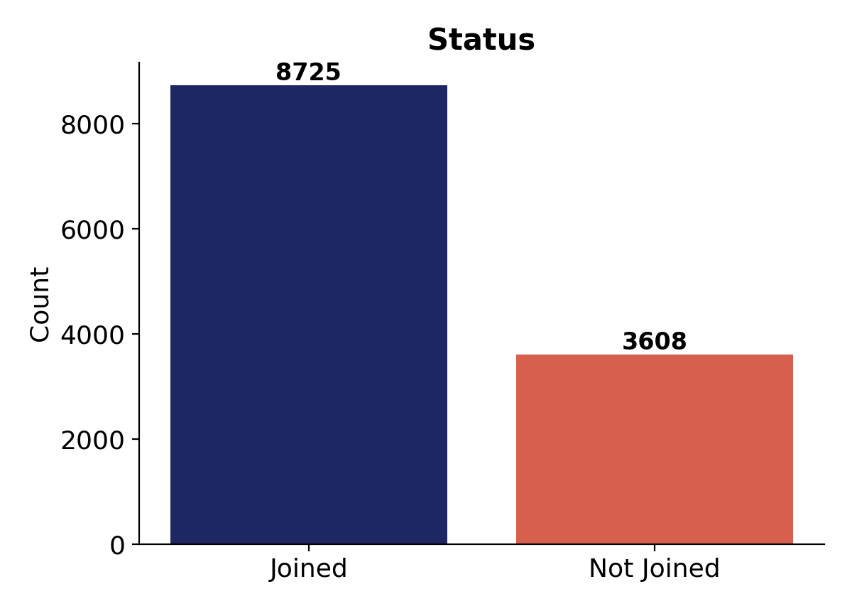
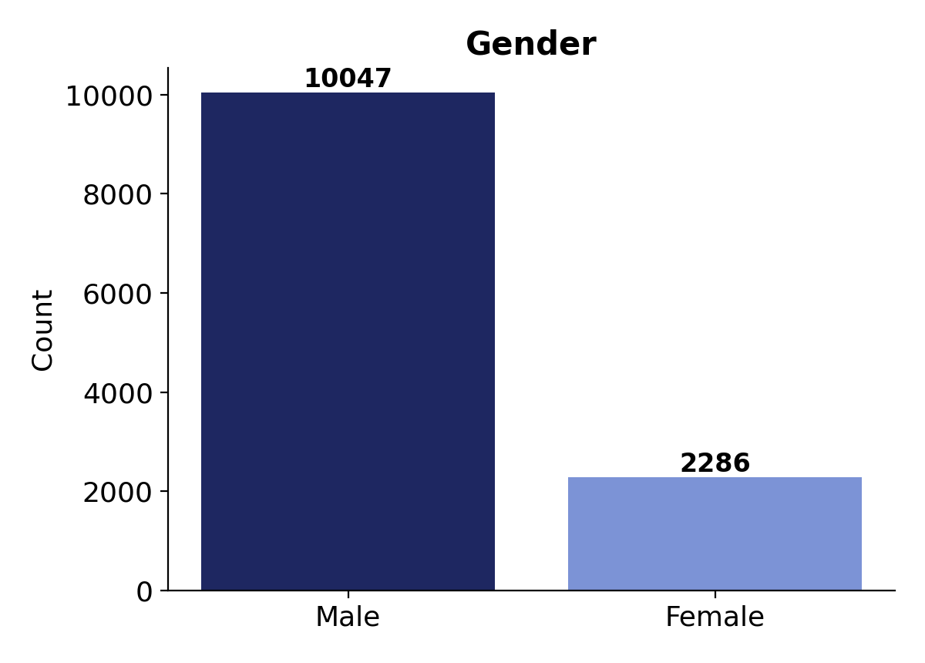
PART 2: EXPLORATORY DATA ANALYSIS
Target Class Balance & Gender Split
SUMMARY
Joined: 8,725 (70.7%) Not Joined: 3,608 (29.3%) Male: 10,047 (81.5%) Female: 2,286 (18.5%)
EDA INSIGHTS
• Class imbalance (~71/29): models must be judged on precision/recall for the minority class, not accuracy alone. • Gender skew (~81.5% male): sourcing pipelines lean heavily male — worth an equity review.
HR Analytics at ScaleneWorks | Predicting Candidate Joining Outcomes
5

Slide 6
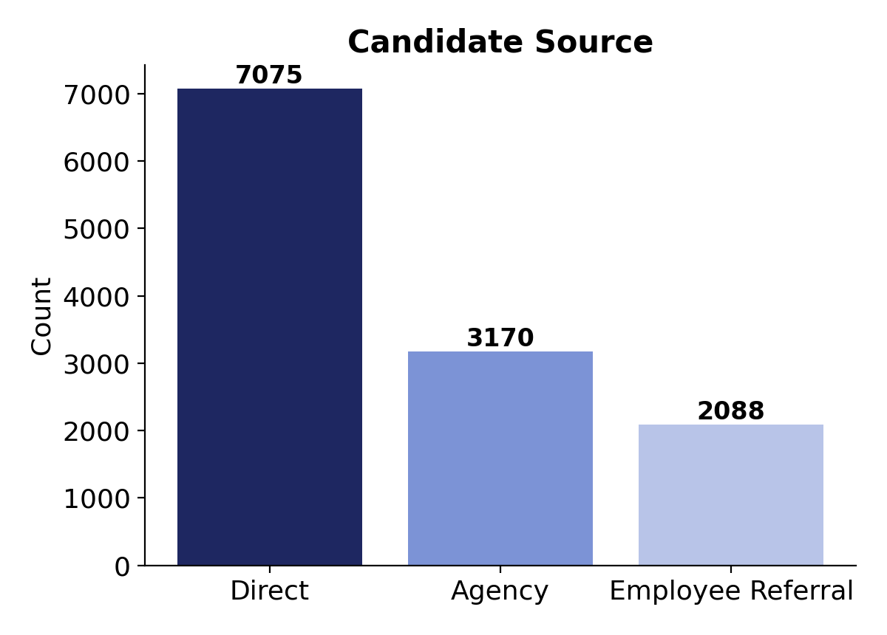
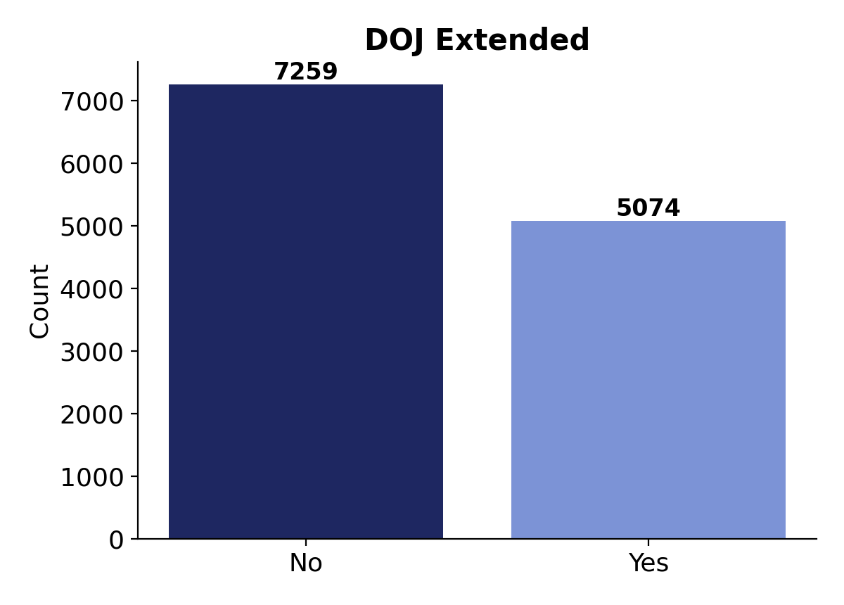
PART 2: EXPLORATORY DATA ANALYSIS
Sourcing Channels & Joining-Date Extensions
SUMMARY
Direct: 7,075 (57.4%) Agency: 3,170 (25.7%) Referral: 2,088 (16.9%) DOJ Extended No: 7,259 (58.9%) Yes: 5,074 (41.1%)
EDA INSIGHTS
• Direct hiring dominates sourcing (57.4%) — agency and referral are secondary pipelines. • 41% requested a DOJ extension — possibly a signal of friction, counter-offers, or long notice periods elsewhere.
HR Analytics at ScaleneWorks | Predicting Candidate Joining Outcomes
6

Slide 7
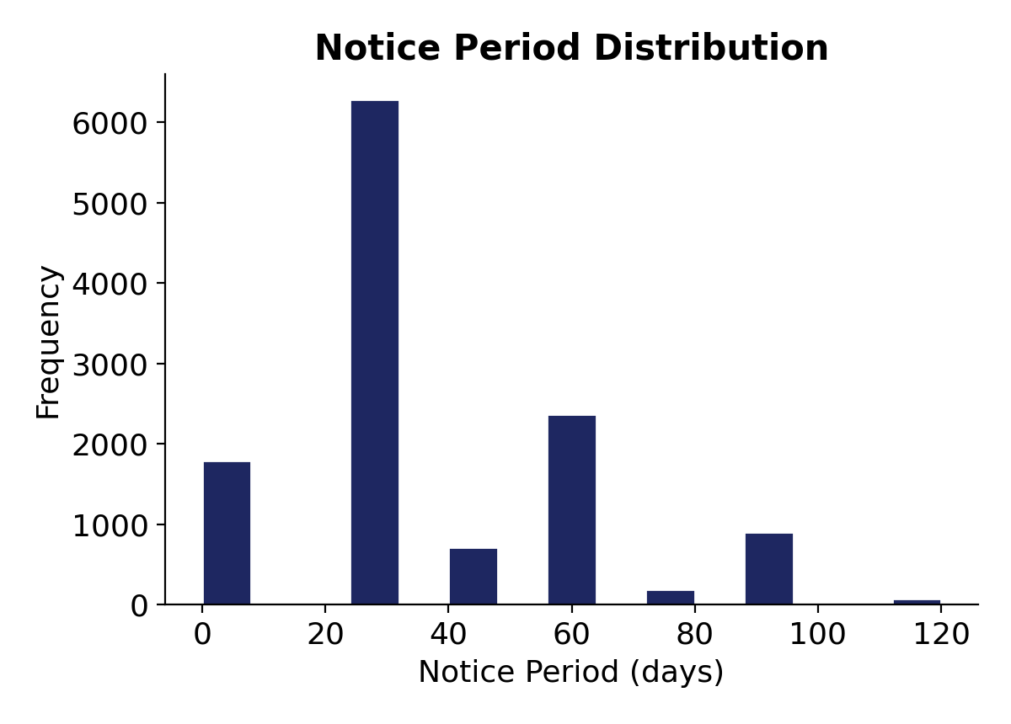
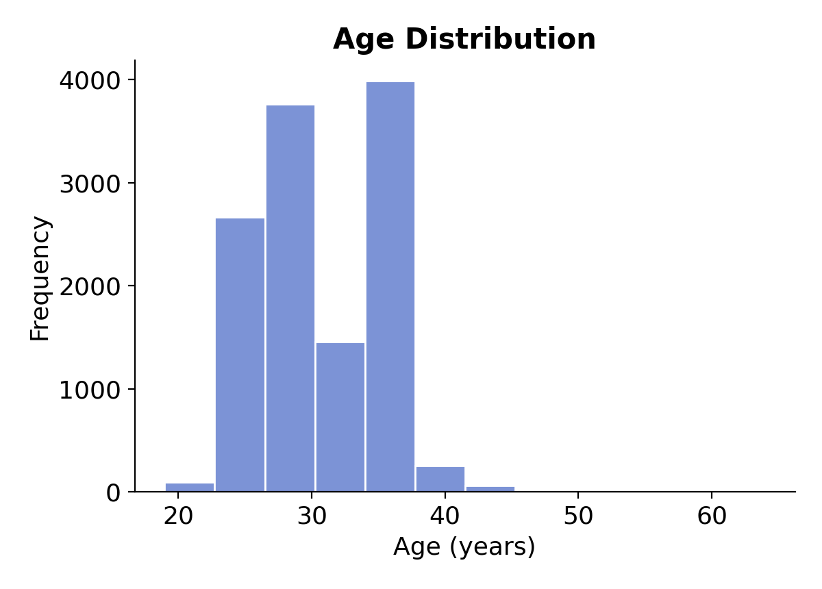
PART 2: EXPLORATORY DATA ANALYSIS
Notice Period & Age Distribution
SUMMARY
Most common notice period: 30 days (6,285 candidates) Median age: 30 years Range: 19 – 64 years Middle 50%: 27 – 34 years
EDA INSIGHTS
• Notice periods cluster at standard values (0, 30, 45, 60, 90, 120 days) — 30 days is by far the norm. • Age distribution skews toward early-career, peaking around 28–34 years, with a long tail beyond 45.
HR Analytics at ScaleneWorks | Predicting Candidate Joining Outcomes
7

Slide 8
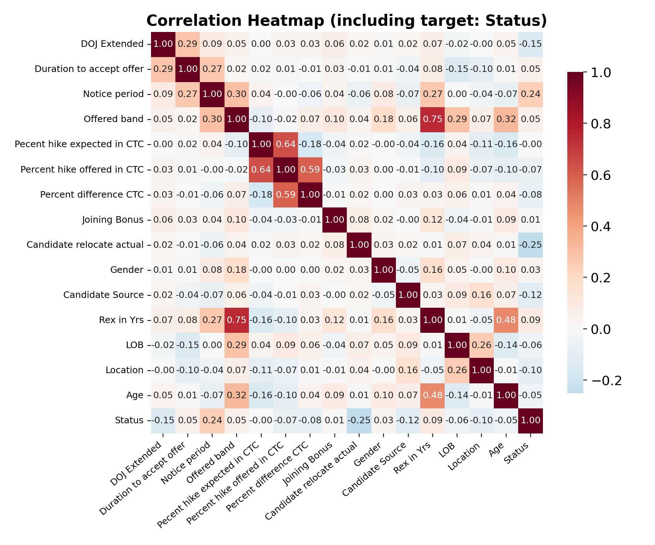
PART 2: EXPLORATORY DATA ANALYSIS
Correlation Heatmap — Including the Target
Reading the heatmap % hike expected vs. offered: r = 0.64 Offered hike vs. % difference CTC: r = 0.59 Offered band vs. REX (years): r = 0.75 Correlation with Status (target) Notice period: r = 0.24 (highest) Candidate relocate actual: r = –0.25 DOJ Extended: r = –0.15 No single feature is strongly linearly related to Status — the largest is only ~0.25 — which is why a non-linear, multi-feature model (tree/ensemble) is needed rather than a simple correlation rule.
HR Analytics at ScaleneWorks | Predicting Candidate Joining Outcomes
8

Slide 9
PART 3: DATA PREPROCESSING
Encoding & Train/Test Split
1
Label-encoded 9 categorical columns (DOJ Extended, Offered band, Joining Bonus, Candidate relocate actual, Gender, Candidate Source, LOB, Location, Status)
PYTHON
from sklearn.preprocessing import \
LabelEncoder
from sklearn.model_selection import \
train_test_split
le = LabelEncoder()
categorical_columns = [
"DOJ Extended", "Offered band",
"Joining Bonus", "Candidate relocate actual",
"Gender", "Candidate Source", "LOB",
"Location", "Status"
]
for col in categorical_columns:
df[col] = le.fit_transform(df[col])
X = df.drop("Status", axis=1)
y = df["Status"]
X_train, X_test, y_train, y_test = \
train_test_split(X, y,
test_size=0.20, random_state=42)
2
Status → 0 = Joined, 1 = Not Joined
3
Separated X (15 features) and y (Status)
4
Split 80% train / 20% test, random_state=42
5
Result: 9,866 training rows, 2,467 test rows
HR Analytics at ScaleneWorks | Predicting Candidate Joining Outcomes
9

Slide 10
PART 4: MODEL BUILDING
Model 1 & 2: Logistic Regression, Decision Tree
MODEL 1: LOGISTIC REGRESSION
MODEL 2: DECISION TREE
Linear baseline model estimating join log-odds. Trained with max_iter=1000.
Non-linear tree that learns multi-feature logical splits (Gini impurity).
Accuracy: 74.83% Confusion Matrix: [[1597, 143], [478, 249]] Recall (Not Joined): 0.34 — misses most non-joiners
Accuracy: 78.03% (+3.2 pts vs LR) Confusion Matrix: [[1466, 274], [268, 459]] Recall (Not Joined): 0.63 — much more balanced
PYTHON
PYTHON
from sklearn.linear_model import \
LogisticRegression
lr = LogisticRegression(max_iter=1000)
lr.fit(X_train, y_train)
y_pred_lr = lr.predict(X_test)
from sklearn.tree import \
DecisionTreeClassifier
dt = DecisionTreeClassifier(random_state=42)
dt.fit(X_train, y_train)
y_pred_dt = dt.predict(X_test)
HR Analytics at ScaleneWorks | Predicting Candidate Joining Outcomes
10

Slide 11
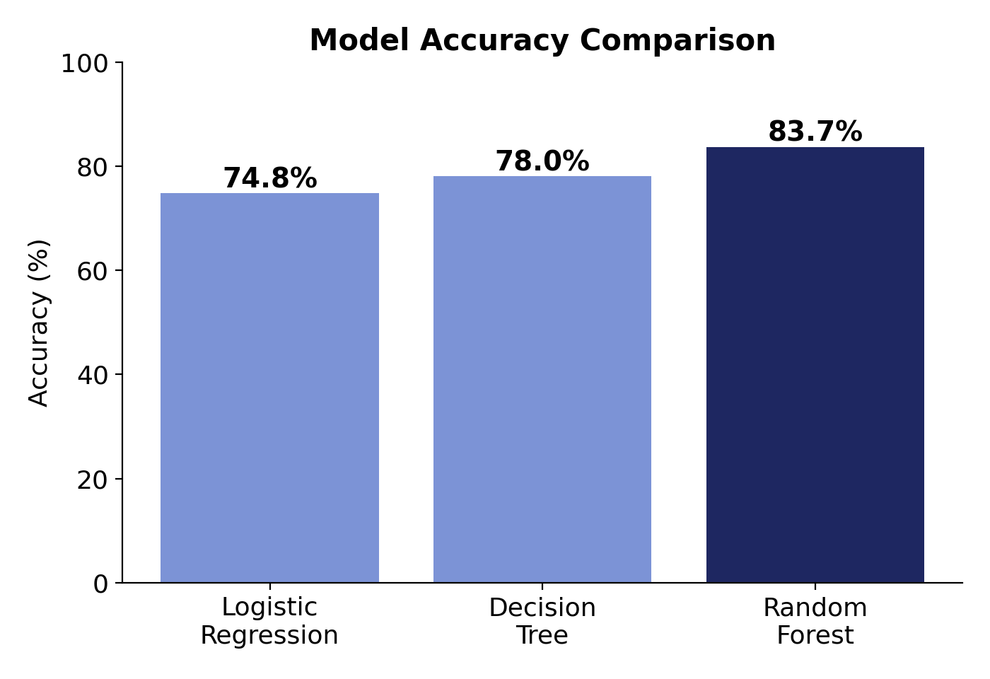
PART 4: MODEL EVALUATION
Random Forest Wins — 83.66% Accuracy
Model | Accuracy | F1 (Not Joined)
Logistic Regression | 74.83% | 0.45
Decision Tree | 78.03% | 0.63
Random Forest | 83.66% | 0.67
Model
Accuracy
F1 (Not Joined)
RANDOM FOREST — WHY IT WINS
Confusion Matrix: [[1656, 84], [319, 408]] Joined class: Precision 0.84, Recall 0.95, F1 0.89 Not Joined class: Precision 0.83, Recall 0.56, F1 0.67 Ensemble bagging of many trees reduces variance and overfitting risk vs. a single tree.
HR Analytics at ScaleneWorks | Predicting Candidate Joining Outcomes
11

Slide 12
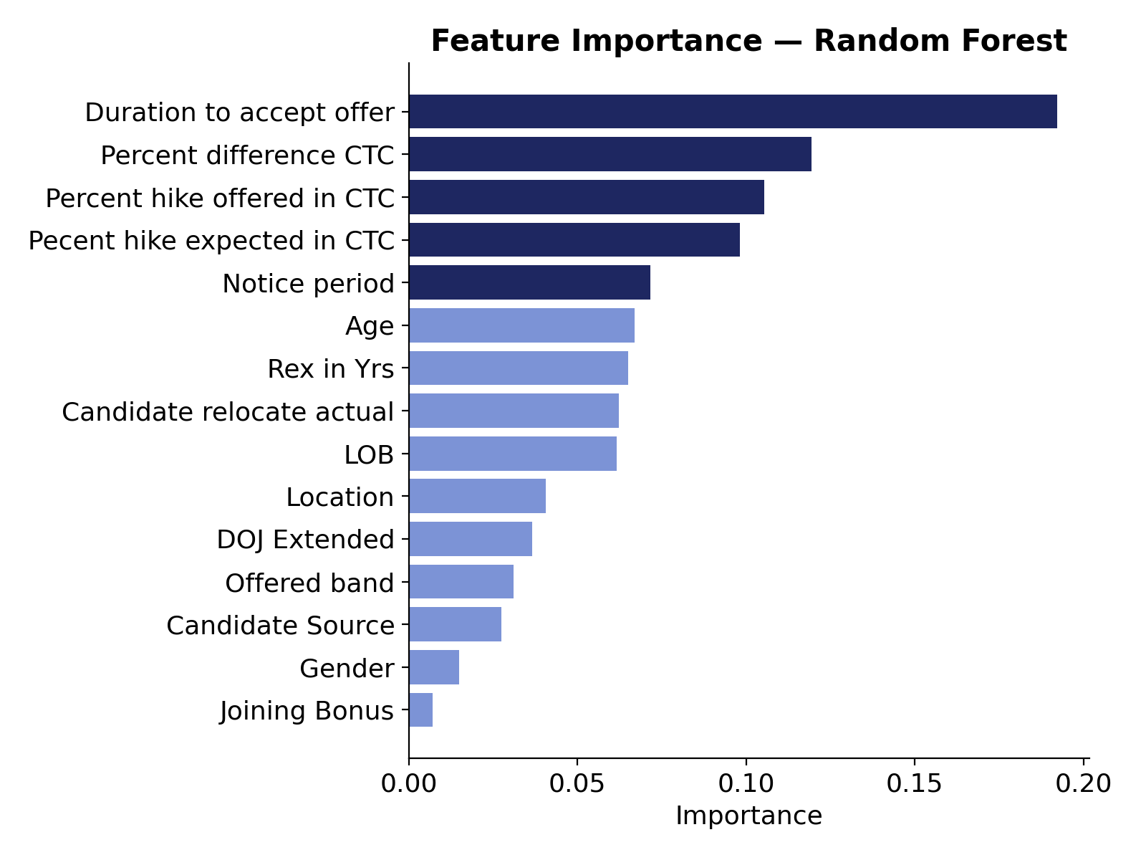
KEY DRIVERS & RECOMMENDATIONS
From Prediction to Action
Top driver
Duration to accept offer (19.2%) — slow acceptance strongly signals a lower chance of joining.
Compensation matters
% hike expected, offered, and CTC difference together drive over 32% of importance.
Model choice
Deploy Random Forest (83.7% accuracy) in ScaleneWorks' post-offer follow-up workflow.
Next steps
Address the 0.56 recall on renege cases with class-weighting or SMOTE; test XGBoost.
HR Analytics at ScaleneWorks | Predicting Candidate Joining Outcomes
12

