Slide 1

Image Forgery Detection
Identifying manipulated images.
Unveiling hidden alterations.
by Invincibles

Slide 2

Project Objectives
Identify Forged Images
Develop Detection Techniques
Distinguish manipulated images.
Explore and refine methods.
Evaluate Performance
Contribute to Security
Assess accuracy and efficiency.
Enhance digital security.

Slide 3
CASIA V.2 Dataset Overview
Categories
Size
Authentic Images
Over 12,500 Images Which Includes over 7490 Original Images and
5122 Tampered Images
Spliced Images
Copy-Move Forgeries
Multiple Resolutions
Retouched Images

Slide 4
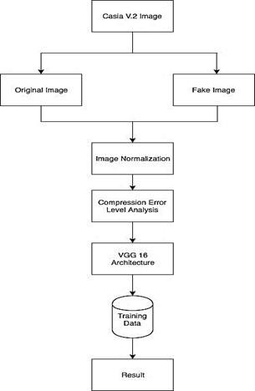
Error Level Analysis (ELA) is
used to check the Level of Compression
in Images.
More the Compression of Images, Less
will be the ELA And Less the Compression
Of Images, More will be the ELA

Slide 5
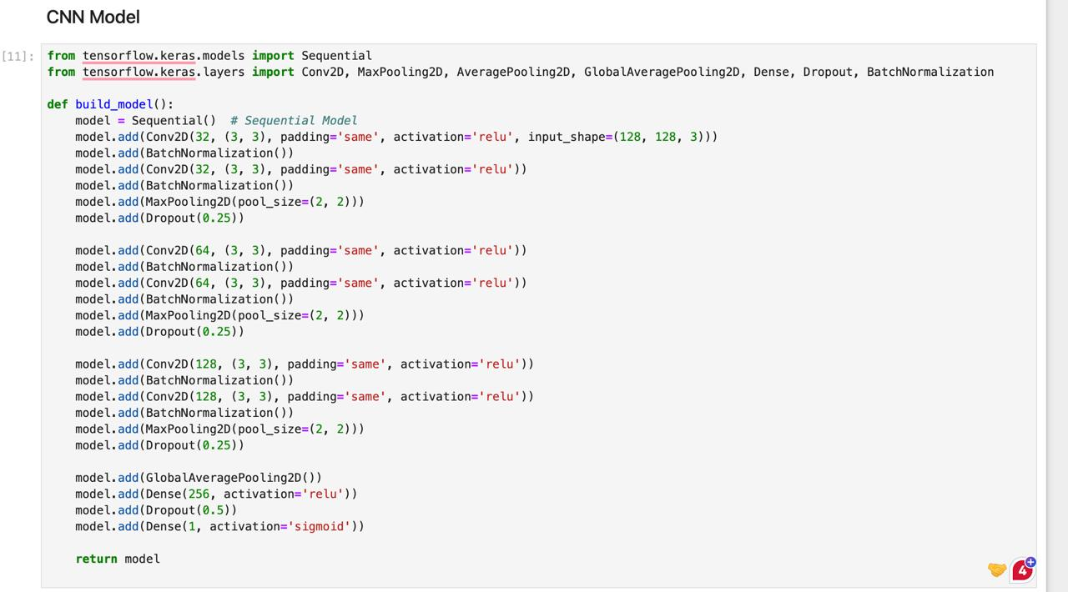





Convolutional Neural Network (CNN) Model
Input Layer
1
Raw image data.
Convolutional Layers
2
Feature extraction.
Pooling Layers
3
Downsampling.
Fully Connected Layers
4
Classification.
Output Layer
5
Forgery prediction.

Slide 6

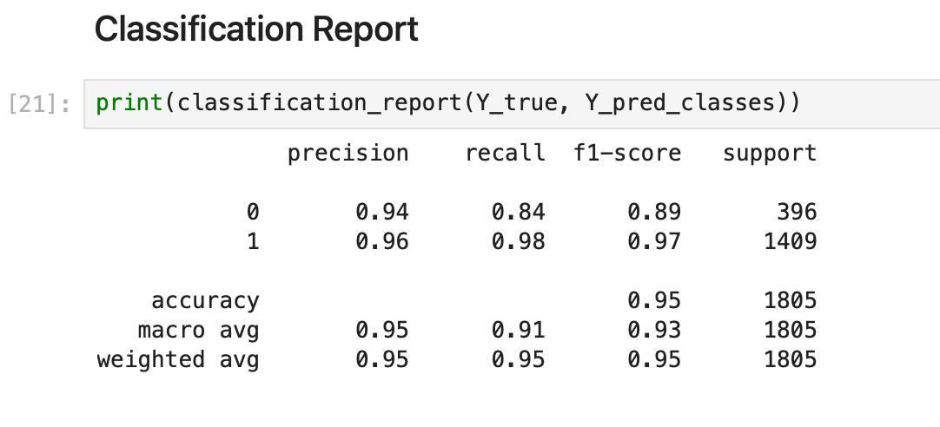
Results and Performance Evaluation
94.95%
94.80%
Accuracy on Unseen Data
Accuracy on Training Data
Correctly identifying forged images.
Correctly identifying forged images.
97%
95%
Recall
F1-score
Minimizing false negatives.
Balancing precision and recall.

Slide 7
Conclusion and Future Directions
Effective Detection
1
Accurate identification of forged images.
Promising Techniques
2
Error Level Analysis and CNN models.
Future Research
3
Explore deep learning advancements.
Real-world Applications
4
Security, authentication, and forensics
.

Slide 8
Demo Video Link :
https://drive.google.com/file/d/1HE8OicPrbJLVPZvdQ0dXelcQ0NDjPlQE/view?usp=sharing
Also Present in the Readme.md file in GitHub

