Slide 1


SANJIVANI GROUP OF INSTITUTES SANJIVANI COLLEGE OF ENGINEERING, KOPARGAON. DEPARTMENT OF INFORMATION TECHNOLOGY.
Engineering Mathematics |||
Guided By : Prof S.S.Pawar 4

Slide 2
GROUP MEMBERS.
108-Omkar Rode.
109-Vaibhav Rohokale.
110-Onkar Unde.
111-Shweta Salunke.
112-Vaibhav Sanap.
113-Sudarshan Sangle.
114-Sanskruti Upadhye.
115-Prajwal Sarode.
116-Parvej Shaikh.
117-Sahil Shaikh.
118-Trupti Shelke.
119-Krushna Shinde.
120-Pranav shinde.
1

Slide 3
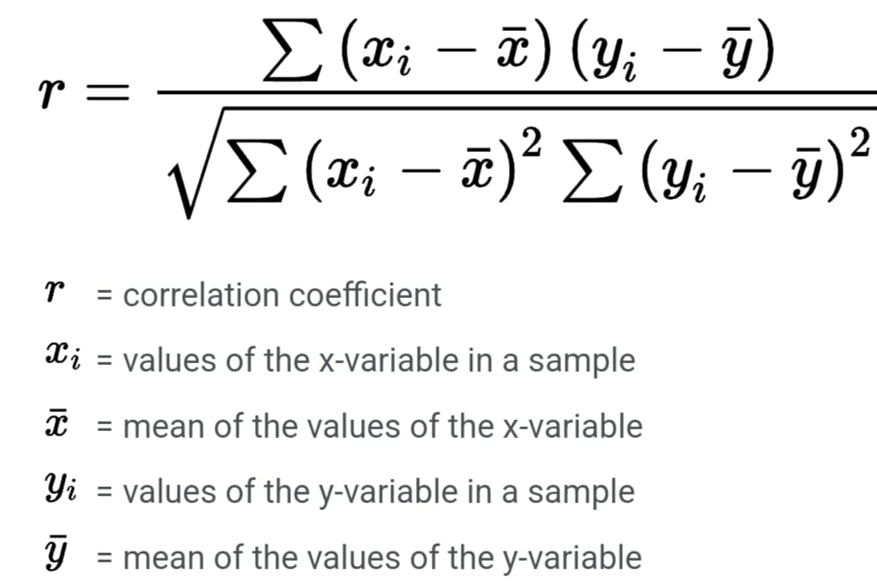
Que no.1
Question: Write a computer program to calculate correlation coefficient.
Ans:
Define:The correlation coefficient is a statistical measure of the strength of a linear relationship between two variables. Its values can range from -1 to 1
Formula:

Slide 4
def correlation_coefficient(x, y):
n = len(x)
mean_x = sum(x) / n
mean_y = sum(y) / n
sum_xy = sum([(x[i] - mean_x) * (y[i] - mean_y) for i in range(n)])
sum_x_sq = sum([(x[i] - mean_x) ** 2 for i in range(n)])
sum_y_sq = sum([(y[i] - mean_y) ** 2 for i in range(n)])
correlation = sum_xy / (sum_x_sq ** 0.5 * sum_y_sq ** 0.5)
return correlation
# Example usage:
x = [1, 2, 3, 4, 5]
y = [2, 3, 4, 5, 6]
print("Correlation coefficient:", correlation_coefficient(x, y))

Slide 5
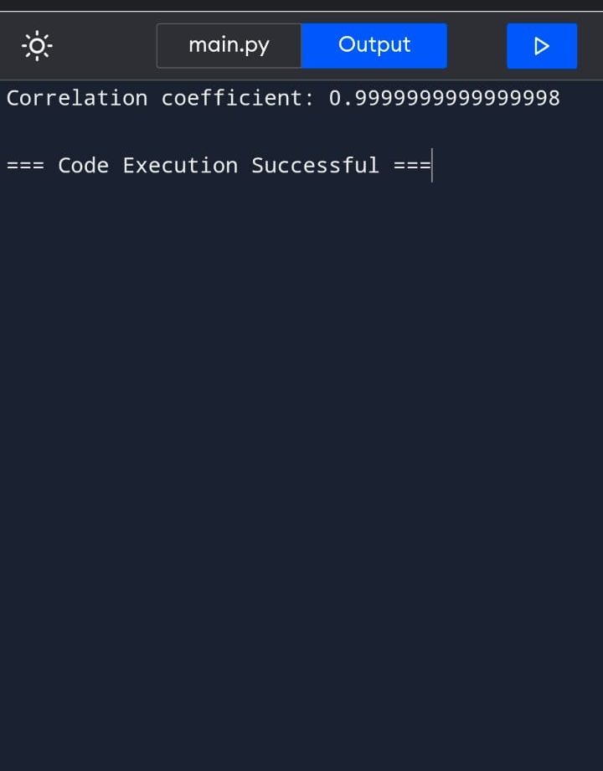

Slide 6
Que no. 2
Question:Give applications of vector analysis with examples in your Engineering branch.
Ans:
Applications :
Computer Graphics:
Transformation Matrices: In 3D computer graphics, transformations like translation, rotation, scaling, and shearing are represented using matrices. These transformations involve vector operations.
Mathematical Formula
(Transformation Matrix):P’ =T . P

Slide 7
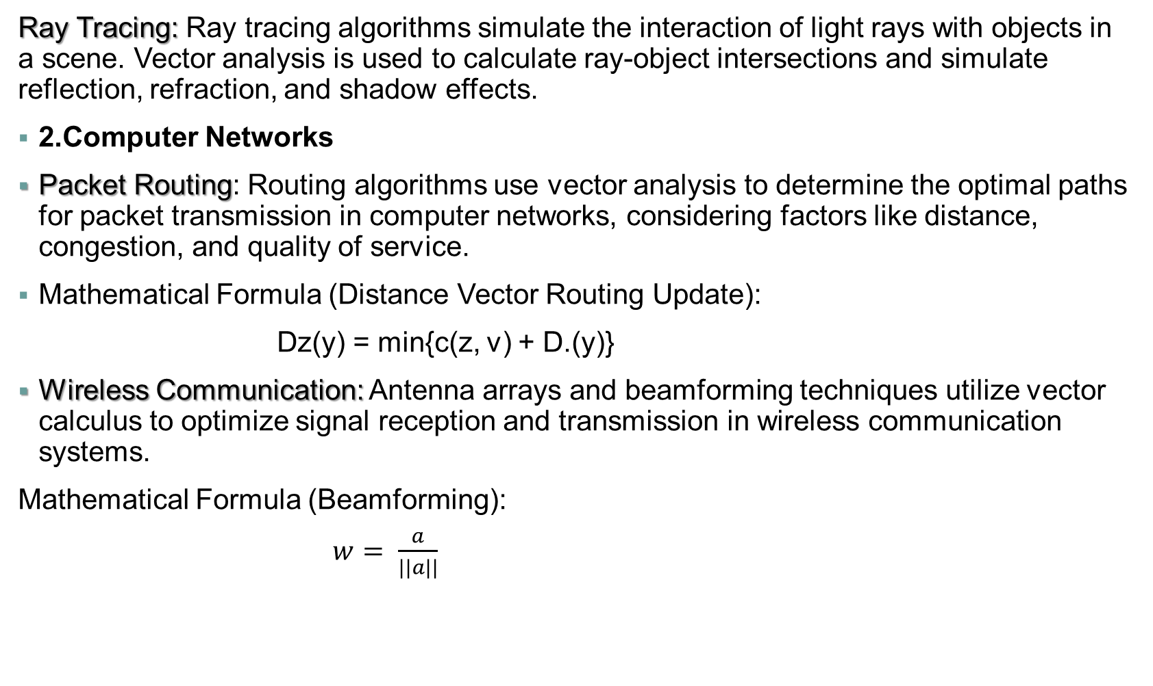
Ray Tracing: Ray tracing algorithms simulate the interaction of light rays with objects in a scene. Vector analysis is used to calculate ray-object intersections and simulate reflection, refraction, and shadow effects.
2.Computer Networks
Packet Routing: Routing algorithms use vector analysis to determine the optimal paths for packet transmission in computer networks, considering factors like distance, congestion, and quality of service.
Mathematical Formula (Distance Vector Routing Update):
Dz(y) = min{c(z, v) + D.(y)}
Wireless Communication: Antenna arrays and beamforming techniques utilize vector calculus to optimize signal reception and transmission in wireless communication systems.
Mathematical Formula (Beamforming):
$w= \frac{a}{||a||}$

Slide 8
3.Data Analysis and Machine Learning :
Principal Component Analysis (PCA): PCA is a dimensionality reduction technique that uses vector analysis to find the principal components of a dataset.
• Mathematical Formula (PCA Projection):
Y=X-V

Slide 9
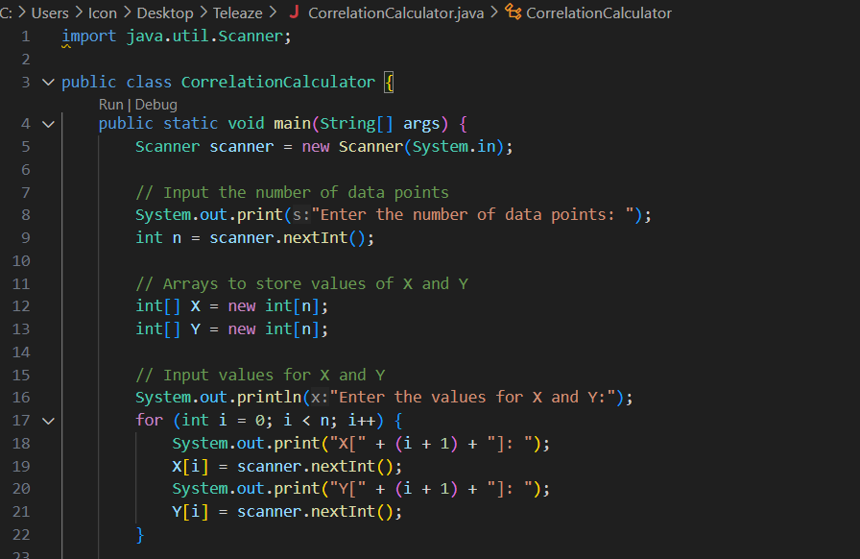
Que no. 3
Question:Visit Sanjivani College Gymkhana, Take Number of people (X) participated in various sports (Y). Find correlation between X and Y. using your computer program.
Ans:

Slide 10
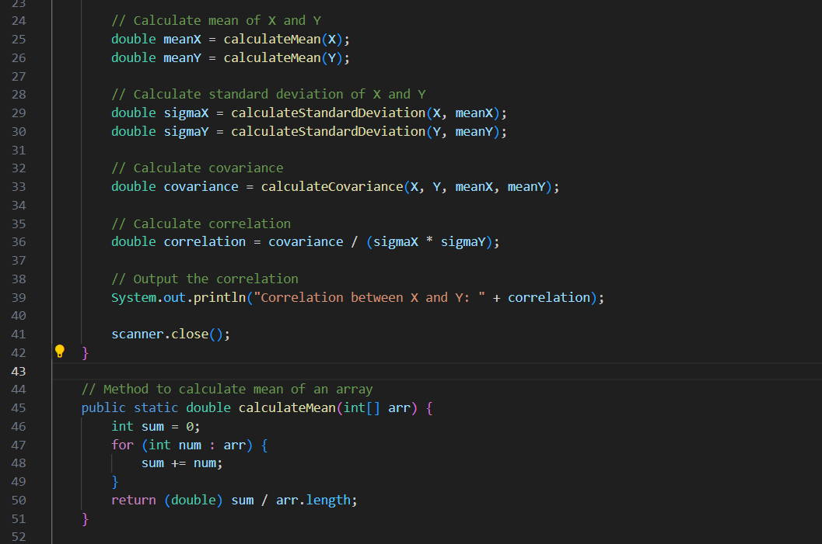

Slide 11
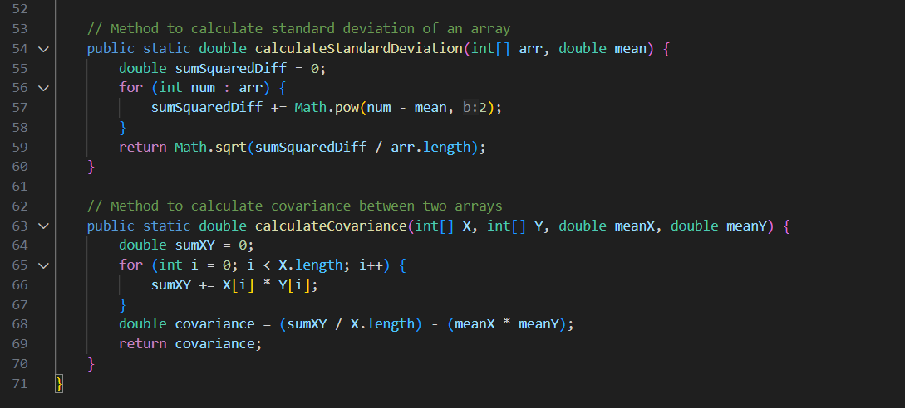

Slide 12
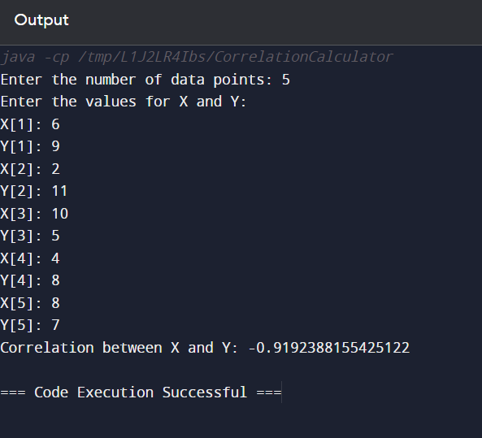
Output

Slide 13
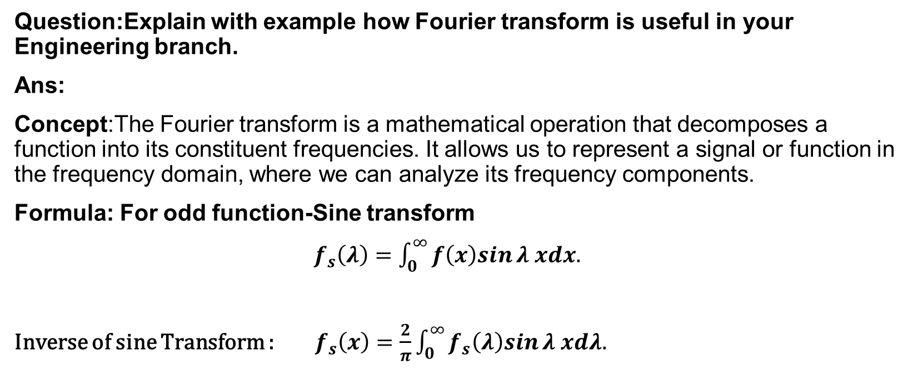
Que no. 4
Question:Explain with example how Fourier transform is useful in your Engineering branch.
Ans:
Concept:The Fourier transform is a mathematical operation that decomposes a function into its constituent frequencies. It allows us to represent a signal or function in the frequency domain, where we can analyze its frequency components.
Formula: For odd function-Sine transform
$f_{s}\left(λ\right)=\int_{0}^{∞}{f\left(x\right)sin}λ xdx.$
Inverse of sine Transform : $f_{s}\left(x\right)=\frac{2}{π}\int_{0}^{∞}{f_{s}\left(λ\right)sin}λ xdλ.$

Slide 14
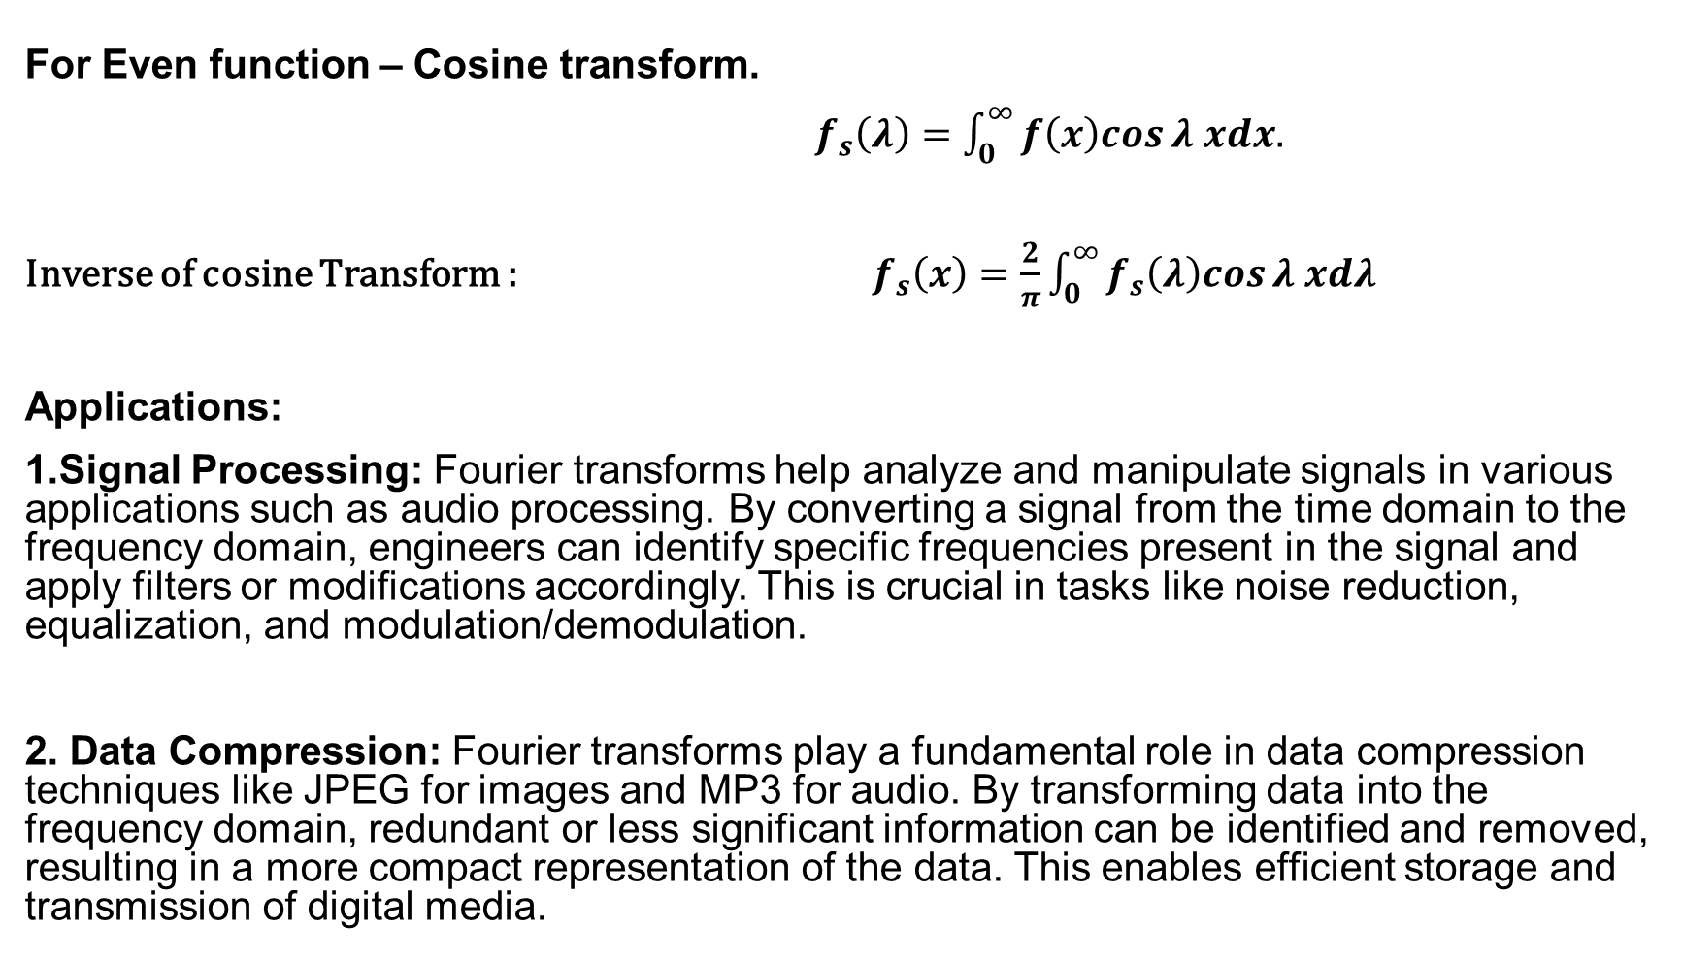
For Even function – Cosine transform.
$f_{s}\left(λ\right)=\int_{0}^{∞}{f\left(x\right)cos}λ xdx.$
Inverse of cosine Transform : $f_{s}\left(x\right)=\frac{2}{π}\int_{0}^{∞}{f_{s}\left(λ\right)cos}λ xdλ$
Applications:
1.Signal Processing: Fourier transforms help analyze and manipulate signals in various applications such as audio processing. By converting a signal from the time domain to the frequency domain, engineers can identify specific frequencies present in the signal and apply filters or modifications accordingly. This is crucial in tasks like noise reduction, equalization, and modulation/demodulation.
2. Data Compression: Fourier transforms play a fundamental role in data compression techniques like JPEG for images and MP3 for audio. By transforming data into the frequency domain, redundant or less significant information can be identified and removed, resulting in a more compact representation of the data. This enables efficient storage and transmission of digital media.

Slide 15
3.Image Analysis: Fourier transforms are used extensively in image processing and computer vision tasks. For example, in image enhancement, Fourier analysis helps identify and remove unwanted frequencies (e.g., noise) while preserving important image features. Fourier descriptors are also used for shape analysis and pattern recognition.
4.Communication Systems: Fourier transform aids in modulation and demodulation processes, ensuring efficient transmission of data over networks. For effective signal representing amplitude modulation(AM),Frequency modulation(FM),Phase modulation(PM).
5.Encryption: Fourier analysis can be utilized in cryptographic algorithms for secure data encryption and decryption.
Frequency-domain encryption - This approach involves transforming plaintext data into the frequency domain using Fourier transform.
Steganography - Fourier transform can also be used in steganography, which is the practice of hiding secret information within non-secret data (such as images, audio, or video).

Slide 16
References
https://byjus.com/maths/fourier-transform/
Fourier Transforms (tutorialspoint.com)
Books : Fourier Transform:(Theory And Solved Examples)Volume % of Engineering Mathematics.
Author : M.D.PETALE.

Slide 17


