Slide 1
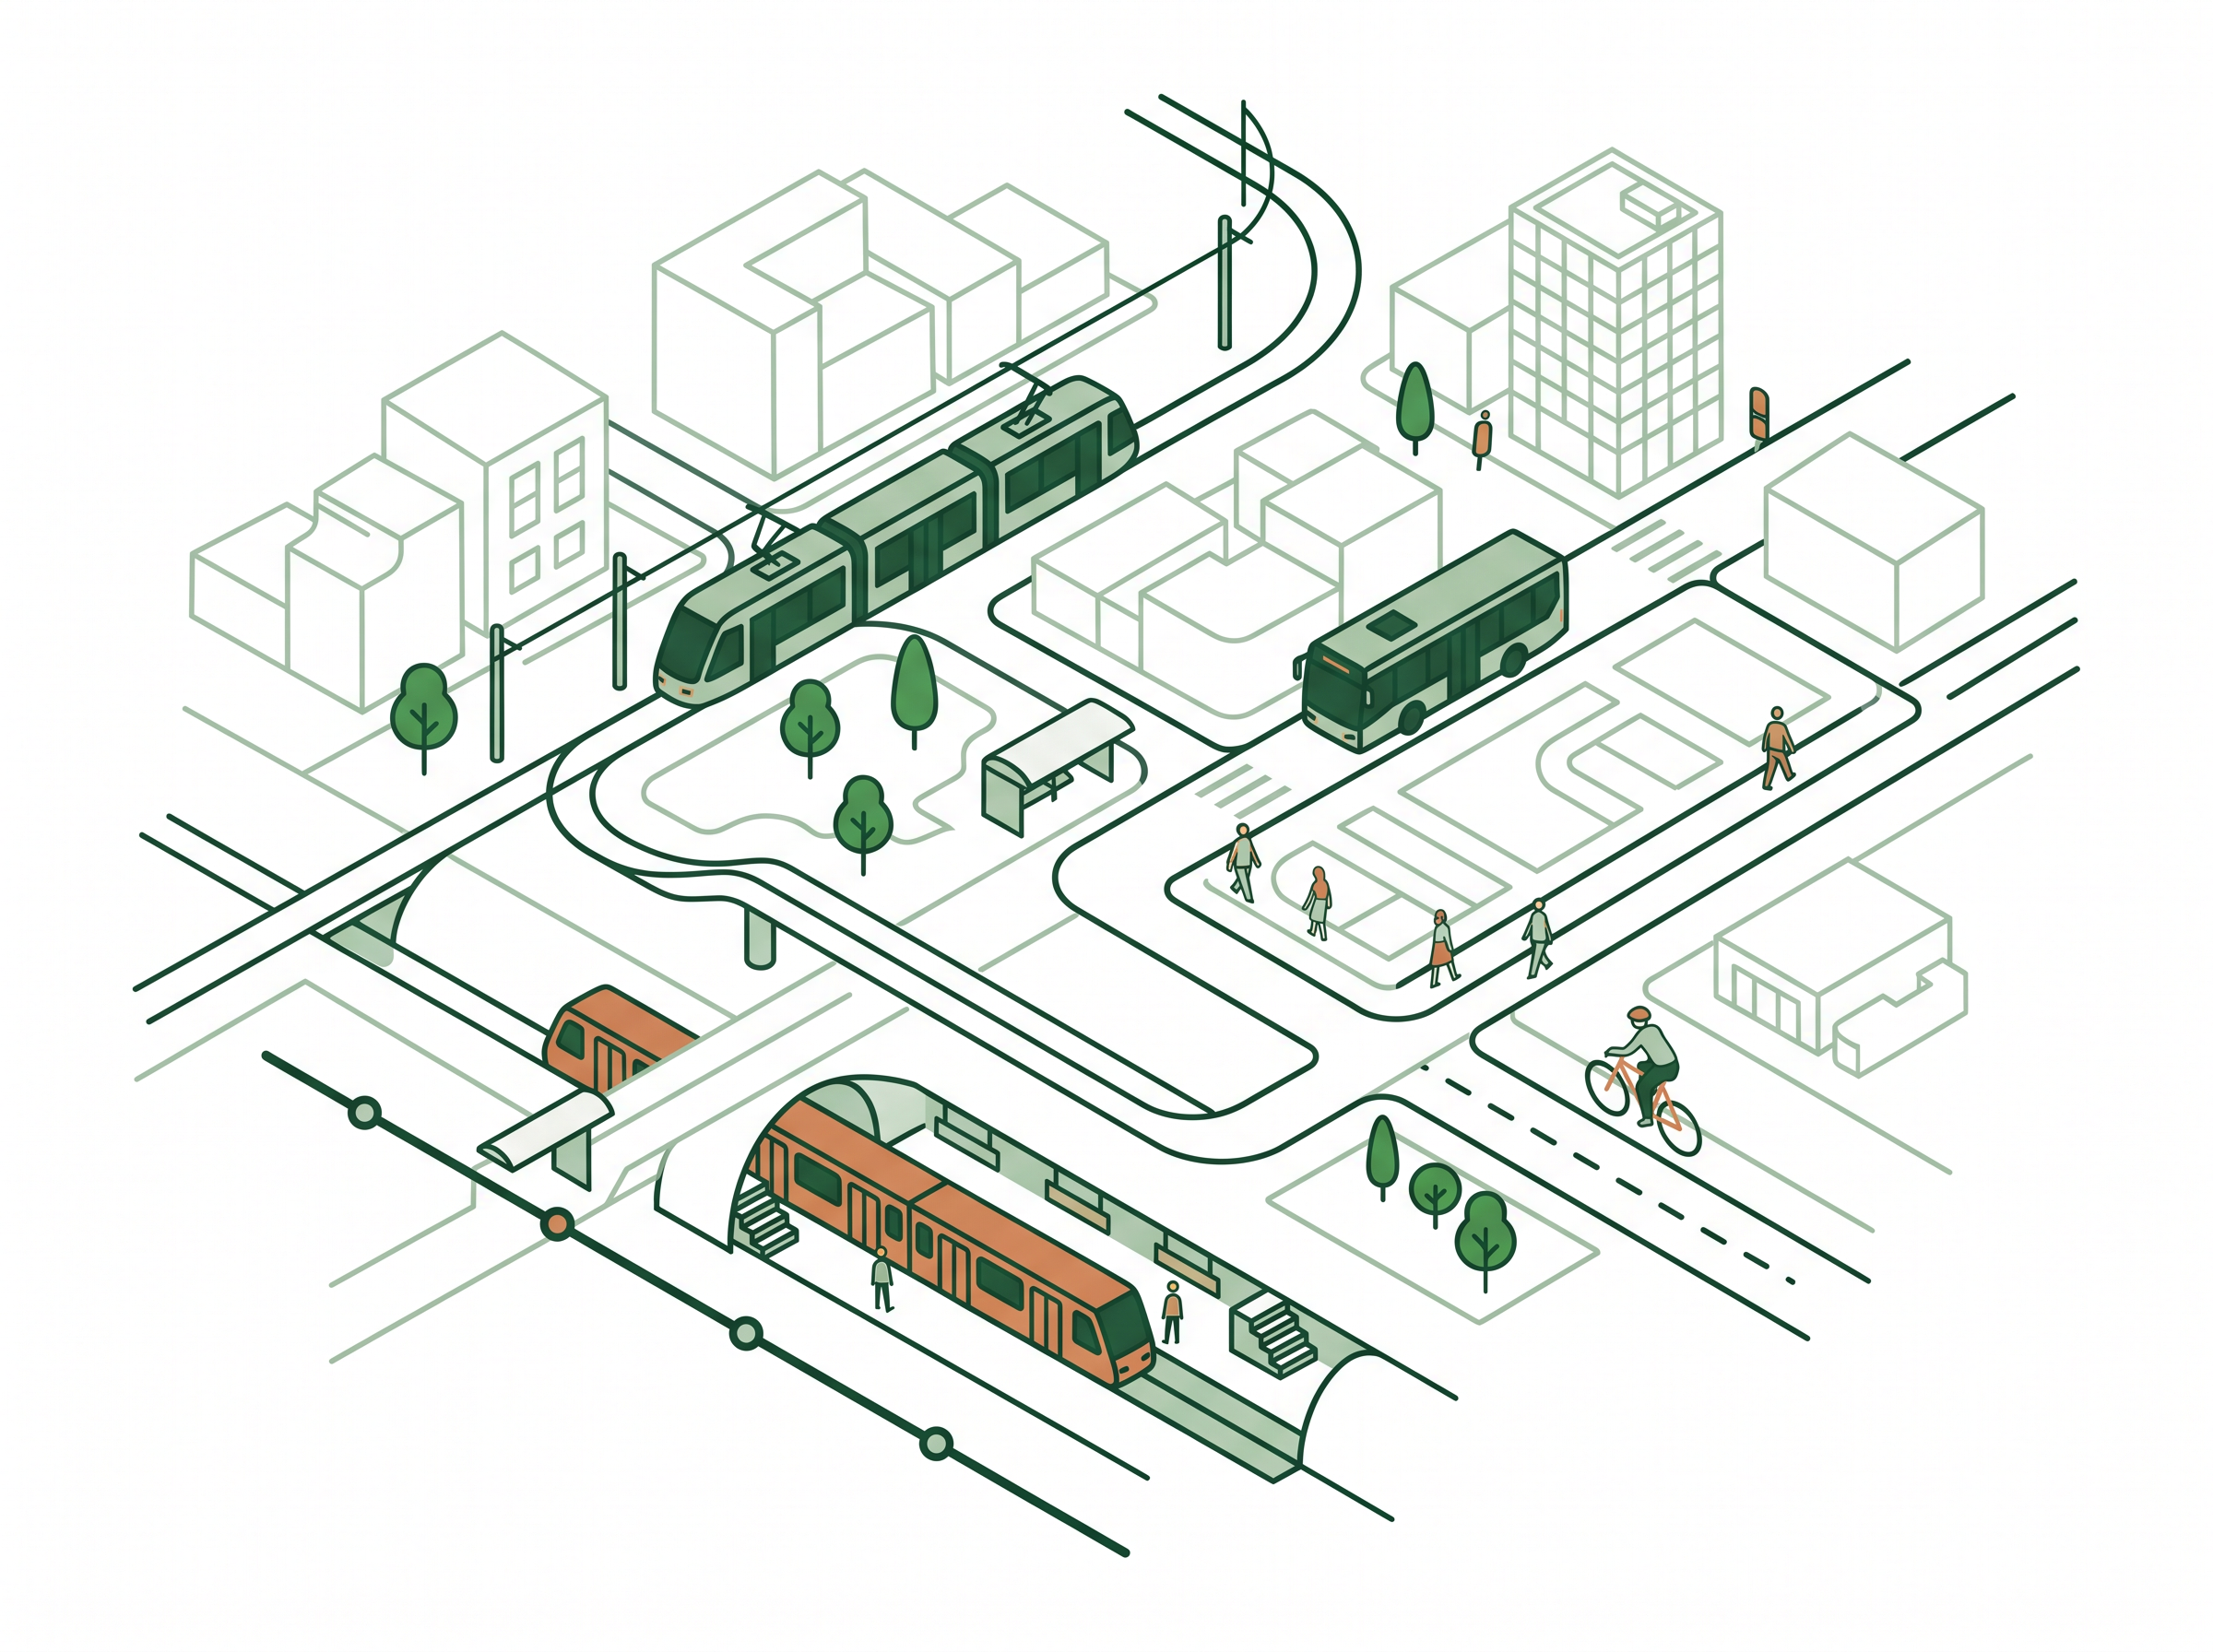
AI AND SUSTAINABILITY INTERNSHIP PROJECT
GreenRoute AI
Transparent Travel Decision Support for Lower-Emission Choices
Presented by Arman Gaurav
SDG 11 · Sustainable Cities
SDG 13 · Climate Action

Slide 2
02 — THE PROBLEM
Commuters Need Clearer Travel Choices
Students and urban commuters choose travel options using more than environmental impact. Their decisions depend on:
PROBLEM STATEMENT
Travel time and reliability
“Students and urban commuters need a transparent way to compare travel options because choosing a lower-emission route depends not only on carbon impact, but also on time, affordability, reliability, safety, weather, walking distance, and real-world availability.”
Cost and convenience
Safety, weather, and walking distance
Transport availability and delays

Slide 3
03 — PROJECT GOAL AND TARGET USERS
GreenRoute AI
GreenRoute AI helps users compare practical travel options and understand the trade-offs between convenience and lower estimated emissions.
TARGET USERS
HOW MIGHT WE
Students travelling to college
Urban and office commuters
Bus, metro, bike, private-vehicle, and walking users
Nearby commuters for whom walking may be practical
“How might we help commuters choose a practical lower-emission travel option while clearly showing trade-offs, local constraints, and the uncertainty behind route and emissions estimates?”
Bus
Metro
Bike
Private vehicle
Walking

Slide 4
04 — SDG ALIGNMENT
Sustainability Impact
PRIMARY SDG
SECONDARY SDG
SDG 11 — Sustainable Cities and Communities
SDG 13 — Climate Action
Supports informed use of lower-emission travel options.
Encourages practical consideration of public transport, metro travel, and walking.
Makes estimated CO₂ impact visible during travel decisions.
Encourages users to consider lower-emission alternatives when practical.
IMPORTANT PRINCIPLE
Lower emissions matter, but users must also consider safety, accessibility, weather, and personal constraints.

Slide 5
05 — DESIGN THINKING PROCESS
From Research to Working MVP
Empathize
→
Define
→
Prototype
→
Test
→
Improve
→
Build
Empathize
Define
Prototype
Test & Improve
Five real commuters shared how they choose travel options.
Focused on transparent route comparison rather than forcing the greenest option.
A GreenRoute AI interface was created in Stitch by Google.
Feedback led to clearer trade-offs, Walking support, estimate explanations, and responsible-AI notes.
Build — a working HTML, CSS, and JavaScript MVP was developed.

Slide 6
06 — USER RESEARCH FINDINGS
What Five Commuters Told Us
KEY FINDINGS
5
All participants understood the time, cost, and CO₂ comparison.
Different people selected different routes based on their own needs.
real participants tested the prototype
Reliability, delays, safety, weather, and walking distance can override sustainability.
Participants wanted to know how CO₂ estimates were calculated.
Participant identities and detailed locations were kept anonymous.
Participants wanted clearer explanation of the Balanced option.
Users expected Walking only when suitable for a short journey.
Qualitative feedback from a small sample; findings are indicative, not statistically representative.

Slide 7
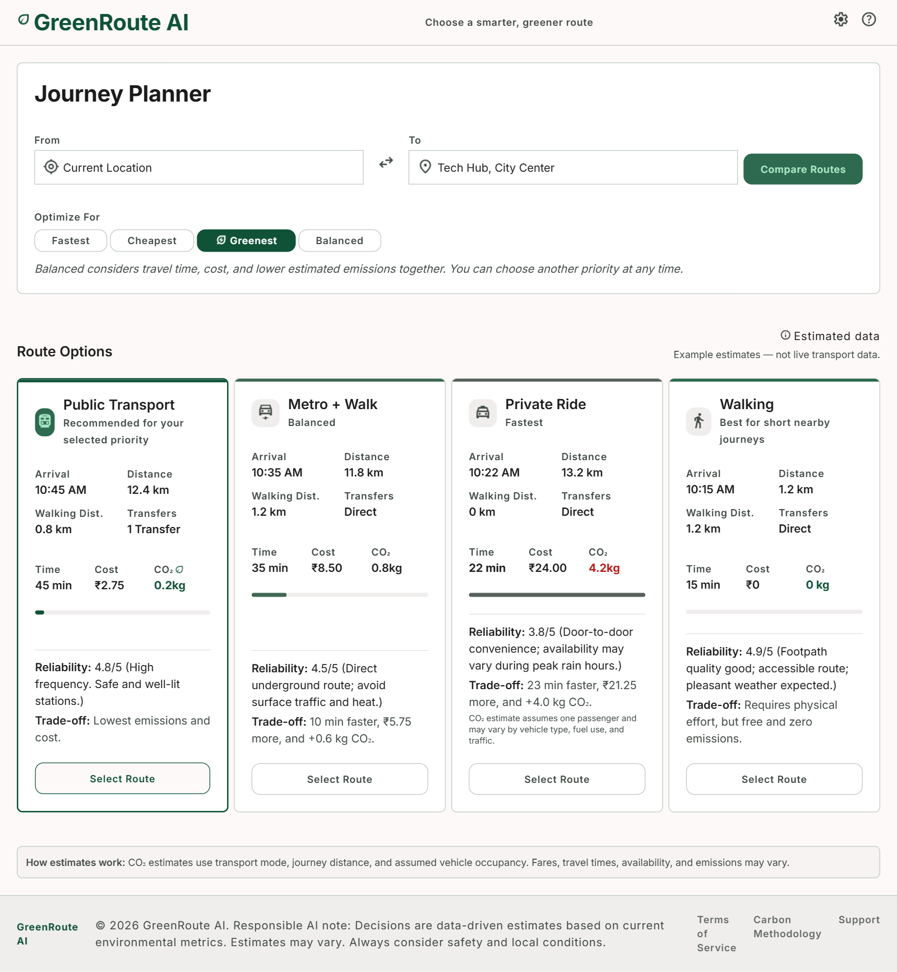
07 — PROTOTYPE ITERATION
Prototype Improved Through User Feedback
CHANGES MADE AFTER TESTING
Added Walking as an option for nearby journeys.
Explained the Balanced priority.
Added route trade-offs.
Added arrival time, distance, walking distance, transfers, and reliability.
Added safety, weather, and availability notes.
Added “How estimates work” and example-data transparency.
Prevented Walking from being recommended for an impractically long journey.
GreenRoute AI — Iterated Prototype After User Testing

Slide 8
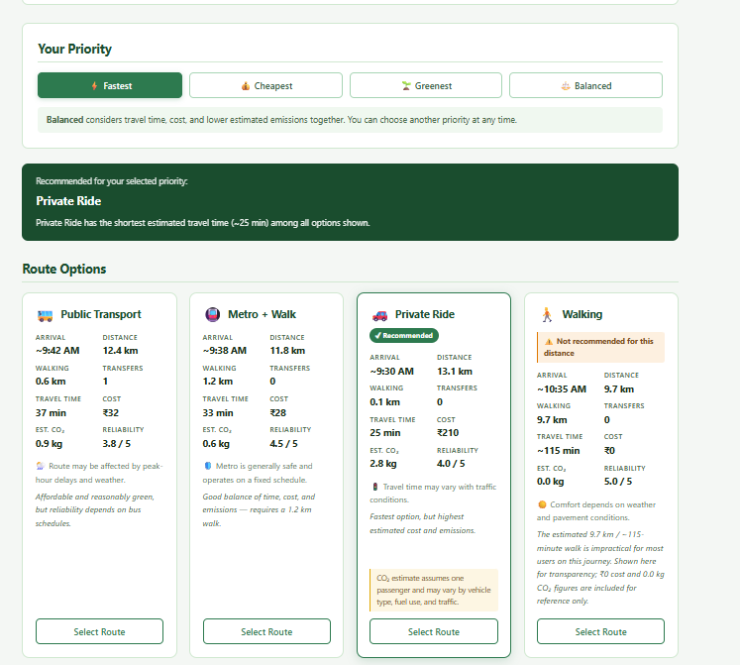
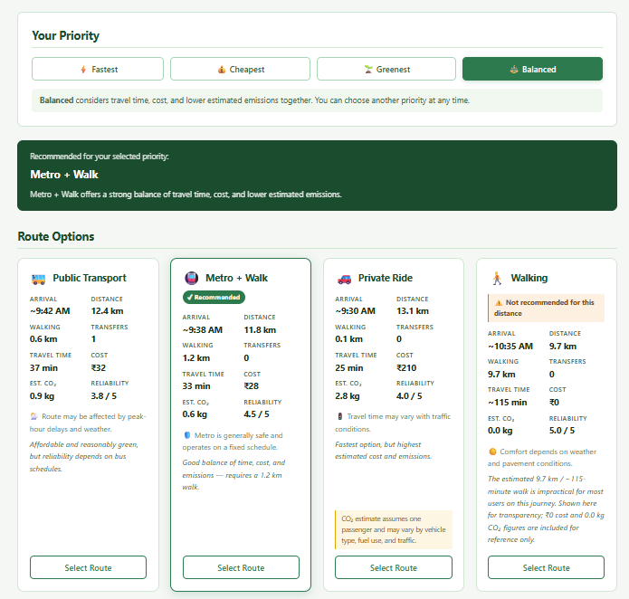
08 — WORKING MVP
GreenRoute AI MVP
BUILT WITH
HTML
CSS
JavaScript
Transparent example route data.
USERS CAN
Enter a starting point and destination.
Select Fastest, Cheapest, Greenest, or Balanced.
Compare Public Transport, Metro + Walk, Private Ride, and Walking.
View time, cost, estimated CO₂, reliability, walking distance, transfers, and trade-offs.
Read an explanation of the recommendation.
Fastest priority
Balanced priority
Example estimates shown in the interface — not live transport data.

Slide 9
09 — DECISION LOGIC AND RESPONSIBLE AI
Explainable Recommendations
The MVP uses transparent priority-based decision logic.
Fastest → Private Ride
RESPONSIBLE-AI SAFEGUARDS
Recommended because it has the shortest estimated travel time.
Example estimates only, not live transport data.
CO₂ values are estimates, not exact facts.
Users see alternative routes and trade-offs.
Walking is not recommended when the distance is impractical.
Safety, accessibility, weather, and local conditions remain important.
Cheapest → Public Transport
Lowest practical-cost option for the long example journey.
Greenest → Public Transport
Lowest practical-emission option for the long example journey.
Balanced → Metro + Walk
Balances travel time, cost, and lower estimated emissions.
Greenest also shows a lower-CO₂ Walking card for reference.

Slide 10
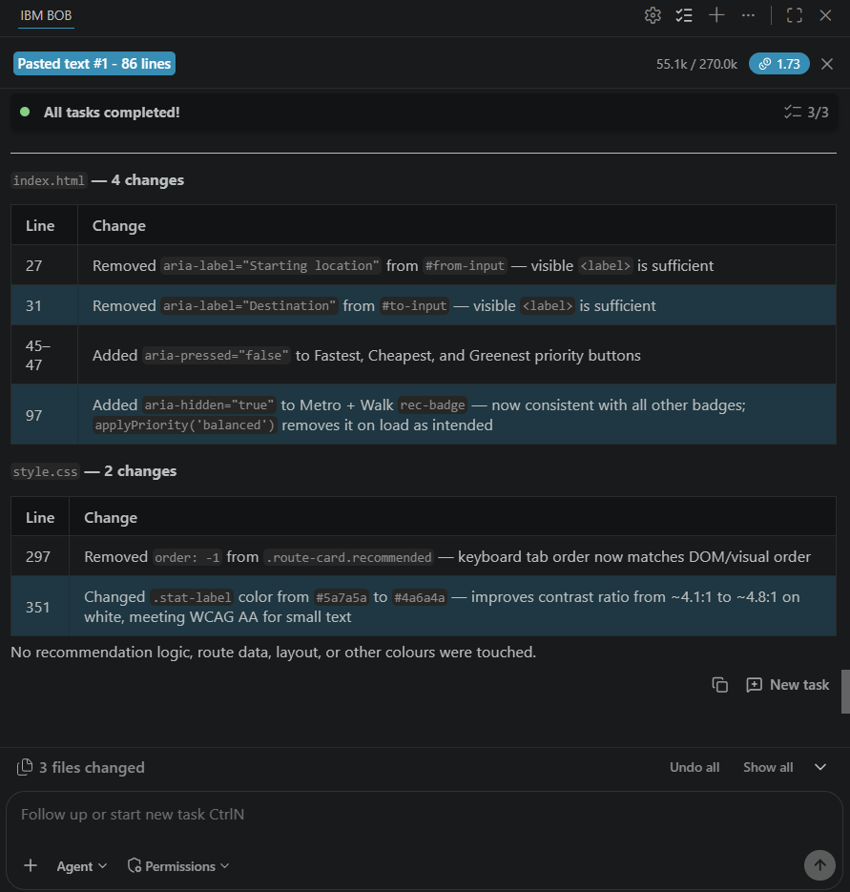
10 — IBM BOB, RESULTS, AND NEXT STEPS
Project Outcome
IBM BOB WAS USED TO
NEXT STEPS
Generate and organize the first MVP files.
Review code for accessibility and usability issues.
Improve ARIA states, text contrast, and keyboard navigation order.
Add verified local route and fare data.
Add live delay and availability information.
Add distance-aware Walking recommendations.
Test with a larger commuter group.
PROJECT OUTCOME
GreenRoute AI demonstrates a working, explainable, sustainability-focused travel decision-support MVP.
IBM Bob accessibility code review
GreenRoute AI helps users make informed travel choices by showing both sustainability impact and real-world trade-offs.

