Slide 1



Implementation of NLP Chatbot
Student name -: Gaurav Rakesh Thawal
AICTE Student ID: STU651902d40794d1696137940

Slide 2

Learning Objectives
Develop a chatbot using Natural Language Processing (NLP).
Train the chatbot using intents and responses stored in JSON.
Implement the chatbot using Python, NLTK, and Scikit-learn.
Deploy the chatbot using Streamlit for an interactive UI.
GOAL
Source :
www.freepik.com/

Slide 3
Tools and Technology used
Programming Language: Python
Libraries: NLTK, Scikit-learn, Streamlit, JSON, TfidfVectorizer, Logistic Regression
Data Processing: Tokenization, Text Vectorization (TF-IDF)

Slide 4
Methodology
Load and preprocess data from intents.json ( User queries and responses ).
Convert text to numerical representation using TF-IDF vectorization.
Train a Logistic Regression Model for intent classification.
Create a Streamlit UI to take user input and display chatbot responses.
Store conversation history in a CSV file.

Slide 5
Problem Statement:
Users require an interactive chatbot that can understand natural language queries and provide meaningful responses efficiently

Slide 6
Solution:
Utilize Machine Learning to classify user input into predefined intents.
Generate dynamic responses based on classified intents.
Implement a user-friendly chatbot UI with Streamlit.
Maintain chat history for better user experience.

Slide 7
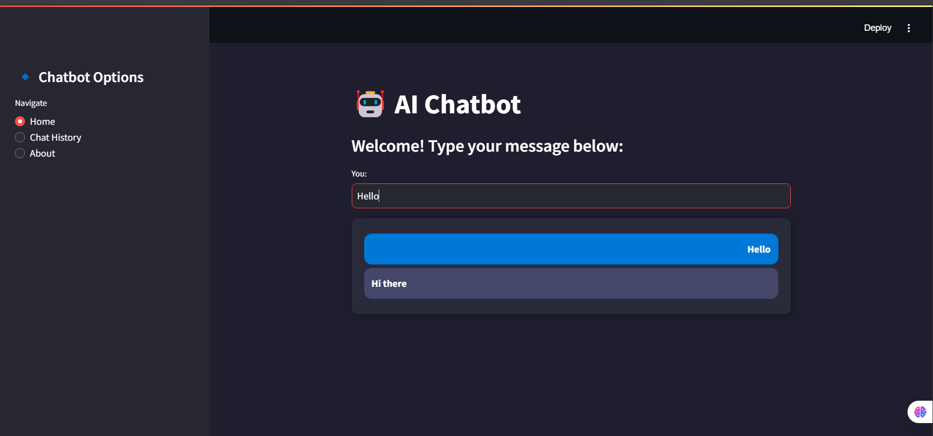

Screenshot of Output:
Real-Time Chatbot Responses

Slide 8
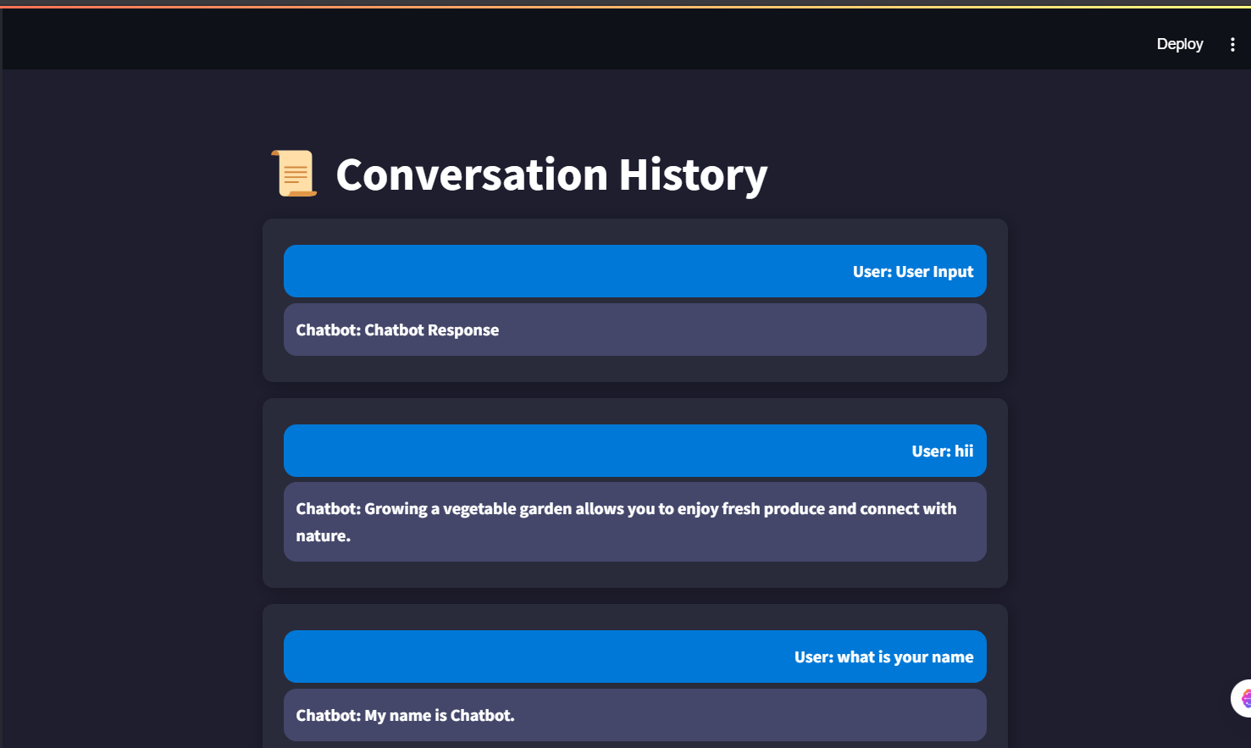
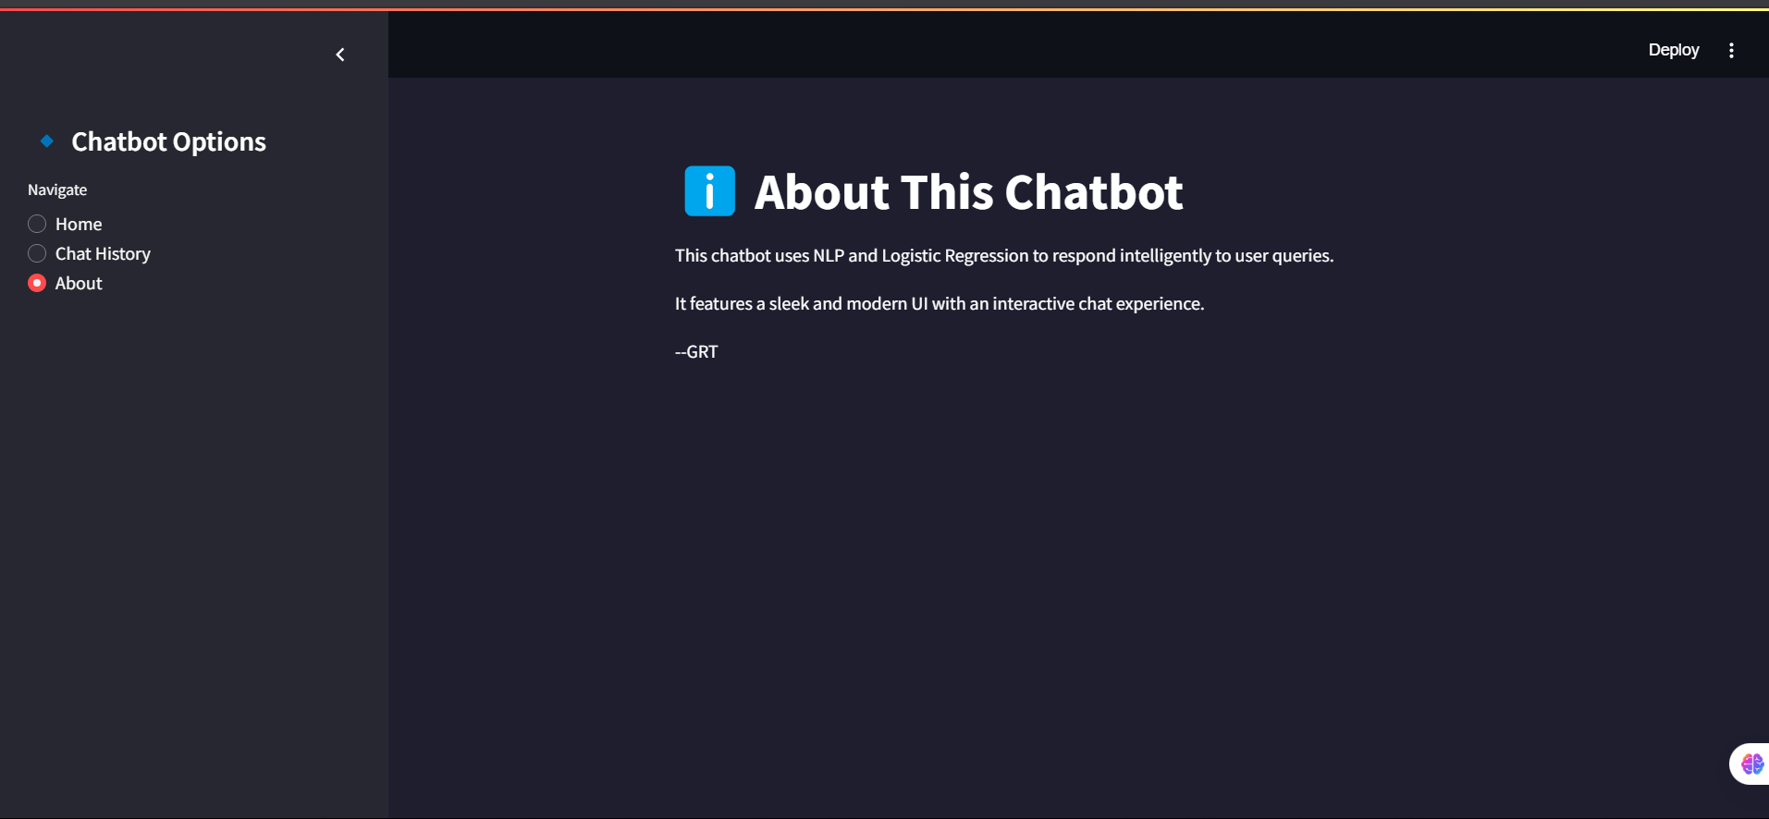
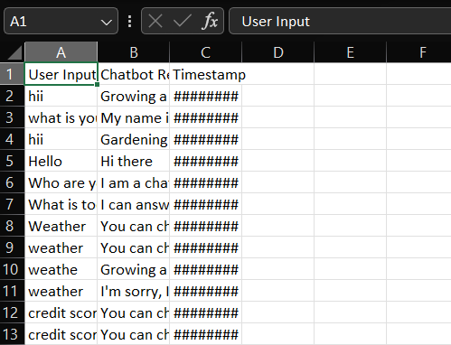
Screenshot of Output:
User Queries and Chatbot Responses Log

Slide 9
Conclusion:
Successfully built an interactive chatbot using NLP & ML techniques.
Model effectively classifies user input and responds accurately.
Future improvements can include deep learning models & real-time data fetching for enhanced performance.
GitHub link- Click here

