Slide 1

HACK4HACK CREW HIRING CHALLENGE 2026 · PROBLEM STATEMENT 1
L
A
S
T
S
E
A
T
Race-proof team formation.
Fifty people click Join on one last seat. Exactly one gets it, every time, on any number of servers, because the database is the only referee.
122 API tests on real Postgres
9 browser tests
p95 114.1 ms at 100 users
8 replica kills, 0 violations
Gaurav Tiwari · github.com/Gauravtiwari31/Race-proof
Notes:
Lastseat is hackathon team formation where every hard guarantee is enforced by Postgres in one transaction, proven by an automated test, and visible inside the product.

Slide 2
Fifty clicks. One last seat
THE PROBLEM
Most team-formation code reads the member count, checks it, then writes. Between the read and the write, everyone else reads the same count. Under real concurrency, a full team keeps accepting people.
NAIVE CODE
LASTSEAT
4
1
We ran both versions against the same database in the app’s Race Arena: 50 real requests, released together.
people got one seat
winner, every run
member_count no longer matches the members
49 clean refusals: 409 TEAM_FULL
Notes:
Same 50 clicks, two implementations. The naive one corrupts the team; ours gives exactly one winner, 20 times in a row, across two server processes.

Slide 3



Every guarantee: enforced, proven, visible
THE APPROACH
Enforced by Postgres
Proven by a test
Visible in the product
One transaction per change. Conditional UPDATE, primary keys, a partial unique index and CHECK constraints are the referee, not application code.
122 API tests run on real Postgres with no mocked data layer. Race tests release 50 connections at a barrier, and a mutation check proves they can fail.
The Race Arena runs 50 bots against the real database in one click. A naive mode shows the bug the tests guard against.
service.ts · 0001_schema.sql
race.last-seat-50 · race.mutation-check
/arena · /ops

Slide 4
One statement, no gap between check and act
THE CORE · apps/api/src/modules/teams/service.ts
1
Racers queue on the team’s row lock.
UPDATE teams
SET member_count = member_count + 1,
version = version + 1
WHERE id = $1
AND member_count < max_size
RETURNING id, member_count, version;
The first UPDATE locks the row; the other 49 wait.
2
The winner commits.
READ COMMITTED re-evaluates each waiter’s WHERE against the new row.
3
Everyone else updates 0 rows.
No row returned means 409 TEAM_FULL. Nothing to roll back by hand.
PRIMARY KEY (hackathon_id, user_id)
UNIQUE INDEX … WHERE role = 'leader'
CHECK (member_count BETWEEN 0 AND max_size)
ONE TEAM PER PERSON
EXACTLY ONE LEADER
LAST LINE OF DEFENCE
Notes:
The WHERE clause is the capacity check. Because check and write are one statement, there is no window for another request to slip in.

Slide 5
Each guarantee, what holds it up, what proves it
TRACEABILITY
Guarantee | Enforced by | Proven by
Exactly one person gets the last seat | Conditional UPDATE in one statement | race.last-seat-50, race.mutation-check
One team per person, per hackathon | memberships primary key + composite FK | race.user-two-teams, rules.composite-fk
Always exactly one leader | Partial unique index + team lock | race.leader-and-member-leave
No deadlocks | One lock order: team, members, user, requests | race.mixed-no-deadlock, race.lock-order-*
Authorisation cannot go stale | Leader check in a new statement after the lock | race.stale-leader-check
No request left pending by a join | User row as a per-person mutex | race.request-vs-join
Retries apply once | Idempotency key row in the same transaction | idem.*, chaos.fault-rollback
A crash loses nothing | One transaction per mutation | chaos.sh: replicas killed mid-storm

Slide 6
Every test was seen to fail on the bug it guards
PROVEN, NOT PROMISED
A test that cannot fail proves nothing. Each fix below was undone on purpose, and the named test went red against real Postgres.
122
Bug put back | Test | What it reported
Read-then-write seat | race.mutation-check | Several winners for one seat
Accept closes the request before adding the member | race.lock-order-accept-vs-redeem | A real deadlock (500) where 409 was due
Redeem locks the code before the team | race.lock-order-redeem-vs-delete | A real deadlock (500) where 404 was due
Leader check inside the locking statement | race.stale-leader-check | A demoted leader removed someone (200)
No per-person lock on join vs request | race.request-vs-join | A request stayed pending after its author joined
API tests, real Postgres
9
browser tests, axe + keyboard
20×
last-seat race, 2 processes

Slide 7
One database referee, any number of servers
ARCHITECTURE
api-a · Fastify
Postgres 18
SQL
Zod on every input. One transaction per change.
The referee. Row locks, keys, CHECKs.
audit_events doubles as the outbox; NOTIFY fans each change out to every replica.
React SPA
Caddy
Radix, optimistic seats, Ctrl K palette. Same origin as the API.
HTTPS
Reverse proxy, spreads load over replicas.
api-b · Fastify
SQL
Identical replica. Holds no state of its own.
LIVE: server-sent events, snapshot + versioned deltas, Last-Event-ID resume
Why not Redis, SERIALIZABLE or WebSockets? One ACID database keeps every side effect in one commit; updates only flow one way.

Slide 8
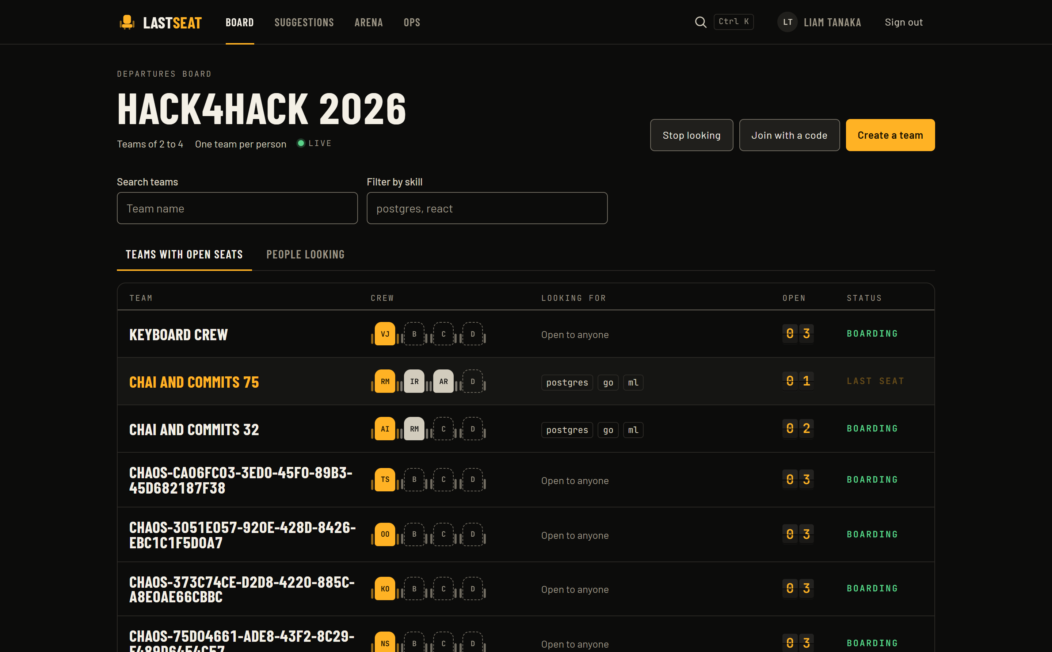






A departures board for hackathon teams
THE PRODUCT
Live board and team pages
Seats change everywhere without a refresh.
Invites and join requests
Expiring, revocable codes; leaders accept or decline.
Optimistic, and honest
A seat appears instantly, rolls back with the reason.
Explained suggestions
Missing skills and time-zone overlap, scored openly.
Audit time machine
Replay any team’s history from the audit log.
Phone, keyboard, axe
360 px, Tab-only flows, Ctrl K everywhere.

Slide 9
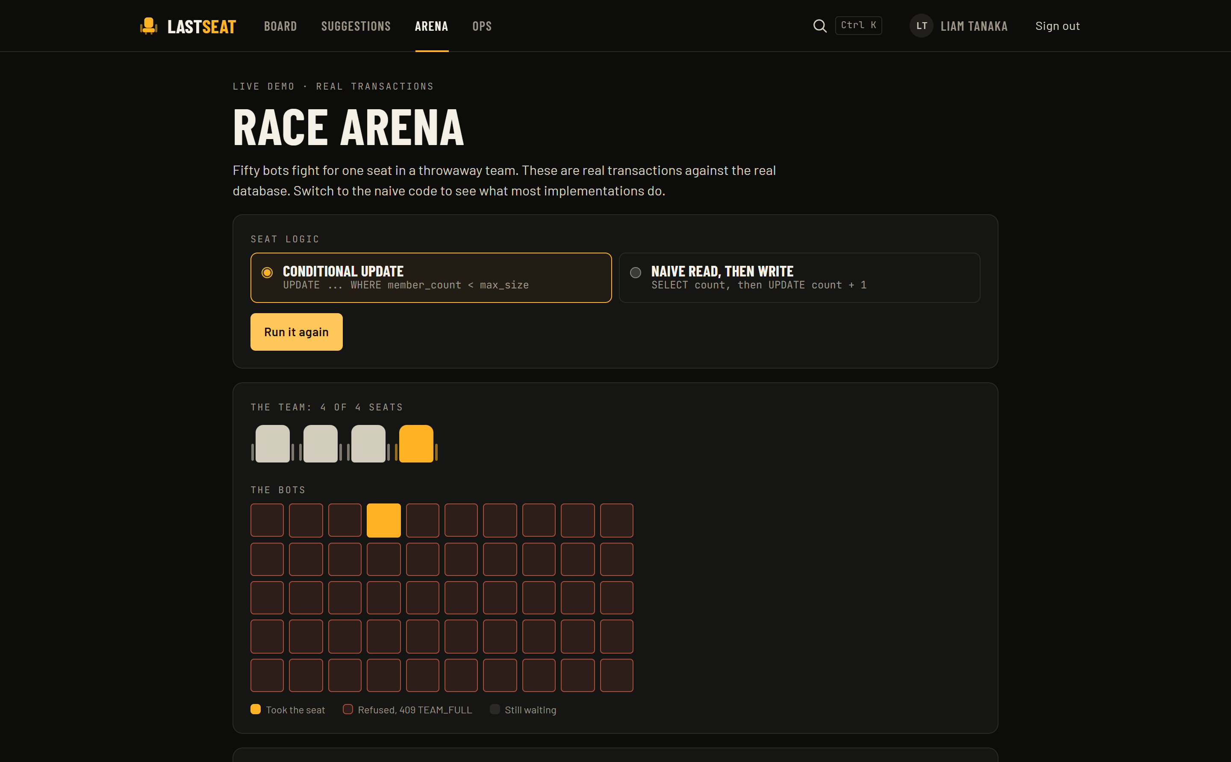
Judges can run the race themselves
THE RACE ARENA
1
Open /arena and press Unleash 50 bots.
50 real transactions hit a throwaway team with one seat left.
2
One amber winner, 49 refusals.
Each refusal is a real 409 TEAM_FULL from the database.
3
Switch to the naive mode, run again.
4 winners in our run, and a corrupted member count.
Sandboxed: its own hackathon, its own small connection pool, rate limited, excluded from the invariant checks.

Slide 10
Board p95 114.1 ms against a 200 ms budget
LOAD · k6, 100 VIRTUAL USERS, 3 MINUTES
326,379
board requests, 0 failed
1,811/s
sustained throughput
10,000
users and 2,000 teams seeded in ~1.5 s
Local Compose: two replicas behind Caddy, k6 on the same laptop. Board reads use a micro-cache keyed by board version; the mixed run keeps invalidating it, so it is the fairer number.

Slide 11

Kill a server mid-join. Nothing is lost
CHAOS · chaos/chaos.sh
8
1,280
0
Idempotent retries
replicas SIGKILLed
seats taken in the storm
invariant violations
Each write may carry an Idempotency-Key. The key row commits in the same transaction as the change, so a crash rolls back both, and a duplicate waits on the key, then replays the stored answer.
Thirty virtual users create, join and leave teams for a minute while a replica is killed every five seconds. Afterwards the same invariant checker the tests use runs over the whole database.
It holds because every mutation is one transaction: a dropped connection rolls back, and the client retries with the same key.
idem.* · chaos.fault-rollback

Slide 12






Private by default, checked after the lock
SECURITY
Leader-only actions
Unguessable invite codes
Durable rate limits
Accept, decline and remove re-check the role in a new statement after the team lock.
50 random bits, shown once, stored only as SHA-256; expiry, revocation, max uses.
Codes, logins, sign-ups and writes; in Postgres, shared by replicas, burst-proof.
Sessions and passwords
Validated input
Append-only audit log
Argon2id; 256-bit tokens stored hashed; httpOnly, SameSite cookies; CSRF header.
Zod on every body, query and parameter. Errors never carry a stack trace.
Written inside each mutation; the app’s database role cannot update or delete it.

Slide 13
Trade-offs we chose, and the next week
DECISIONS
TRADE-OFFS
WITH ONE MORE WEEK
Denormalised member count
Commit-ordered event log
CHECKED
SCHEDULED
Fast board reads; one transaction and an invariant checker keep it true.
Logical replication instead of id order for the live feed.
Server-sent events, not WebSockets
Waitlist with seat holds
ON TIME
SCHEDULED
Updates flow one way; reconnect and resume come for free.
Offer a freed seat to the next person for ten minutes.
Rate limits in Postgres, not Redis
Organiser console
ON TIME
SCHEDULED
Durable and shared; costs one write per attempt.
Create hackathons, set team sizes, export teams.
Fixed-window limiter
WebAuthn and audit partitioning
NOTED
SCHEDULED
Simple and durable; up to 2× the limit across a boundary.
Passkeys; audit table partitioned per hackathon.

Slide 14




TRY IT
F
I
F
T
Y
C
L
I
C
K
S
O
N
E
S
E
A
T
O
N
E
W
I
N
N
E
R
Live demo
https://lastseat-b4mi.onrender.com
Code, tests, design doc
github.com/Gauravtiwari31/Race-proof
Demo sign-in
user1@seed.local / demo-password-123
Run it locally
docker compose up -d --build → localhost:8080

