Slide 1
MULTIPLAYER GAME WEBSITE
MULTIO
GAURAV THAKUR
2111981291

Slide 2


INTRODUCTION
Welcome to Multio – Your ultimate destination for a diverse range of engaging multiplayer games! Challenge friends or meet new ones in a fun and competitive environment.
Diverse Game Collection – Enjoy timeless classics like Tic Tac Toe and Rock Paper Scissors, strategic Card Games, creative Scribble Games, and challenging Memory Games. There's something for everyone!
Seamless Multiplayer Experience – Our platform guarantees smooth gameplay, allowing you to connect and compete with players worldwide in real-time. Enjoy uninterrupted fun with friends and new acquaintances.
Fun for All Ages – Designed for players of all ages, Multio offers endless hours of entertainment. Whether you're a casual player or a gaming enthusiast, you'll find joy and excitement here.

Slide 3











REACT
WEB SOCKET
Aceternity UI
NODE JS
EXPRESS JS
TECH STACK
MONGO DB
TAILWIND CSS

Slide 4
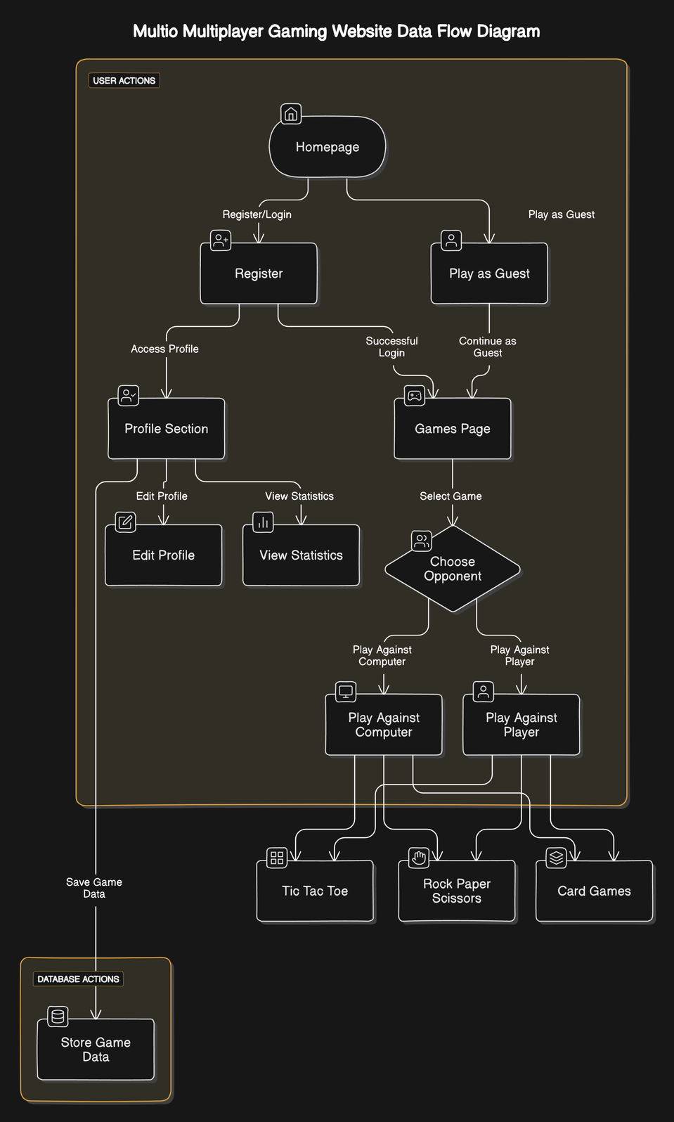
Data Flow Diagram

Slide 5
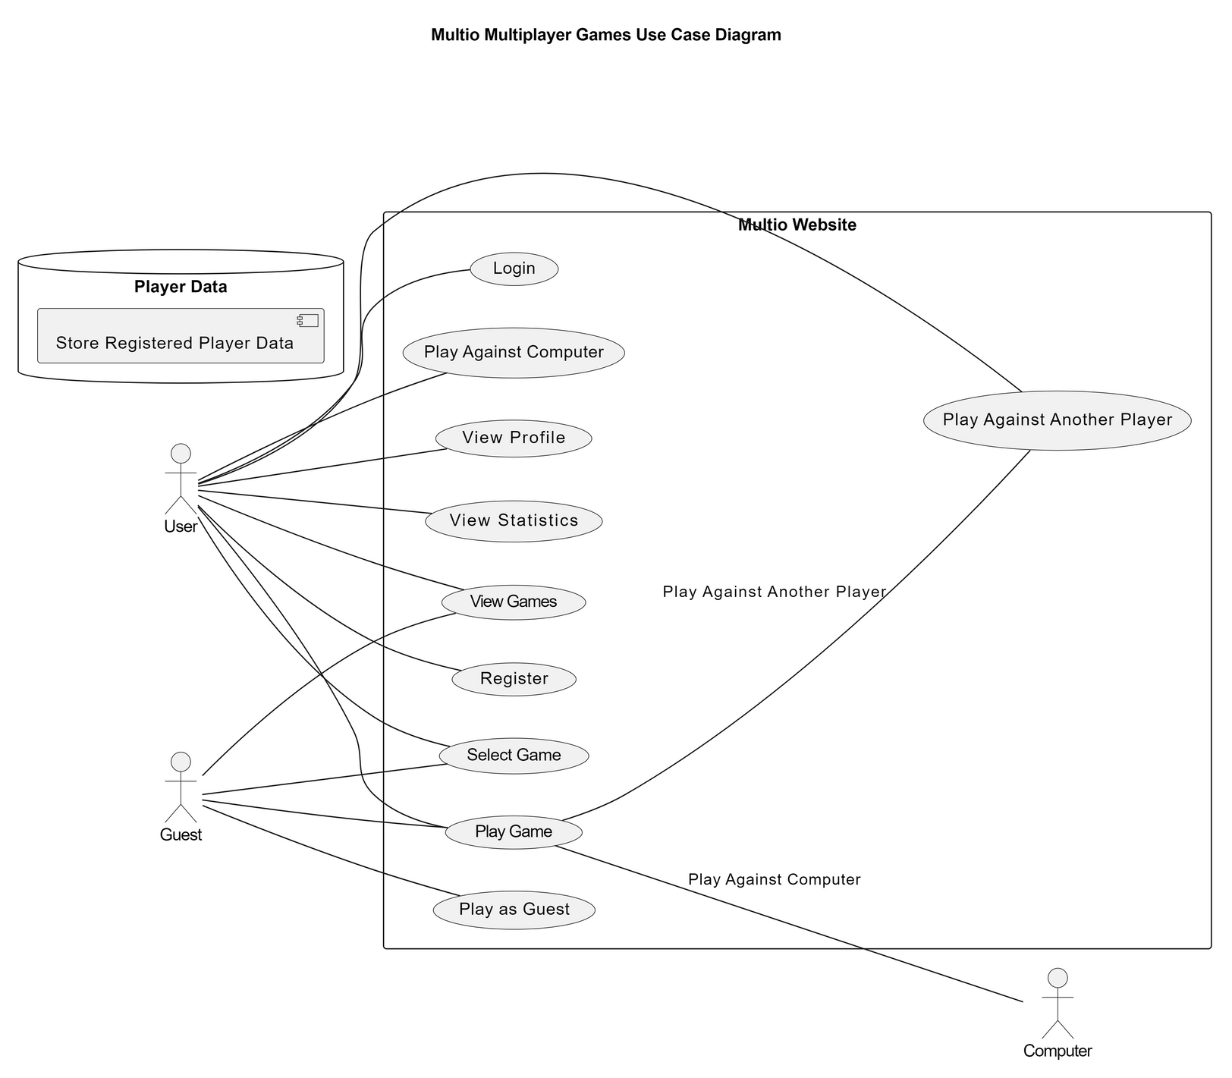
Use Case Diagram

Slide 6
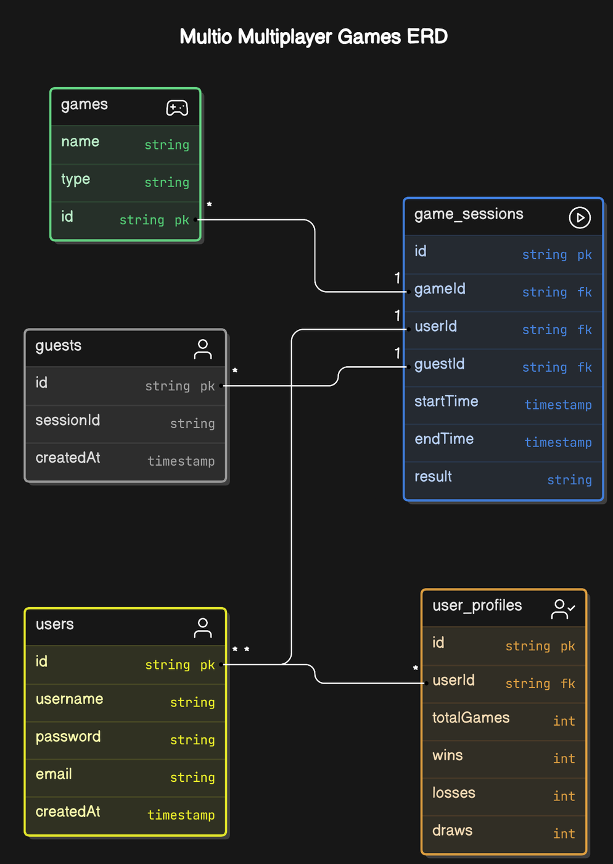
ER
DIAGRAM

Slide 7




1
Real-Time Multiplayer Functionality
2
Play Against Computer
FEATURES
3
User Profiles and Leaderboards
4
User Authentication
5
Create and Join Rooms

Slide 8








LIMITATIONS
DATA PRIVACY
SCALABILITY
USER RETENTION
Real-time Gaming involves transmitting code over the internet, which can pose security risks if not properly encrypted and secured.
Handling multiple simultaneous users and large volumes of data can strain server resources and impact performance.
Keeping users engaged over the long term can be difficult, especially with the vast number of gaming options available.Regularly introducing new content and features is essential to maintain interest.

Slide 9



FUTURE SCOPES
MORE GAMES
SEO OPTIMIZATION
TOURNAMENTS
Host competitive gaming tournaments with rewards, fostering community engagement and enhancing user experience through organized, exciting competitions.
Continuously expand the game library to include diverse genres and popular titles, ensuring fresh and engaging content for all users.
Implement effective SEO strategies to improve search engine rankings, increasing website visibility and attracting more players to the platform.

Slide 10
THANK YOU
THANK YOU

