Slide 1

Playstream
MINI PROJECT - II
A Video Streaming Platform

Slide 2

PROJECT: PLAystream
Mentor:
Mr. Bhanu Kapoor Sir
(Technical Trainer in GLA University)
Presented by:
201500371 LOKESH
201500252 GAURI AGRAWAL

Slide 3
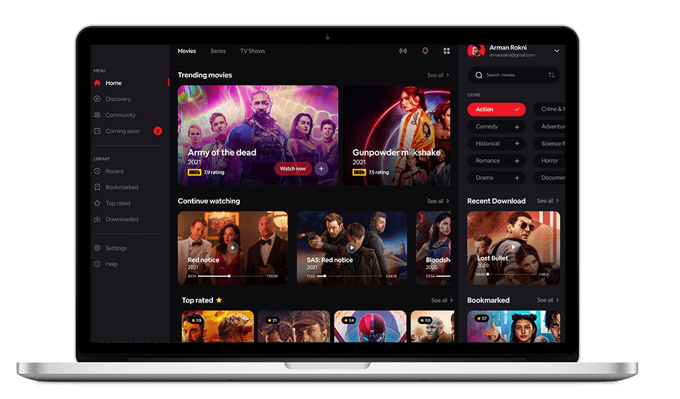
CONTENTS
Introduction​
Technologies Used and Description
​Screenshots
​Conclusion and Scope
Project Visualization

Slide 4
Introduction
This platform boasts a sleek and modern interface, making it easy to navigate and explore the vast array of videos available.
Our platform is mobile-friendly, allowing users to access and share videos on the go.

Slide 5
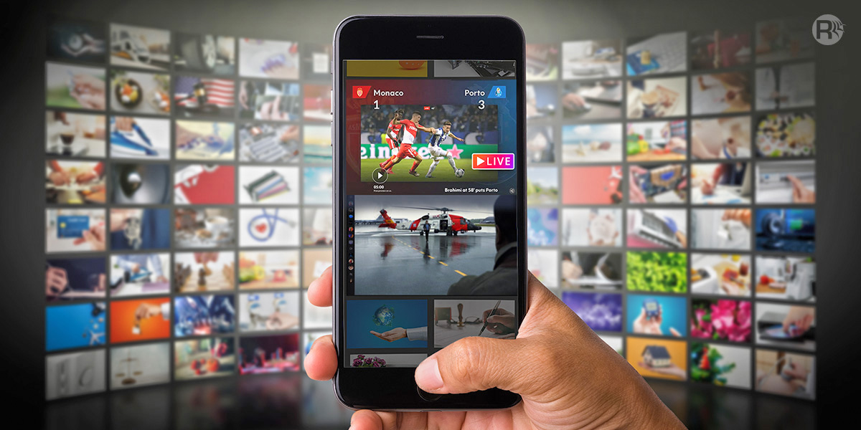
The purpose of developing this website is to entertain the end user.
Another purpose is to increase the accuracy and efficiency of exploring videos.
Long-term goal: PLAYSTREAM can be used to provide Live streams and can improve user interaction.

Slide 6
TECHNOLOGIES AND DESCRIPTION
The base technology used is based on React, scss, JSX.
Back end and Database management of this system is developed with the help of Firebase database.
The architecture allows you to easily construct a three-tier architecture (front end, back end, database) entirely using React, scss JavaScript and Firebase.

Slide 7

React is a popular open-source JavaScript library used for building user interfaces. Developed by Facebook, React allows developers to create reusable UI components that are efficient, declarative, and easily maintainable. With its virtual DOM and one-way data flow, React provides a performant way to build dynamic, interactive web applications. React's component-based architecture and extensive ecosystem of tools and libraries make it a preferred choice for modern web development, enabling developers to create highly interactive and responsive user interfaces.
Firebase helps developers to build their apps faster and in a more secure way. No programming is required on the firebase side which makes it easy to use its features more efficiently. It provides services to android, IOS , web, and unity. It provides cloud storage. It uses NoSQL for the database for the storage of data.

Slide 8
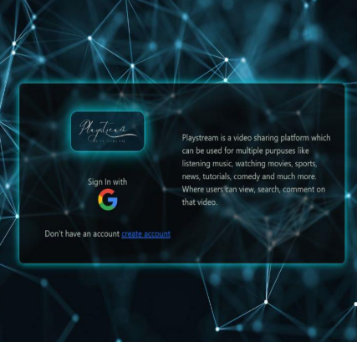
LOGIN PAGE:
Sign In with Google for more secure authentication.
If the user is not registered then click on “create account" button .
You must have Google Account to login to our website
Notifications will announce themselves if the username or password doesn’t match or gets any invalid entry accordingly .

Slide 9
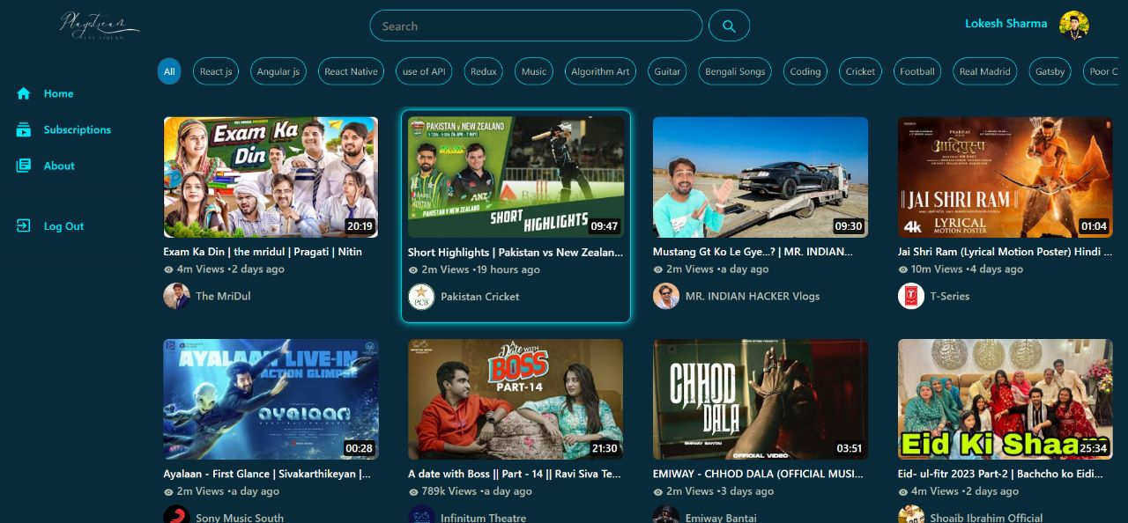
Homepage of the website:

Slide 10
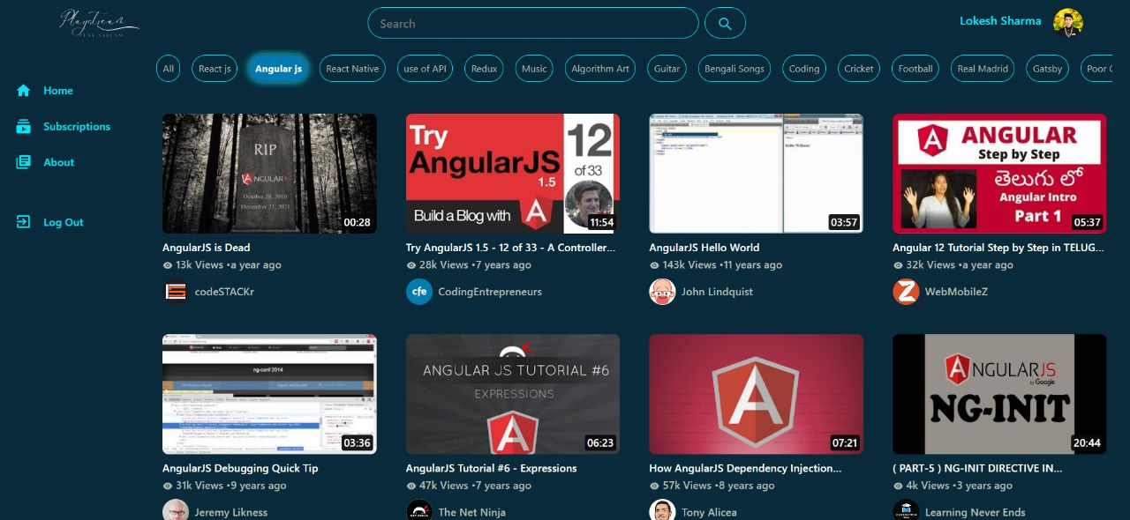
Categories Bar

Slide 11
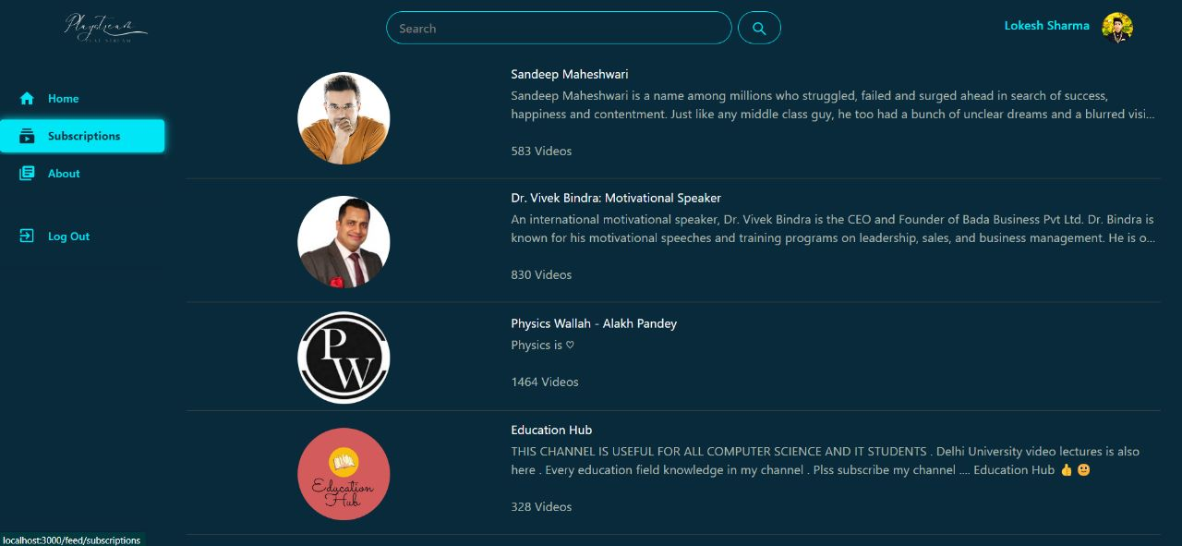
Subscription Screeen

Slide 12
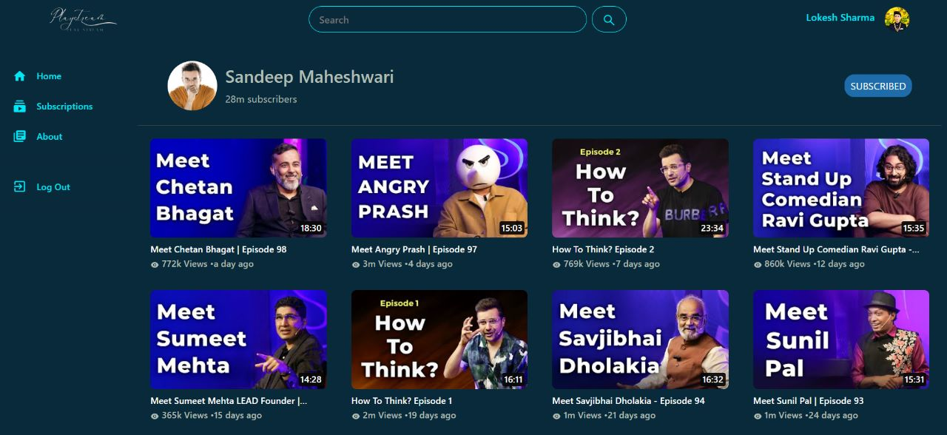
Channel Screeen

Slide 13
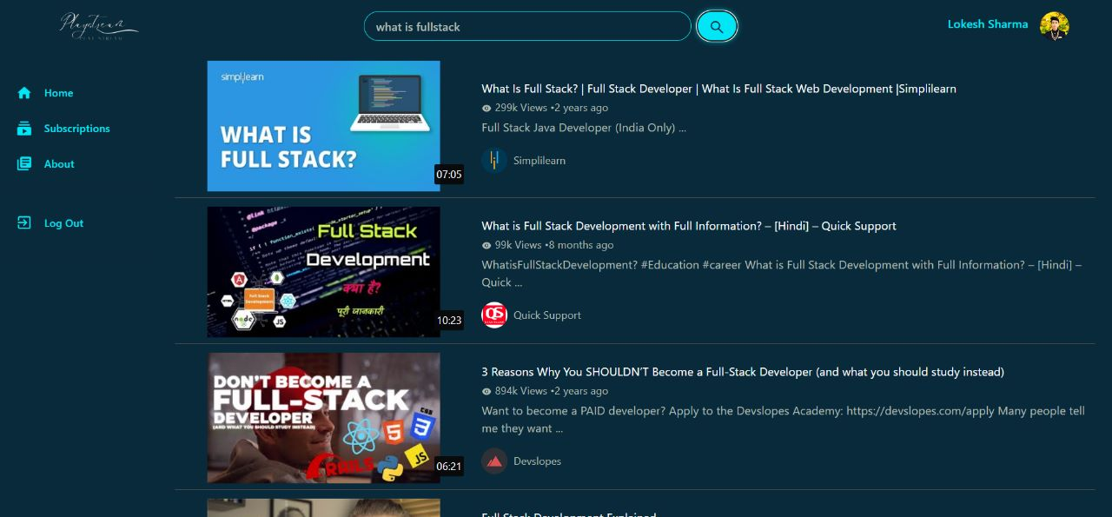
Search Screeen

Slide 14
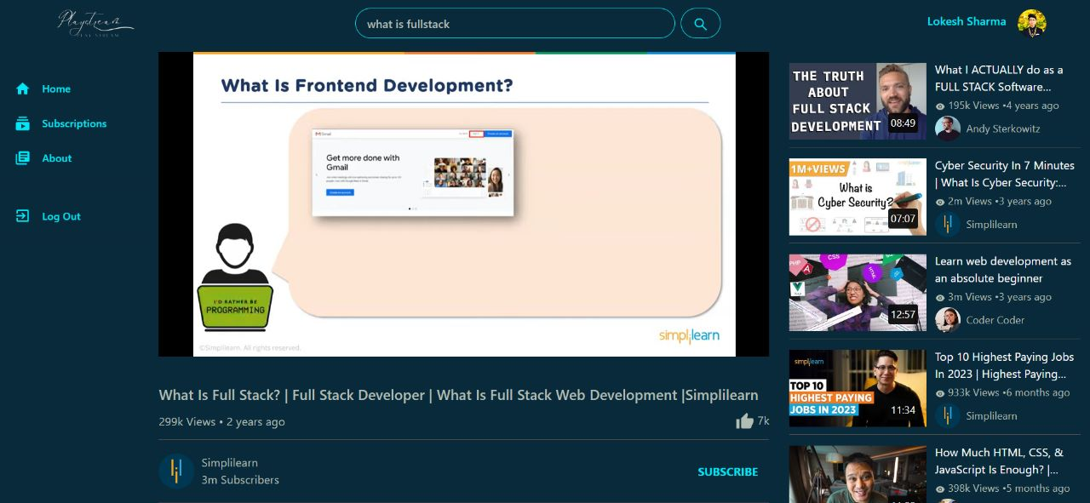
Selected Video Screeen

Slide 15
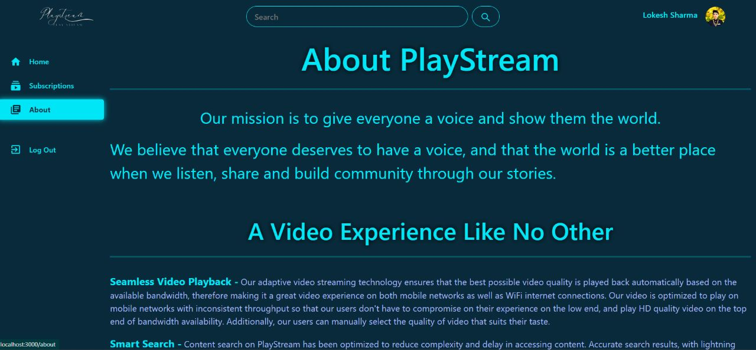
About Page

Slide 16
CONCLUSION AND SCOPE
We aim to provide a platform for content creators to showcase their talent, share their stories, and connect with audiences globally. Video sharing platforms have also become a powerful tool for businesses, marketers, and educators to communicate their messages and engage with their target audiences.
The rapid growth and popularity of video sharing platforms have transformed the media landscape, creating new opportunities and challenges for users, content creators, and platform operators alike.
The scope of video sharing platforms is vast and ever-evolving. With advancements in technology and changing user behaviors, the scope of video sharing platforms continues to expand.

Slide 17
Github link
https://github.com/Lokeshsharma1703/video-streaming-app

Slide 18
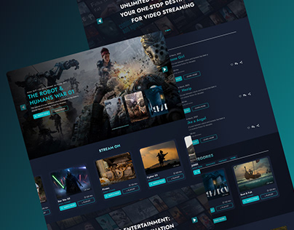
THANK YOU

