Slide 1
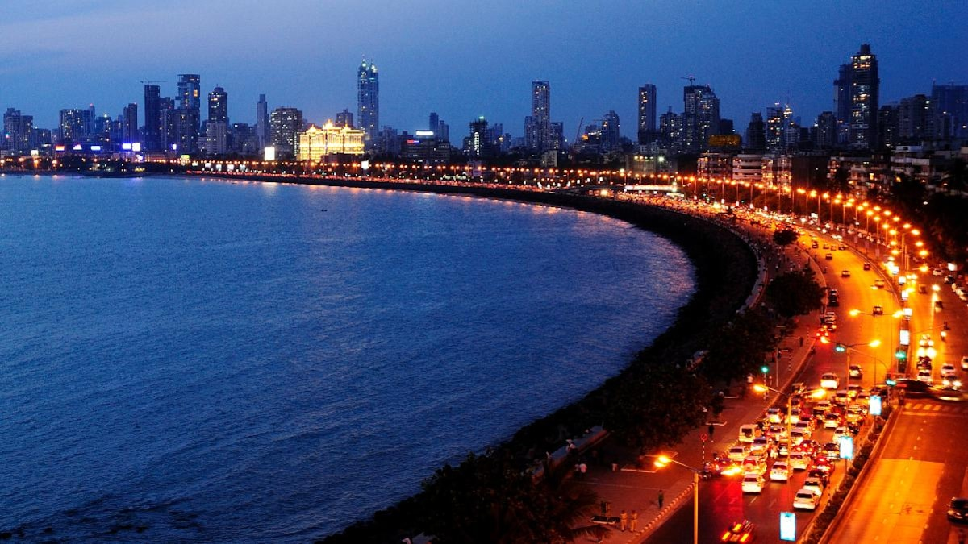
Recommending Gym Venues in Mumbai
By: Gauri Jamsandekar
July 2020

Slide 2

Business Problem
Location of Gym/Fitness Centre is one of the most important decision that will determine whether the gym will be a success or a failure.
Objective: To analyse and select the best locations of Mumbai, India to open a new Gym/Fitness Centre
Since there are lots of Gyms in Mumbai we will try to detect locations that are not already crowded with gyms.
Business question:
In the city of Mumbai, India, if a property developer is looking to open a new Gym/Fitness centre, where would you recommend them to open it ?

Slide 3
Data
Data required
List of neighbourhoods in Mumbai
Latitude and longitude coordinates of the neighbourhoods
Venue data, particularly data related to Gyms
Sources of Data
Wikipedia page (https://en.wikipedia.org/wiki/List_of_neighbourhoods_in_Mumbai)
Geocoder package for latitude and longitude coordinates
Foursquare API for venue data

Slide 4
Methodology
Web Scraping Wikipedia page for neighbourhoods list
Get latitude and longitude coordinates of Mumbai using Geocoder and plot the map using Folium
Use Foursquare API to get venue data
Group data by neighbourhood and take the mean of the frequency of occurrence of each venue category
Filter venue category by Gym/Fitness Centre
Perform clustering on data using K-Means technique
Visualize clusters in a map using Folium

Slide 5
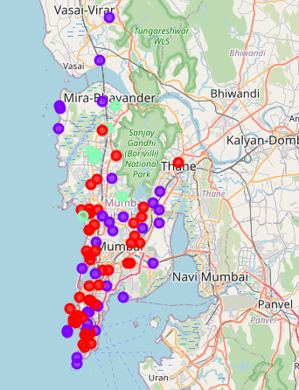
Results
Categorized neighbourhoods into 3 clusters:
Cluster 0: Neighbourhoods with moderate number of gyms
Cluster 1: Neighbourhoods with low number to no existence of gyms
Cluster 2: Neighbourhoods with high concentration of gyms

Slide 6
Recommendation
Open new gym or fitness centre in Eastern and Harbor suburbs of Mumbai with little to no competition
One with unique selling propositions can also open new Gyms/Fitness Center in neighborhoods in South Mumbai with moderate competition, to stand out from the competition
Avoid neighbourhoods in western suburbs of Mumbai as there is already high concentration of gyms.

Slide 7
Conclusion
The neighbourhoods in cluster 1 are the most preferred locations to open a new shopping mall
Findings of this project will help the relevant stake holders to capitalize on the opportunities to open a Gym or Fitness Center in Mumbai while avoiding overcrowded gym areas .

Slide 8
Thank You!

