Slide 1

Unlocking Chicago:
A Hidden Map Experience for City Explorers
Group 8: Hasti Mehta, Gauri Khanolkar, Taha Mir, Gage Bergmann

Slide 2
Requirements
Safe Exploration Paths: As a student or newcomer, I want the app to provide detailed information about safe, well-lit, and frequented routes to feel secure while exploring unfamiliar areas.
Progress and Achievement Tracking: As a user, I want a progress tracker that shows the parts of the city I’ve uncovered and awards achievements, allowing me to celebrate my exploration journey.
Local Cultural and Historical Facts: As a history or art enthusiast, I want the app to display interesting facts about landmarks I encounter, so I feel more connected to the city’s heritage.
Social Engagement and Contribution: As a user, I want the option to upload photos of places I discover and interact with other users, so I feel part of a community of explorers.
Leaderboard and Friendly Competition: As a competitive user, I want to compare my progress with others through a leaderboard and friendly challenges, which will motivate me to continue exploring.

Slide 3
Persona 1 - Emily
Demographics:
Age: 19
Gender: Female
Ethnicity: Hispanic
Occupation: Undergraduate student
Location: Recently moved to Chicago from a rural area for college
Goals:
To become familiar with Chicago's cultural, historical, and hidden locations at her own pace
To find local hangouts and safe places to explore near her college
Frustrations:
Finds large cities overwhelming and gets disoriented without clear guidance
Prefers to explore areas known to be safe and popular among her peers
Motivations:
Wants to feel independent and secure navigating a new city
Enjoys discovering lesser-known places that provide unique experiences

Slide 4
Persona 2 - Sarah
Demographics:
Age: 24
Gender: Male
Ethnicity: Middle Eastern
Occupation: Junior software developer
Location: Recently relocated to Chicago for a new job
Goals:
To explore neighborhoods outside of his immediate area to feel more settled and connected
To locate activities and landmarks that align with his interests in history and art
Frustrations:
Limited free time outside of work, which makes planning difficult
Finds general navigation apps uninspiring, lacking cultural or historical context
Motivations:
Interested in discovering Chicago’s rich history and vibrant arts scene
Enjoys competitive elements, tracking his progress and sharing achievements

Slide 5
Scenarios
Sharing Campus Tracking Progress with a Friend
A user is talking to their friend about the area they live in -> they show them how they’ve tracked where they’ve already been on campus with the app-> they then share them the link to their account so they can be friends on the app
Exploring Landmarks After a South Loop Trip
A user arrives home from a day trip to the South Loop neighborhood, so they go to the landmarks page and filter by South Loop to see a sorted collection of the landmarks they’ve found -> The user spends a few minutes reading facts about the places they just saw in the location description.
Discovering New Routes to Routine Destinations
A user needs to go to the store, but is tired of the same path they take each trip. -> They analyze their map, approximate an undiscovered section -> User stumbles upon a landmark, and learns something new about their neighborhood

Slide 6
Implications for Design
Design and tweak features with the goal of keeping users from getting discouraged or overwhelmed:
In the current state of development, our app presents balancing issues that relate to some of the core concepts of the “game”. To put it simply, Chicago is a big city. Dedicating a page in the app that allows a user to see how much of the city they’ve discovered is novel in concept, but becomes a bit harder to justify when functionally, it just puts into perspective how unreasonable it is to expect a median user to make visible progress on their *macro* map. The real solution to this problem is to potentially re-orient our app to focus on smaller areas for a user to discover, such as a college campus, but a short term answer might be to de-emphasize the completion aspect of it.
Precision with what is labeled on the map and what isn’t to ensure intended usability
One of the aspects of this app which is immensely important to user experience is how we display our information to our users. Things like roads, food markers, and pre-packed points of interest conflict with the locations we want to include as part of our app. Neglecting those features isn’t possible with the free version of our map library, so keeping them from distracting the UE is a high priority. Additionally, added labeling can be implemented in our neighborhood data, such as neighborhood names. Lastly, we want to discourage users from “exploring” potentially dangerous places labeled on our map as explorable, such as highways or airports.

Slide 7
Information Design
Neighborhood map boundaries denoted with GeoJSON coordinate data, rendered by Leaflet Javascript Library.
Allows us to upload publicly available boundary data for all of chicago neighborhoods as a collection of polygons, giving us the ability to display each neighborhood as their own unique, actionable entity
User’s location data denoted with GeoJSON coordinates, applied to neighborhood map data using Turf.js geospatial toolkit.
Allows us to apply more mathematical functions to the boundary data, such as calculating the areas of each neighborhood (for user completion percentages) as well as applying intersections between multiple sets of polygons (allows us to “subtract” the explored user area from the original neighborhood data upon rendering).

Slide 8
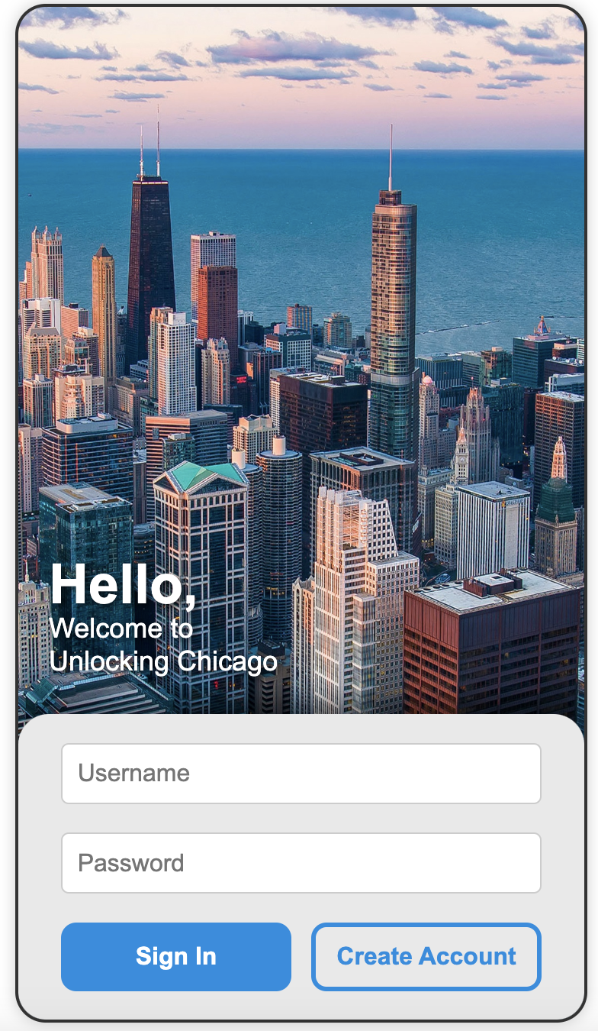
Link to Prototype
https://github.com/GageBergmann/422-Project
To use:
Load repository on IDE.
Navigate to UnlockChicagoSignIn.html
Launch with live server

Slide 9


