Slide 1

SANJIVANI UNIVERSITY
School of Engineering & Technology (SET)
DEPARTMENT
ARTIFICIAL INTELLIGENCE & DATA SCIENCE
“Intelligent Sign Language Interpretation System Using Multi-Modal Deep Learning Architectures”
Presented by:
Siddhi Gawali (2124UDSF2059)
Gauri Lad (2124UDSF2008)
Under Guidance of:
Prof. Jeevesh Upadhyay

Slide 2
DATASET OVERVIEW
Source: ASL Alphabet Dataset (29 classes: A–Z, del, nothing, space)
Size: ~87,000 labeled images
Split: 80% training, 20% validation
Preprocessing:
  Resize: 224×224 pixels
  Normalization (mean/std scaling)
  Data Augmentation: Rotation, flip, brightness adjustments
Visual: sample dataset images.

Slide 3
Model Architecture 1 (CNN)
Title: Convolutional Neural Network
Content:
Layers: 4 Convolution + 3 Fully Connected
Activation: ReLU + MaxPooling
Regularization: Dropout 0.5
Parameters: ~2M trainable parameters
Purpose: Extract robust visual features from raw images
Visual: CNN architecture diagram

Slide 4
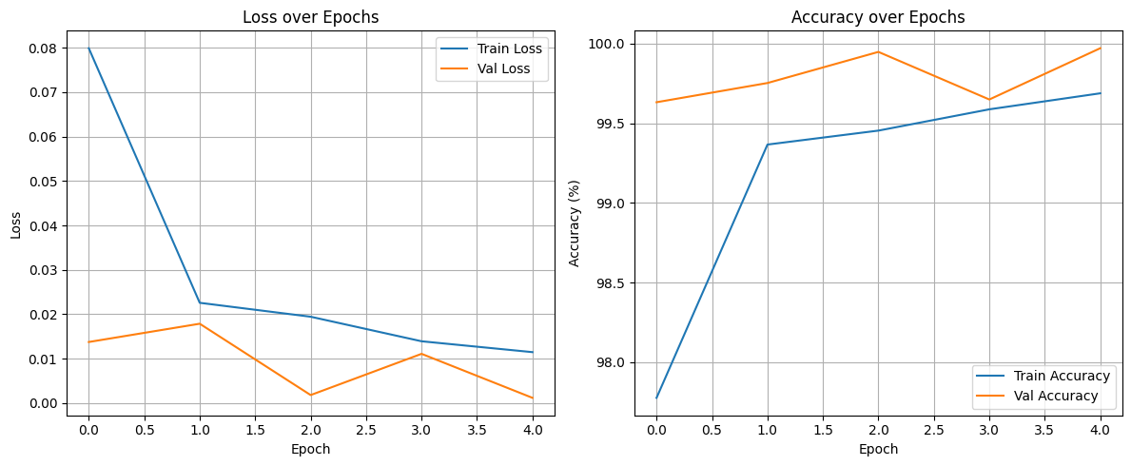
Model Architecture 2
Title: ResNet-18 (Transfer Learning)
Content:
Base: Pre-trained ResNet-18 on ImageNet
Modification: Replace final FC layer → 29 outputs
Training: Fine-tuning with frozen early layers for efficiency
Purpose: Leverage pretrained deep features for higher accuracy
Visual: ResNet training graph.

Slide 5
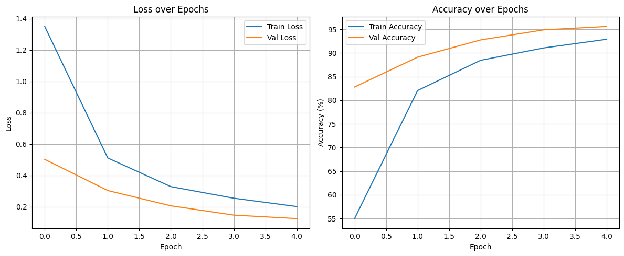
Model Architecture 3 & 4
Title: Vision Transformer (ViT) & Graph Neural Network (GNN)
Vision Transformer (ViT):
Patches: 8×8
Encoder Layers: 3
Attention Heads: 4
Position embeddings + classification token
Graph Neural Network (GNN):
Nodes: Image patches
Edges: Spatial adjacency
Layers: 3 GCN + global pooling
Node features: Color + position statistics

Slide 6
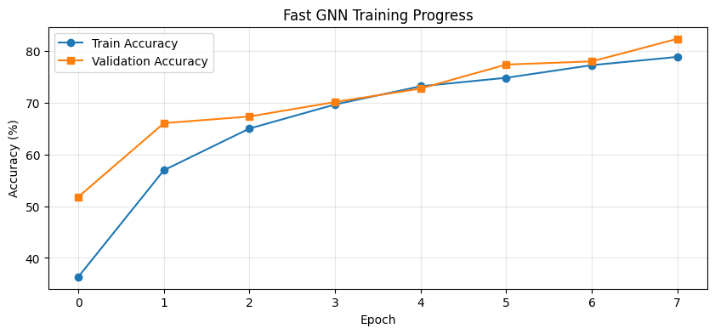
GNn training

Slide 7
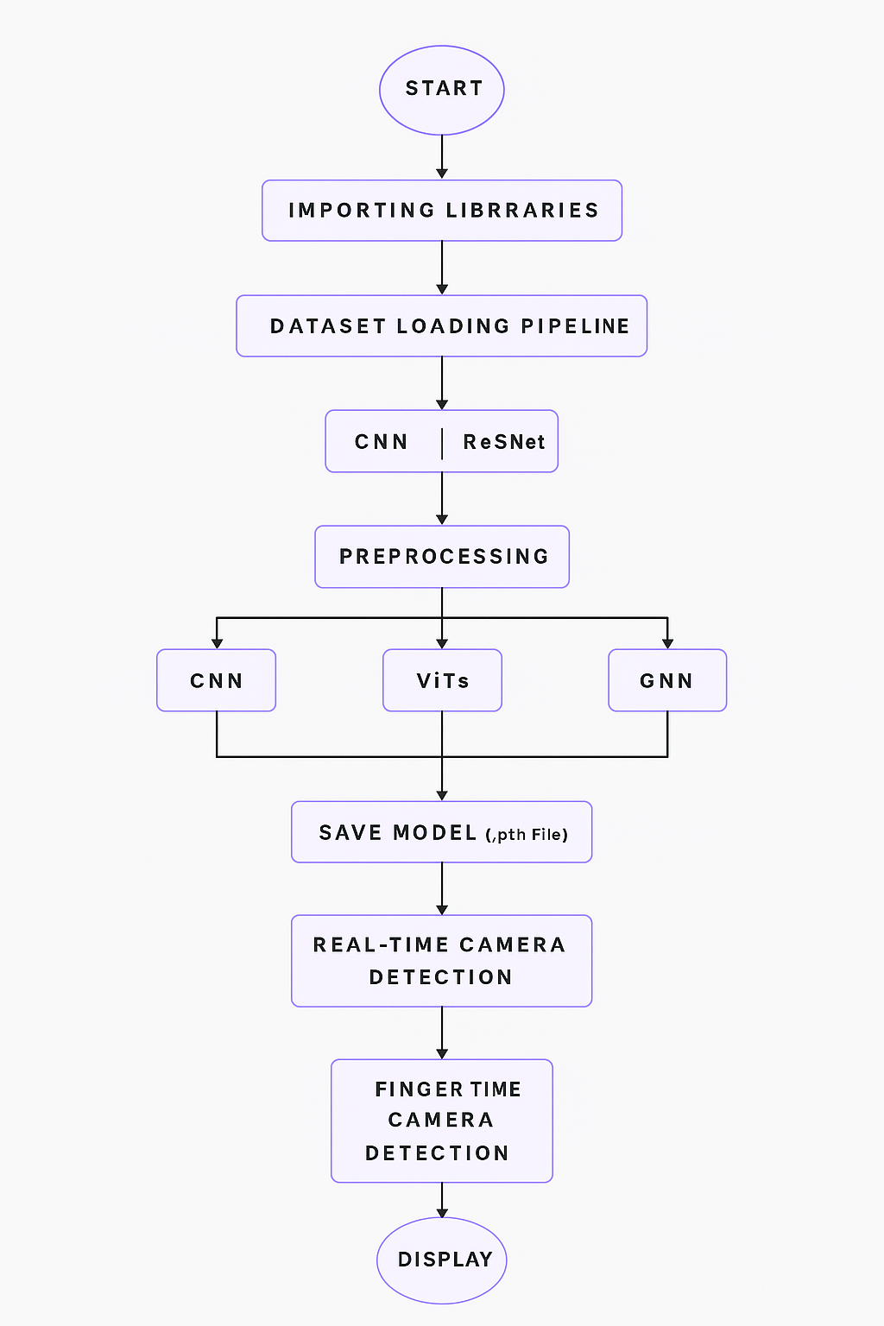
FLOWCHART

Slide 8
Model Training Pipeline
Data Loading – Batch size: 32
Training – Adam optimizer (lr = 0.001)
Validation – Cross-entropy loss monitoring
Early Stopping – Patience = 10 epochs
Model Saving – Best accuracy checkpoint
Visual: Flowchart showing Training Loop: Load → Train → Validate → Save

Slide 9
FUTURE WORK
Enhanced Model Training – Further optimize CNN, GNN, and ViT architectures for higher train and test accuracy through hyperparameter tuning, regularization, and larger datasets.
Cross-Model Performance Comparison – Conduct detailed evaluation of all three models (CNN, GNN, ViT) to identify the most effective approach for ASL recognition in terms of speed, accuracy, and generalization.
Finger Spelling Analysis – Extend the system to handle continuous finger spelling and complex sequences, improving recognition of subtle hand shape variations.
Dataset Expansion – Incorporate real-world ASL video data and diverse lighting/angle conditions to improve robustness.
Real-Time Optimization – Reduce inference time for real-time camera-based detection without compromising accuracy.

Slide 10

THANK YOU!

