Slide 1
MTB Isolate vs SpitSeq Sample Analysis

Slide 2
Project Overview
Objective: Analyze MTB isolate samples for variants using WGS data.
Steps:
Identify drug-resistance markers: Particular SNPs that occur in genes develop resistance to antibiotics (e.g., rpoB for rifampicin, katG for isoniazid). Detecting these helps predict drug susceptibility.
Study evolution and lineage: SNP patterns help classify isolates into lineages and understand evolutionary relationships between strains.
Track outbreaks: Comparing SNP profiles across isolates can reveal transmission chains in a population.

Slide 3
Pipeline
Raw Read QC: Assess sequencing quality and identify potential issues in raw FASTQ files using FastQC.
Read Trimming: Remove sequencing adapters and low-quality bases using Trimmomatic.
Post-Trim QC: Reassess read quality with FastQC to confirm successful preprocessing.
Read Alignment: Align cleaned reads to the M. tuberculosis H37Rv reference genome using BWA-MEM.
BAM Processing: Add read-group information and identify PCR duplicates using GATK MarkDuplicates, generating processed BAM files for downstream analysis.
Variant Calling: Identify genomic variants using GATK HaplotypeCaller with ploidy = 1, reflecting the haploid nature of M. tuberculosis.
Variant Filtering: Retain high-confidence variants by filtering based on variant quality (QUAL ≥ 20) and read depth (DP ≥ 10).
Drug-Resistance Annotation: Annotate variants using TB-Profiler to identify mutations associated with antimicrobial drug resistance.

Slide 4
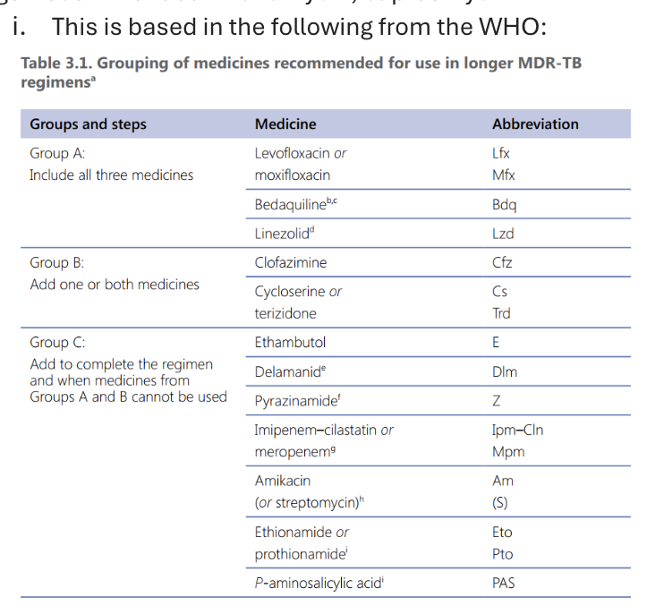
Tb profiler
TB-Profiler generates:
drug resistance predictions – gene, type, frequency
lineage classification
variant reports
Drug resistance predictions include mutations associated with resistance to:
First line drugs = isoniazid, rifampin, ethambutol, pyrazinamide
Group A Drugs = bedaquiline, linezolid, moxifloxacin, levofloxacin
Group B Drugs = clofazimine, cycloserine
Group C Drugs = pretomanid, delamanid, amikacin, streptomycin, ethionamide, PAS
No longer recommended = kanamycin, capreomycin
Table 1: Grouping of medicines based on MDR-TB regimens

Slide 5
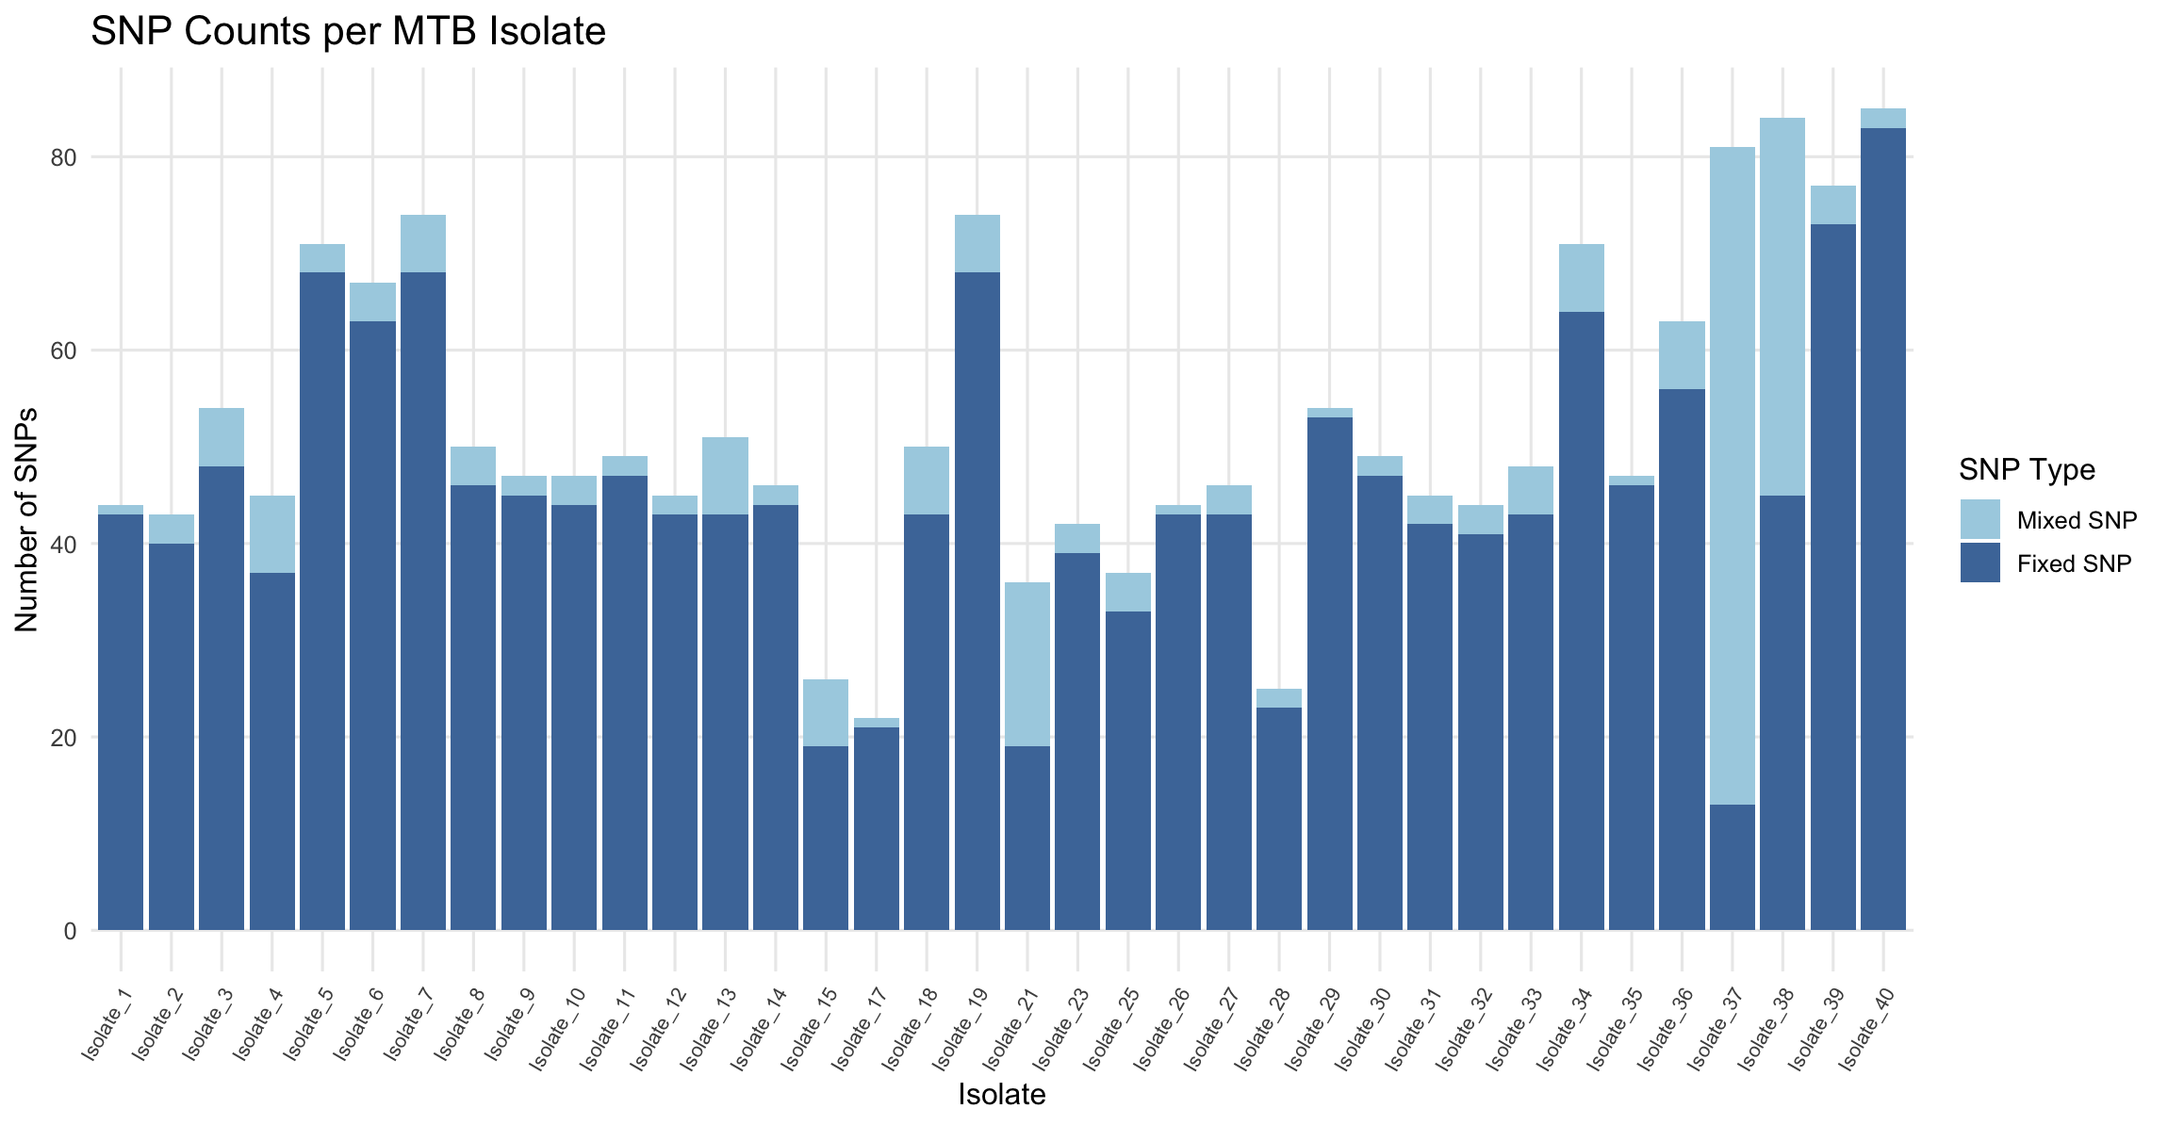
Results
Quantify genomic variation across MTB isolates
Observation
Most isolates contained ~50-60 relevant SNPs
Fixed SNPs comprised the majority of detected variants
Mixed SNPs varied across isolates
Takeaway
Isolates show substantial genomic variation with differences in within-sample diversity
Fig 1: Displays number of fixed vs mixed SNPs across samples

Slide 6
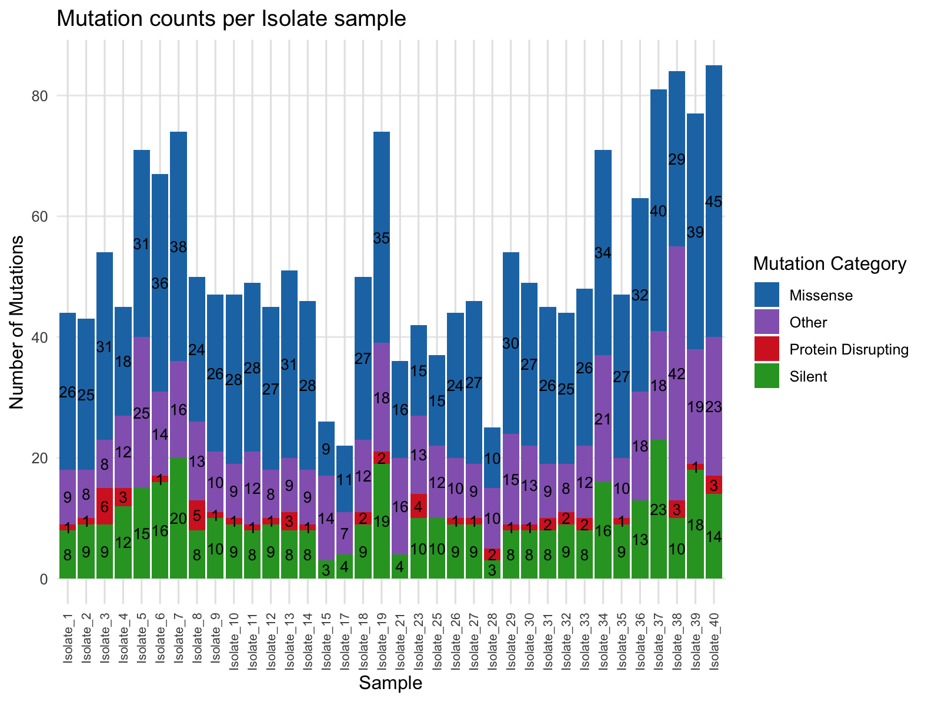
Results
Characterize and assess the functional consequences of mutation types across isolates
Outcome
Silent and missense mutations were most abundant
Protein-disrupting mutations and indels occurred less frequently
Mutation burden and composition varied across isolates
Takeaway
Most detected variation is silent or missense, with a smaller subset of potentially higher-impact mutations
Fig 2: Mutation category based on patient (sample data)

Slide 7
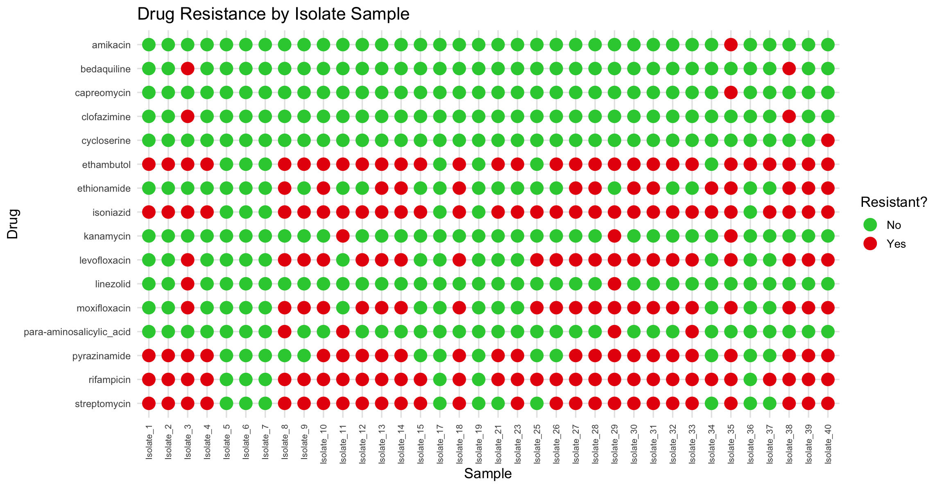
Results
Fig 3 : This chart shows resistance to different drugs with respect to each patient (sample data)

Slide 8
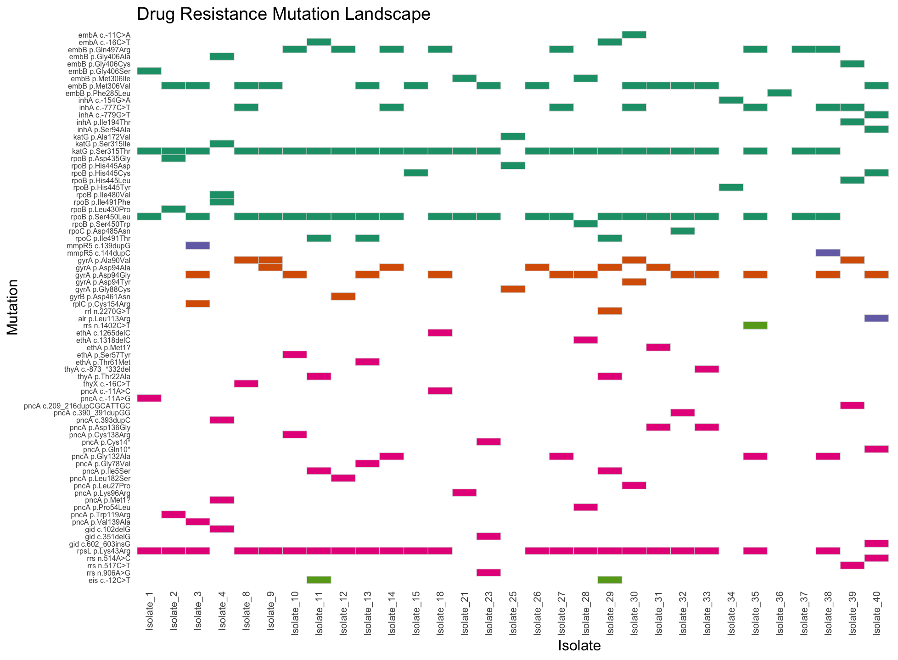
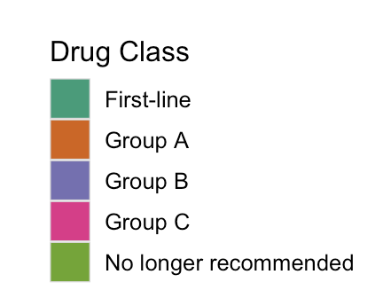
Results
Depicts the resistance profile of each cultured isolate
Provides a reference for determining whether SPIT-SEQ detects the same resistance-associated mutations
Fig 4: Mutations associated with drug resistance across samples

Slide 9
Discussion
Key Findings
Substantial genomic variation was observed across MTB isolates
Drug-resistance profiles differed between isolates
Most mutations were silent or missense
Multiple recurrent resistance-associated mutations were identified
Relevance to SPIT-SEQ vs. Isolate WGS
These results establish the genomic and resistance profiles of cultured isolates
Comparison with SPIT-SEQ will determine whether direct-from-sputum sequencing captures comparable resistance-associated information

Slide 10
Future steps
Process SPIT-SEQ data
Identify resistance-associated mutations detected directly from sputum
Compare SPIT-SEQ vs. isolate WGS at the mutation level
Evaluate shared, missed, and uniquely detected variants
Assess detection of mixed variants and their potential impact on resistance profiling
Quantify concordance between the two sequencing approaches

