Slide 1
Automated PCOS Detection from Ultrasound Imagery
A Comparative Analysis of Naive Bayes and Convolutional Neural Networks
Author: Gauri
April 2026

Slide 2
I. Introduction
Polycystic Ovary Syndrome (PCOS) is a common hormonal disorder among women.
Early detection through ultrasound imagery is crucial for effective treatment.
Manual interpretation by doctors can be subjective and time-consuming.
Goal: Build an automated computer program to classify ovarian ultrasound images as Normal or Abnormal.

Slide 3
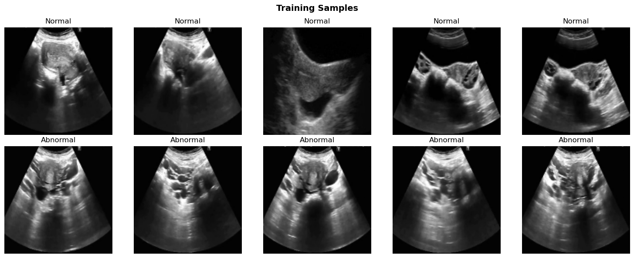
II. Dataset Information
Custom dataset split into training (3,200 images) and test sets (1,468 images).
Class 0: Normal ovaries (903 training images).
Class 1: Abnormal / PCOS ovaries (2,297 training images).
The dataset reflects real-world clinical imbalances.

Slide 4
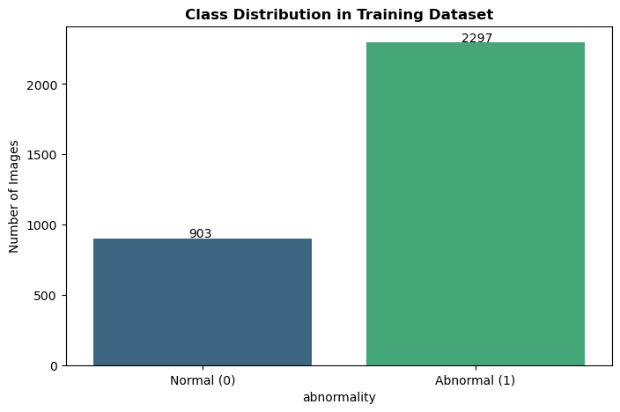
III. Class Distribution Profile
Significant categorical imbalance inherent in the clinical repository.
Normal cases: 903 | Abnormal cases: 2,297.
Requires robust metrics (like Recall) to evaluate effectively.

Slide 5
IV. Image Preprocessing
1. Grayscale Conversion: Removes unnecessary color information.
2. Resizing: Resizes all images to 128x128 pixels for uniformity.
3. Normalization: Scales pixel values to a standard range (Z-score normalization).
4. Flattening: Converts 2D images into 1D vectors for the Naive Bayes model.

Slide 6
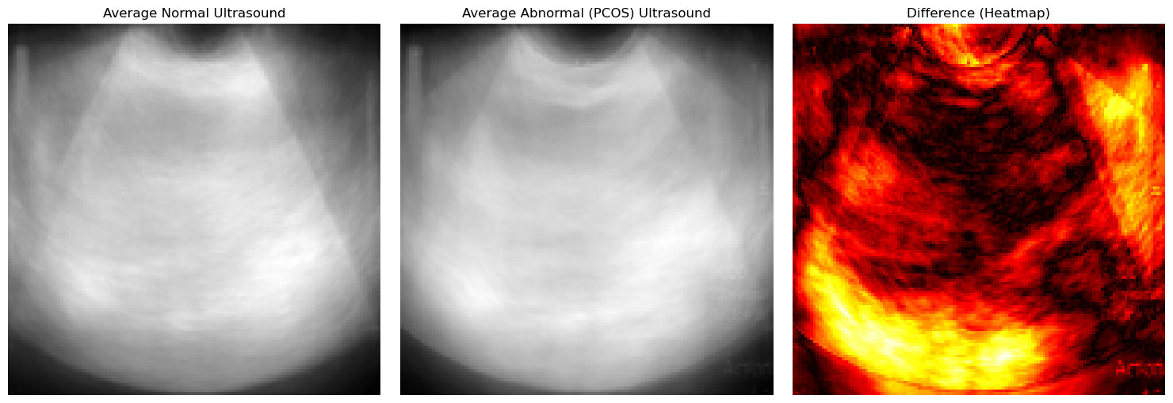
V. Structural Difference Heatmap
Visual structural comparison of Average Normal vs Average Abnormal Ultrasounds.
Heatmap exposes subtle regions of morphological variance.
Confirms that pathogenic features (follicular distributions) are spatially correlated.

Slide 7
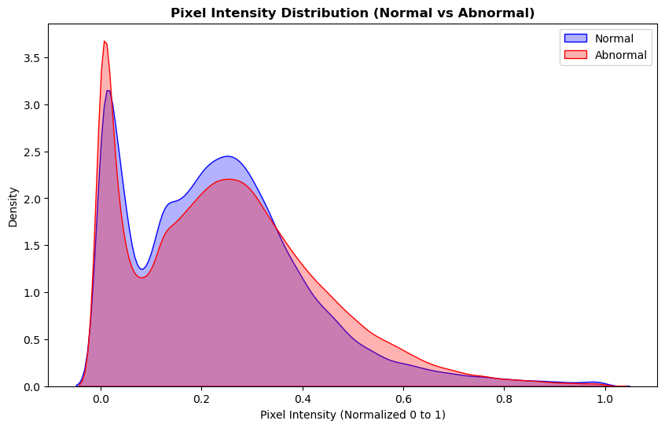
VI. Pixel Intensity Distributions
Kernel Density Estimation across Normal and Abnormal classes.
Significant overlap demonstrates non-linear structural complexities.
Highlights why baseline probabilistic classification (Naive Bayes) will struggle.

Slide 8
VII. Gaussian Naive Bayes Model
Serves as the traditional machine learning baseline.
Treats every pixel independently without considering its neighbors.
Limited because it ignores the spatial shapes and patterns in the image.
Struggles to reliably identify clustered structures like PCOS follicles.

Slide 9
VIII. Convolutional Neural Network (CNN)
Designed to exploit local spatial correlations within a grid-like topology.
Convolutional Blocks: 4 layers with progressively increasing filters (32 -> 256) utilizing 3x3 kernels.
Activation & Pooling: ReLU activations coupled with 2x2 Max Pooling.
Regularization: Batch Normalization and 50% Dropout regularization.
Output: Softmax dense layer for final binary classification.

Slide 10
IX. Results and Evaluation
Focus lies heavily on Recall (Sensitivity) given the clinical context of medical screening.
Minimizing False Negatives ensures critical pathological structures are not overlooked.
Performance validated across standard categorical dimensions: Accuracy, Precision, Recall, and F1-Score.

Slide 11
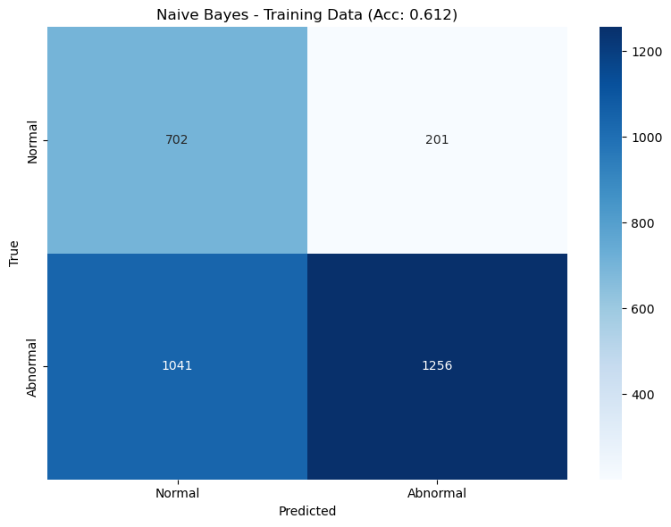
X. Gaussian Naive Bayes Performance
Accuracy: 61.19%
Precision: 86.20%
Recall: 54.68%
F1-Score: 66.92%
Critically hampered by False Negatives due to feature independence assumptions.

Slide 12
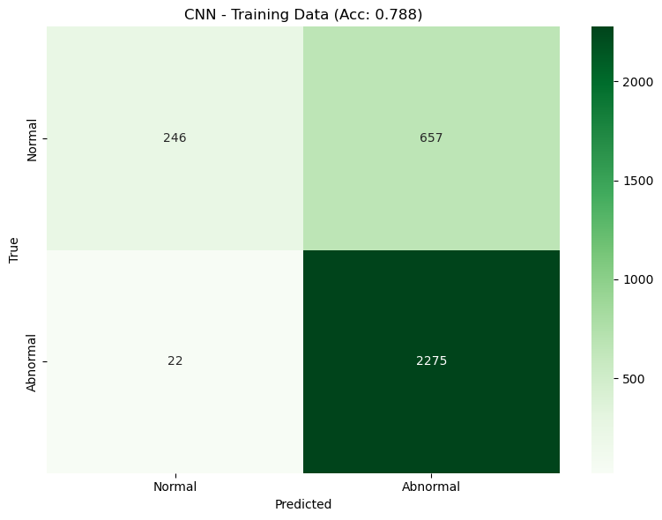
XI. Convolutional Network Performance
Accuracy: 78.78%
Precision: 77.59%
Recall: 99.04%
F1-Score: 87.01%
Demonstrates robust spatial feature extraction and minimal False Negatives.

Slide 13
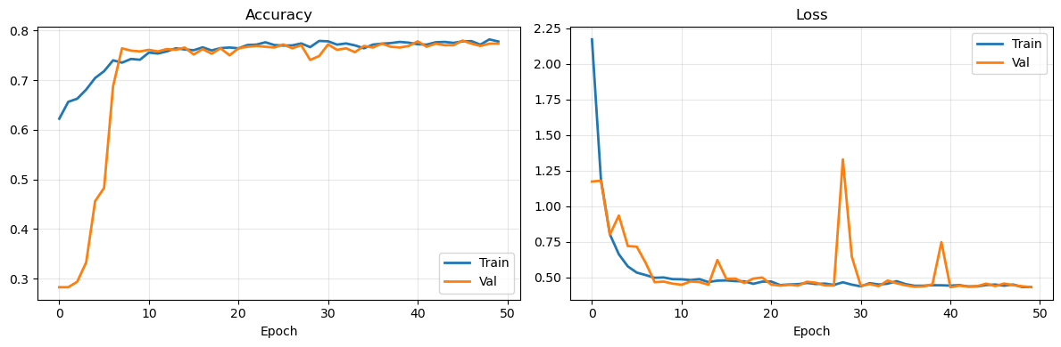
XII. CNN Optimization Stability
Trained over 50 epochs utilizing the Adam optimizer.
Steady convergence patterns across loss gradients without aggressive geometric spiking.
Excellent generalization verified by validation metrics.

Slide 14
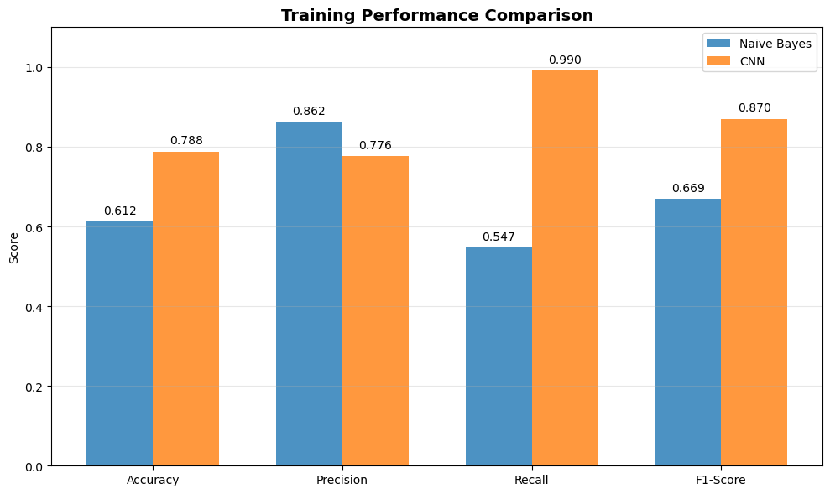
XIII. Performance Comparison
The CNN yielded a massive +17.59% absolute increase in Accuracy.
Crucially, the CNN delivered a +44.36% surge in Recall capability.
The deep spatial feature mapping drastically outperformed probabilistic, pixel-wise estimation.

Slide 15
XIV. Conclusion and Future Work
Deep convolutional architectures are fundamentally better equipped for CAD systems in gynecology.
Successfully bypassed the theoretical limitations of pixel-wise probability mapping.
Future vectors: Integrating Transfer Learning (EfficientNet, Vision Transformers).
Future vectors: Deploying spatial attention mechanisms (like Grad-CAM) to establish visible structural accountability.

