Slide 1
Live-Project
Animal behaviour Prediction
Prepared by – Gauri Golande

Slide 2
Milestone-1
Research of the given problem statement

Slide 3
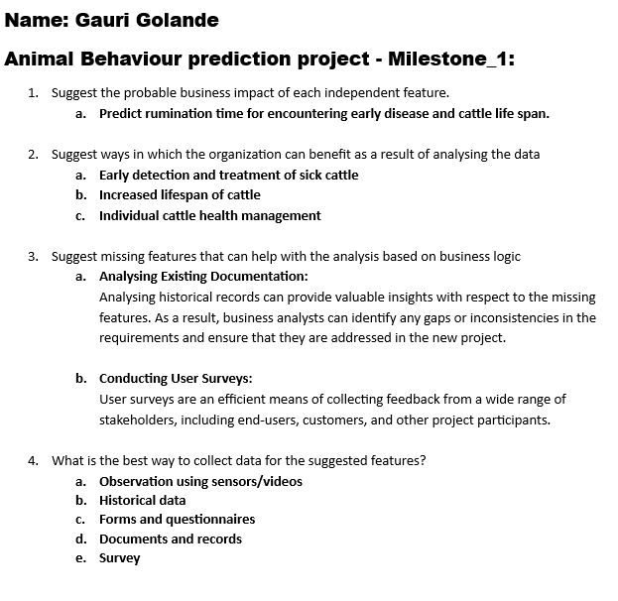

Slide 4
Milestone-2
Data Analytics Phase: Drawing Insights from the data

Slide 5
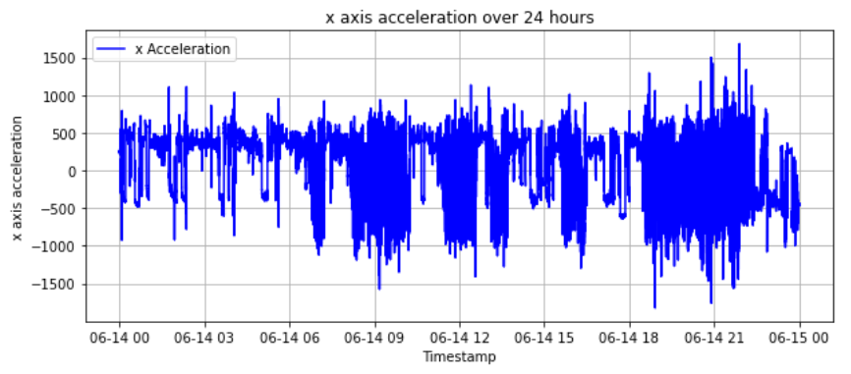
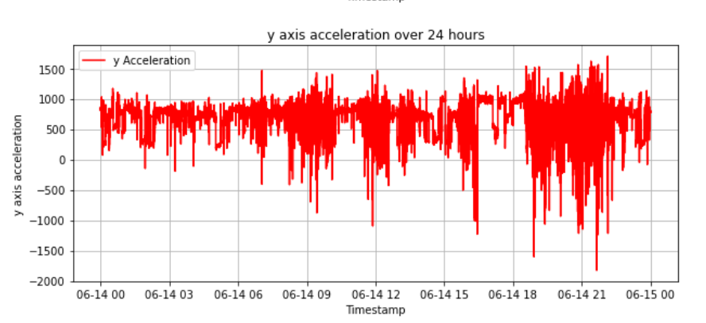
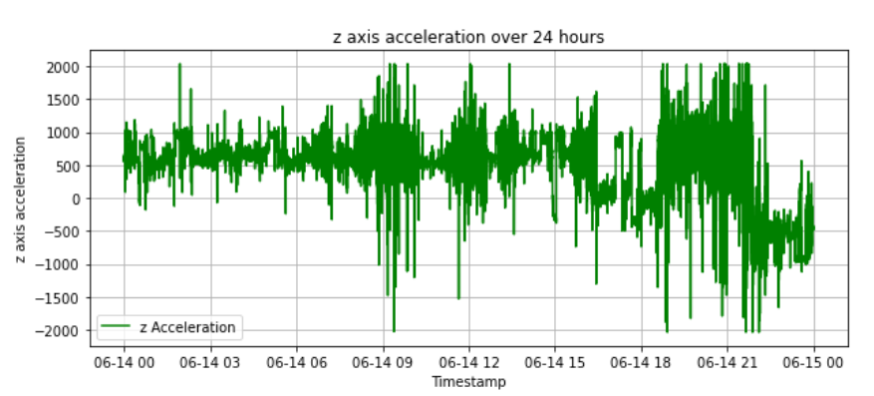
Acceleration vs Timestamp graph (24 hrs time interval):
Hypothesis:
For all the 3 axes the acceleration recorded from 18:00:00-22:00:00 hrs (for more than 60s) give indication that the cattle might be ruminating.
(ruminating behavior is instances where it persisted for more than 60 s)

Slide 6
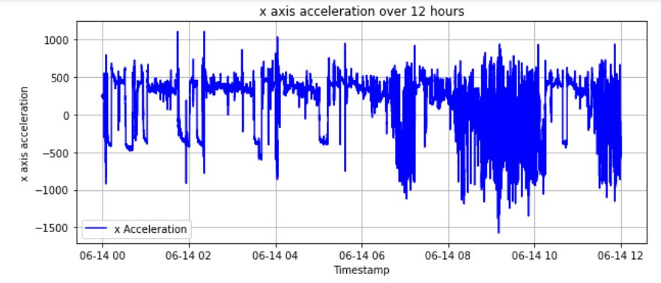
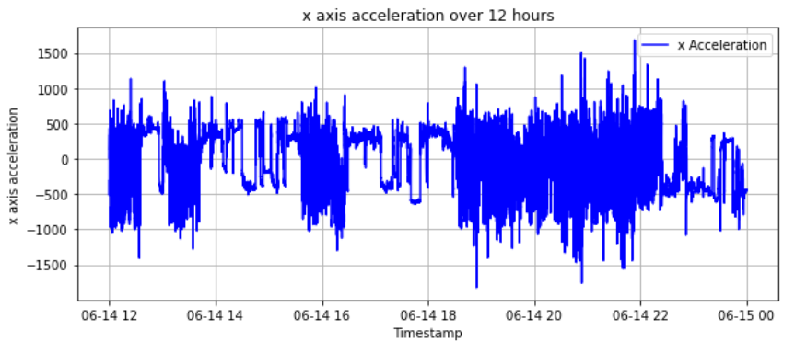
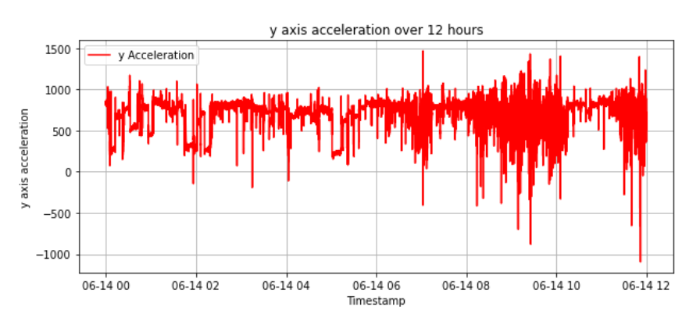
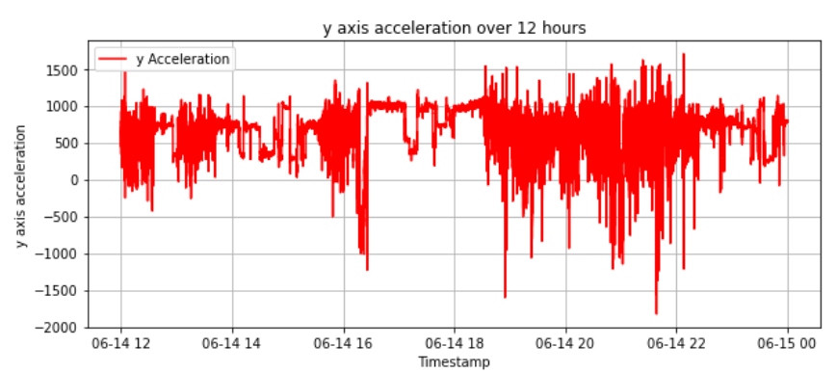
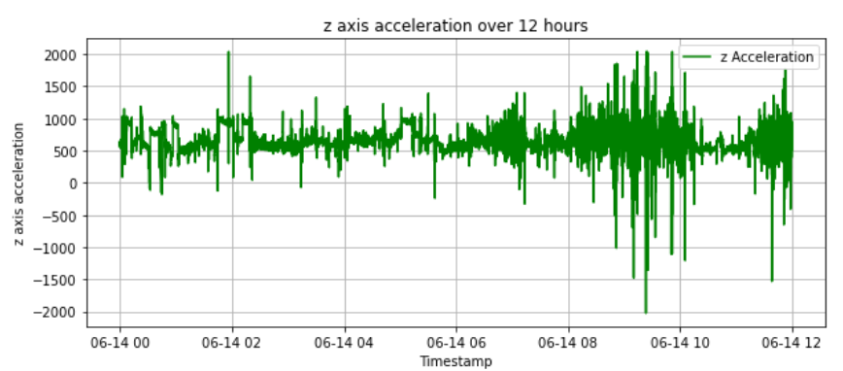
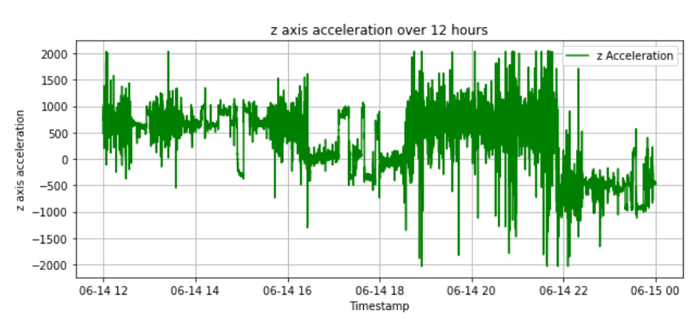
Acceleration vs Timestamp graph (12 hrs time interval):
Hypothesis:
Sudden ups in positive direction seen in the acceleration might be indication of cattle standing up (transition) - rising from a lying state to a standing state
Sudden dips in negative direction seen in the acceleration might be indication of cattle lying down (transition) - changing from a standing state to a lying state

Slide 7
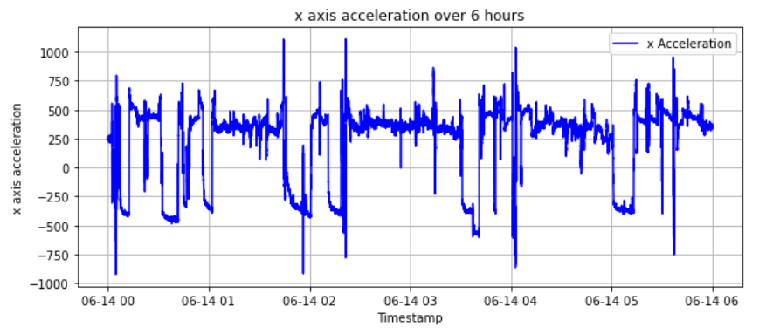
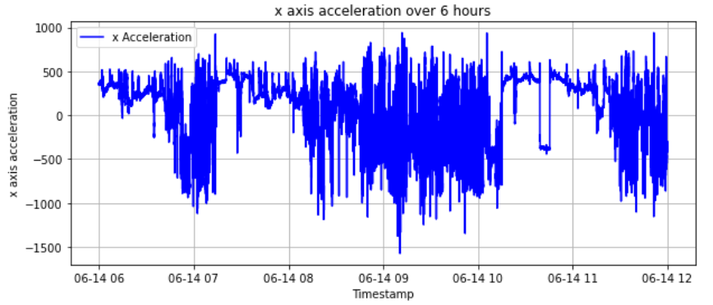
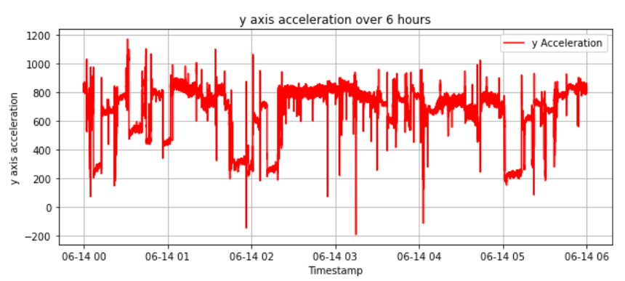
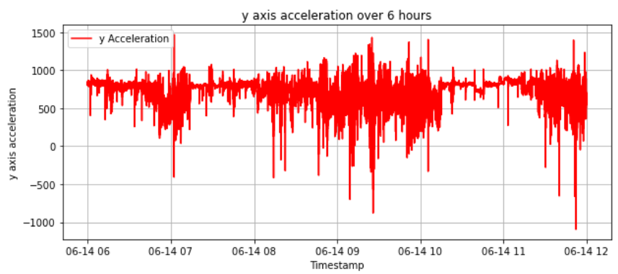
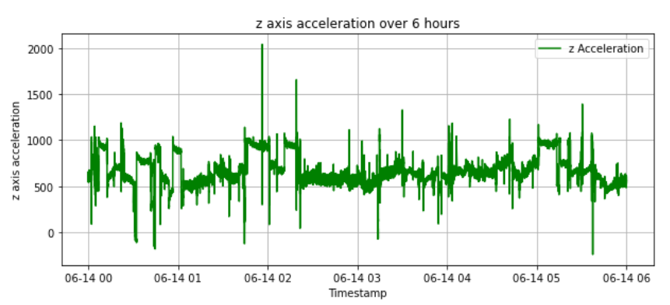
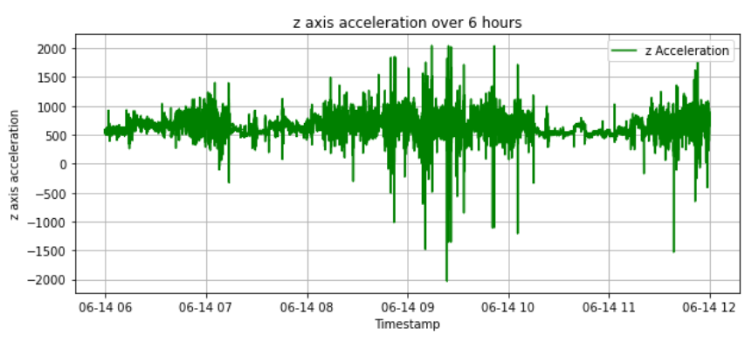
Acceleration vs Timestamp graph (6 hrs time interval):
Hypothesis:
Uniform acceleration recorded (as indicated in yellow dotted line) could be an indication of the cattle resting
Acceleration movement recorded around at 07:00:00 indicates that the cattle is feeding.

Slide 8
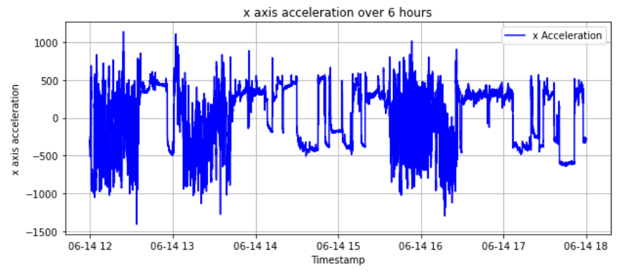
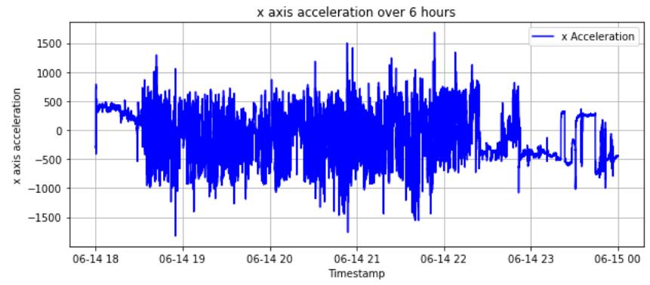
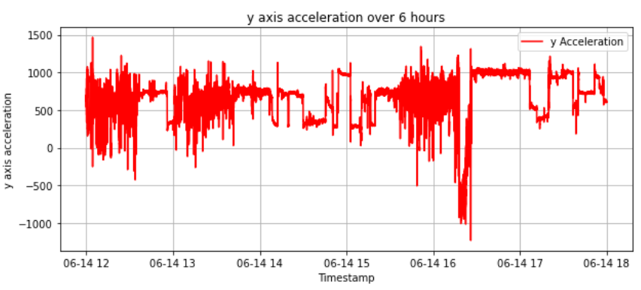
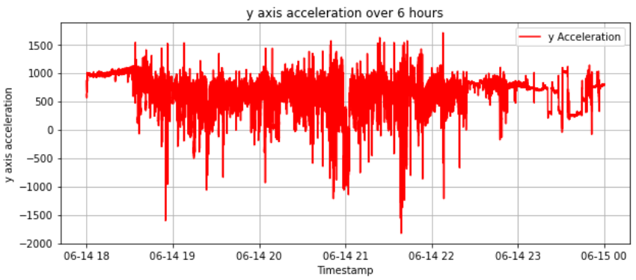
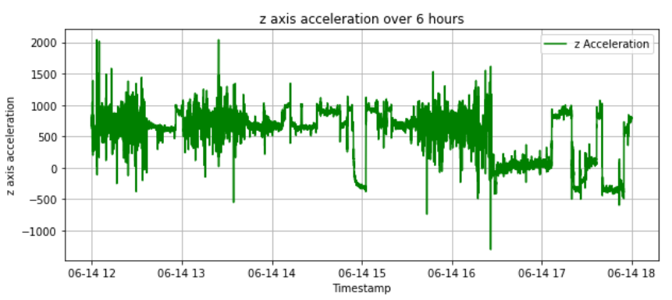
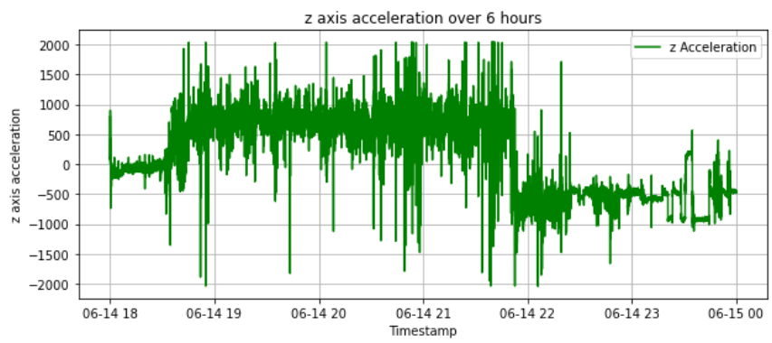
Hypothesis:
Yellow dotted lines indicate that the acceleration captured for huge time interval could be indication of cattle ruminating.

Slide 9
Milestone-3
Feature Engineering – PCA and K-Means clustering

Slide 10
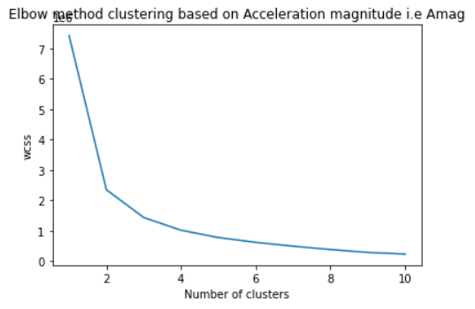
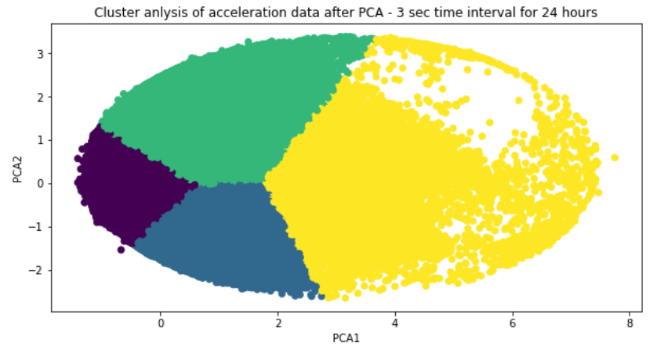
Cluster Analysis of acceleration data:
After reducing the dimensions using PCA technique and using k-means clustering method, the following categories were obtained.
Optimal used k = 4

Slide 11
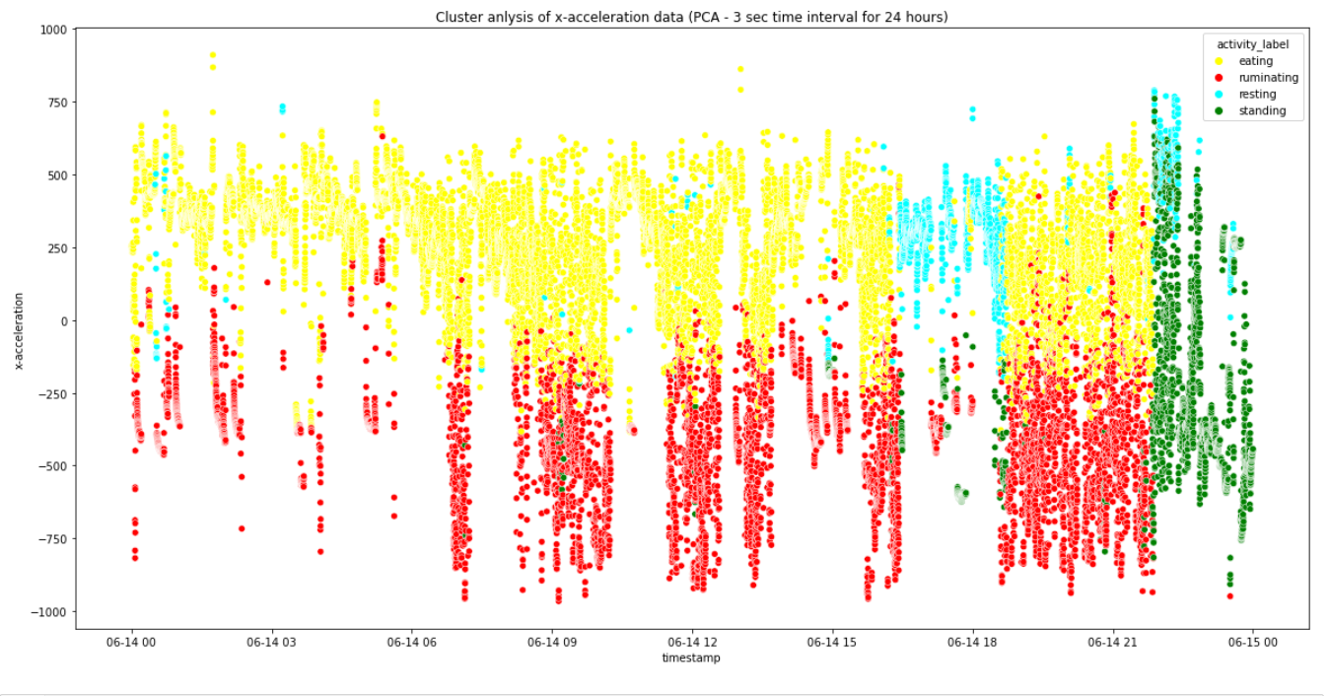
X-Acceleration vs timestamp with 3 sec interval:
Clusters observed on x-acceleration for 24 hrs:

Slide 12
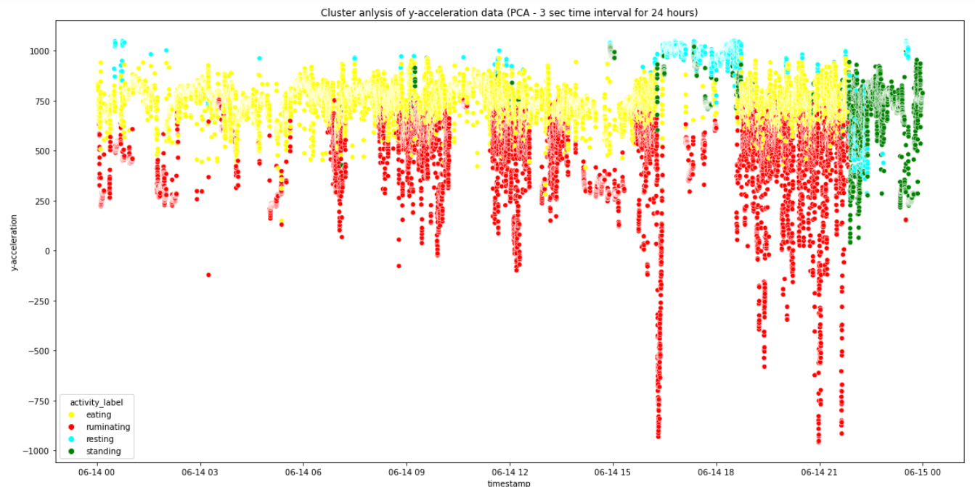
Y-Acceleration vs timestamp with 3 sec interval:
Clusters observed on y-acceleration for 24 hrs:

Slide 13
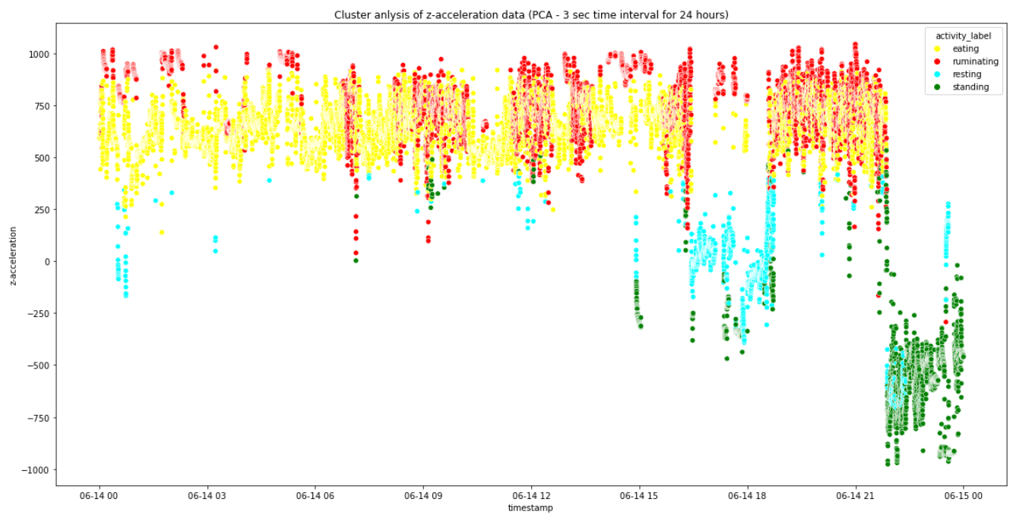
Z-Acceleration vs timestamp with 3 sec interval:
Clusters observed on z-acceleration for 24 hrs:

Slide 14
Milestone-4
Model building & evaluation

Slide 15
Model building and evaluation stage:
Models used :
KNN classification model
Random Forest classification model
SVM classification model

