Slide 1
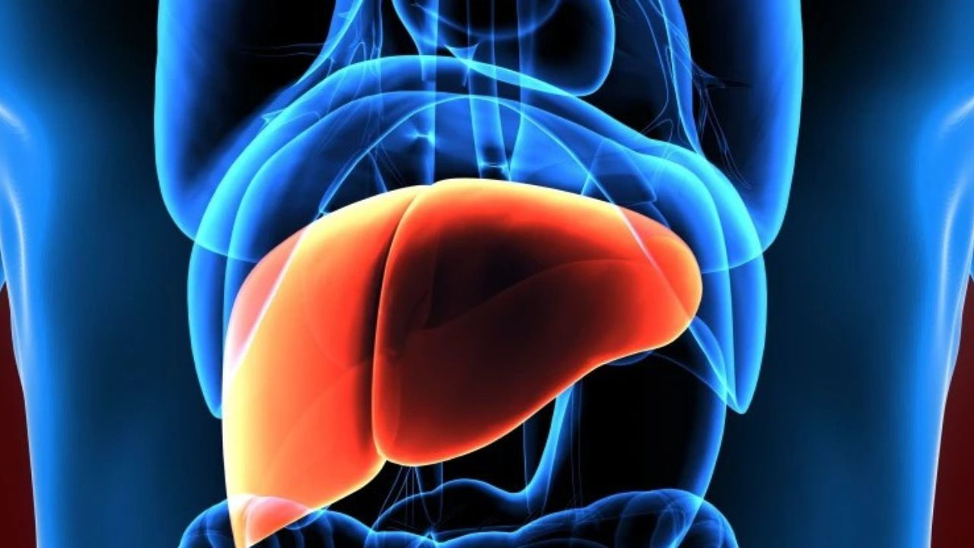
PREDICT LIVER DISEASE

Slide 2
GROUP- IV
Thallu Indrasena Reddy
Errabelly Vijay Kumar
Maaz Ahmed Khan Alamgir khan
Allam Arunkumar
Kola Manju Bhargavi
Gauri Dubey
Kalpesh patil

Slide 3
Content
Introduction
Data summary
Data preprocessing
Data Visualisation
Model Building
Deployment
Conclusion

Slide 4
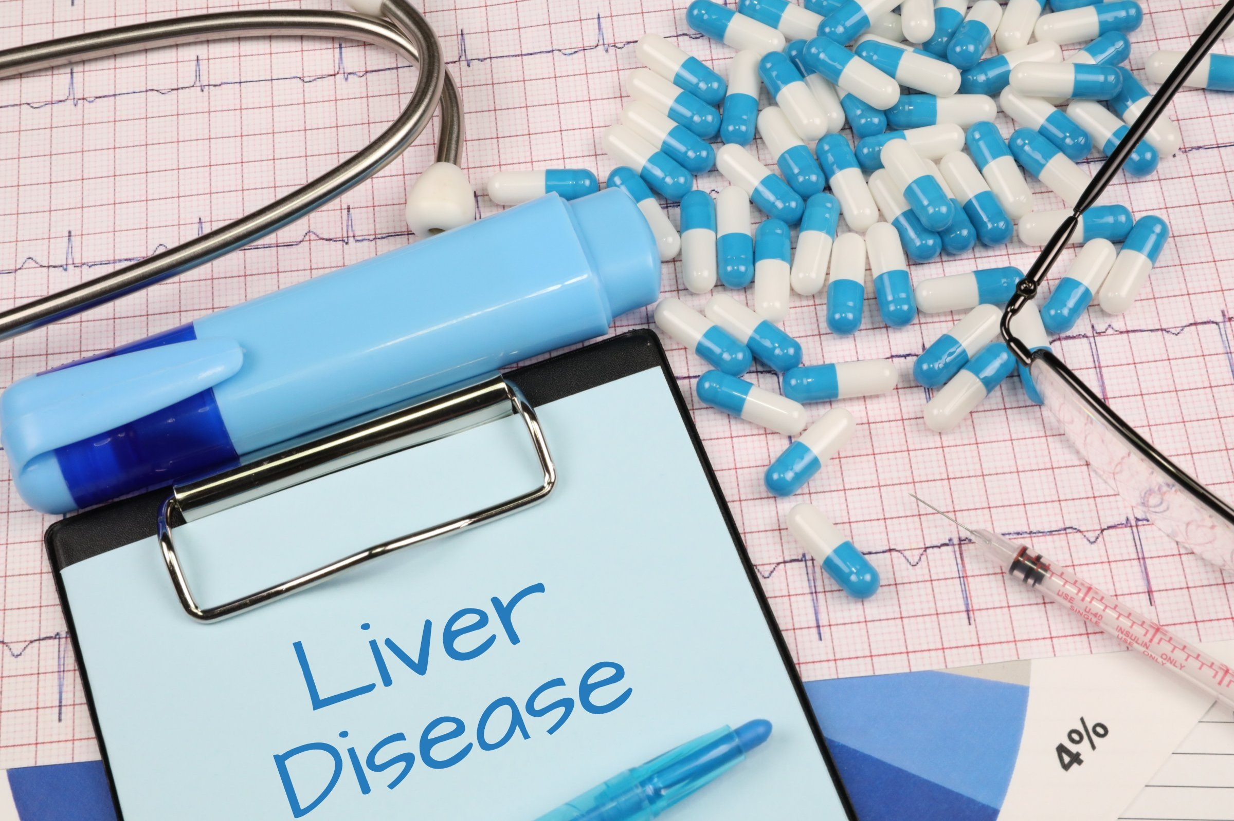


INTRODUCTION
Liver disease is a significant health concern globally, and in India, it poses a substantial burden on public health.
this modeling project aims to analyze a dataset specific to liver disease in Indian patients, leveraging advanced machine learning techniques.
We're diving into a project to understand and tackle liver disease among people in India.
The goal? To predict and catch liver problems early, so doctors can help people better

Slide 5
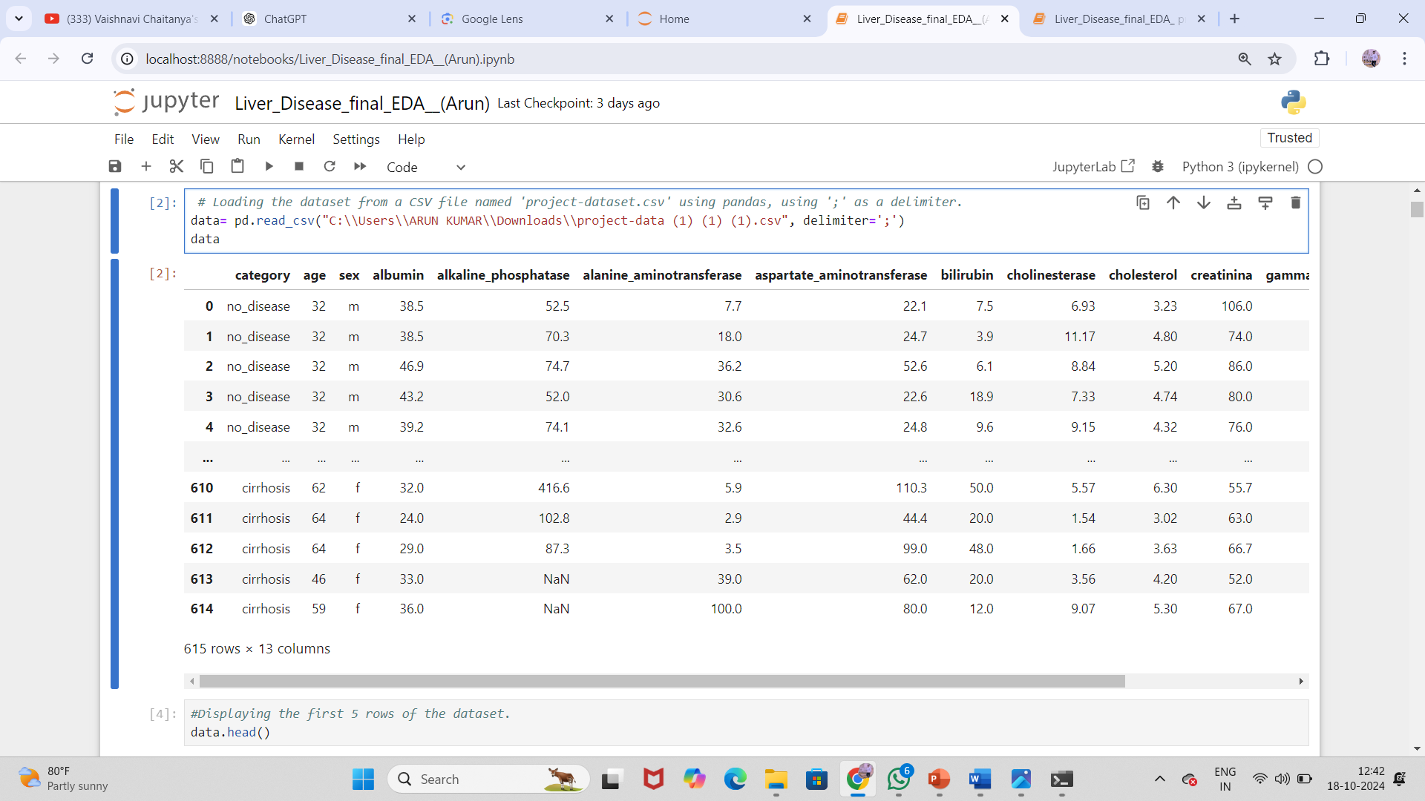
DATA SUMMARY

Slide 6
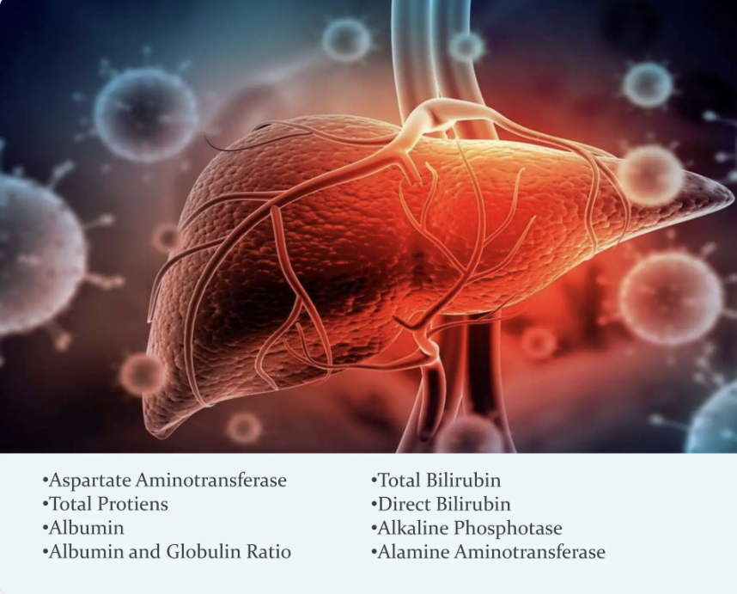
DATA PREPROCESSING

Slide 7
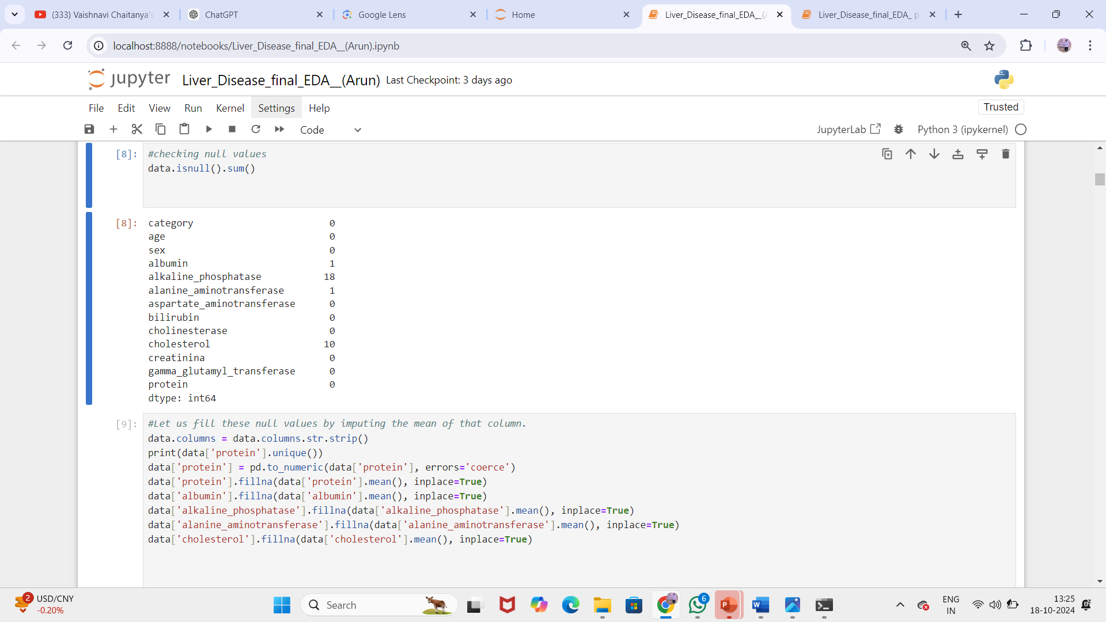
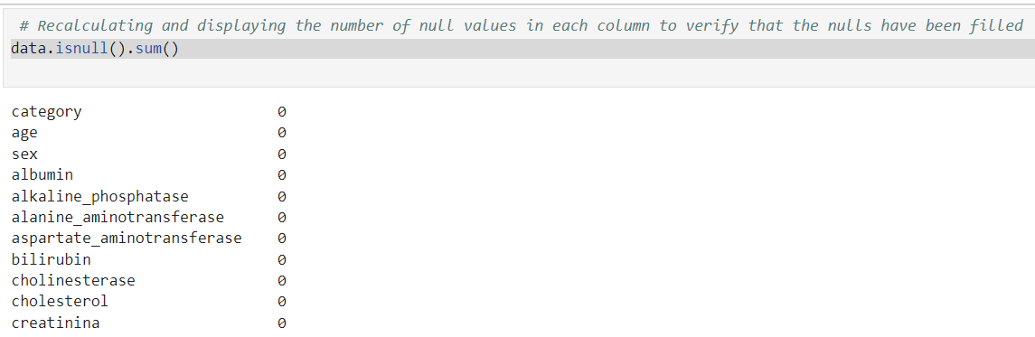
Missing Null values- null values have been filled

Slide 8
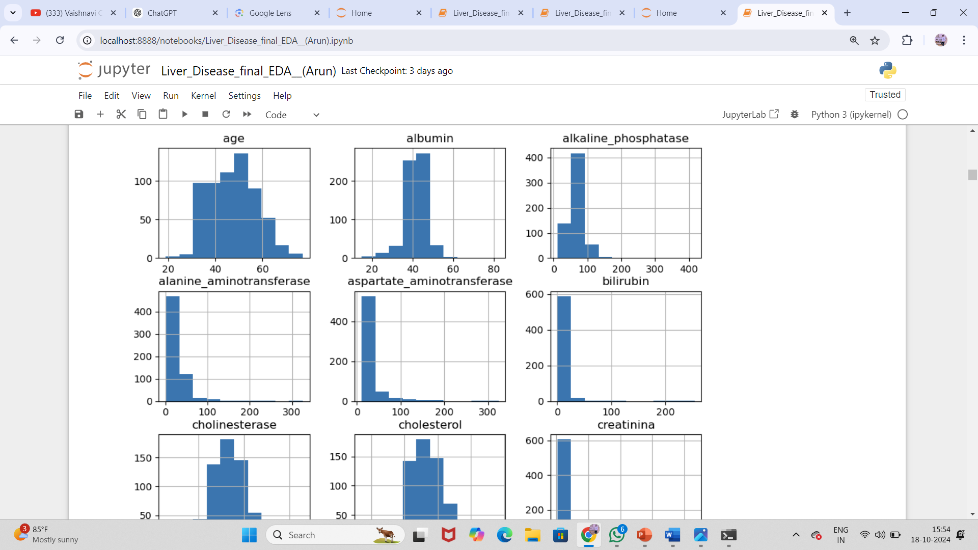
visualization
histogram
This histogram provides insights into the distribution of important numerical features like liver enzyme levels and age. Understanding these distributions aids in selecting the right preprocessing techniques.

Slide 9
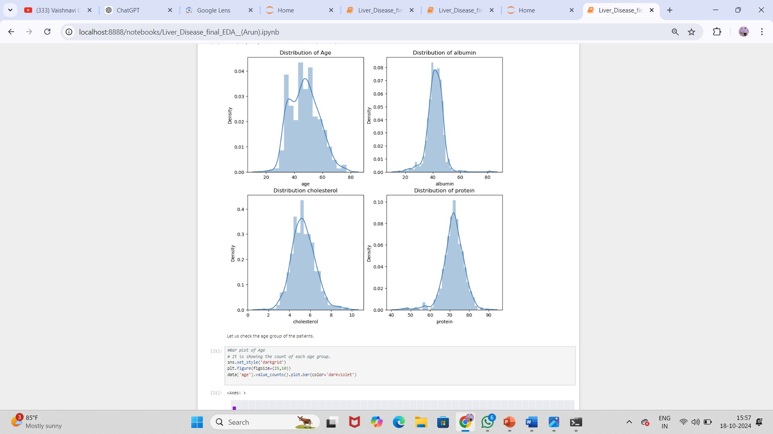
Age group of patients
Age: Shows the distribution of patients' ages.
Albumin: Displays the distribution of albumin levels in the dataset.
Cholesterol: Represents the cholesterol distribution among the patients.
Protein: Depicts the distribution of protein levels.
These plots provide insights into the spread and central tendency of the data, aiding in further analysis and model building.

Slide 10
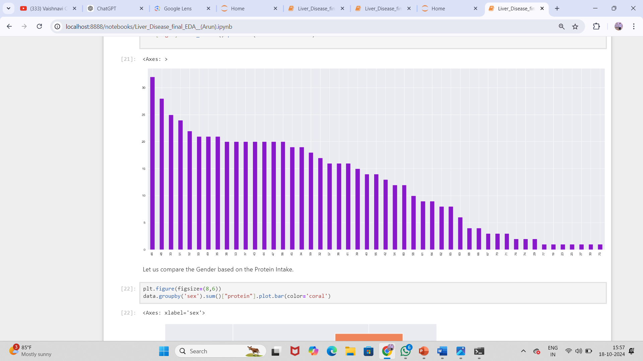
Bar plot Gender based on protein intake
The bar chart visualizing the comparison of protein intake across different values. The x-axis contains a range of numerical categories, while the y-axis represents the corresponding values of protein intake. The bars are colored in purple and arranged in descending order, highlighting the variation in protein intake levels among the categories.

Slide 11
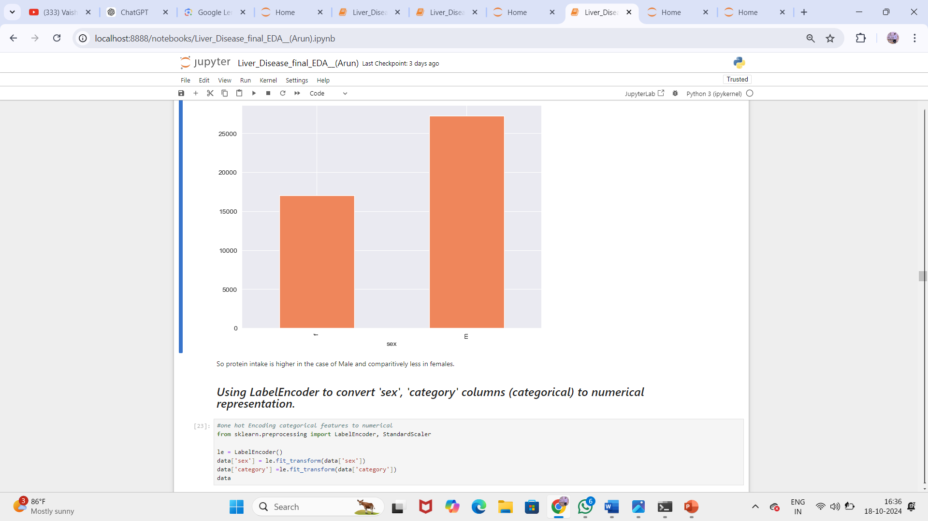
Protein in sex

Slide 12
MODEL BUILDING
Algorithms Used Tried multiple classification models, including Logistic Regression, Decision Trees, Gradient Boosting
Feature Selection Selected key features such as albumin, alkaline phosphatase, and bilirubin for better accuracy.
Train-Test Split Split the dataset into 80% training and 20% testing for model validation.
Model Training Trained models on the training set to learn patterns and relationships between features and liver disease categories.
Hyperparameter Tuning Optimized model parameters to improve accuracy and performance.
.

Slide 13
Model Accuracy Comparison
Model Comparison:
Model Accuracy
Logistic Regression:92%
Random Forest :93%
SVM :91%
XG Boost:91%
KNN :91%
Decision Tree :93%
Neural network:91%

Slide 14
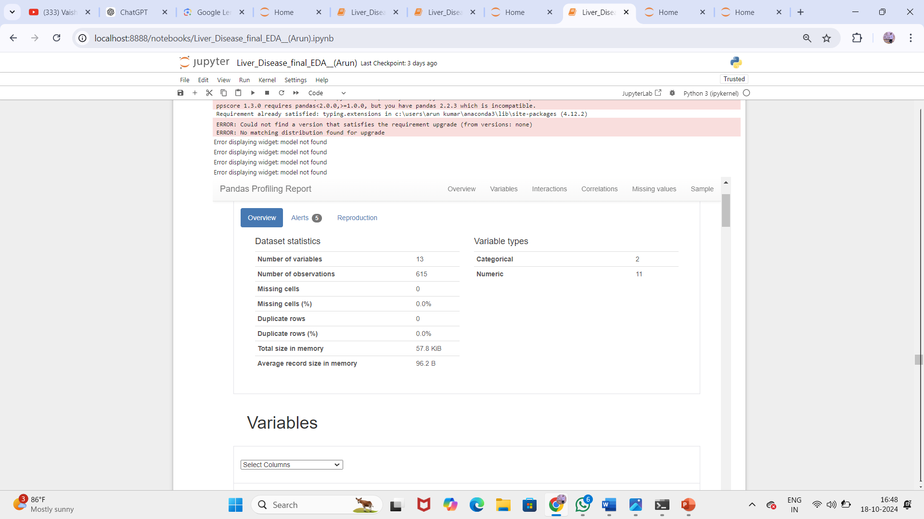
Pandas profiling report

Slide 15
Prediction of liver disease
Currently, the liver related diseases are identified by analyzing liver function blood test reports and scan reports. It takes more time as well as expensive. While employing different data mining algorithms to ease this process it is possible to reduce the time for diagnosing the liver disease.
Liver disease doesn't always cause symptoms that can be seen or felt. If there are symptoms of liver disease, they may include: Yellowing of the skin and the whites of the eyes, called jaundice. Yellowing of the skin might be harder to see on Black or brown skin

Slide 16
Important of prediction liver diseases
Early diagnosis of liver diseases can prevent the progression to severe conditions like cirrhosis or liver cancer, improving patient survival rates.
Timely intervention based on predictive models helps in managing liver diseases more effectively, reducing the need for invasive treatments like liver transplants.
Predicting liver diseases allows for personalized treatment plans, which can minimize complications and enhance the quality of life for patients.
Prevention and early detection through prediction can significantly reduce the long-term healthcare costs associated with advanced liver diseases.

Slide 17
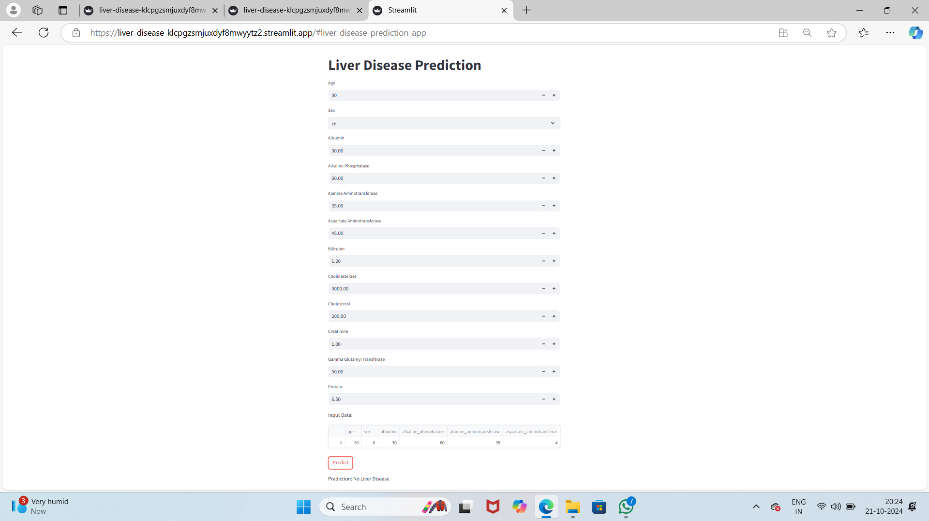
Deployment

Slide 18
In this project, the machine learning model for liver disease prediction was deployed using Streamlit, a popular Python framework for creating interactive web applications. The deployment process involved several steps to ensure the model is accessible, user-friendly, and provides real-time predictions.
This web-based liver disease prediction tool, built using Streamlit. The app includes a set of input fields where users can enter medical data such as age, gender, and various liver function test values like albumin, alkaline phosphatase, bilirubin, and others. Once the data is entered, the user can press the "Predict" button to receive a prediction. In this particular screenshot, the prediction result displayed at the bottom indicates "No Liver Disease."
This section demonstrates how the deployed model can be used to make predictions in real time. By inputting new patient data such as age, albumin levels, and liver enzyme results, the model predicts the likelihood of liver disease. This functionality enables healthcare providers to quickly assess a patient's condition and take necessary actions based on model output.

Slide 19
Conclusion
predicting liver diseases is vital for catching problems early and providing timely treatment. It helps prevent serious conditions, reduces the need for invasive procedures, and improves patients' quality of life. By identifying risks early, we can take better care of patients and lower healthcare costs in the long run.
By combining innovative algorithms and efficient data processing, it can significantly enhance user satisfaction and platform loyalty.

Slide 20


