Slide 1
Online Food Delivery
Gauri Rankhamb [EBEON062261501]
Sandya Dharpure [EBEONFWL613827]
Guggilla Supriya[EBEON0622613798]
Komal Dangde [EONFWL619647]
Priyanka Pawar [EBEON0622617844]
Vaishnavi Jadhav[EONFWL615833]
Guided by:-Varadharajan Sir

Slide 2
Introduction
The Online Food delivery System's main purpose is to maintain track of information such as Item Category, Food, Delivery Address, Order, and Cart. It keeps track of information about the Item Category, the Customer, the Cart, and the Item Category. Only the administrator gets access to the project because it is totally built at the administrative level.
The project's purpose is to develop software that will cut down on the time spent manually managing Item Category, Food, Customer, and Delivery Address. It saves the Delivery Address, Order, and Cart information.

Slide 3
Objective of Applicaton
In that application we Designed as simple and easy .
It’s fast, easy and comfortable.
An online menu is simpler to manage.
To provide the bug-free Online Food Delivery system to user as well as admin.
The main objective is here to provide a nice and secure platform for delivering food.
To maintain the records Product ,Category available into the system.

Slide 4
Online Food Delivery Modules
Delivery module : We can manage all the operations related to Delivery from this module.
Food Item module : This module is normally developed for managing the Food Item operations.
Order module : All the operations related to Order will be managed by Order.
Customer module : This module manages Customer functionalities.
Category module : Category modules performs all the create, read, update and delete operations of Category.
Login module: all the operation related to login of user and admin will be managed by this module .

Slide 5
MyModule:Admin
Admin is the highest level of access to your application.
Admin can add content on all pages and access all items in the Admin dashboard.
Admin can control site-wide settings like the design of your application and homepage layout.
Admin can ADD/EDIT/DELETE/UPDATE User records and can approve or deny edits made by user/customers.
Admin can Manage ,update, delete the food items and there category.
Admin can track the order records.
Admin can also change status of delivery status of the order.

Slide 6
HomePage
A home page is the default or front page of application.
It is the first page that visitors see when they load a URL.
Home pages act as a virtual directory for a site — they provide top-level menus where user can go deeper into various areas of the application.
Online Food delivery has a homepage with menu items like “about us,” “contact us” ,”Category”
“logout,” “register” or “login.”

Slide 7
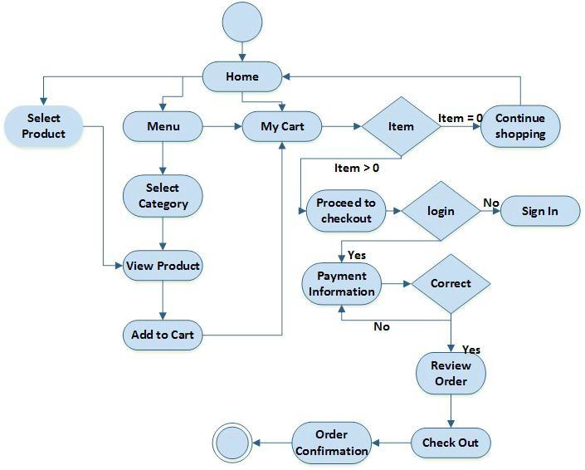
Project Architecture

Slide 8
Entity Relationship Diagram
id
Catrgory_id
Mobile_no
category
Email_id
id
has
user
city
food
name
discount
First_name
name
password
Last_name
price
description
has
have
id
description
have
payment
Delivery_status
have
order
Food_id
card
Delivery_date
Food_id
User_id
Order_date
Email_id
bank
Order_id

Slide 9
Future Work
Allow customers to modify orders: Allow clients to customise their food orders.
Improve the user interface by include more interactive features for the user. Add information about deals and promotional offers on the home page.
Payment Options: PayPal, cash, and gift cards are just a few of the options available. Allows you to save payment details for future use.
Order Process Estimate: Show the customer a graphical order status gauge.

Slide 10
Challenges issues
I faced error issue while creating connection with mysql database. After that I am resolve with the help of mysqlconnection.javapoint.com
In this project ,challenging thing is the emerging technologies in java like spring frame works spring boot ,spring security, microservices and it get resolve with the help of stackoverflow site .
I got more ideas from our project guide ,they always tell me easy way to remove error.

Slide 11
Technologies Used
Backend :Spring Boot, Spring MVC, jdk 18.0.2
Frontend :JSP , HTML , CSS , Java Script
Styling : Bootstrap
Project Management : Maven
Database :MYSQL
Server : Embedded Tomcat Server
Operating System : Windows-10

Slide 12
Conclusion
Finally, for the online food delivery system, we created a secure, user-friendly food delivery administration system.
Whether they are Administrators or Customers, this system can look after them all. This system will let them manage client meals, delivery boy data, and expand without creating any disruption.
This system is completely secure because each user is assigned a unique user ID and password, preventing unauthorised access.
As a result, using this strategy will help to minimise labour expenses while also giving clients more opportunity to enjoy the services.

Slide 13
THANK YOU

