Slide 1






MACHINE LEARNING PROJECT
Predicting Onset of Diabetes based on different diagnostics measures from the Pima Indians Diabetes Database.

Slide 2
In this project, onset of diabetes is predicted based on different diagnostics measures. The dataset used is the Pima Indians Diabetes Database taken from kaggle. All the patients in the dataset are females at least 21 years of age and of Pima Indian heritage.
The different variables used in the prediction of the outcome are:
Pregnancies: Number of times pregnant
Glucose: Plasma glucose concentration a 2 hours in an oral glucose tolerance
Blood Pressure: Diastolic blood pressure (mmHg)
Skin Thickness: Triceps skin fold thickness
Insulin: 2-Hour serum insulin(mu/Uml)
BMI: Body mass index (weight in kg/(height in m)^2)
DiabetesPedigreeFunction: Diabetes pedigree function
Age: Age (years)

Slide 3
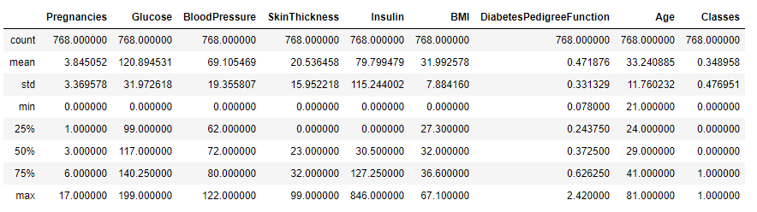
DATA WRANGLING AND DATA CLEANING
Data has been acquired from Kaggle (website: https://www.kaggle.com/uciml/pima-indians-diabetes-database)
This dataset is originally from the National Institute of Diabetes and Digestive and Kidney Diseases.
The data is loaded into a pandas Dataframe and all the column values are type cast in to float data type.
The features used for prediction of diabetes in the data set is normalized to have zero mean before applying machine learning algorithms.

Slide 4
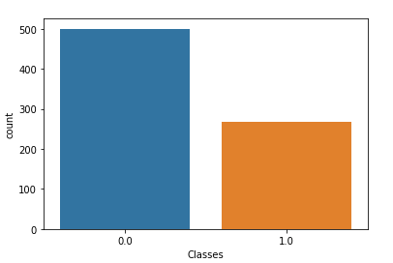
Exploratory Analysis
Based on the Countplot, we have more non-diabetics than diabetics in the data set.
For good health, the body must be able to keep insulin and glucose levels in balance. With too little insulin, blood sugar remains higher than normal (a condition known as hyperglycemia) and cells can't get the energy they need. This condition is termed as Type 1 diabetes. However, there is another type of Hyperglycemia which occurs due to insulin resistance where body is no longer able to utilize the insulin efficiently causing high level of glucose in blood. This is Type 2 diabetes. With too much insulin, blood sugar decreases (hypoglycemia), causing symptoms such as sweating, trembling, light headedness, and in extreme cases, shock. The most common cause of abnormal fluctuations in blood sugar is diabetes.

Slide 5
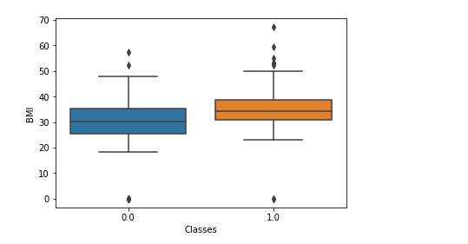
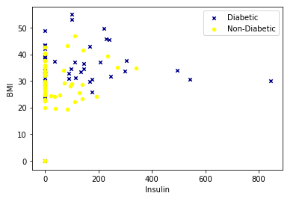
Exploratory Analysis
Obese people with higher Body mass index (BMI) tend to be more diabetic also showing higher level of insulin.

Slide 6
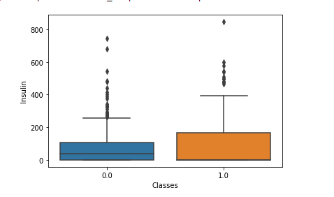
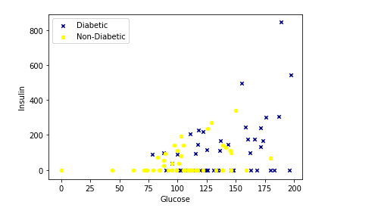
Exploratory Analysis
Most of the diabetic patients have high blood glucose level and insulin levels as in case with Type 2 diabetes where tissues become resistant to insulin. Some patients tend to have high blood sugar but low insulin level and show hypoglycemia.

Slide 7
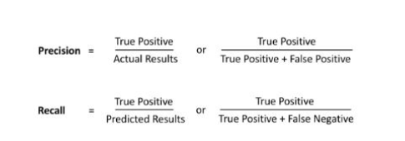

PREDICTIVE ANALYSIS USING MACHINE LEARNING ALGORITHMS:
Steps involved in the Data Analysis:
Data is split into training set and test set and data is normalized.
Different Machine learning Algorithms from the sklearn package in python have been imported and applied on the Train set to find the best fitting model such as:
Support Vector Machines
K-Nearest Neighbor
Decision Tree Algorithm
Logistic Regression
The model is then evaluated using the test set based on two different evaluation metrics: 1. F1-score, 2. Jaccard Similarity index
f1-score value which is the harmonic average of both precision and recall of a model
Jaccard similarity score which shows how close are the predicted labels to actual labels

Slide 8
Evaluating different Machine learning Models
A Classification report is printed which is a function imported from metrics module of sklearn library. The classification report shows the precision, recall, and f1-score of each classification label and the average accuracy and f1-score of the model. The confusion matrix is also printed which shows numbers of actual diabetic patients as compared to predicted diabetic patients.

Slide 9
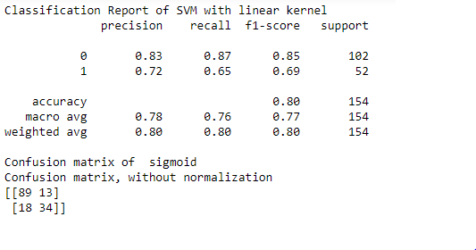
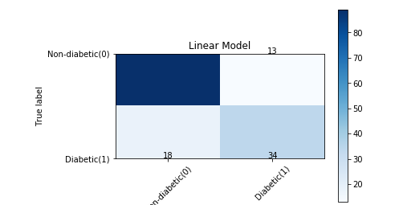
Support Vector Machine (SVM)
SVM maps the data set to a higher dimension producing large margin decision boundaries between the different output response classes. The algorithm is useful when working with complex non-linear decision boundaries.
SVM with Linear kernel has been implemented for predicting the onset of diabetes.

Slide 10
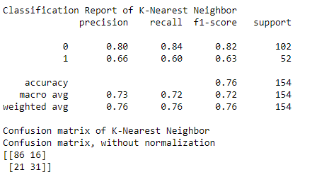
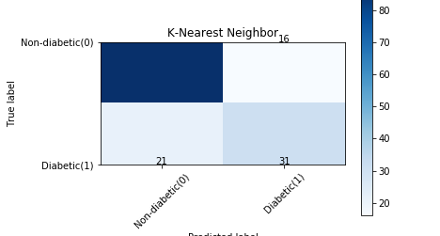
K-Nearest Neighbor
K-Nearest Neighbors is an algorithm for supervised learning where the data is 'trained' with data points corresponding to their classification based on the distance between each data point with it's neighbors. Once a point is to be predicted, it takes into account the 'K' nearest points to it to determine it's classification. The mode of the 'K' nearest response labels is assigned to each data point. By evaluating the Accuracy for different values of K, the best ‘K’ value was determined to be 7.

Slide 11
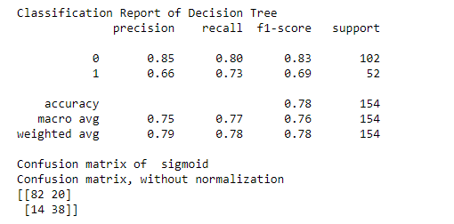
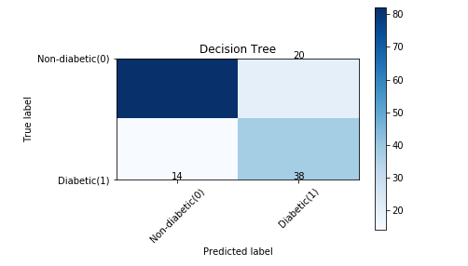
Decision Boundary Algorithm
In decision tree model, the training example is split into nodes which represents the features/ conditions. The branches from the nodes are the results of those features which in turn forms the leaf nodes which represents the labels for the different classes assigned to each patient. We keep splitting at each node till we get pure leafs or response labels for the classes. The training example is first split with the feature that leads to decrease in entropy or randomness and increase in information gain, i.e. the feature that will produce the purest subset or leaf from it's branches. The results yielded by the node on which the training example is first split is mostly pure.

Slide 12
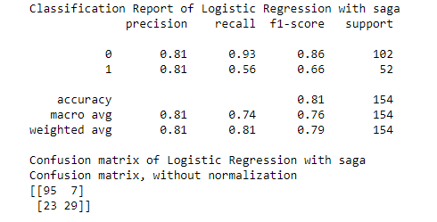

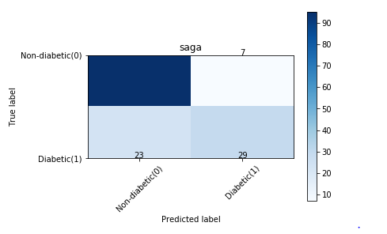
Logistic Regression
In Logistic regression the linear regression hypothesis function (θ^{T}X) gets transformed in to a S-shaped logistic sigmoid function which predicts the probability of the output value being classified as ‘1’ or Positive for a given training example.
We will build our model using Logistic Regression from Scikit-learn package. The logistic regression functions uses different numerical optimizers to find parameters, including ‘newton-cg’, ‘lbfgs’, ‘liblinear’, ‘sag’, ‘saga’ solvers. Based on the cost computed from each optimizer, we have used saga as the optimizer for Logistic Regression model.
The version of Logistic Regression in Scikit-learn, support regularization. Regularization is a technique used to solve the overfitting problem in machine learning models. C parameter indicates inverse of regularization strength which must be a positive float. Smaller values specify stronger regularization.

Slide 13
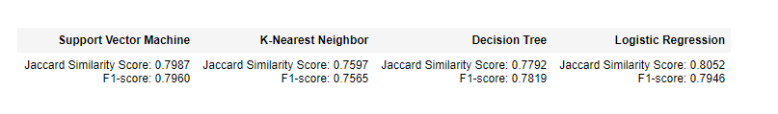
Results:
All the four models have been evaluated by calculating their F1-score values and their Jaccard similarity score value by importing the metrics module from the sklearn package. The results for the different evaluation metrics for each of the Algorithms used is represented in the table below:

Slide 14
Conclusion:
For SVM, the best kernel to be used is the linear kernel.
For K-Nearest neighbors classifier, the best value of k to be used is 7 nearest neighbors that gives the highest accuracy in the test set.
For Logistic Regression classifier, the best optimizer to be used that gives the lowest cost or error in the model is saga.
Both SVM and Logistic Regression models performs better than K-Nearest and Decision tree classifier in predicting the right labels and gives higher F1-score and Jaccard Similarity score values and can be promising models for predicting future outcomes.

Slide 15
THANK YOU
Gauri Priya Saran
Gauri.saran100@gmail.com

