Slide 1


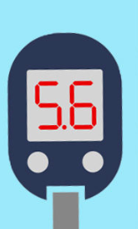



MACHINE LEARNING PROJECT
Predicting the progression of diabetes based on different demographic determinants using Machine learning Algorithms.
Diabetes Diagnosis

Slide 2
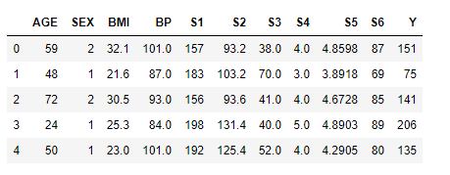
Objective:
The goal of this project is to use different machine learning models to predict the progression of diabetes one year after baseline. There are 10 independent variables that are used for the prediction of the disease progression namely- age, sex, body-mass index, average blood pressure, and six blood serum measurements: low density lipoproteins (LDL), high density lipoproteins (HDL), total cholesterol (TC), triglyceride (TG), serum concentration of lamotrigine (LTG), glucose (GLU).. The data used for this project was originally used in Lars Paper (website: https://projecteuclid.org/euclid.aos/1083178935) and has been scraped off from the following website: ‘https://web.stanford.edu/~hastie/Papers/LARS/diabetes.data’ using beautiful soup library and then it is finally read in to a text file. The text file is then converted in to excel file and is then read in to a pandas dataframe which has 442 rows/ training examples and 11 columns/ features.

Slide 3
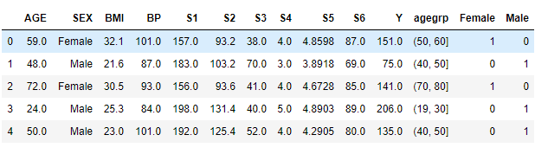
DATA WRANGLING:
The Dataset is type cast in to float data type.
The data set is also stratified into different age groups for visualization purpose.
The Input features in the data set is normalized before applying machine learning algorithms.
One hot encoding is performed in the SEX column to make two extra columns Male and Female with binary values.
The SEX column is dropped before applying the machine learning algorithms to the data set.

Slide 4
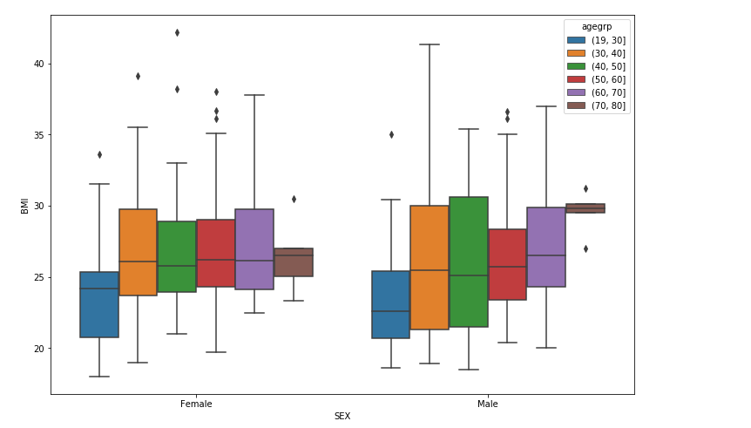
DATA EXPLORATORY ANALYSIS AND DATA VISUALIZATION
Distribution of BMI in different sex across different age groups:
The BMI in females tends to be higher than in males. However, the males shows larger variation in their distribution for the BMI as compared to females in earlier age groups specially between 30s and 50s.

Slide 5
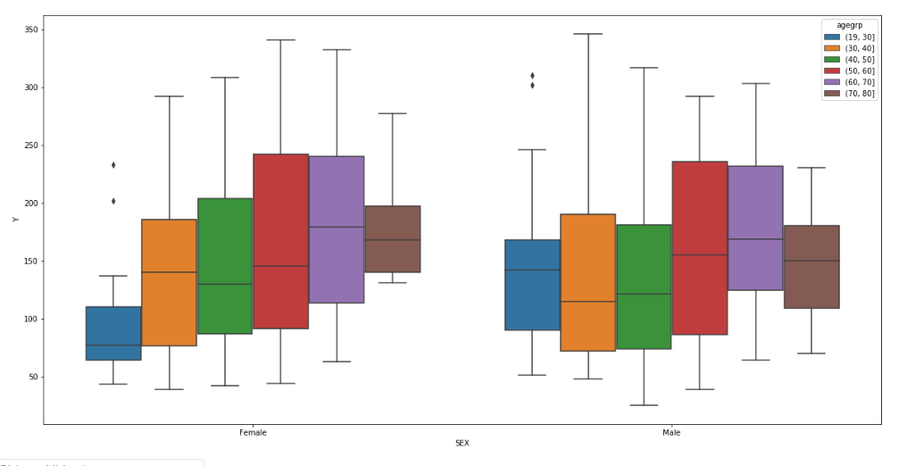
DATA EXPLORATORY ANALYSIS AND DATA VISUALIZATION
Distribution of diabetes progression one year after baseline in different sex across different age groups:
Males tend to show higher progression of diabetes in the earlier age groups from 20s to 50s whereas females show higher progression of diabetes in later age groups from 50s to 80s.

Slide 6
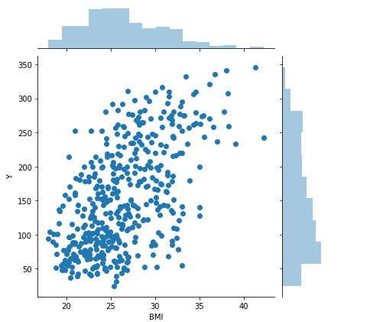
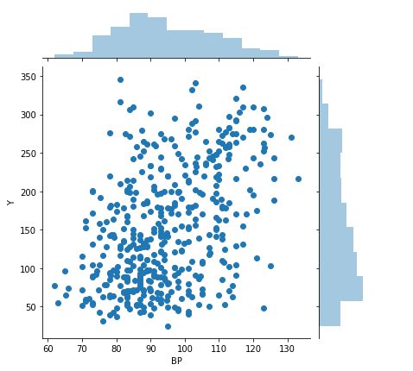
DATA EXPLORATORY ANALYSIS AND DATA VISUALIZATION
There seems to be a linear relationship between Body mass index and diabetes progression after one year.
Also the distribution of BMI and response variable disease progression seem to have a rightward skew.
Again the relationship between BP and disease progression seems to be linear from the scatter plot.
The distribution of BP seems to be normal. However distribution of disease progression is skewed right showing that few people tend to show much higher progression.

Slide 7
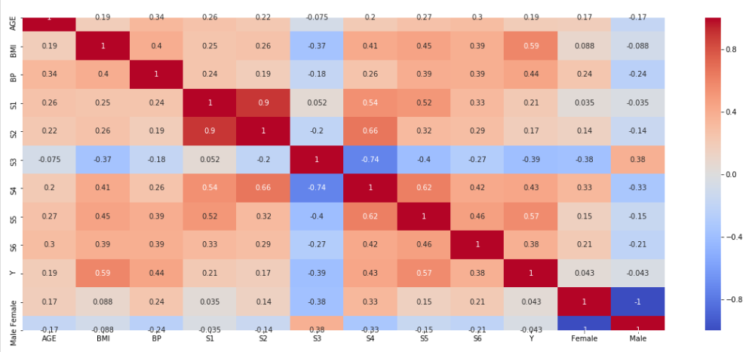
DATA EXPLORATORY ANALYSIS AND DATA VISUALIZATION
The heat map, shows that there is higher correlation between the response variable- Y (disease progression) and blood serum concentration S5, S4 and S6. Also a strong correlation is observed between disease progression and BMI followed by BP.
The strongest correlation coefficient is between BMI and disease progression.
There is negative correlation between blood serum concentration S3 and disease progression.

Slide 8


MACHINE LEARNING
Machine Learning Application to find the best fitting model:
1. The Data set is split in to training set and test set using the train_test_split estimator from the Scikit learn package.
2. The model is trained and fitted on to the training set.
3. The Following Machine learning Algorithms are used from the Scikit learn package:
Linear Regression with Single Variable (BMI as it showed the highest correlation with response variable).
Linear Regression with Multivariable
Polynomial Regression (Regularized and Unregularized)
4. After training the data with different Algorithms, model evaluation is performed by conducting both in-sample evaluation and out of sample evaluation.
MODEL EVALUATION:
Rsquared value and the mean squared error in the model is calculated. Rsquared represents how much variation in the response variable can be explained by the model we used to predict the response variable. It compares the best fit line to a worse fitted line which is at the mean value of response variable, i.e. it takes the ratio of squared sum of residuals from the best fit line to the squared sum of residuals from the worse fit line. Larger the Rsquared value, better is the fit of our model.
The mean squared error is the mean of the squared difference in the actual response value from the predicted response value. It shows how close are the data points to the best fit line. Smaller the mean squared error, better is the fit of out model.

Slide 9
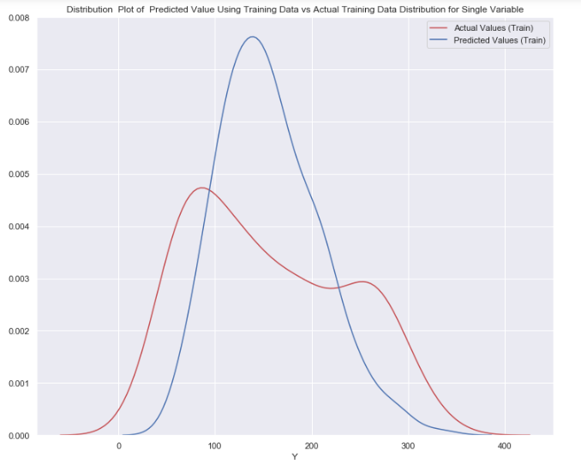
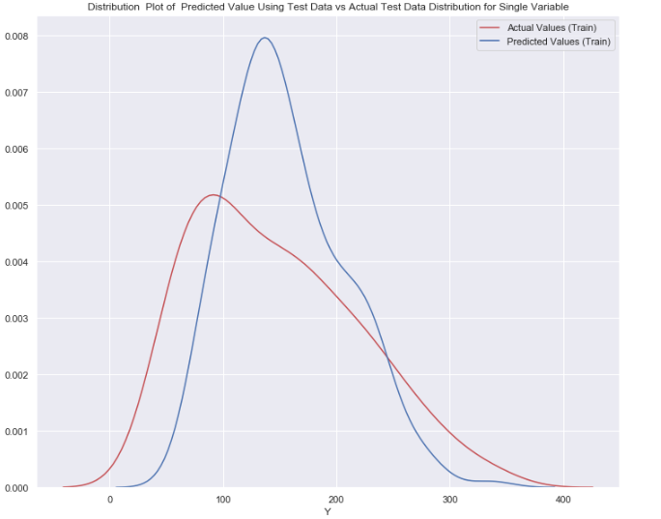
MACHINE LEARNING
SINGLE VARIABLE LINEAR REGRESSION MODEL: Distribution plot have been made to compare the predicted response variable with actual response variable.
The Distribution plots have also been made on both the training set (In-sample testing) and the test set (Out-of-Sample testing) for comparison.

Slide 10
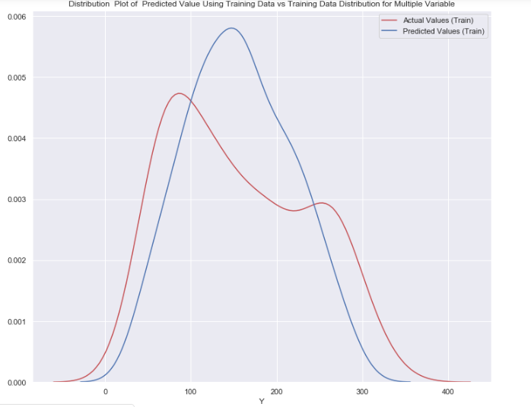
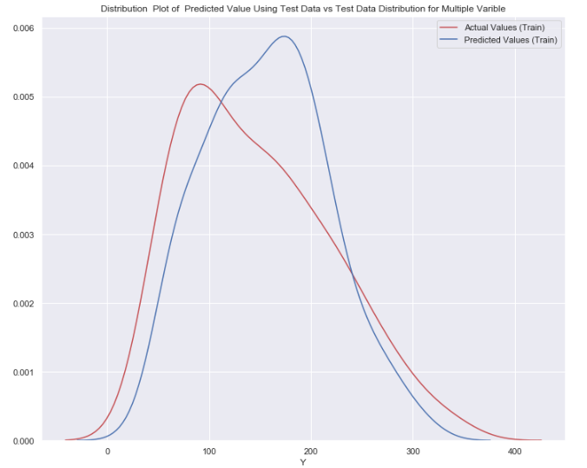
MACHINE LEARNING
Multivariable Linear Regression Model: Since there was significant amount of different the actual values for the response variable as compared to the predicted values in both test set and train set, Mutivariable linear regression model was used for fitting to the training set and the distribution plots were made for the Multivariable Model.

Slide 11
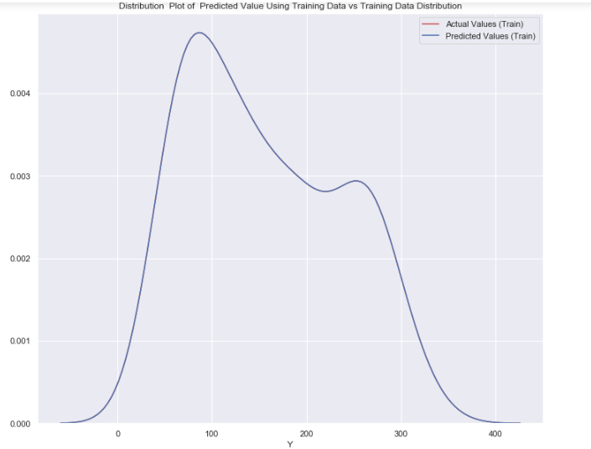
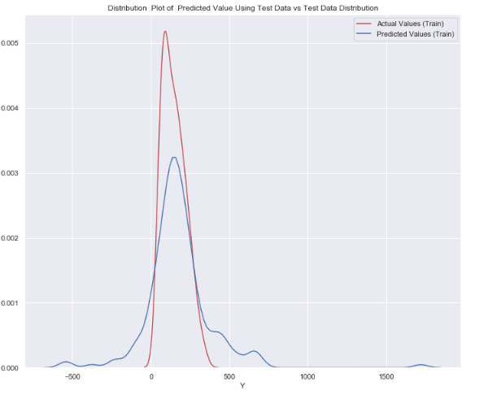
MACHINE LEARNING
Polynomial Regression Model (Without Regularization): Even though the Multivariable model seems to perform much better than the single variable model, there still seems to be some difference in the actual response values and the predicted response values. Therefore, Polynomial regression model has been where the input features are transformed to higher order polynomial terms adding extra features to the data set.

Slide 12
OVERFITTING/ HIGH VARIANCE:
From the Distribution plot for the Polynomial Regression model, it is observed that the model fit extremely well on the training set and performs very well on the in-sample evaluation of the training set. However, the model fails to generalize over new examples and therefore, performs poorly on the out-of-sample evaluation on the test set. This shows that our model is now capturing the noise in the data leading to overfitting of the model on the training data and high variance.
To overcome the problem due to overfitting, we use Regularization to reduce the weights/ parameters associated with each variable by using a regularization parameter called as alpha. To select the optimum regularization parameter that will reduce the effect of overfitting but at the same time increase the accuracy of our model to generalize well on the new unseen examples, we make a plot of the mean squared error vs the alpha values to find out the right alpha where the mean squared error is small for test set and train set.

Slide 13
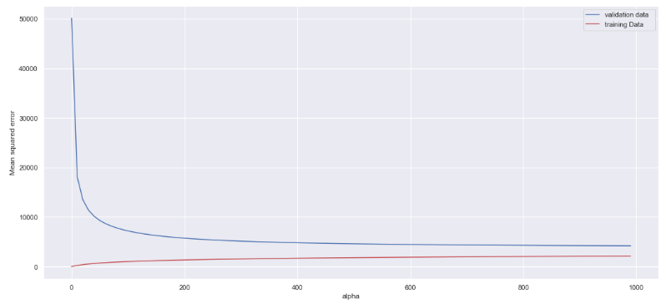
OVERFITTING/ HIGH VARIANCE:
We can see from the plot that the mean squared error has dropped for test set considerably somewhere around 200. The mean squared error for the test set keeps decreasing for the test set as alpha increases, however, the mean squared error increases slightly for train set with increase in alpha. After trying couple of values for the regularization parameter between 50 and 500, 400 was chosen as the optimum value of regularization parameter (alpha) for making a Ridge object and then fit the training set to the Ridge object which is then used to predict the values for the test data set and is used to calculate the Rsquared value and the mean squared error on the train and test set.

Slide 14
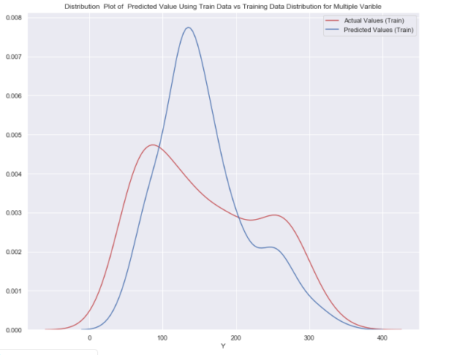
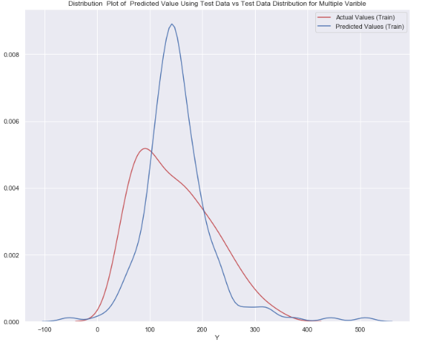
MACHINE LEARNING
After fitting the Regularized Polynomial regression model to the training set, the distribution plots were made for both the training set and test set.

Slide 15
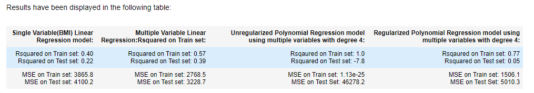
Results:

Slide 16
Conclusion:
The BMI and diabetes progression seems to have a strong positive linear relationship as seen from the correlation heatmap which shows that obesity and diabetes progression is linearly related to each other. Increase in one leads to the increase in the other.
From the above, we can see that Rsquared value of the training set is the highest in Unregularized polynomial regression model. However, the model failed to generalize well on the test set.
However, after regularization, We can see that the error has greatly reduced in the test data model from unregularized polynomial regression model. The mean squared error for the unregularized polynomial model was 46278.2 whereas the mean squared error for the regularized model is 5010.3.
The Rsquared value has decreased increased from -7.8 to 0.05. Based on the above results we conclude that the Regularized polynomial regression model is better than Regularized model. However, it may not be the best model because the out of sample evaluation on the test set shows a larger mean squared error in Polynomial regression model (5010.3) as compared to multivariable linear regression model (3228.7). The in-sample evaluation on the train set shows smaller mean squared error for Polynomial regression model (1506.1) as compared to Multivariable linear regression model (2768.5). Therefore, there seems to be a tie between multivariable linear regression model and the regularized polynomial regression model for predicting the progression of diabetes in one year from baseline based on different factors such as BMI, BP, Age, Sex and blood serum concentrations.

Slide 17
THANK YOU
Gauri Priya Saran
Gauri.saran100@gmail.com

