Slide 1
COMMUNICATION CRITERIA

Slide 2
COMMUNICATION CRITERIA
Connecting smart objects depends on application, range, and connectivity requirement
Many protocols support the connectivity of smart objects
Protocols also depend on a wired or wireless connection
Wireless connectivity is very popular
It may use IEEE802,WiFi, cellular networks, Bluetooth, ZigBee, and various other forms of wireless connection

Slide 3
COMMUNICATION CRITERIA
To select communication criteria there are various factors
RANGE
FREQUENCY BANDS
TRANSMISSION SPEED
POWER CONSUMPTION
TOPOLOGY
CONSTRAINED DEVICES
CONSTRAINED NETWORKS

Slide 4
COMMUNICATION CRITERIA RANGE
How far signal needs to travel
Desired coverage area
Indoor wireless connectivity would be small
Outdoor wireless connectivity would be more
SHORT RANGE
MEDIUM RANGE
LONG RANGE

Slide 5
COMMUNICATION CRITERIA RANGE
SHORT RANGE
IEEE802.15.1, Bluetooth, IEEE802.15.7 used for indoor facility
Area range up to 100 m
Bluetooth LE is for LOW POWER CONSUMPTION and LOW range APPLICATIONS
MEDIUM RANGE
Zigbee and WiFi is used for connectivity. Range is few hundred meters Generally distance between two devices 1 KM
LONG RANGE
Cellular technologies ( 2G,3G,4G,5G)
Generally distance greater than 1 Km

Slide 6
COMMUNICATION CRITERIA FRQUENCY BAND
BAND NAME OPERATING FREQUENCY
Industrial Band 902-928 MHz
Scientific Band 2.4GHz- 2.48GHz
Medical Band 5.725-5.8 GHz
Bands are different for different applications so crosstalk and interference will be avoided

Slide 7
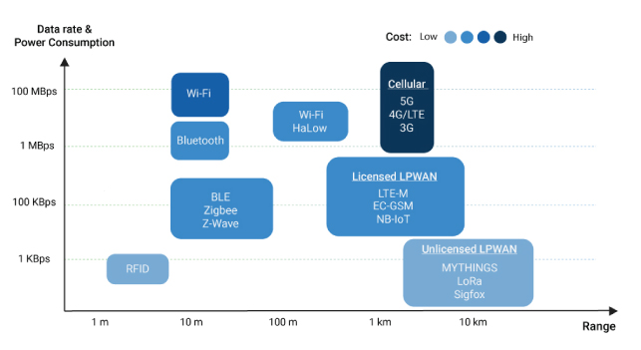
COMMUNICATION CRITERIA TRANSMISSION SPEED

Slide 8
COMMUNICATION CRITERIA POWER CONSUMPTION
IOT devices either connected to a power source or battery operated
Battery-operated devices always have power constrained based on batter lifetime requirement
IOT and WSN must address power consumption and low power consumption

Slide 9
COMMUNICATION CRITERIA TOPOLOGY
Topology depends upon the range for which IOT needs to be used
STAR TOPOLOGY
Long-range and short-range uses cellular, LPWAN and Bluetooth
PEER TO PEER , STAR, MESH TECHNOLOGY
Medium range uses

Slide 10
COMMUNICATION CRITERIA CONSTRAINED DEVICES AND NETWORK
IOT devices are low on resource capability
They lack processing power like standard devices like LAPTOP, DESKTOP and SMART PHONES
They are not able to communicate over various protocols
Device must be LIGHT WEIGHT, ENERGY EFFICIENT AND CONSUME LESS BANDWIDTH
Various network constrains for various devices will be depending on THROUGHPUT, RANGE,TOPOLOGY etc

Slide 11
IEEE

Slide 12
IEEE 802
It is the protocol or standard to networking protocol and networking devices.
Various N/W requires various standards depending upon the requirement like Local Area Network is the data transfer may be between two buildings or within buildings.
In Metropolitan Area Network data transfer may be between two different cities.
In both cases ranges are different speed requirement is different, so protocols are different.

Slide 13
IEEE 802
IEEE 802.3 defines protocols for ETHERNET.
IEEE 802.11 defines for WIFI
In WIFI basically needs greater range, speed of communication also very high.
So IEEE 802.11 standard cannot be used for low power devices where range is low and battery power is also low.

Slide 14
IEEE 802.15.4
To communicate between sensor to sensor at low rate, low power consumption IEEE 802.15.4 is used.
It is similar to IEEE 802.11. But communication protocol specially designed for 100 power nodes where data rate requirement is less.
Rest of the functionality will be same as IEEE 802.11
It is standard specially designed for Low Rate Wireless Personal Area Network. (LR-WPAN)

Slide 15
IEEE 802.15.4
In OPEN SYSTEM INTERCONNECTION MODEL (OSI)model is 7 layered MODEL
It will have PHYSICAL LAYER,DATA LINK LAYER,NETWORK LAYER, TRANSPORT LAYER,SESSION LAYER , PRESENTATION LAYER AND APPLICATION LAYER
802.15.4 defines PHY layer and MAC (Medium access control layer) specifications for low data rate wireless connectivity.
Sensors between which communication can happen may be fixed, portable or moving devices with no battery or very limited battery.

Slide 16
IEEE 802.15.4
Devices which can participate in this N/W are of two types:
Full Function device
Reduced function device
Full Function Device (FFD)
It can work as coordinator in Personal Area Network, Network coordinator ,a normal sensor device, RFD-TX device or RFD-RX device.
Network coordinator means it can be leader of the N/W.
Its function as N/W coordinator collecting the data, processing the data and sending over the other N/W.
Its function as device, it will generate data by sensing environment and can collect data from other devices and send in the N/W to the N/W coordinate.
Any N/W will have at least one FFD and one N/W coordinator called (PAN coordinator).

Slide 17
IEEE 802.15.4
FFD working as PAN coordinator
It manages the N/W.
It sends the processed data to the internet and through the gate.
It usually plugged into a power source.
It associates with PAN ID network with different PAN IDS cannot communicate directly with each other.
It allow nodes to join and leave the PAN. If necessary it initiates, it terminates and routes the communication.

Slide 18
IEEE 802.15.4
Reduced function device
It cannot work as FFD or PAN coordinator.
It is just a sensor or a device.
It may be a device, RFD-TX, RFD-RX device.
It is nothing but a sensor node which can sense the environment and generate the data.
It is connected to the only FFD at a time.
It is implemented using minimal resources and internal capacity.

Slide 19
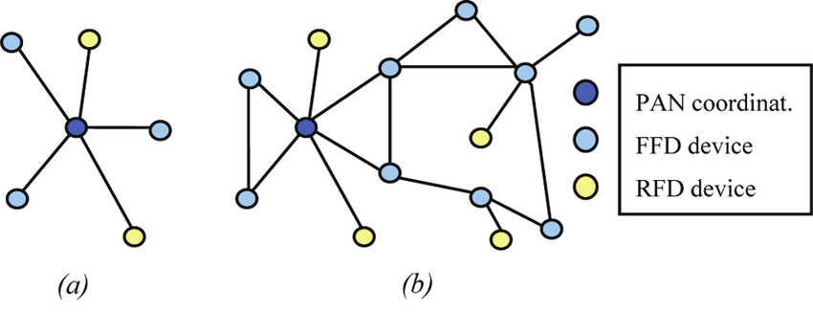
IEEE 802.15.4 (TOPOLOGY)
IEEE802.15.4 can operate in either STAR or peer to peer topology.

Slide 20
IEEE 802.15.4 ( STAR TOPOLOGY)
STAR Topology
Communication in established between the devices and a single central coordinator called as PAN coordinator.
PAN coordinator is the primary coordinator of the Personal Area N/W.
Every device operating in the PAN has unique address called as EXTENDED ADDRESS
During association process a device can be assigned a short address
Every devices will have short address or extended address for communication
STAR Topology is used over small areas.
Application where STAR Topology is preferred Home automation, personal computer peripheral, personal Health care, etc.

Slide 21
IEEE 802.15.4 (Peer to Peer)
Any device can communicate with other device in the PAN without going through PAN coordinator.
PAN coordinator perform usual function in coordinating & managing the N/W.
Device operating on the N/W will have unique address called as Extended address.
Device will be given short address during association process.
Device can use either extended or short address for communication within PAN.
Peer to Peer topology spams over large area and suitable for industrial control and monitoring wireless sensor N/W, Inventory tracking, intelligent architecture and security.
Peer to Peer topology allows more complex Network function such as tree OR mesh Networking topology.

Slide 22
IEEE 802.15.4 (High Level Architecture)
IEEE 802.15.1 standard released in 2003 adopted wide band physical layer using Direct Sequence Spread Spectrum technique (DSSS).
It provides operation in 3 frequency bands
868 MHZ in Europe.
915 MHZ in US
2.4 GHZ ISM (802.4) it is unlicensed band available for sending data, when we use 802.15.4.
27 channels are supported by the 3 bands.
868 MHZ – 1 channel
915 MHZ – 10 channels
802.4 MHZ – 16 channels
Three band provide transmission rate 20Kb/s, 40kb/s & 250 kb/s.
Later 2006/2007/2009 new bands have been added.

Slide 23
Physical layer IEEE 802.15.4
It is responsible for low level function like data transfer & reception energy detection of current channel link quality indication.
Physical layer –
What ever information present in the device digitally will be converted into analog and will be transmitted.
Another physical layer device will accept this analog information convert it into digital & send to the Upper OSI layer.

